Slide 1
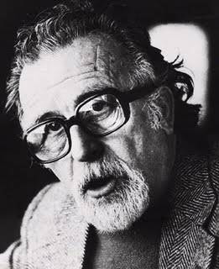
The Greek School
1st Experimental General High School of Thessaloniki
“Manolis Andronikos”

Slide 2
General Info
The 1st Experimental General High School of Thessaloniki “Manolis Andronikos” offers general education to 168 students (56 in each grade, separated in 2), aged between 16 and 18 years old.
In the 3rd grade, it mostly prepares them for the university entrance exams.

Slide 3
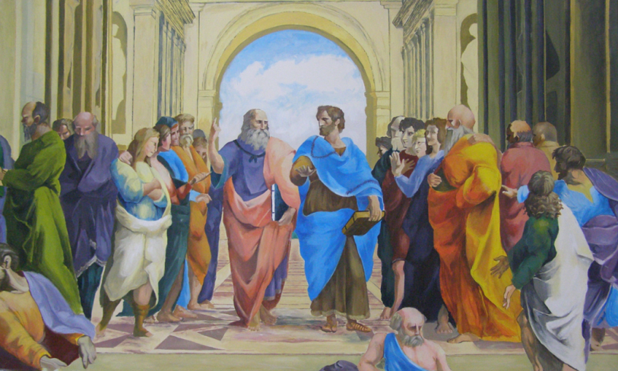
General Info
Students are selected by lottery, except for the period 2013-2015 when they were selected through exams. The school employs 20 teachers, that have been selected through an evaluation process.
It is one of 15 Experimental High Schools in Greece, that operate under a special legal regime, offering clubs of interests and other educational opportunities to its students as well as to students of a wider region.

Slide 4
School facilities
The teaching process is facilitated by the following:
Physics lab
Computer lab
Library
Interactive whiteboards
Laptops
Projectors
Multipurpose hall etc

Slide 5
Extra-curriculum Activities
For the time being, many activities are taking place in our school.
In addition to compulsory teaching, which takes place after normal working hours (that means after 8.10 p.m. – 2.10 a.m., including 5-10 minute break-time), the school offers many creative activities, the “clubs”

Slide 6
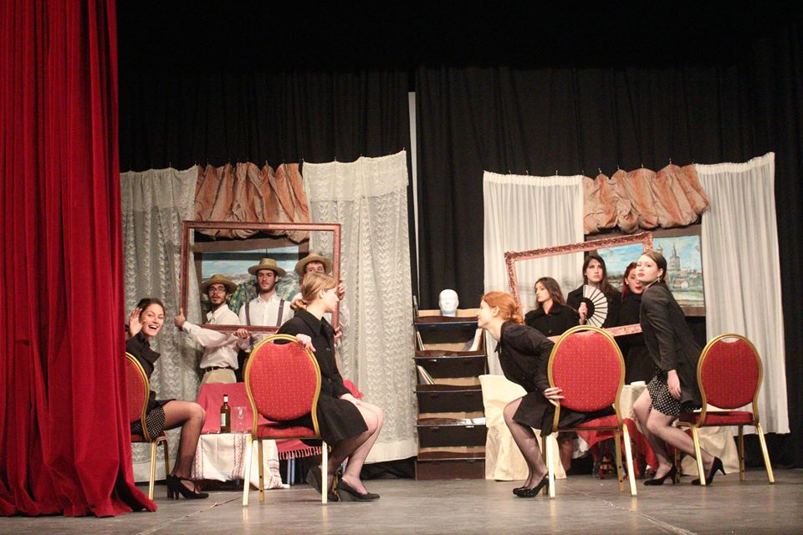
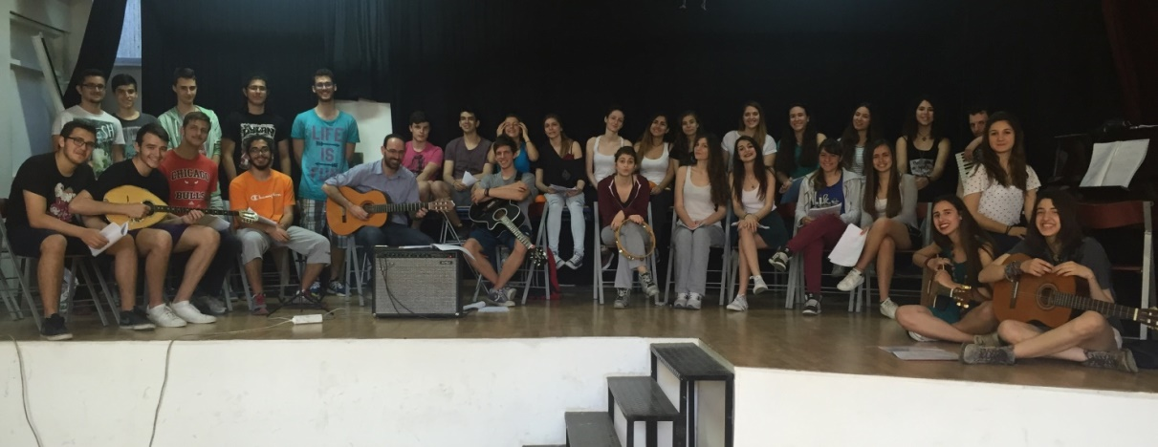
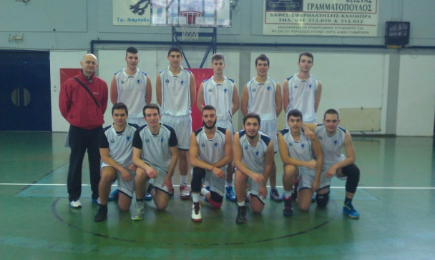
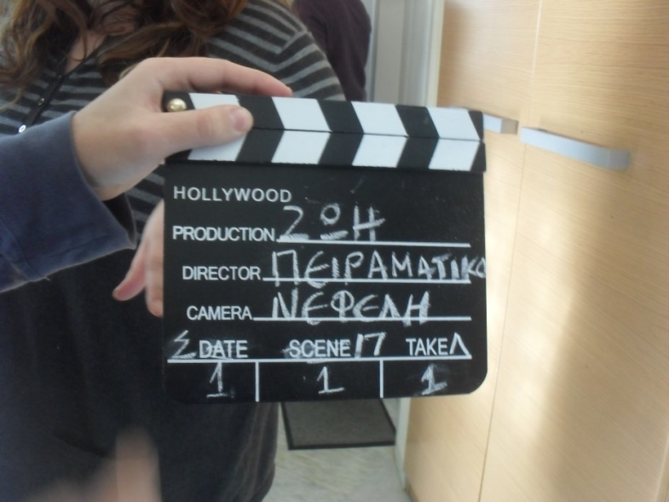

Slide 7
Competitions
In addition, the school organizes student competitions, open to students from all over Greece:
Creative Writing Contest
Logic and Mathematic Contest (LogiGame)
Modern Greek Language Contest (LexiGame)
Social Sciences Contest ("THINK.ing SO.cially")

Slide 8
Location
The school is located in Toumpa region, an area close to the centre of Thessaloniki but students come from many different areas to it.

Slide 9
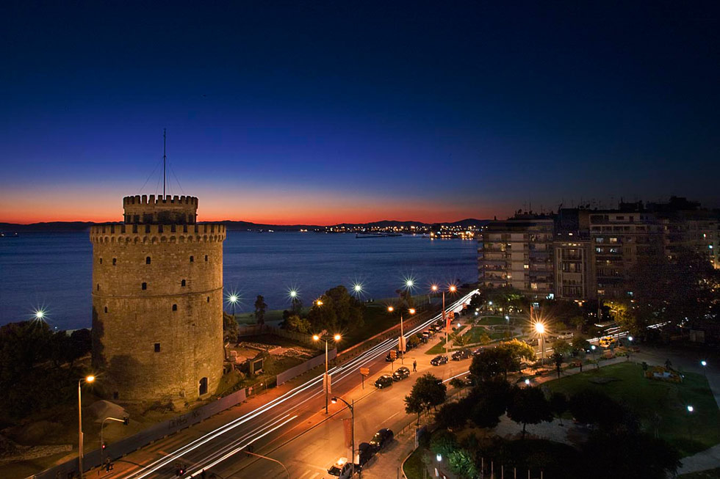
The city of Thessaloniki

Slide 10
Thessaloniki
Thessaloniki is the most populated city of Greece after Athens.
It is in the north part of Greece (Macedonia)
It is famous for its rich history and sights, such as the White Tower, the statue of Alexander the Great, byzantine churches, roman monuments and many more.

Slide 11
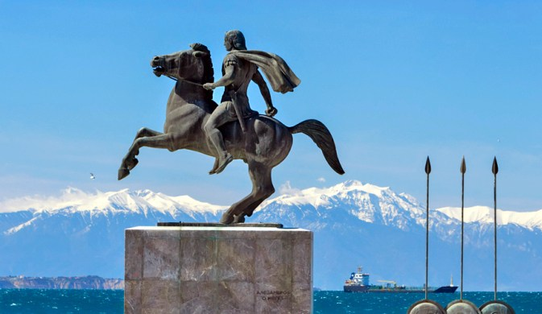
Statue of Alexander the Great

Slide 12
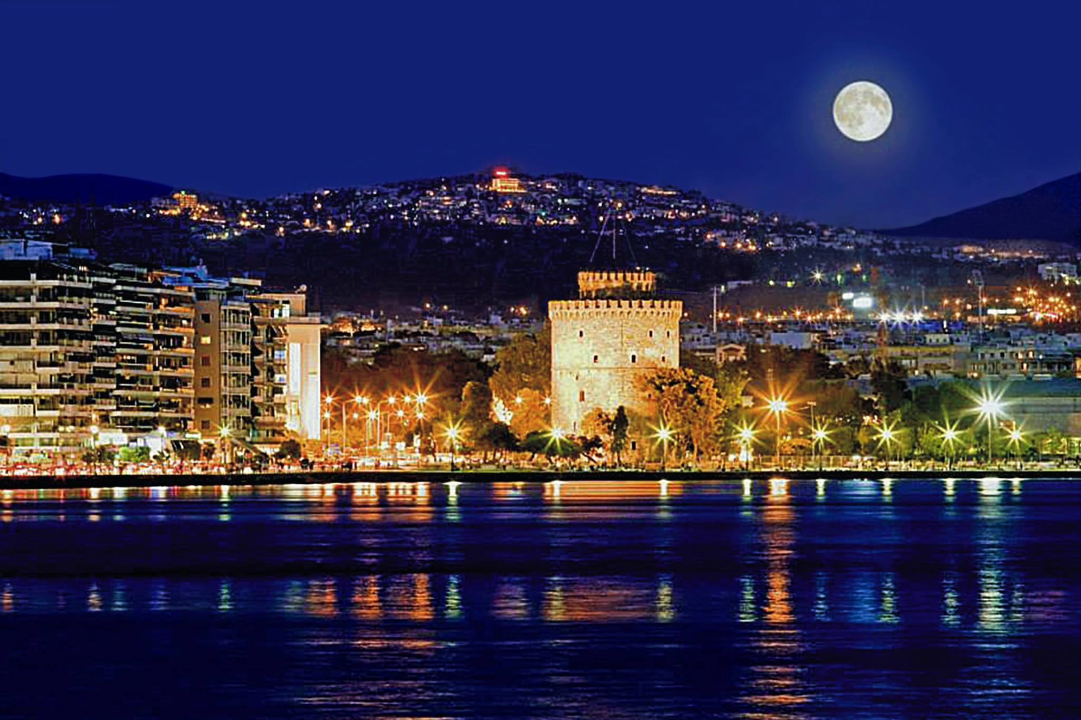
The White Tower under the moonlight

Slide 13
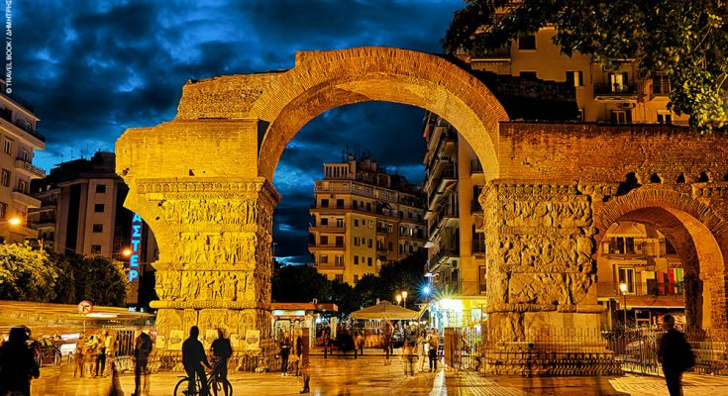
Camara

Slide 14
Thessaloniki
Thessaloniki is known for its night life.
Ladadika and Valaoritou are the most famous areas with traditional greek restaurants (tavernas) and night clubs

Slide 15
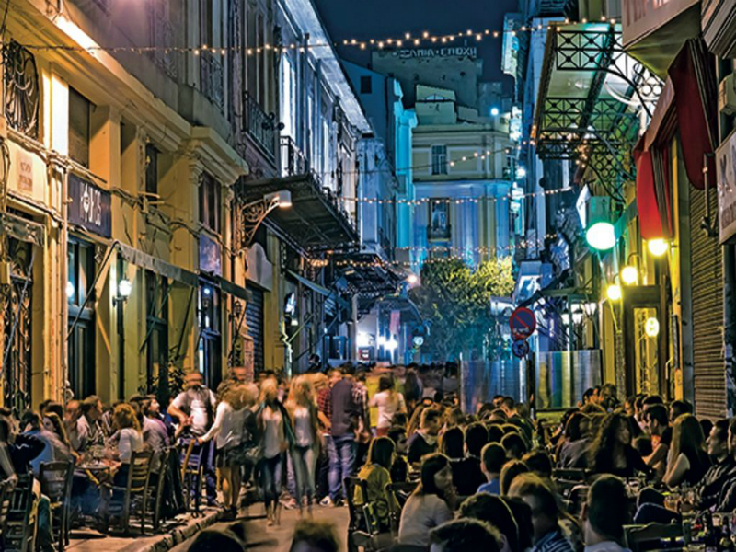
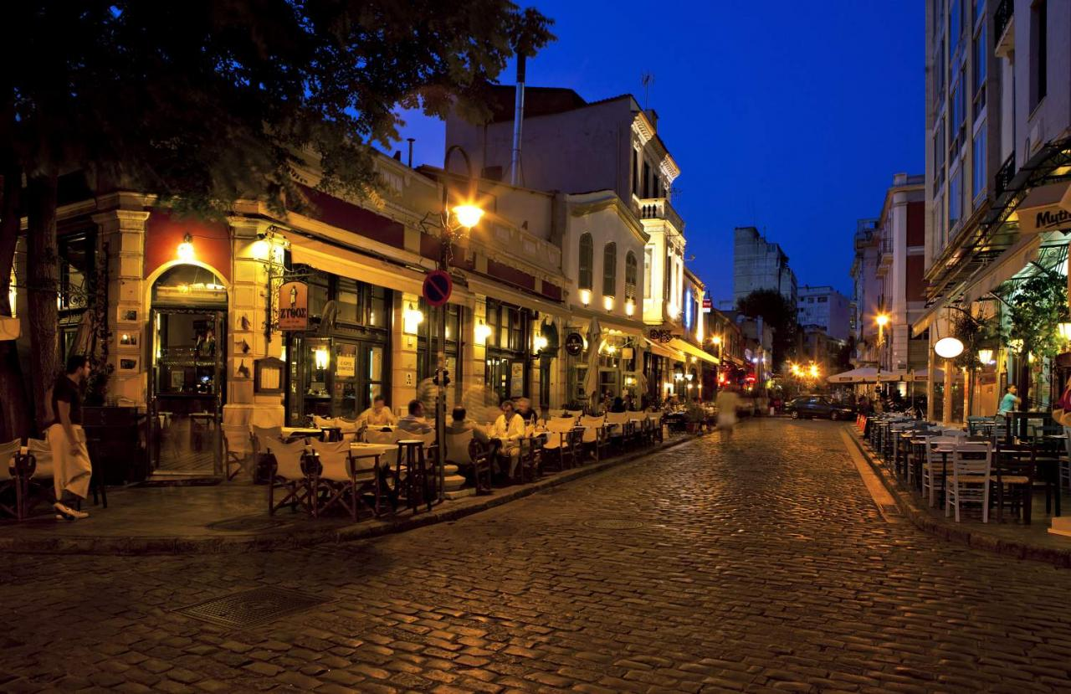
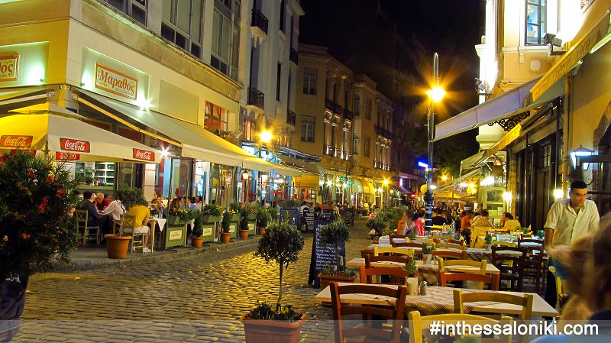
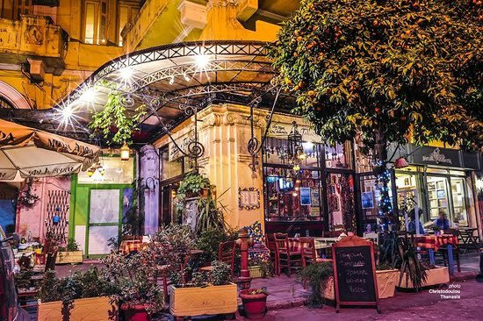

Slide 16
Thessaloniki
Aristotelous square and the seaside promenade are the best places to hang out during the day or at night.

Slide 17
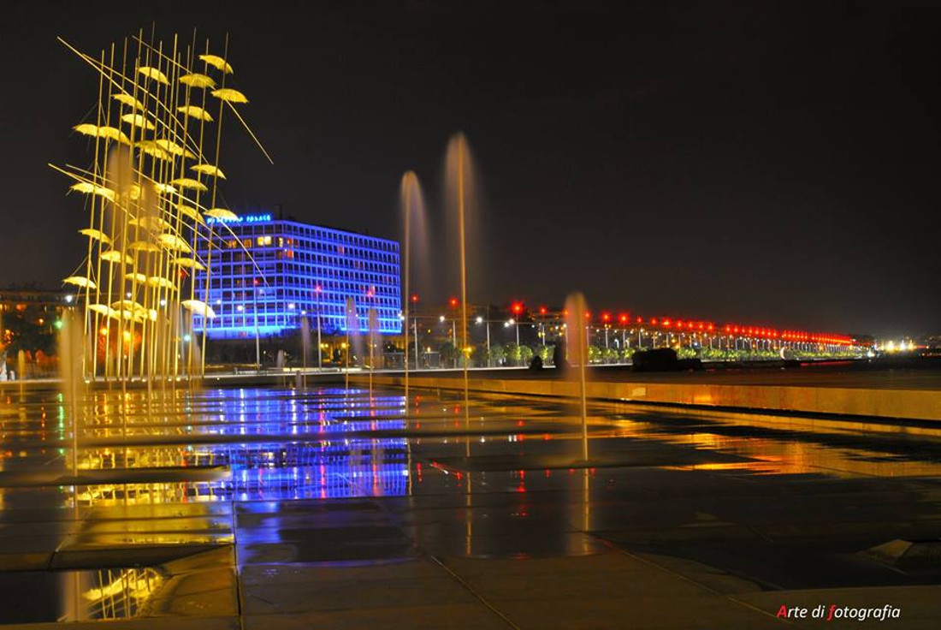

Slide 18
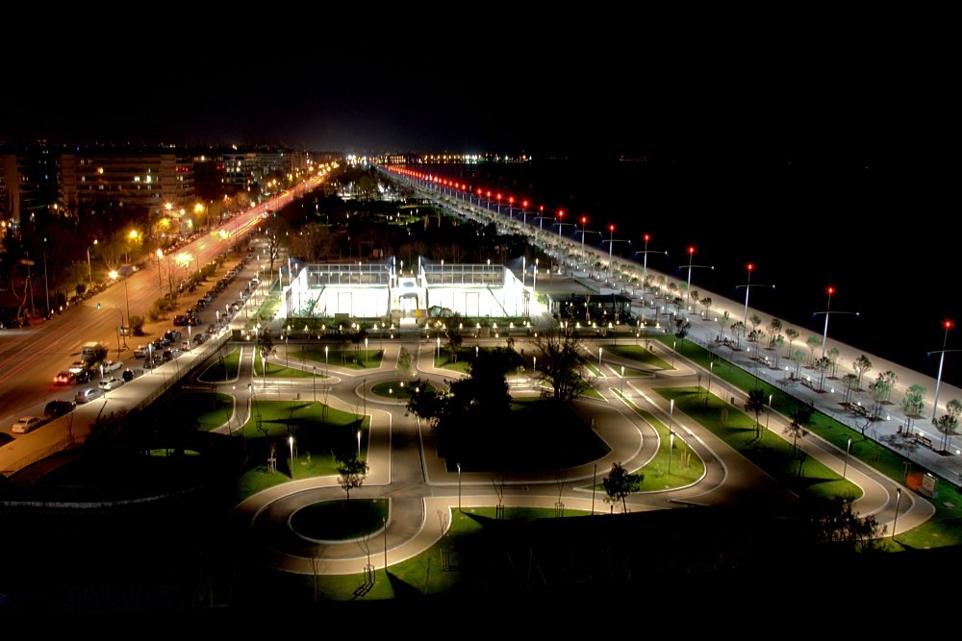

Slide 19
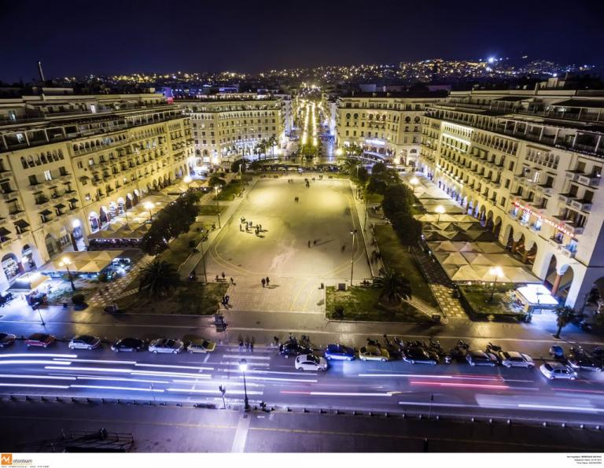

Slide 20
