Slide 1
Introducing France
And château-Thierry

Slide 2
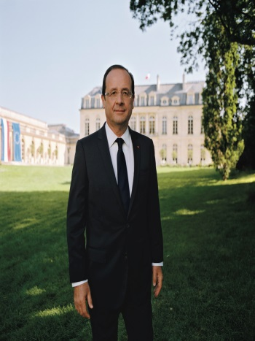
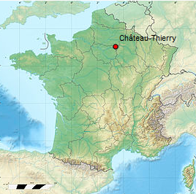
France
Key informations about
66,03 M inhabitants
Political system : Republic
National Anthem : La Marseillaise
President : François Hollande
Capital : Paris
François Hollande
Motto :
« Liberty, Equality, Fraternity »
National Flag
Location of our city

Slide 3
Château-Thierry
14400 inhabitants
95km from Paris
Region : Picardie
Mayor : M. Krabal

Slide 4
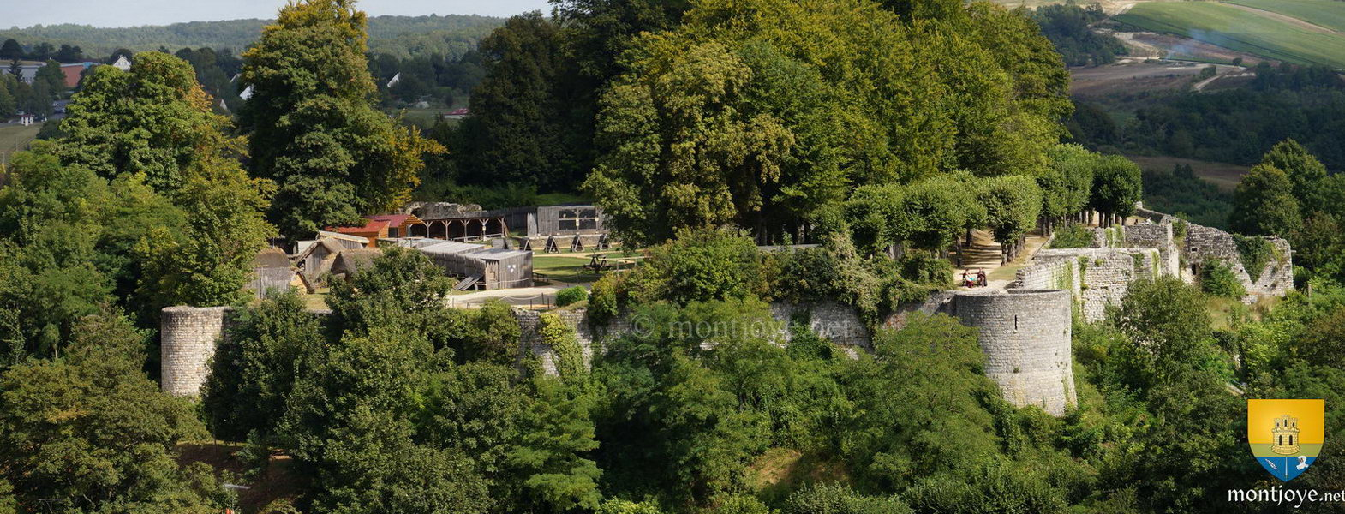
The Old Castle
is part of our national heritage

Slide 5
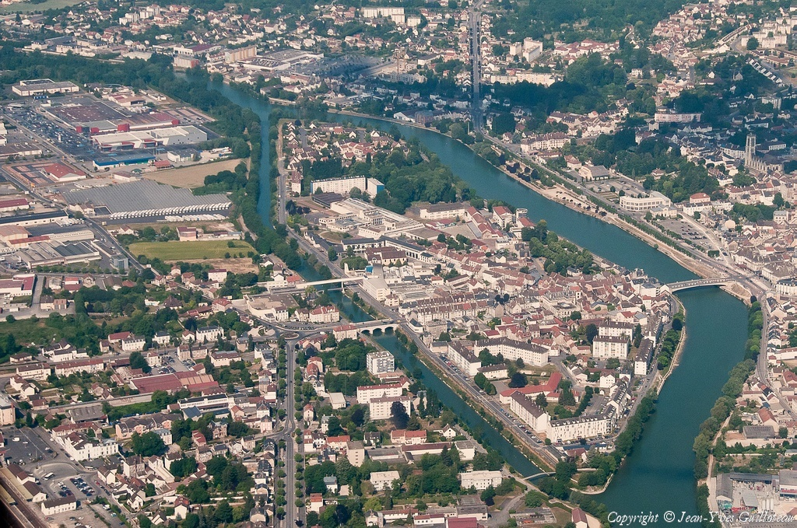
Château-Thierry

Slide 6
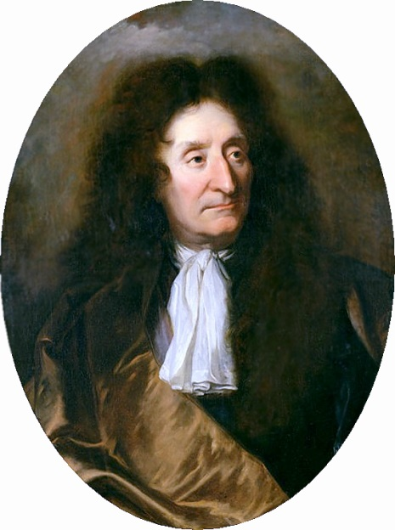
Jean de la Fontaine
A famous French fabulist
Born in the 17th century in Château-Thierry
He used animals in order to criticize the monarchy
The most famous fable : The Fox and the Crow

Slide 7
The educational system
We all prepare our A-level degrees
Our students have three different opportunities
HUMANITIES
Litterature
Languages
ECONOMICS
Economics
History
SCIENCES
Maths
Physics
Biology
Philosophy
Politics

Slide 9
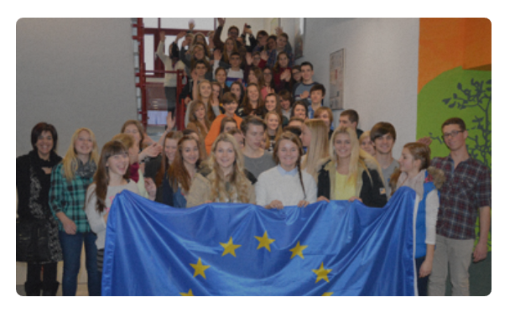
The last Comenius Project (2013-2015)
Jean de La Fontaine High School worked for two years on sustainable development with five European partners: Germany, Spain, Netherlands and Norway.
Kamenz (Germany), Arendal (Norway), Igualada (Spain) and s’Hertogenbosch (Netherlands).

Slide 10
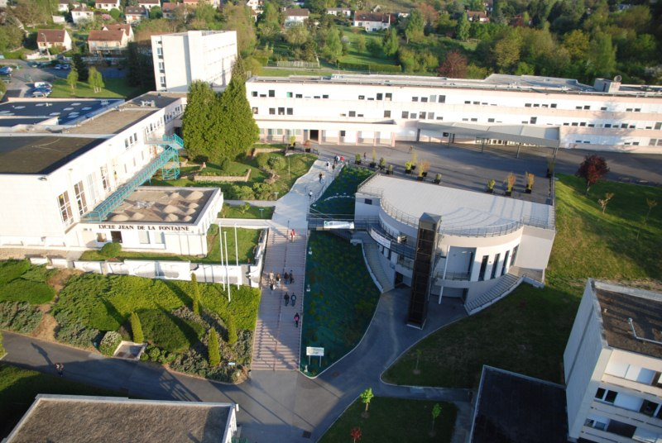
Lycée Jean de la Fontaine

Slide 11
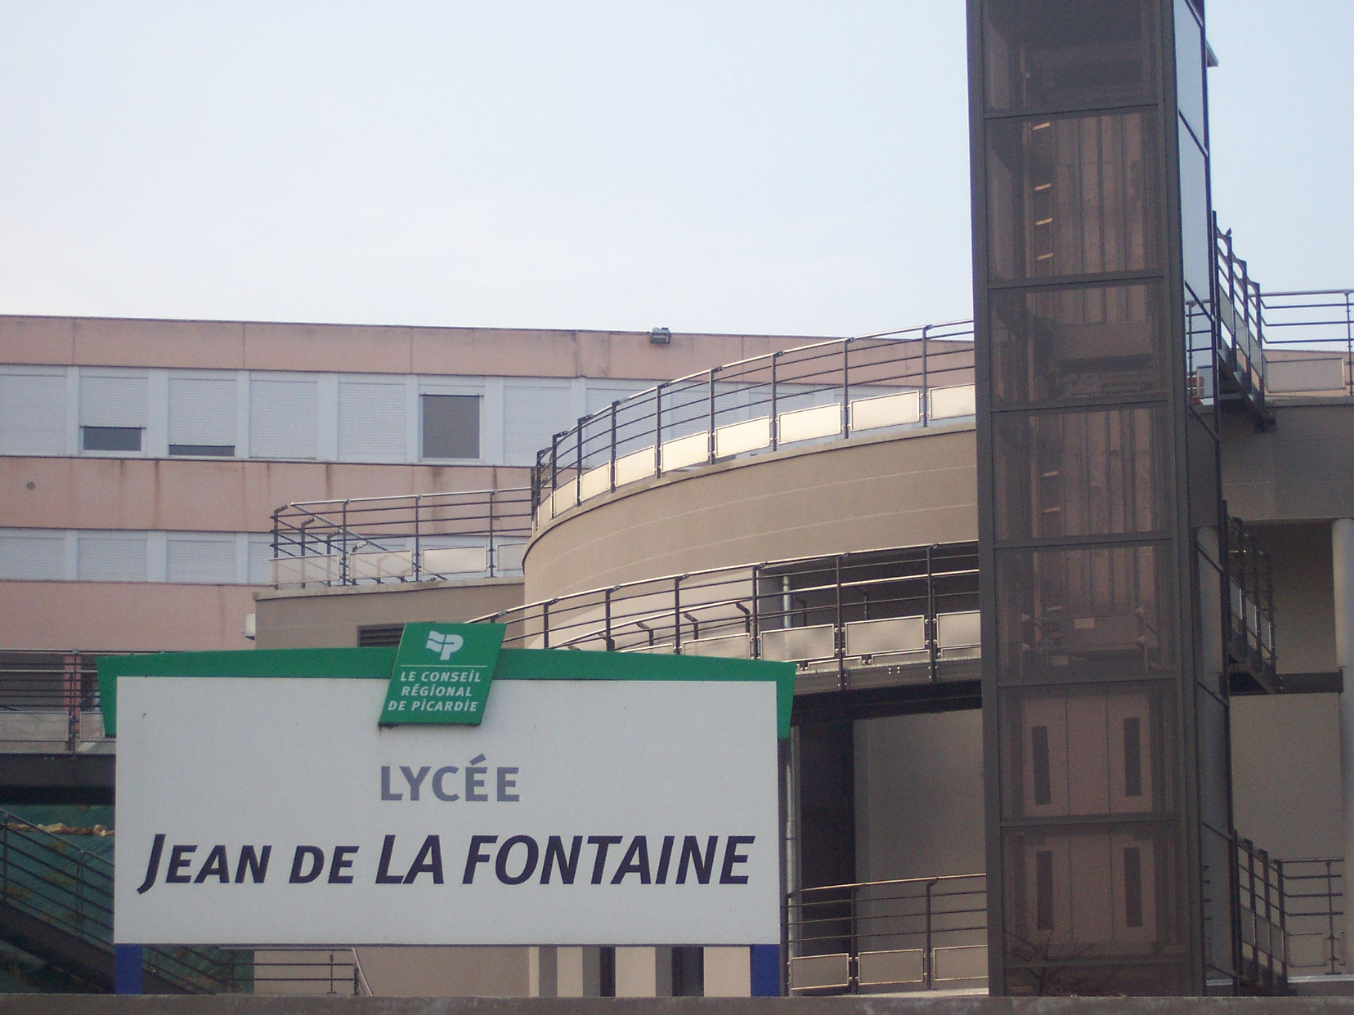
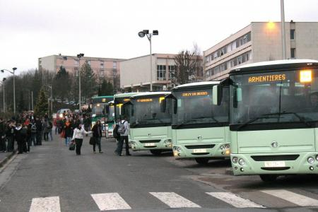

Slide 12
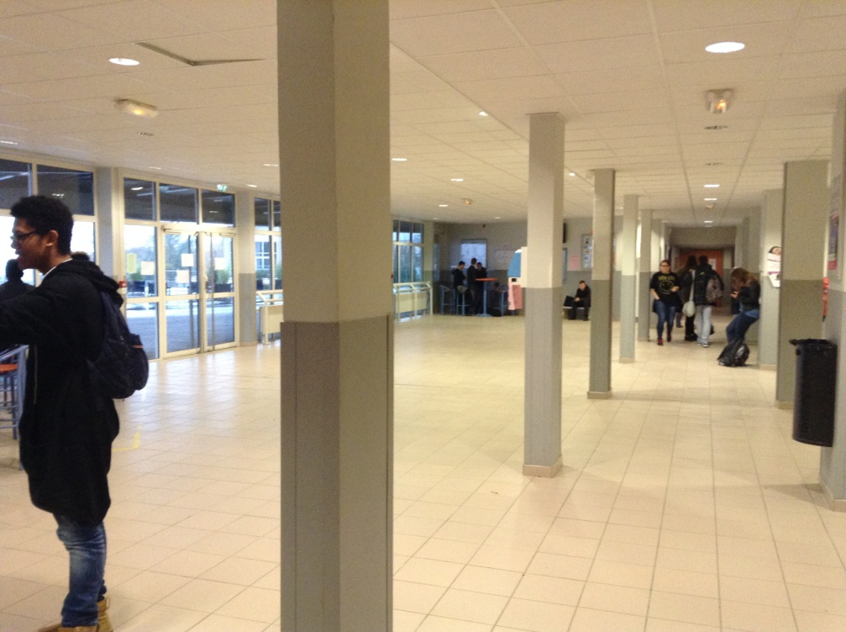
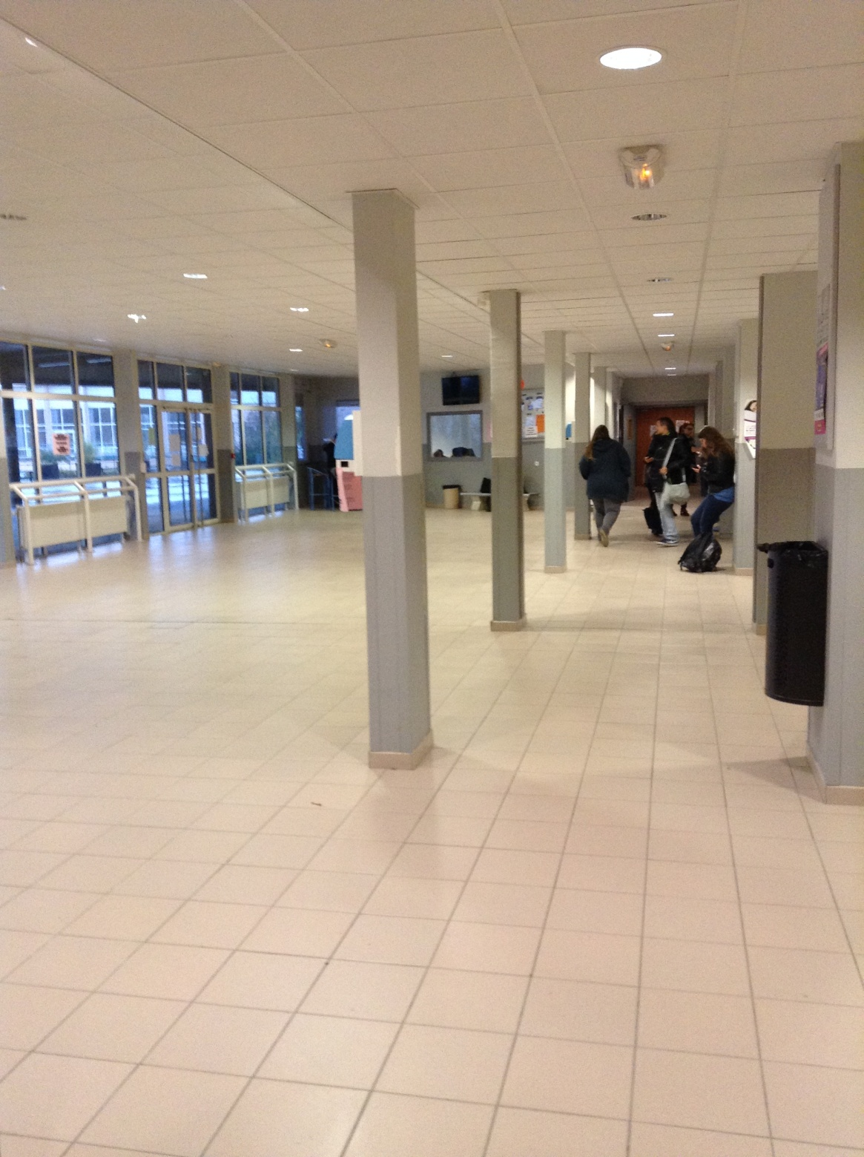
Hall

Slide 13
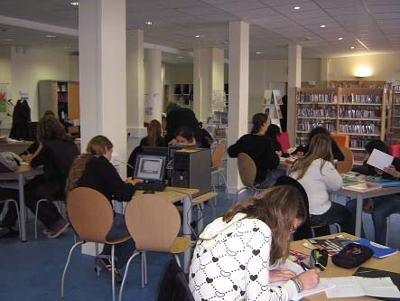
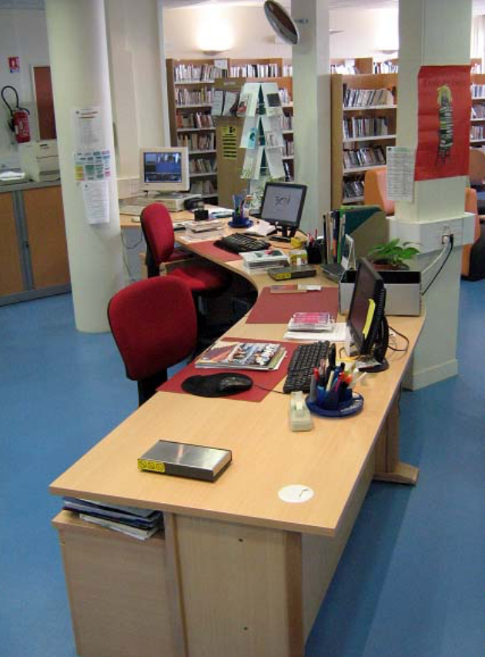
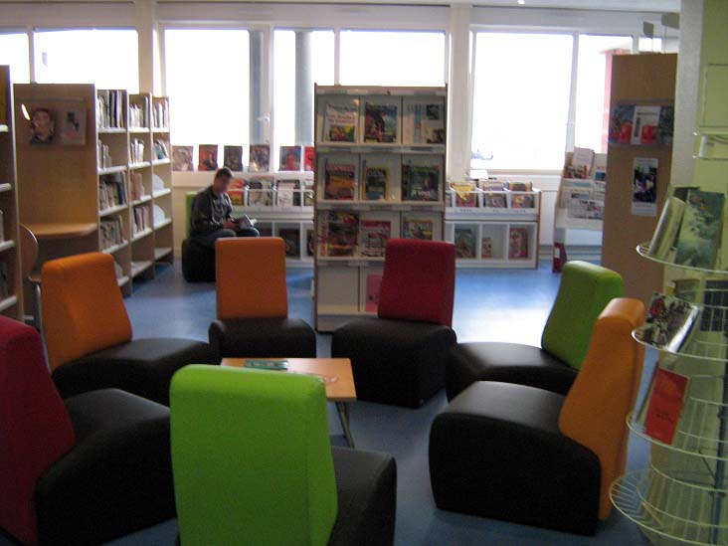
School library and students advising office ( CDI )

Slide 14
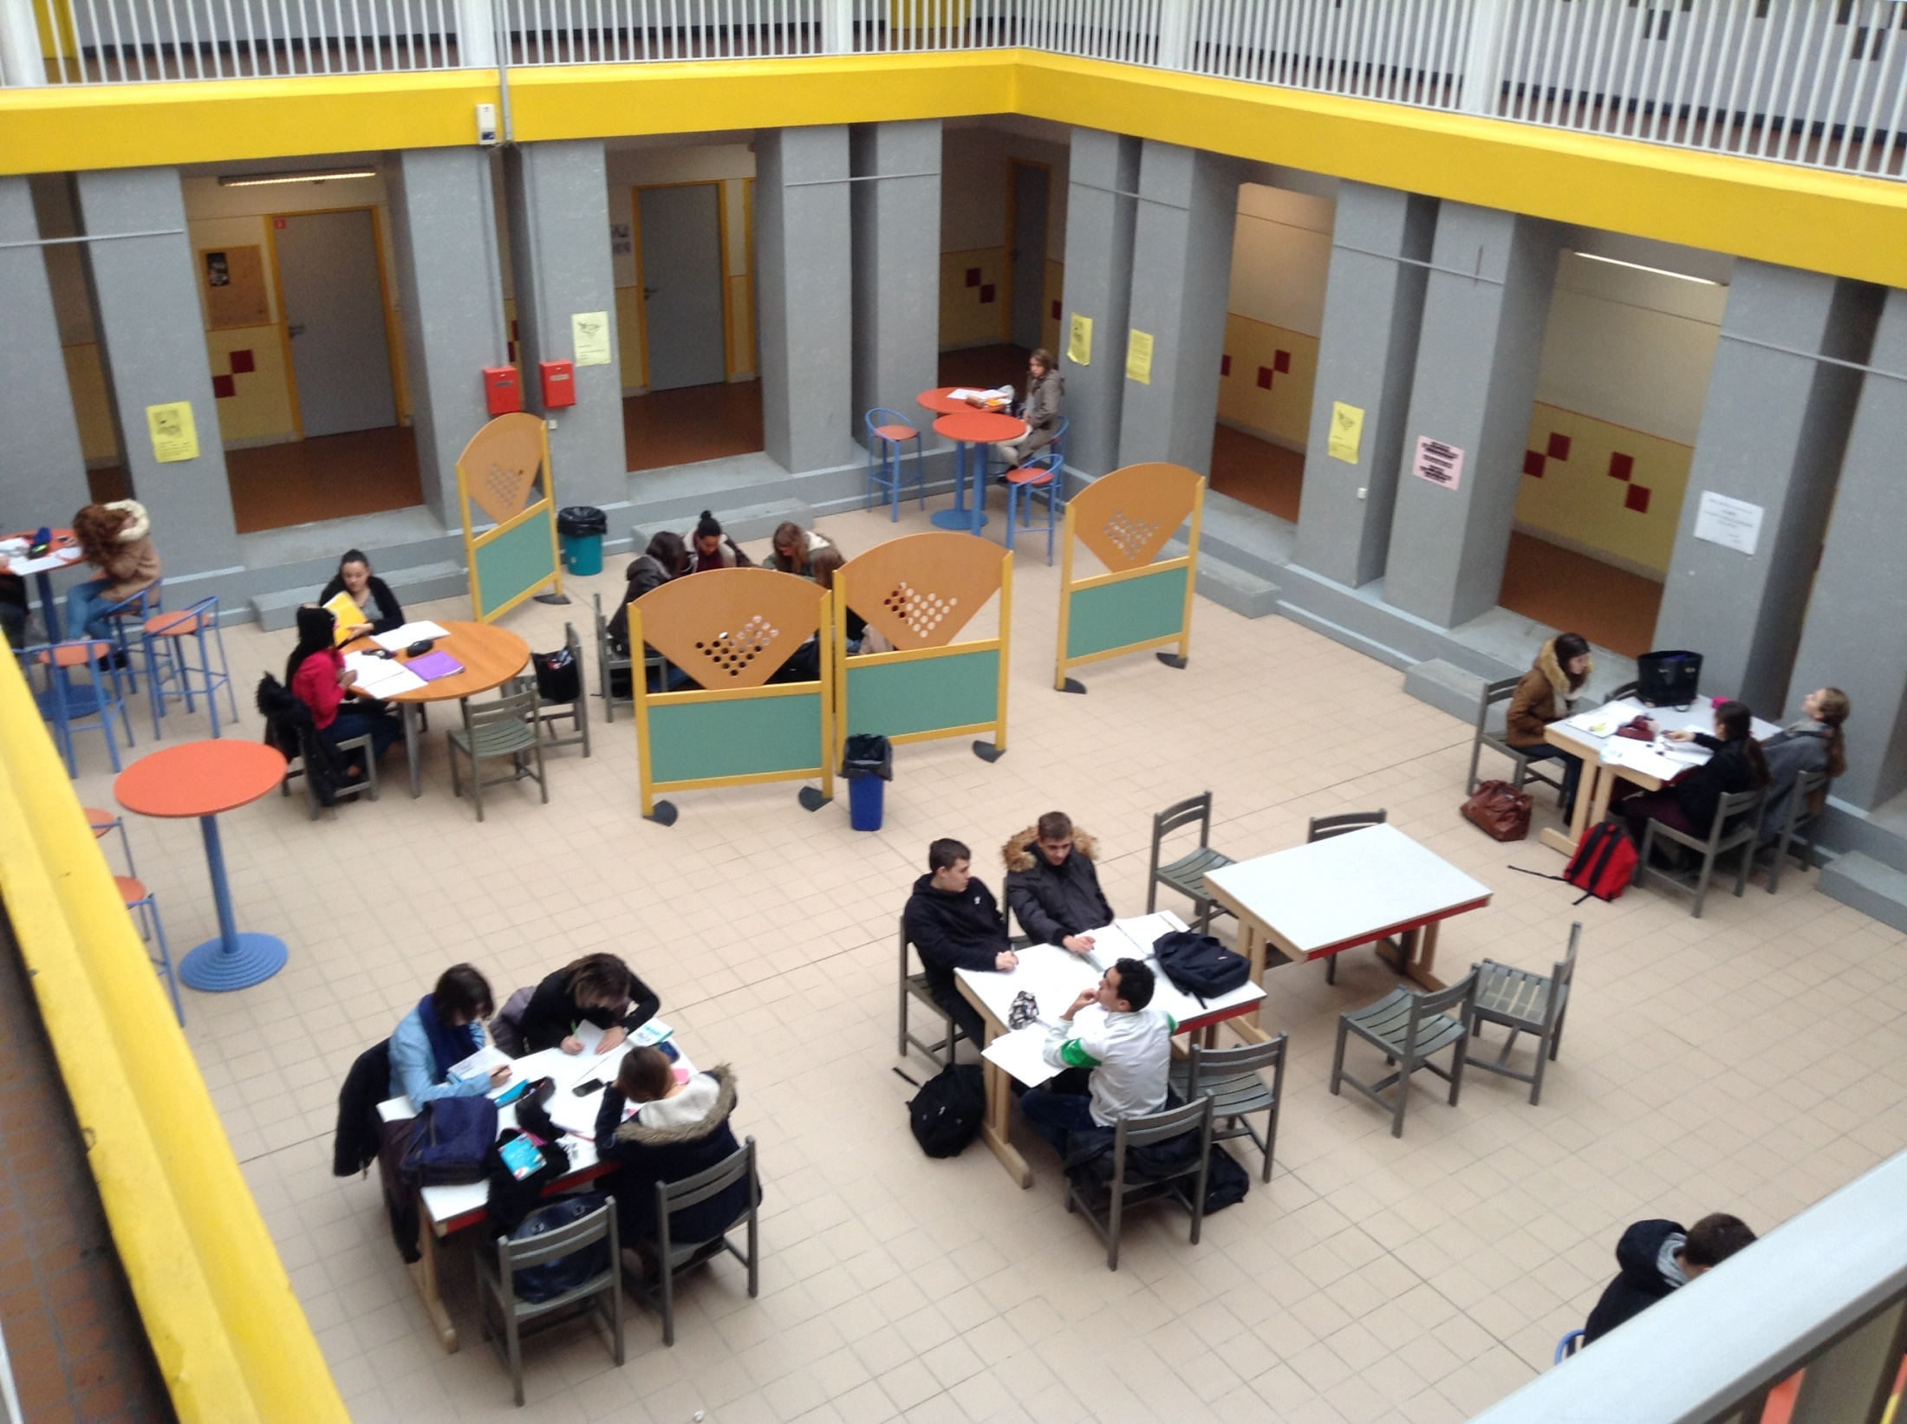
Hall for working (« le patio » )

Slide 15
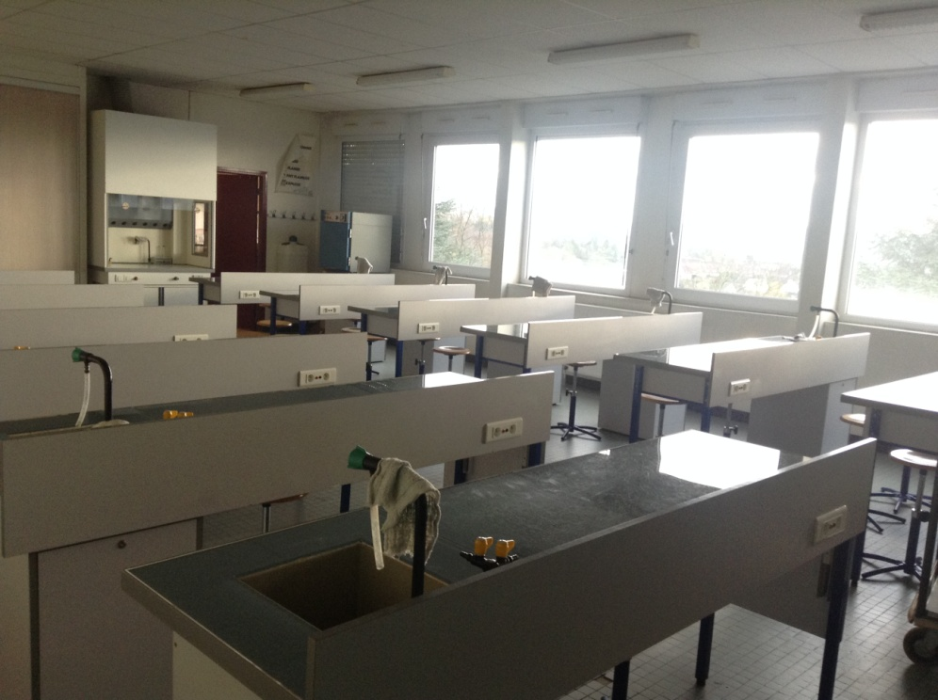
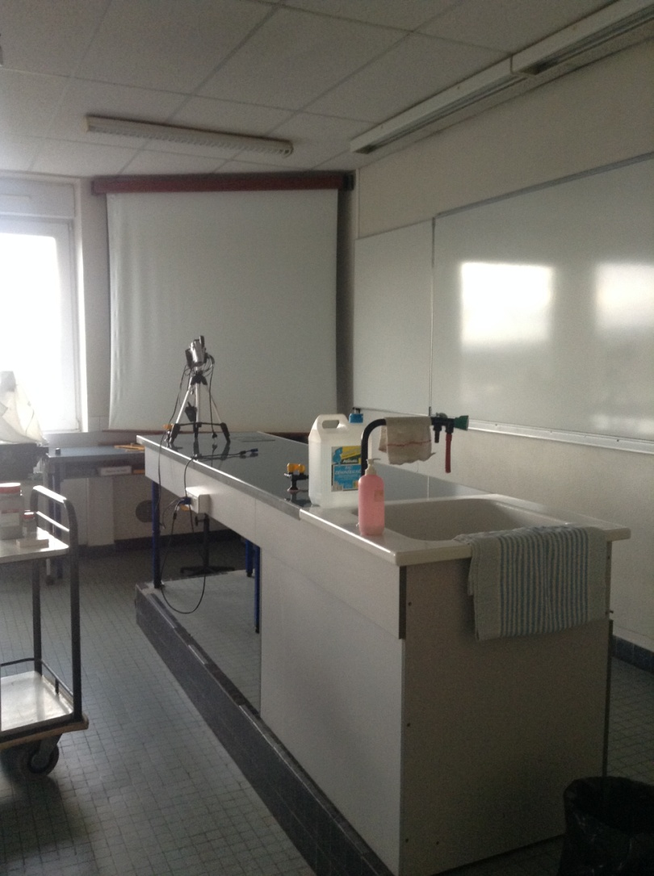
A science classroom

Slide 16
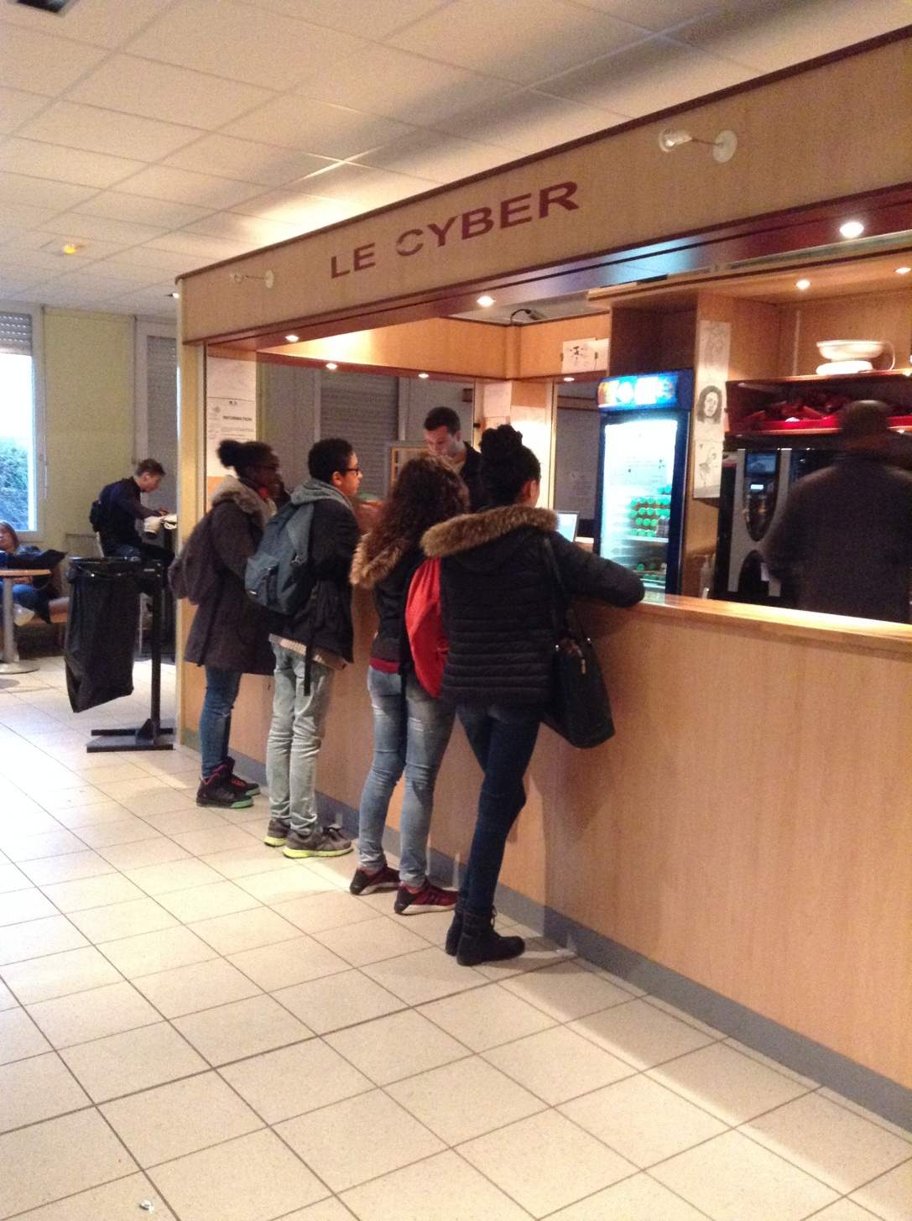
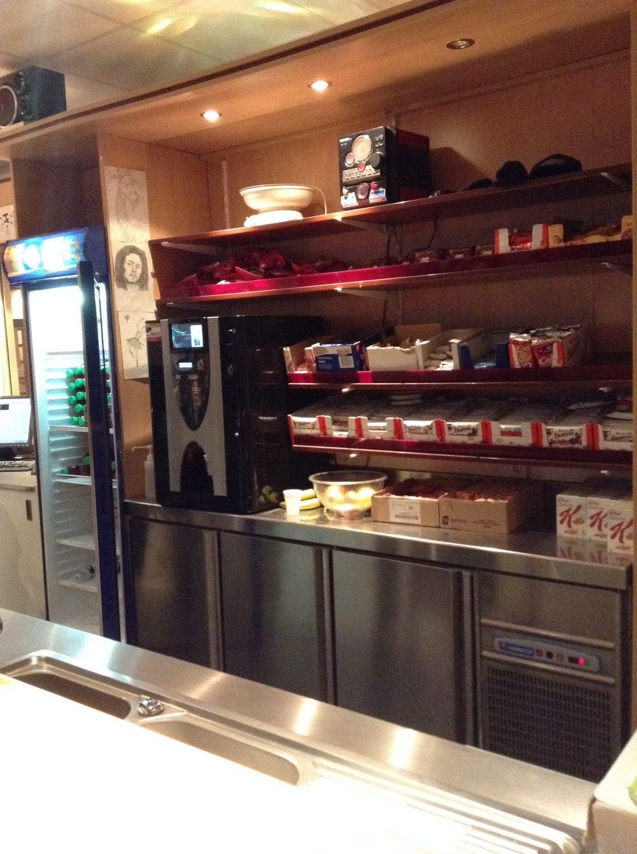
The cyber café

Slide 17
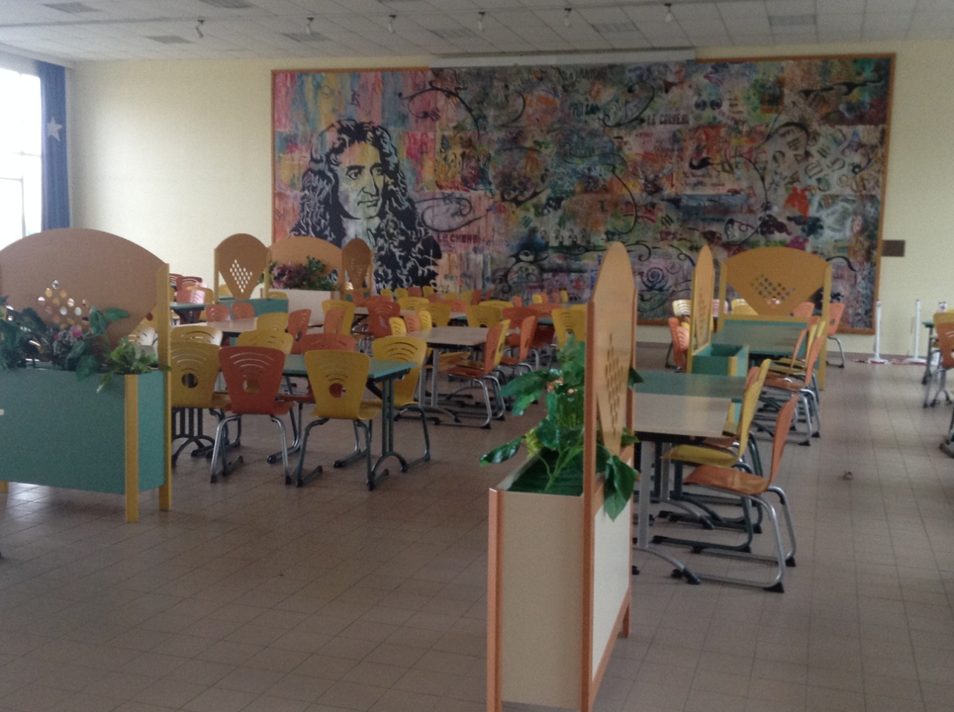
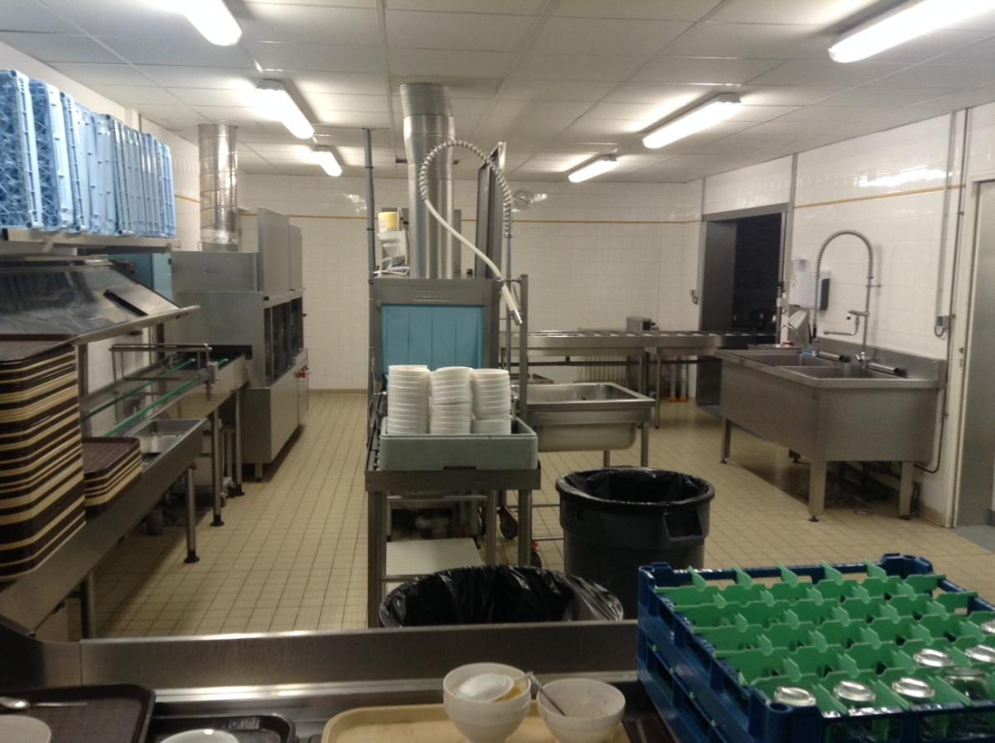
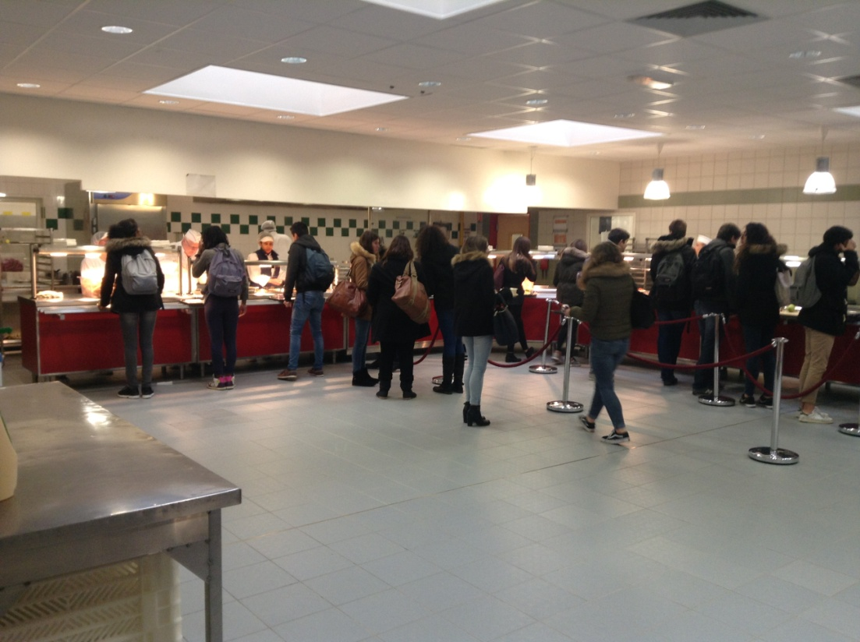
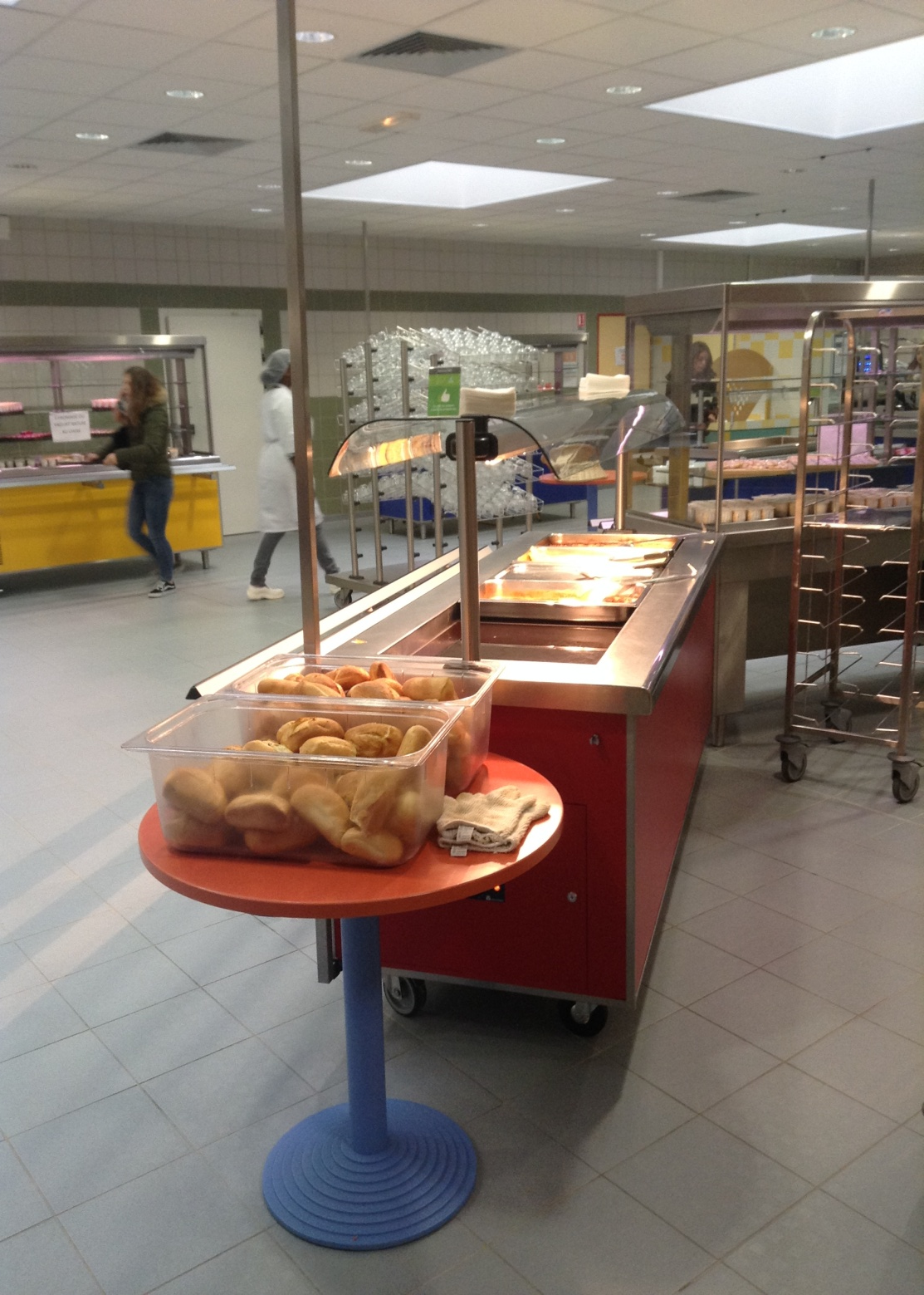
The canteen
(500 places)

Slide 18
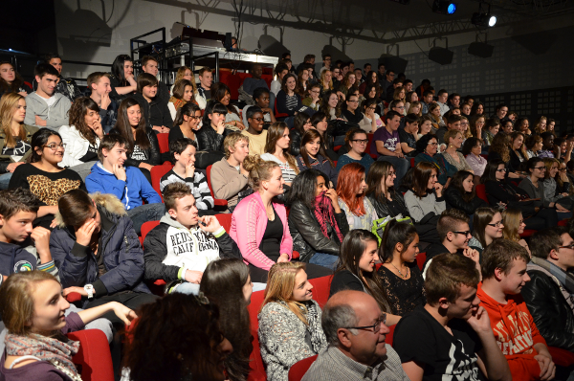
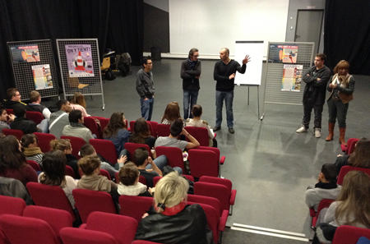
Auditorium « Estruch »

Slide 19
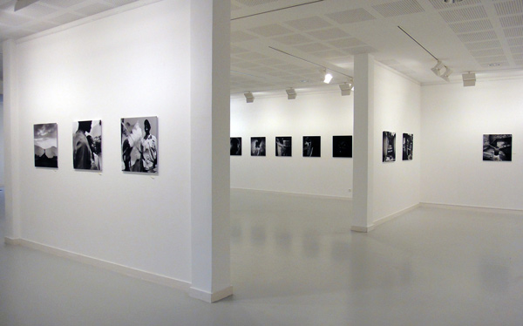
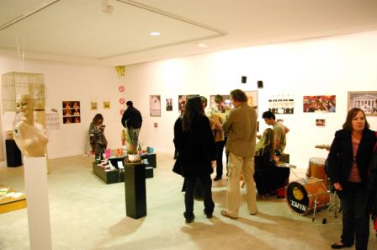
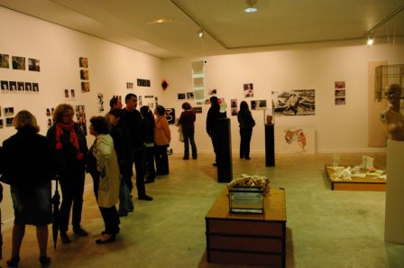
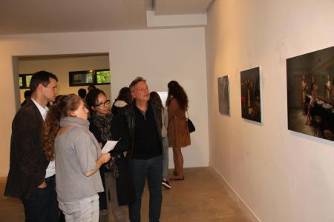
The Art Gallery

Slide 20
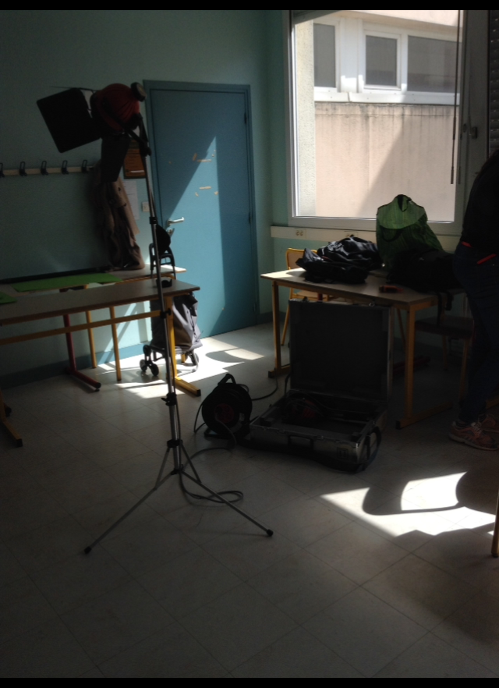
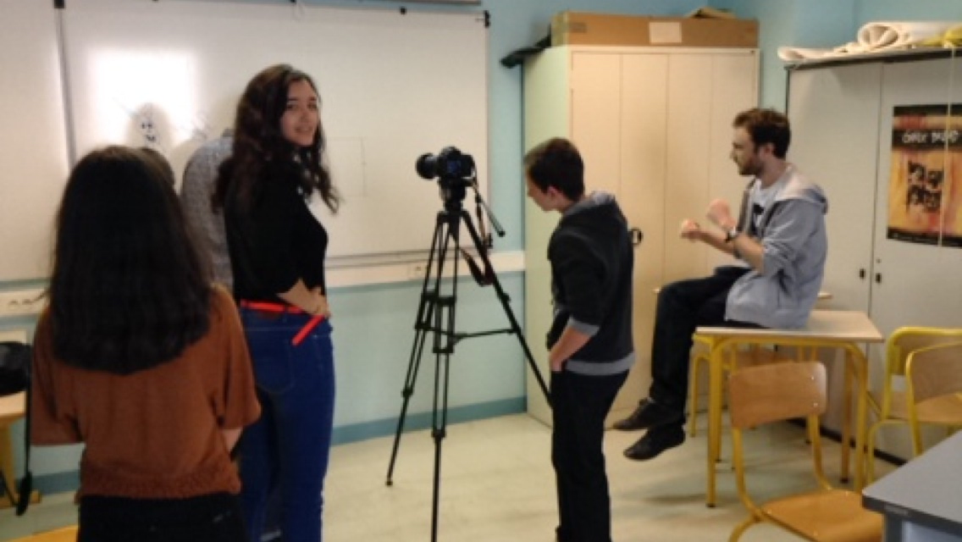
Video workshop !

Slide 21
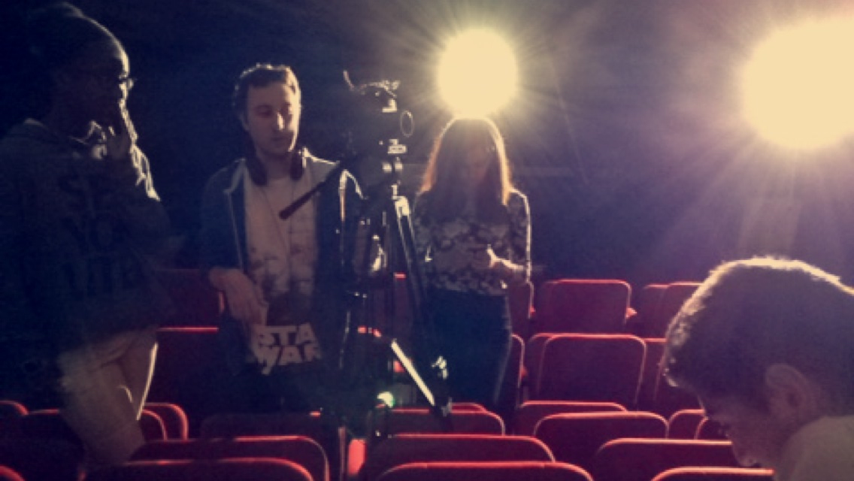
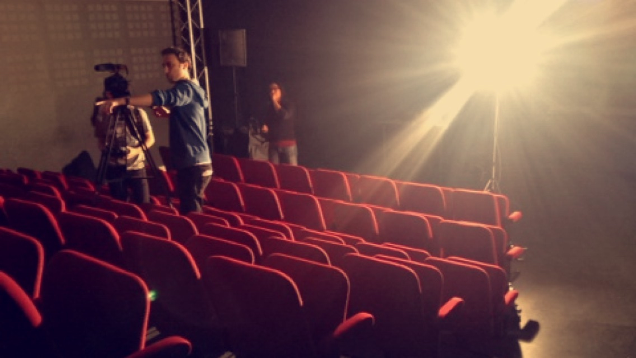
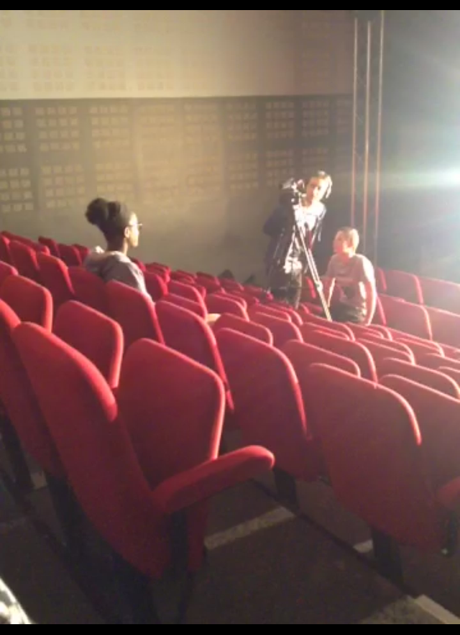
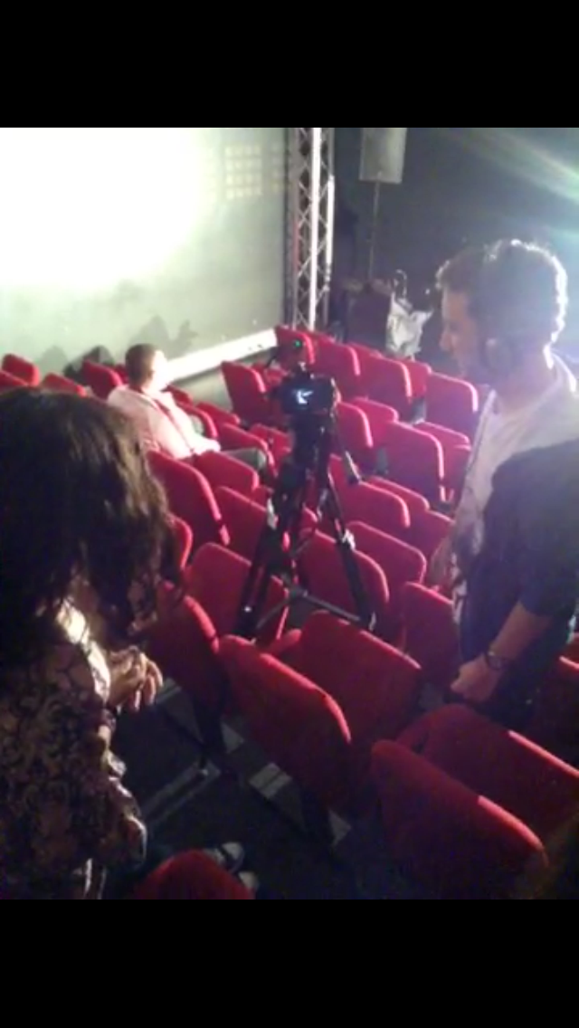

Slide 22
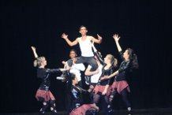
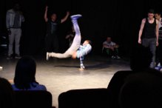
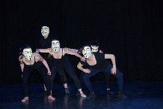
Dance

Slide 23
Thank you for your attention , many thanks to our friends from Desenzano
Rare as is true Love,
True Friendship is rarer
Jean de La Fontaine

