Slide 1
Sima Martausová
Sabína Ferenčíková

Slide 2
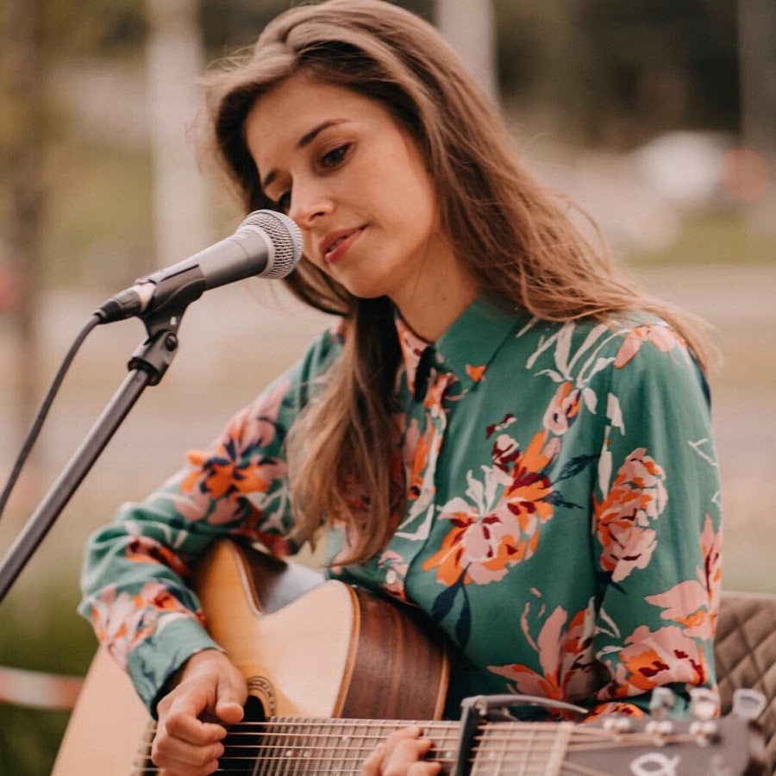
Personality
is a Slovak singer and former theater actress
She was born on February 26, 1988 (33) Považská Bystrica
She works as a singer and songwriter
She graduated from an industrial high school (technical information service department)
she wanted to study architecture, but since she failed the entrance exams, she enrolled in acting
In 2009, she won the Gospel Talent music competition
In addition to acting, you realize that music means more to her and she began to devote herself fully to it

Slide 3
Music career
In 2017, she was nominated for the Slovak of the Year award in the Art and Culture category
In addition to serial albums, she also sang music to Slovak films - the songs "The Way of the Cross" for film 6743
In February 2020, she received the Crystal Wing award for 2019 in the popular music category, and in September of that year, she again won the title of Singer of the Year for 2019 in the Television Screen Personality poll.
Katie Melua, Norah Jones, Coldplay, Jaromír Nohavica, Tomáš Klus are among their favorite music and musical models.

Slide 4
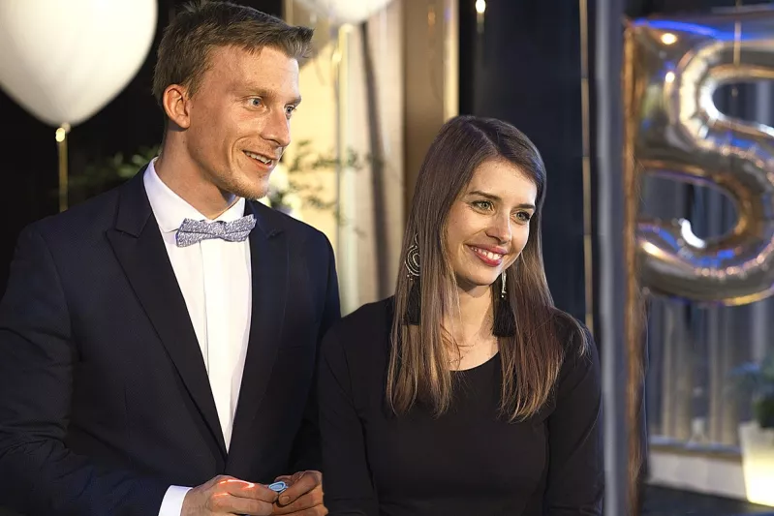
Personal life
Simona Martausová is a believer
he professes to the Catholic Church
She states that her faith and relationship with God is reflected in her music
She loves mountain hiking, she also climbed the highest peak in Europe, Mont Blanc.
In the years 2018 - 2019, she formed a couple with the Slovak actor Juraj Bač.
has long been involved in events to support pediatric cancer patients, including the Children's Hope Club and Children with Cancer
She sang two songs for Children with Cancer, Ballet in 2016 and Zore in 2020

Slide 5
Tracks
Nenahraditeľná
Len ma ľúb
Čokoláda
Čaro obyčajných vecí
Srdce nepokojné
Modlitba
Baránok
Spojiť sily
Nádherný svätý

Slide 6
Questions
What was the name of the music competition in which it was a winner in 2009?
What did she want to study but did not pass the entrance exams?
What film did she sing songs to?
Who were: Norah Jones, Coldplay, Jaromír Nohavicua, Tomáš Klusa, Katie Melua
What church does he belong to?
What hill has she climbed in Europe?
Who did she form a couple with?
What two songs did she sing for children with cancer?
Say at least 2 of her songs .....

Slide 7
Thank you for your attention !!!

