Slide 1
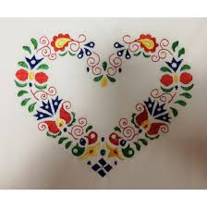
SLOVAKIA
BEAUTIFUL COUNTRY

Slide 2
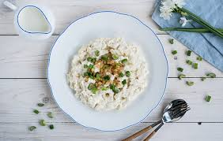
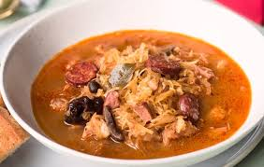
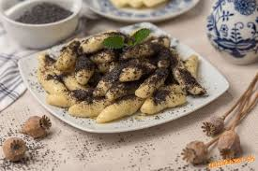
TRADITIONAL FOODS

Slide 3
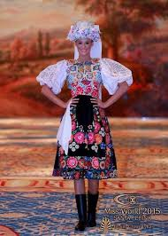
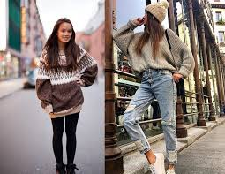
THE CLOTHES
Traditional
Today

Slide 4
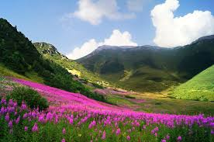
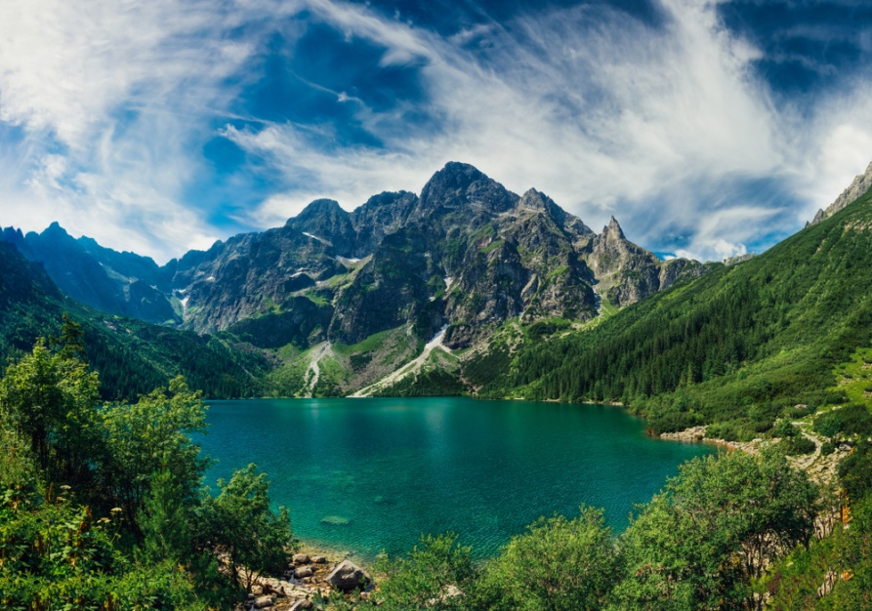
MOUNTAINS

Slide 5
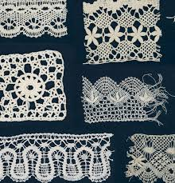
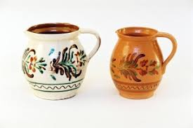
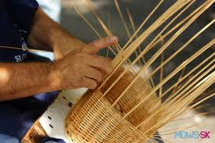
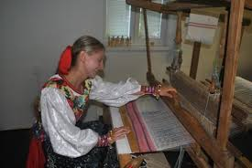
TRADITIONAL CRAFTS
Lacemaking
Pottery
Basketry
Weaving

Slide 6
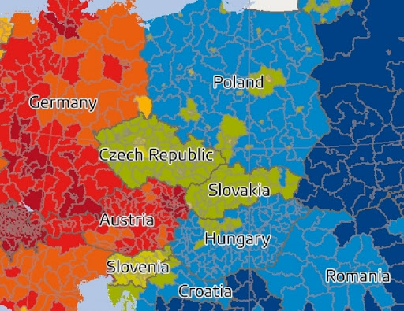
PEOPLE WITH BIG HEARTS LIVE HERE
COME TO VISIT

Slide 7
THE END
EMA ŠTEFANOVÁ

