Slide 1
ENERGY SOURCES IN SLOVENIA
Gimnazija Tolmin
Recharge the world

Slide 2
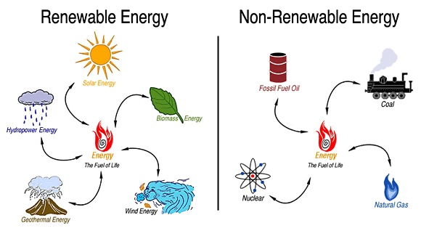

Slide 3
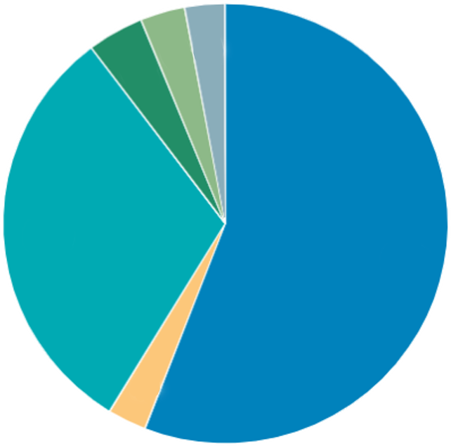
STRUCTURE OF RENEWABLE ENERGY SUPPLY IN SLOVENIA IN 2015
RENEWABLE SOURCES | PERCENTAGE
Wood, solid biomass | 55,9%
Water | 31,0%
Liquid biofuels | 2,9%
Geothermal energy | 4,1%
Biogas | 2,8%
Solar energy | 3,3%
Liquid biofuels
Solar energy
Geothermal energy
Water
Wood, solid biomass
Biogas

Slide 4
COMPARISON OF RENEWABLE ENERGY SOURCES BETWEEN 2011 AND 2015
 | 2011 | 2015
Wood, solid biomass | 52,1% | 55,9%
Water | 36,6% | 31,0%
Liquid biofuels | 4,32% | 2,9%
Geothermal energy | 3,17% | 4,1%
Biogas | 2,87% | 2,8%
Solar energy | 0,89% | 3,3%

Slide 5
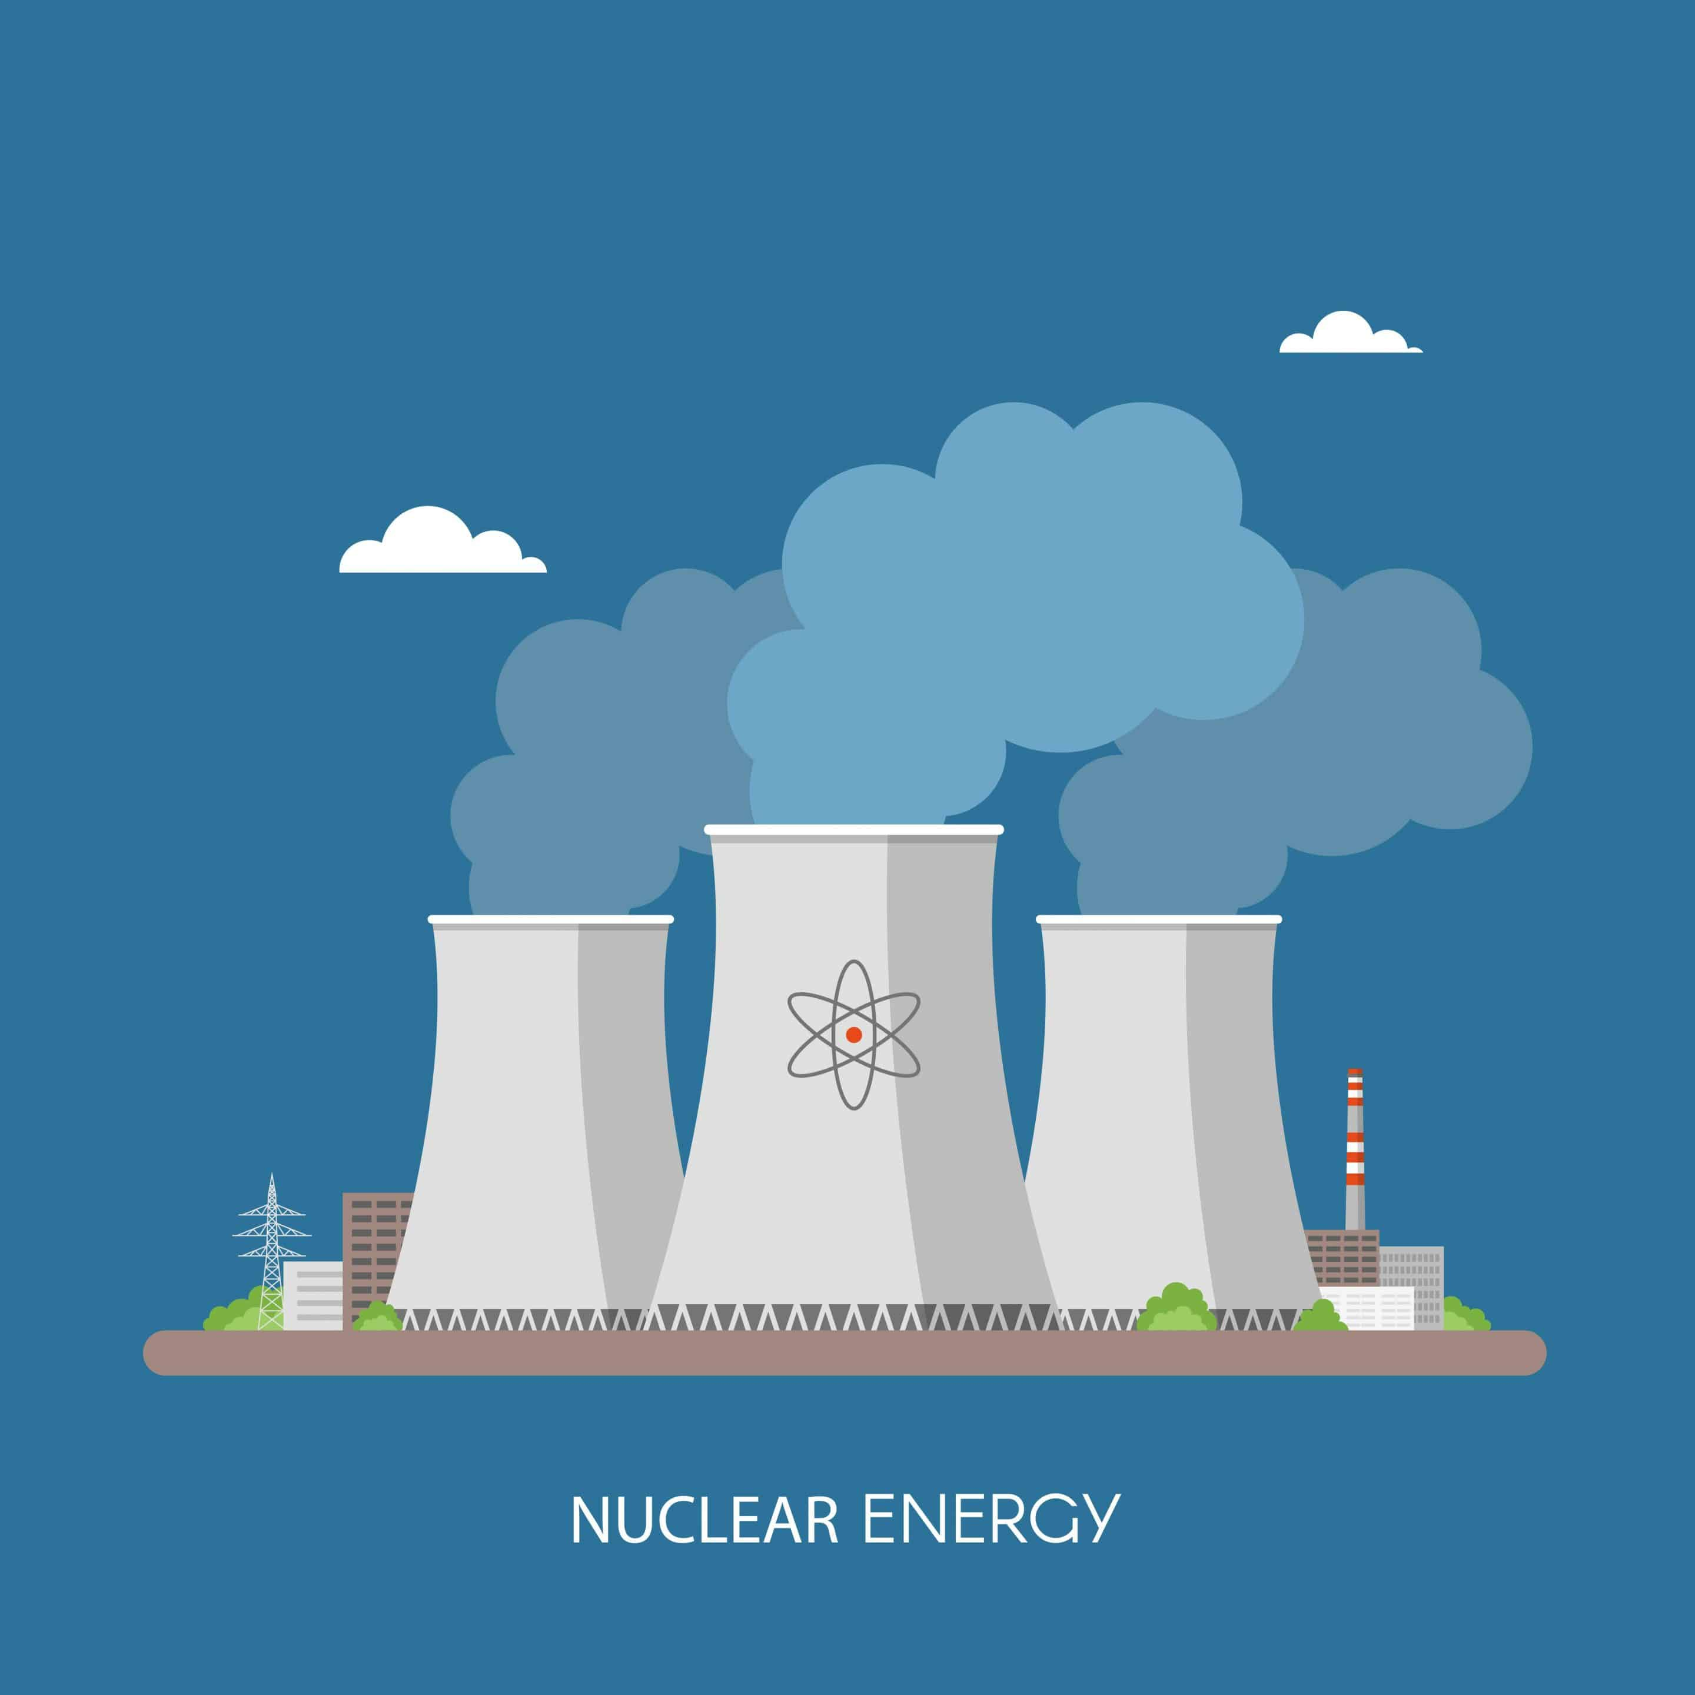
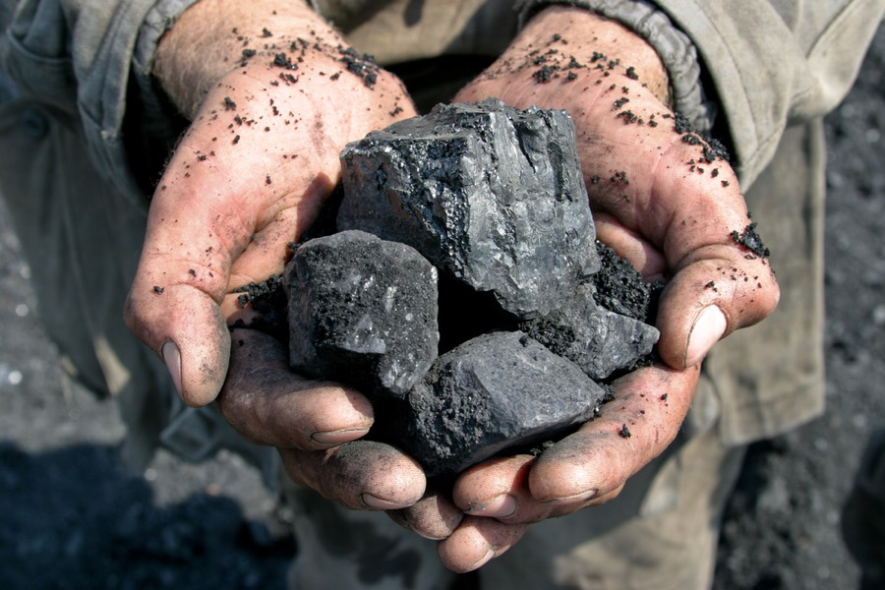
NON-RENEWABLE SOURCES
The majority of energy production comes from non-renewable sources:
Petroleum products
Natural gas
Coal
Nuclear energy

Slide 6
Main power stations in Slovenia

Slide 7
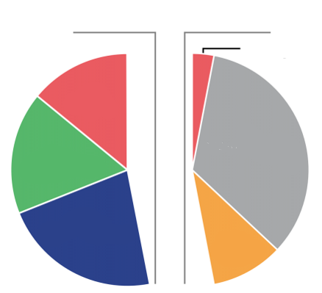
DOMESTIC AND IMPORTED ENERGY SOURCES IN SLOVENIA IN 2016
DOMESTIC SOURCES
IMPORTED SOURCES
ENERGY SOURCES | DOMESTIC | IMPORTED
Coal | 14 % | 3 %
Renewable sources (wood, biogas) | 17 % | /
Nuclear energy | 22 % | /
Natural gas | / | 10 %
Petroleum products | / | 34 %
TOTAL | 53 % | 47 %
Coal
Coal
Renewable sources
Petroleum products
Nuclear energy
Natural gas

Slide 8
SOURCES
http://kazalci.arso.gov.si/sl/content/obnovljivi-viri-energije-3
https://e-gradiva.golea.si/delezi-ove-v-sloveniji-in-svetu/
https://e-gradiva.golea.si/neobnovljivi-viri-energije/
https://www.stat.si/StatWeb/News/Index/7094
https://www.i-energija.si/ienergija/energetika-v-sloveniji-in-svetu-statistika/
https://www.pinterest.com/pin/474707616962929837/
https://www.greenandgrowing.org/why-are-renewable-sources-of-energy-better-than-nonrenewable-sources/
https://www.mining.com/this-firm-may-make-coals-future-a-lot-brighter/

Slide 9
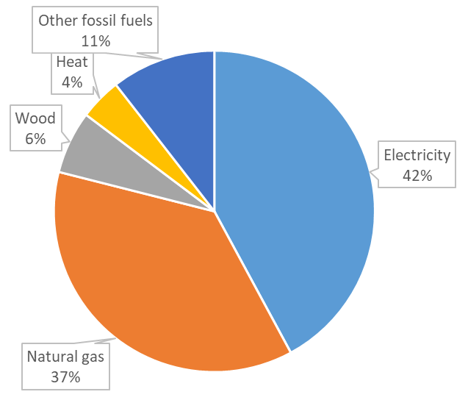
Current use of energy in Slovenia…

Slide 10
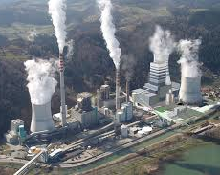
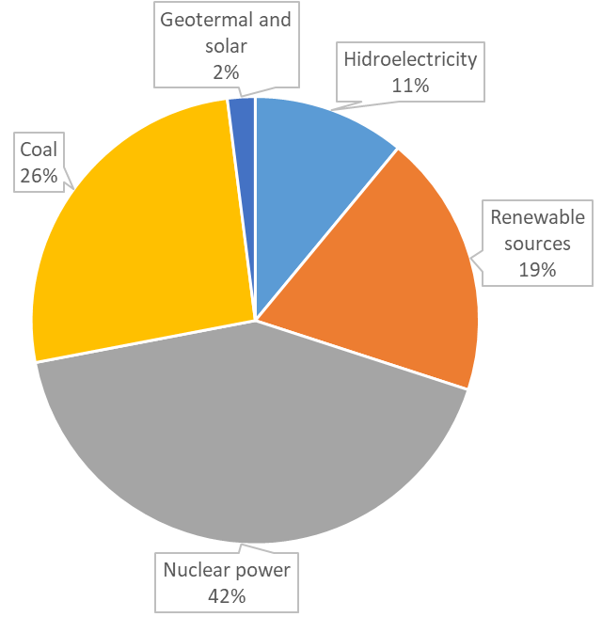
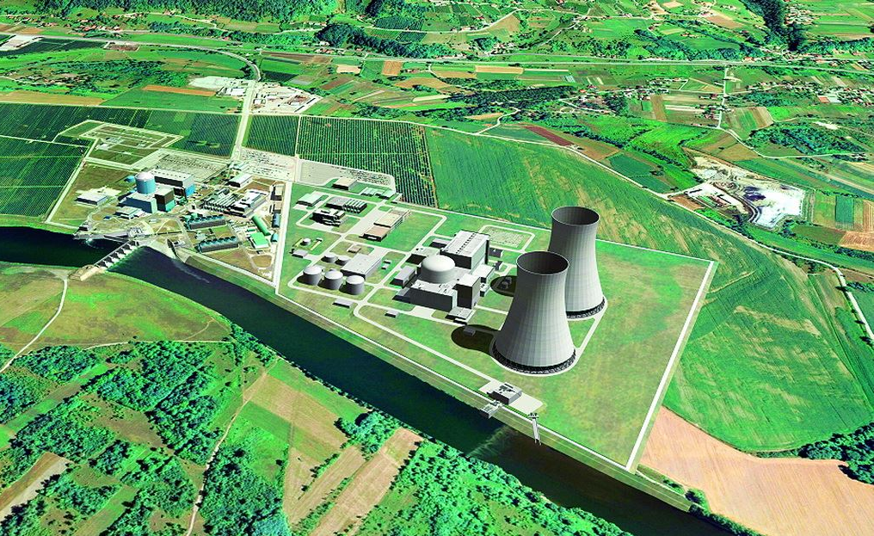
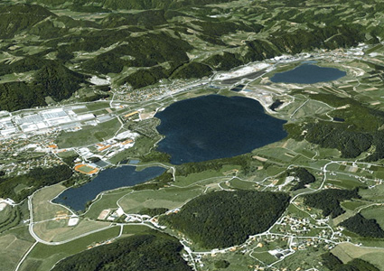
… and its consequences
Velenje lakes
Air pollution
Protests against a new nuclear reactor in Krško
A higher demand for electricity in the winter due to an increasing amount of people that are using it for heating
A decrease in air pollution

Slide 11
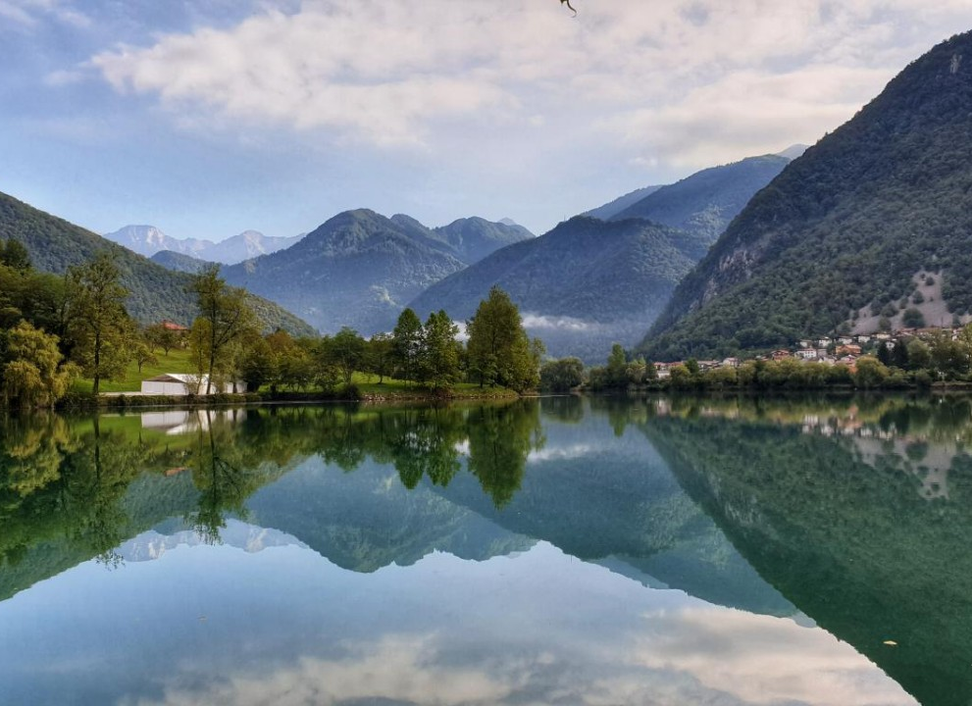
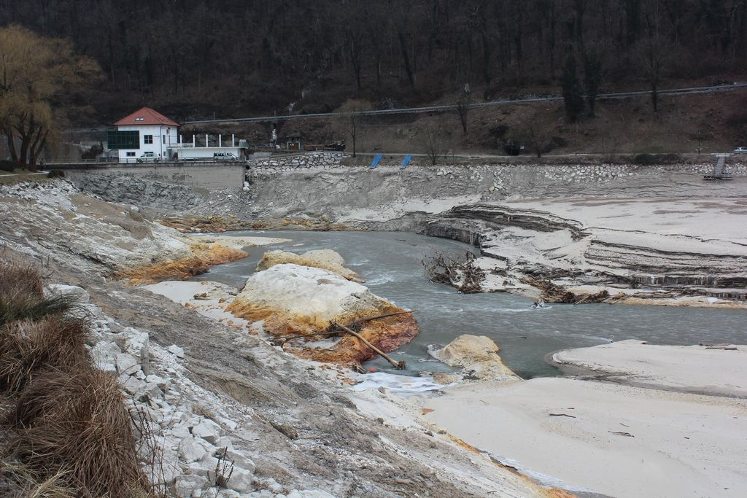
Most na Soči lake
Consequence of hydroelectric powerplants

Slide 12
Laws and regulations which encourage use of renewable sources
Investment is funded 20% by the state
A loan that can cover max. 80% of the investment, minimal loan is 25.000€
The produced electricity is subtracted from the electricity bill
Funds can be used to:
optimize heating,
isolate the building,
build a solar power plant.

Slide 13
Sources
https://ekosklad.si/prebivalstvo/pridobite-spodbudo/seznam-spodbud/mikro-soncne-elektrarne
https://www.i-energija.si/ienergija/energetika-v-sloveniji-in-svetu-statistika/
https://www.soca-valley.com/sl/znamenitosti/narava/jezera/2017112015534651/jezero-pri-mostu-na-soci/
http://www.primorskival.si/novica.php?oid=9187
https://www.delo.si/novice/slovenija/mostarska-soteska-je-spet-potopljena.html
http://ciklon.si/stran/?p=14499
https://www.levica.si/ali-v-sloveniji-res-potrebujemo-drugi-blok-nuklearne-elektrarne-krsko/
https://sl.wikipedia.org/wiki/Termoelektrarna_%C5%A0o%C5%A1tanj_blok_6#/media/Slika:Termoelektrarna_%C5%A0o%C5%A1tanj_SV_blok_6.jpg

Slide 14
Gimnazija Tolmin, February 2020

