Slide 1
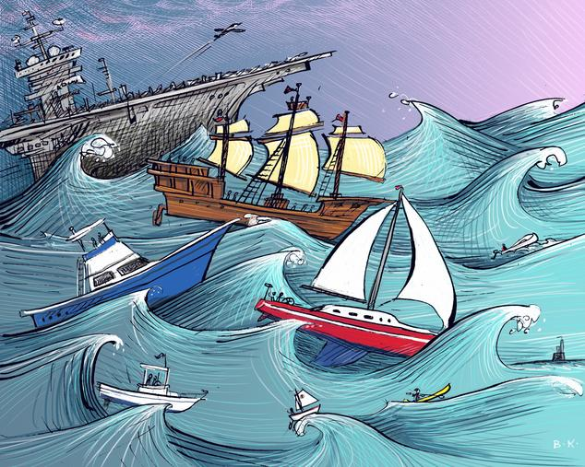
My Journey Through The Storm

Slide 2
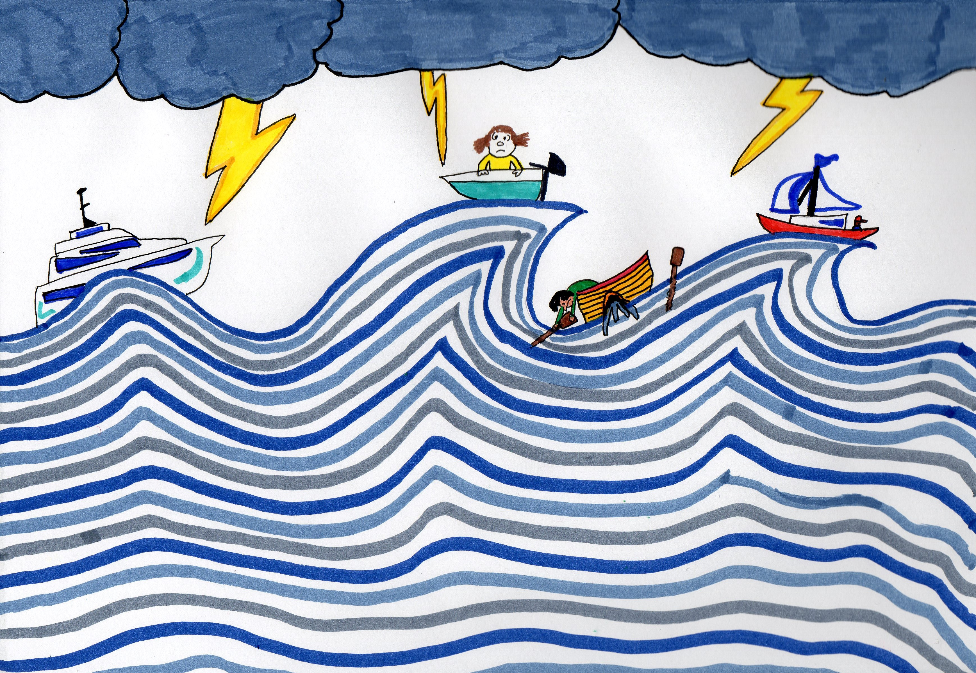
You are all in different boats on our journeys to becoming a teacher, however, we have all had to navigate the same storm.

Slide 3
You have a special story to tell about your journey to your destination to the teaching profession or as we will now know it as The Magical Land of Learning.

Slide 4
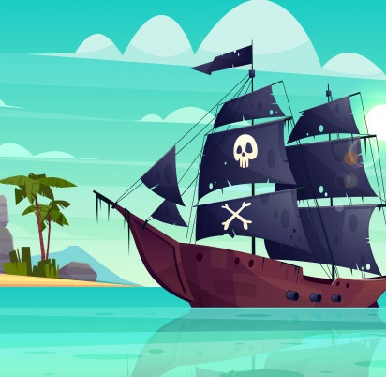
Your journey is about how you were guided along to the Magical Land of Learning. This could be through University (lectures, workshops, tutorials and online learning. During placements through professionals in school, working with children and support from University. Support from other students, your friends and family. Also, advice or information given from other sources: government, social media, online education sites etc.
Think about how all the above play a key part in your story to get you to your final destination.
Like all good stories, the reader wants to know what your thoughts and feelings were throughout your journey. Also, your motivation and engagement and the strategies you adopted to help you at each stage of your journey.

Slide 5
Your special story should be made as a PowerPoint presentation which has:
A slide for each part of the story.
The story can be typed or handwritten.
Each part of the story has an illustration (this can be a very simply image or as detailed as you wish it to be).
Each part of the story has a piece of music to accompany the story, just like watching a movie where the music changes at different times. Your music will represent how you felt at each stage. All you need to do is use the Insert Audio option in the PowerPoint menu bar. You can record audio from your computer or from and external device. You can also place a link to the music online, however, a recording on each slide would be better.

Slide 6
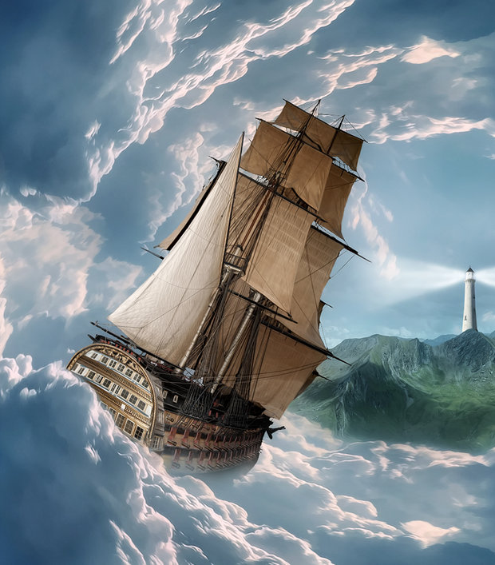
Your story: Who, where and what?

Slide 7
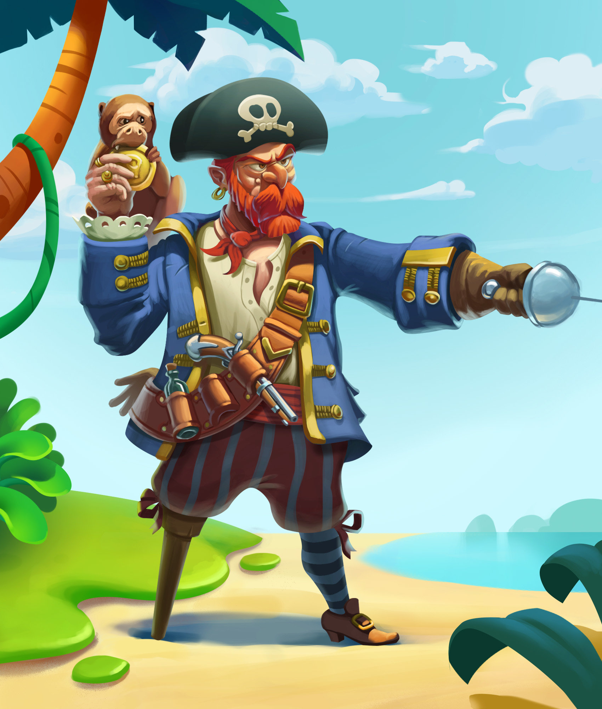
Every story has a character. Who is the main character in your story?
Describe your character to the reader: gender, age and some characteristics.

Slide 8
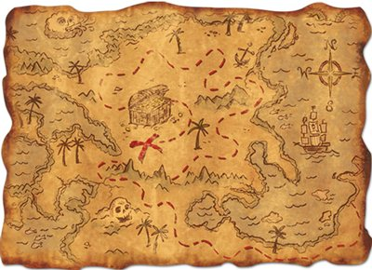
Every story has a journey. Use the following navigation route to tell your story.

Slide 9
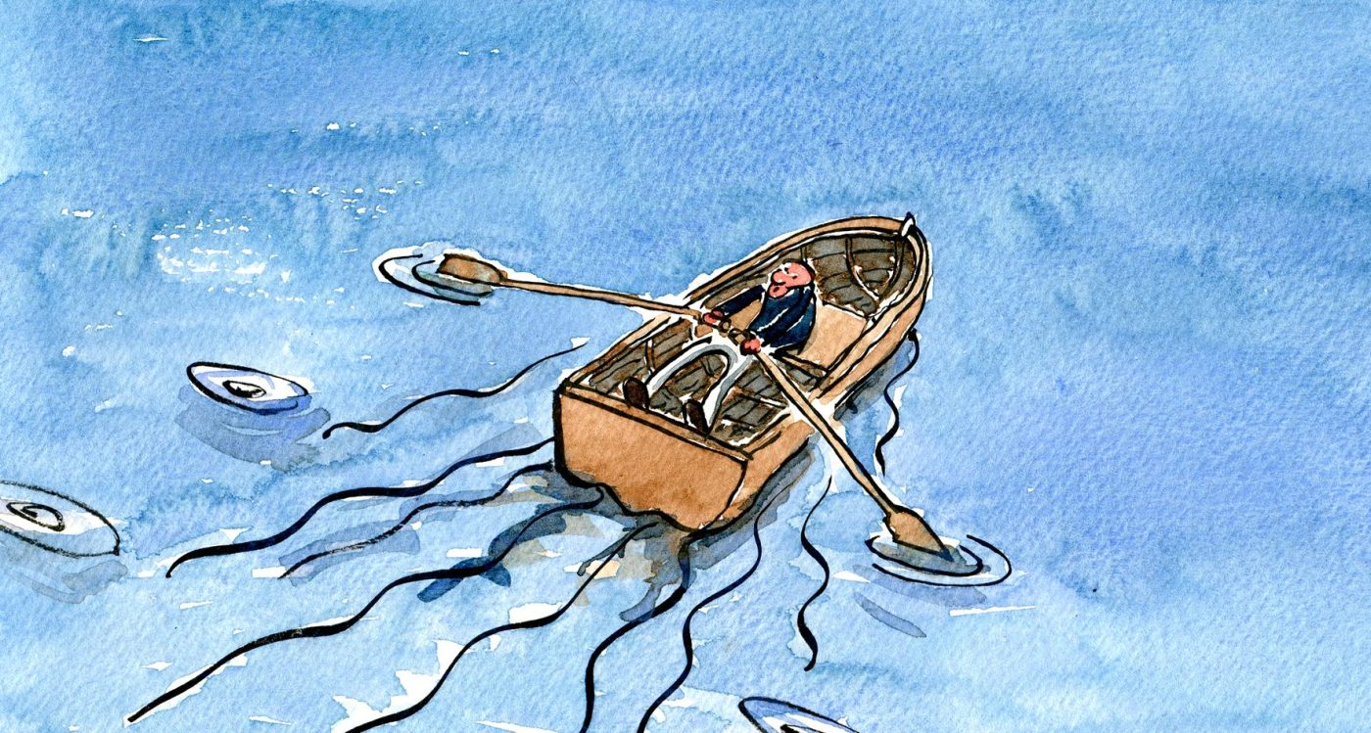
Once upon a time, before the storm, you were heading on a journey to the Magical Land of Learning where you would be a teacher. What was this journey like then?

Slide 10
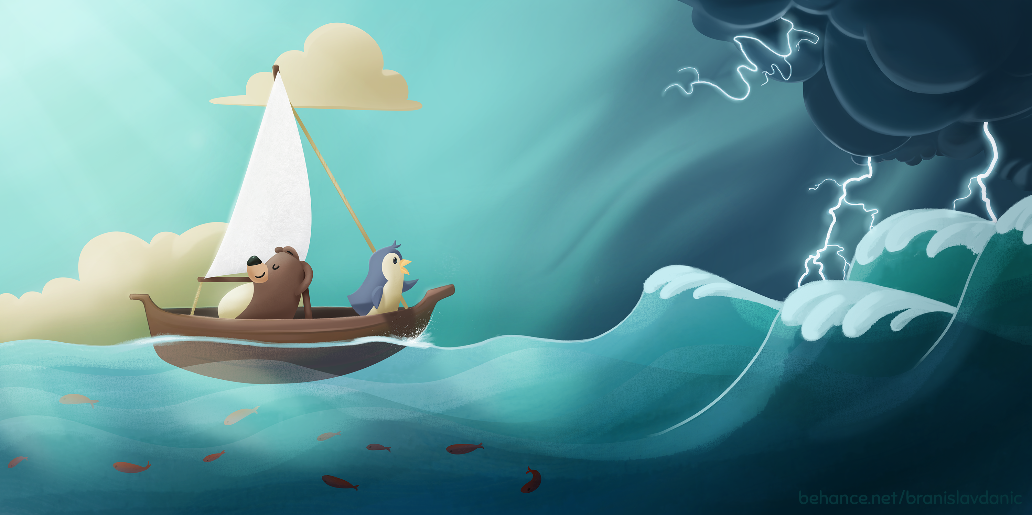
Suddenly, an announcement was made that there was a storm coming your way. What happened at this moment on your journey to the Magical Land of Learning.?

Slide 11
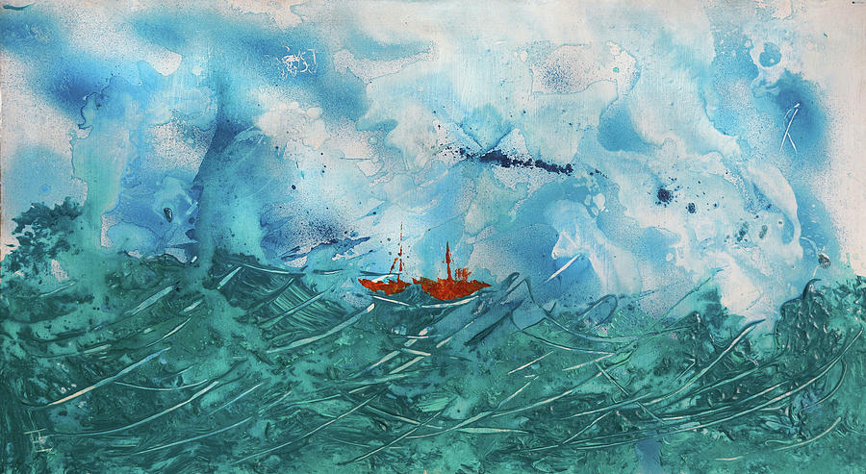
Before you knew it, the storm had hit your boat and now you were in the middle of the raging storm. You had to lock all the doors and windows of your boat to stop the storm getting in. What happened during the first two weeks of the storm?

Slide 12
Although the storm was still raging around your boat, you still managed to keep moving to the Magical Land of Learning. How did you do this? What challenges did you manage to overcome?

Slide 13
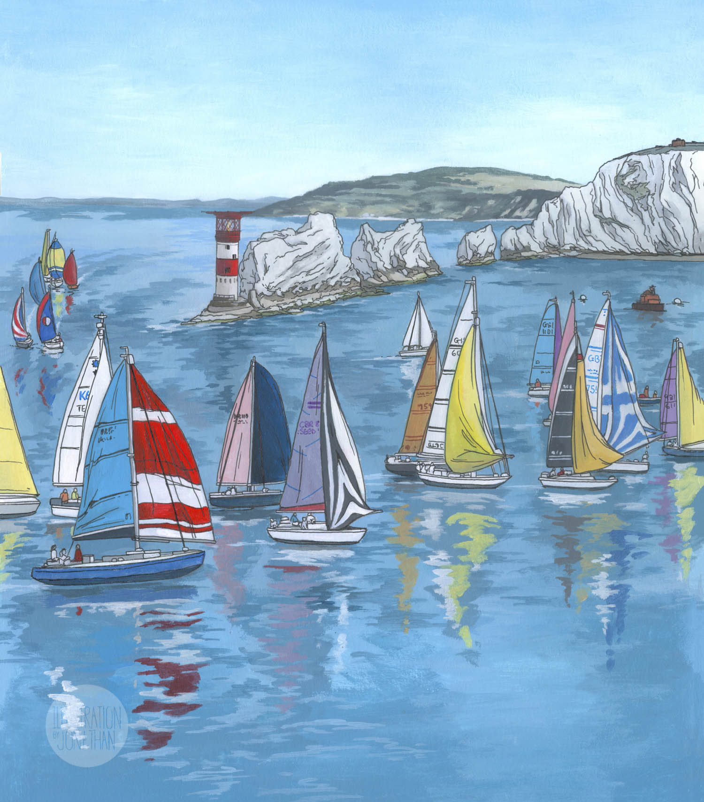
You and your friends have managed to get through the storm and are just about to reach the Magical Land of Learning. Does it look like what you were expecting at the start of your journey? Do you want to go there? Are you ready to disembark and start your new journey?

