Slide 1
SCHOOLS IN CATALONIA AND EDUCATION STAGES
BY Núria, Martina, Júlia and Anna

Slide 2
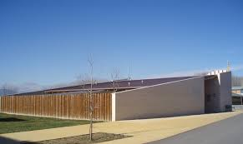
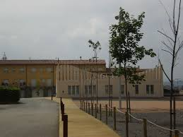
KINDERGARDEN
Age: 4 months to 3 years
This is the kindergarden in Roda de Ter

Slide 3
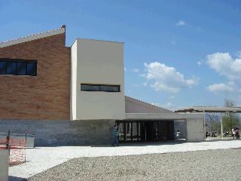
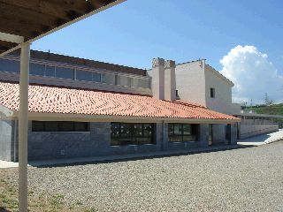
PRE-SCHOOL
This is one of the
two pre-schools that we
have in our town
Age: 3 years to 5 years

Slide 4
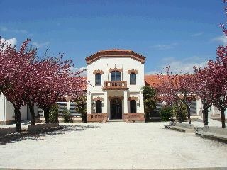
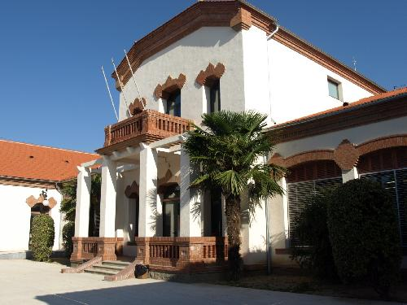
Primary School
This is one of the
two primary
schools that we
have in our town
Age: 5 years to 12 years

Slide 5
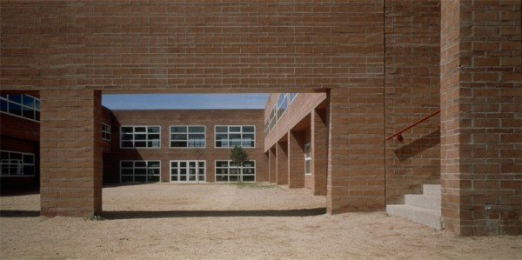
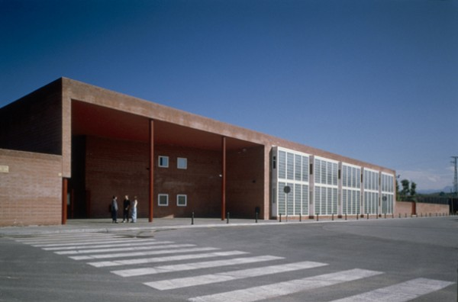
SECONDARY SCHOOL
This is our High School
Inside our high school, the
playground
Age: 12 years to 16 years

Slide 6
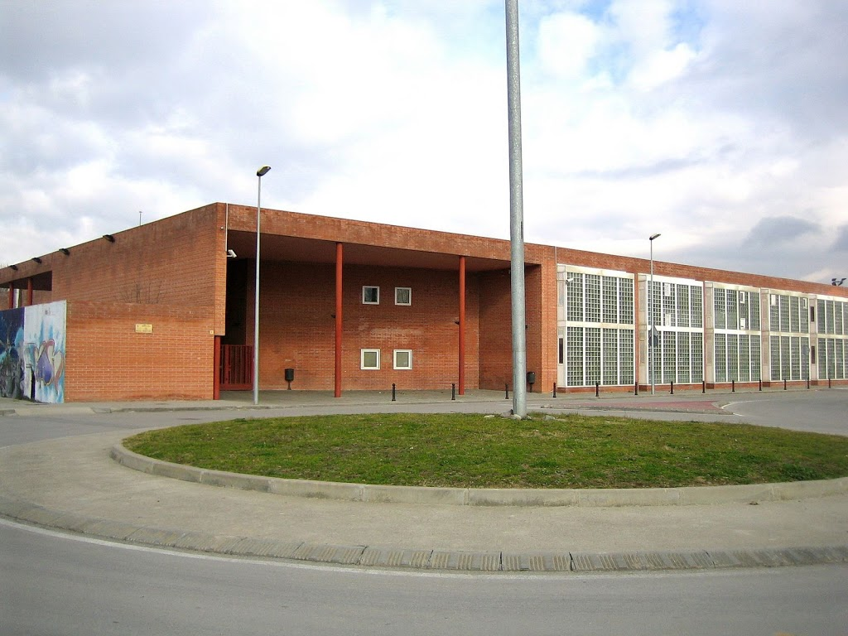
POST-COMPULSORY EDUCATION “Batxillerat”
Age: 16 years to 18 years
When you finish the post-comulsory education you have to pass the “selectivitat” it's similar to A-levels.
In our high school, you can
also study “Batxillerat”.

Slide 7
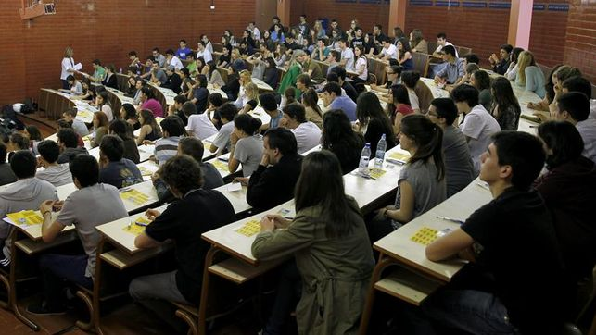
VOCATIONAL EDUCATION AND TRAINING
Age: 16 years to 18 years
Different courses focused on the labour market.
Examples: There are three different blocks:
- Art and design
-Sports
-Professional formation

Slide 8
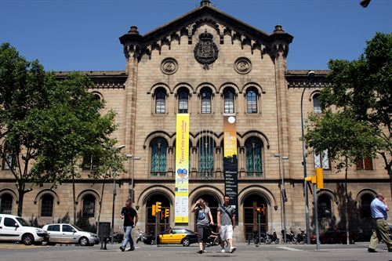
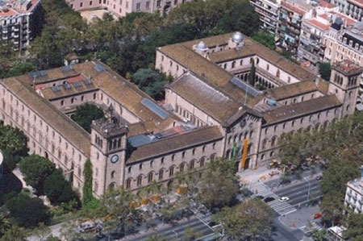
UNIVERSITY
When you finish Post Compulsory Education, you can go to the University and study a degree.
In Catalonia we have many universities. This one is in Barcelona

