Slide 1
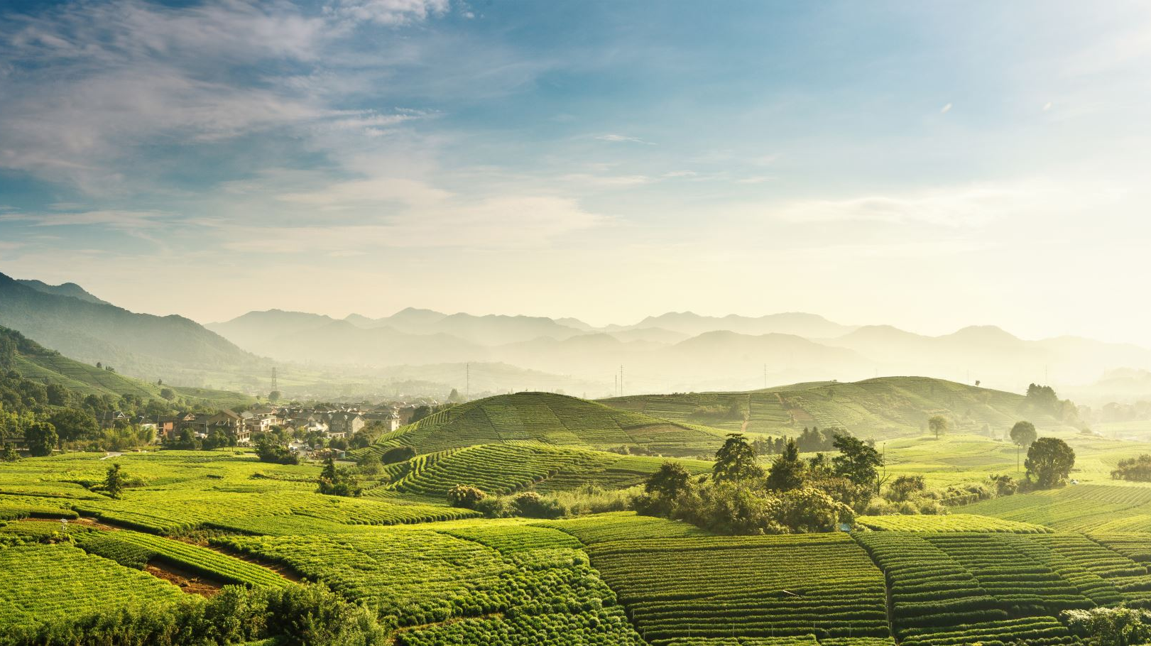
CROATIA
IVa skender
6.razred

Slide 2
something about croatia!
The Republic of Croatia is a European country
In Croatia, the Croatian language and the Latin alphabet are officially used.
Croats are a people who immigrated to the area of today's Croatia during the seventh century.
Croatia won in 1991.years against Serbia
Croatia has a lot of national parks and tourist places
https://www.youtube.com/watch?v=SW3eDNiYhao

Slide 3
Cultural Heritage
Croatia has a lot of dances Circulation Lindo taraban Trusa Trojan
Traditional instruments dvojnice tamburitza tambourine solitary bagpipes, lirica, fićoške harp diplice, diple flute fiddle harmonica triestina
Wedding customs Bednjan wedding at the Bednjan speech
Croatian cultural heritage is a collection of all customs, traditions and goods in Croatian history
https://www.youtube.com/watch?v=fjm9QXUVYLA
https://www.youtube.com/watch?v=INZyYaQh1Wg
https://www.youtube.com/watch?v=zotftt-A13g
https://www.youtube.com/watch?v=OP5eAABGYS0

Slide 4
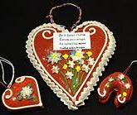
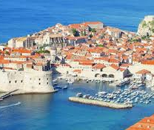
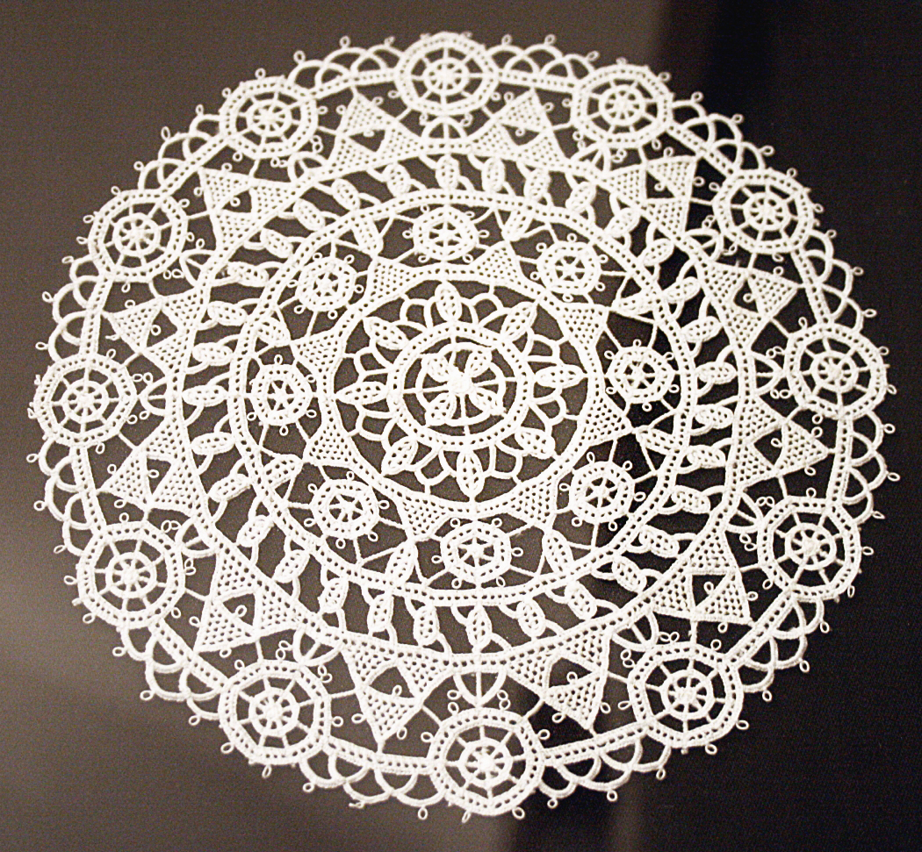
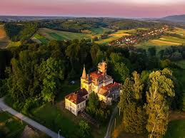
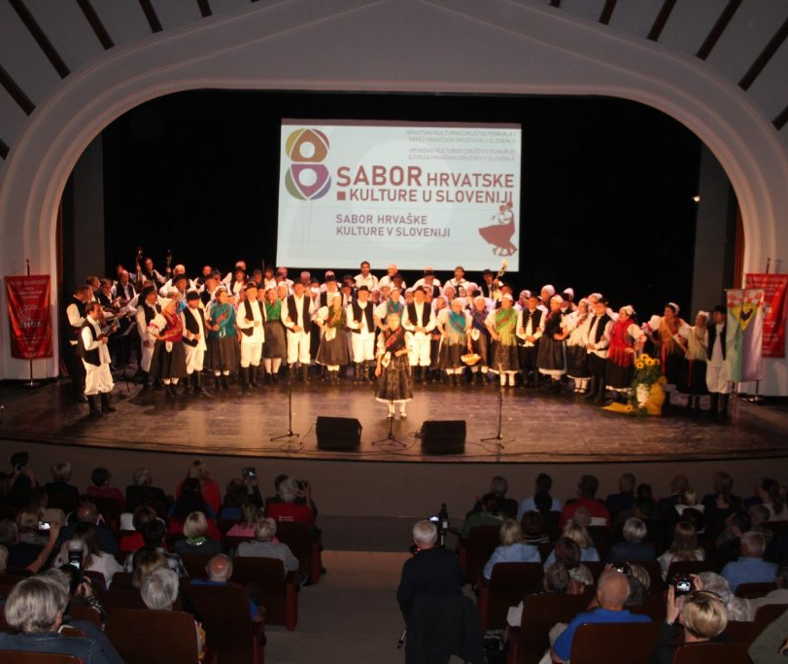
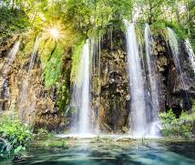

Slide 5
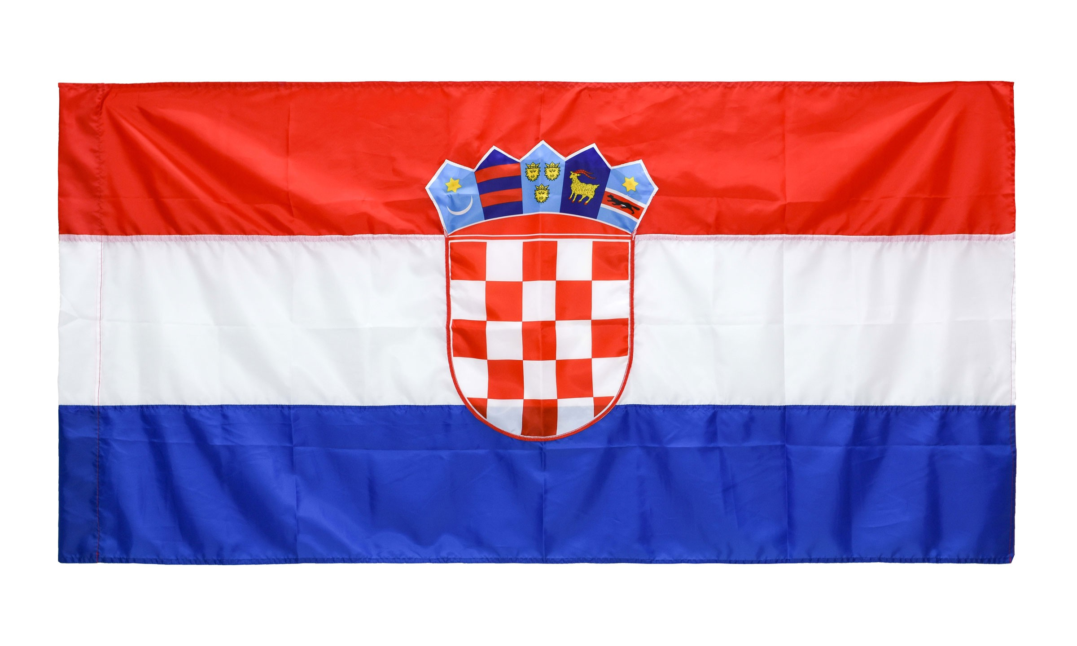
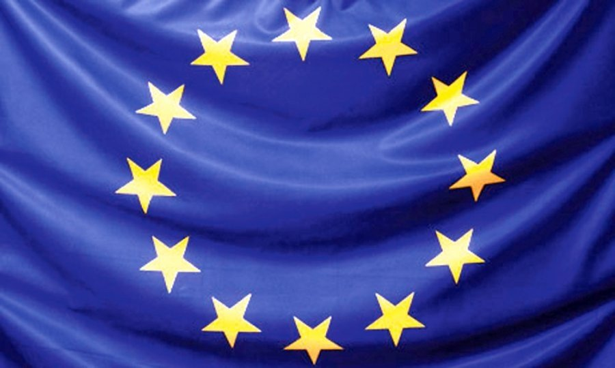
European Union
Croatia is the 28th member of the European Union
On July 1, 2013, Croatia became the 28th member of the European Union and along with Greece, which joined the Union in 1981, is the only country that entered the EU on its own

Slide 6
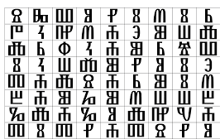
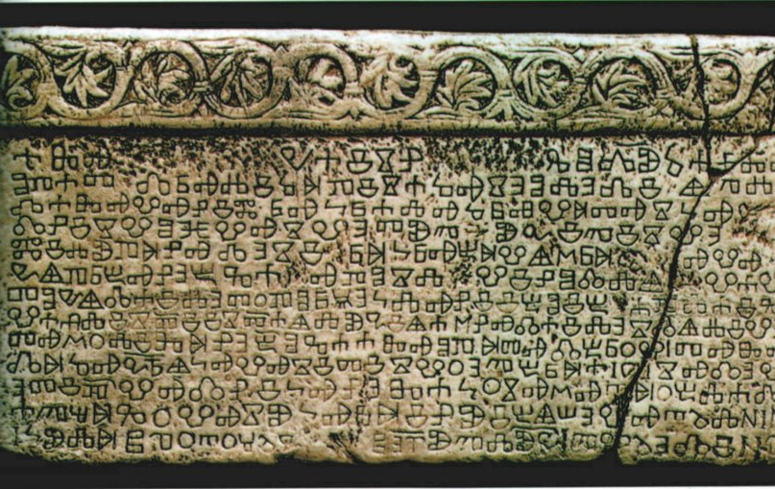
Baščanska plate
Pločica Baška is an old Croatian monument, written in the transitional form of the Glagolitic alphabet, around 1100. It was found on September 15, 1851 in the church of St. Lucia in Jurandvor near Baška on the island of Krk, thanks to the Baška priest Petar Dorčić
Baska is an old Croatian monument, written in the transitional form of the Glagolitic alphabet, around 1100. It was found on September 15, 1851 in the church of St. Lucia in Jurandvor near Baška on the island of Krk, thanks to the Baška priest Petar Dorčić

Slide 7
THANK YOU FOR ATTENTION

