Slide 1
Examples of 3D models created by students of the School Klasika in the framework of the eTwinning and Erasmus+ project “ICT WORLD - Imaging, Coding, Transforming and Simulating the World” 2017 - 2019

Slide 2
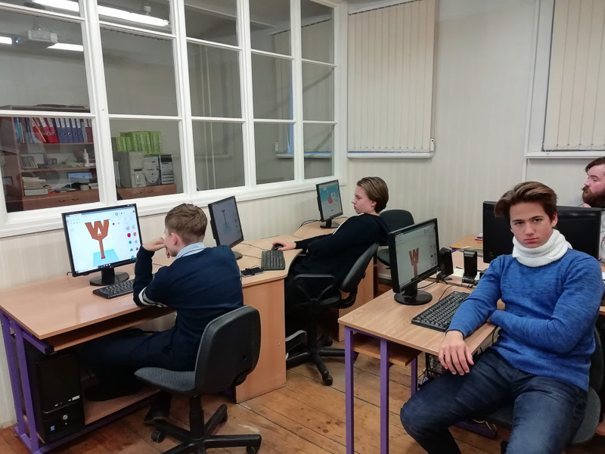
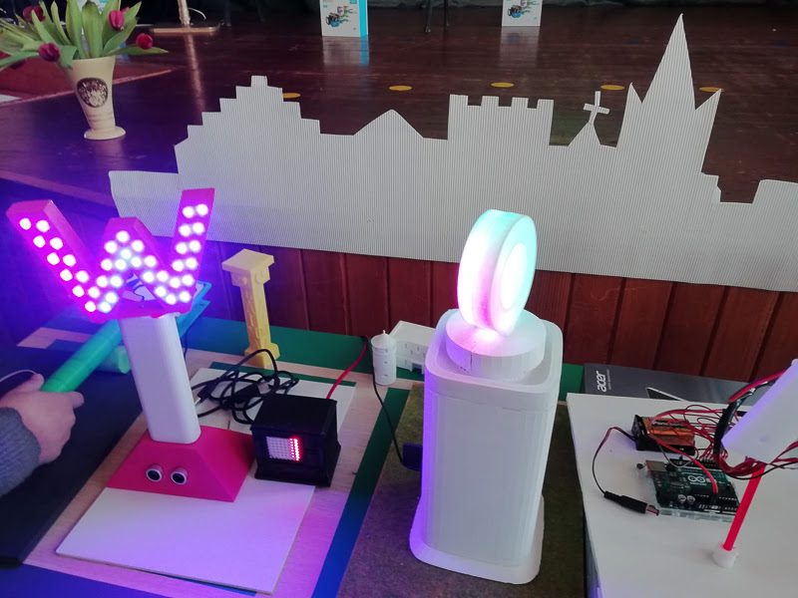
Our letter “W”

Slide 3
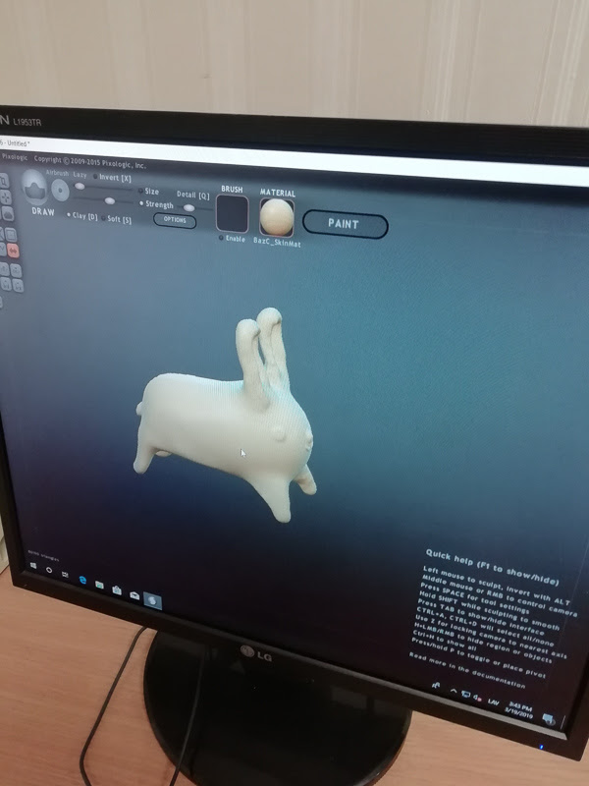
Fairy-tale heroes

Slide 4
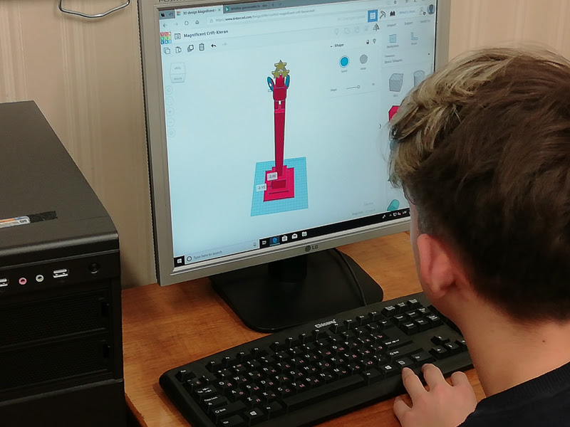
Favorite architectural objects of Riga

Slide 5
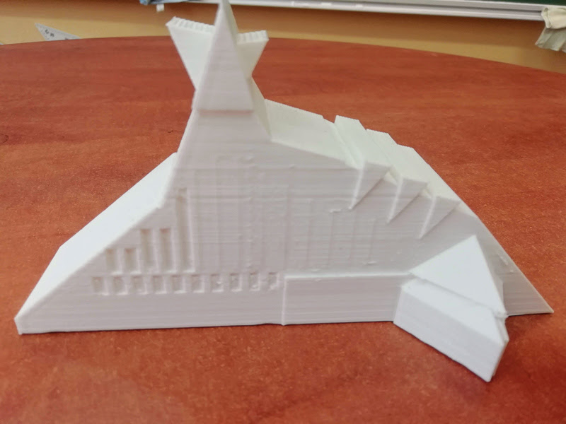
Favorite architectural objects of Riga

Slide 6
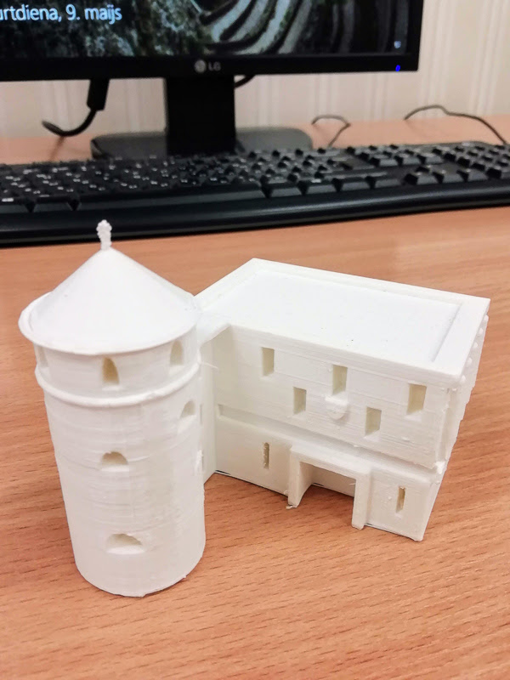
Favorite architectural objects of Riga

Slide 7
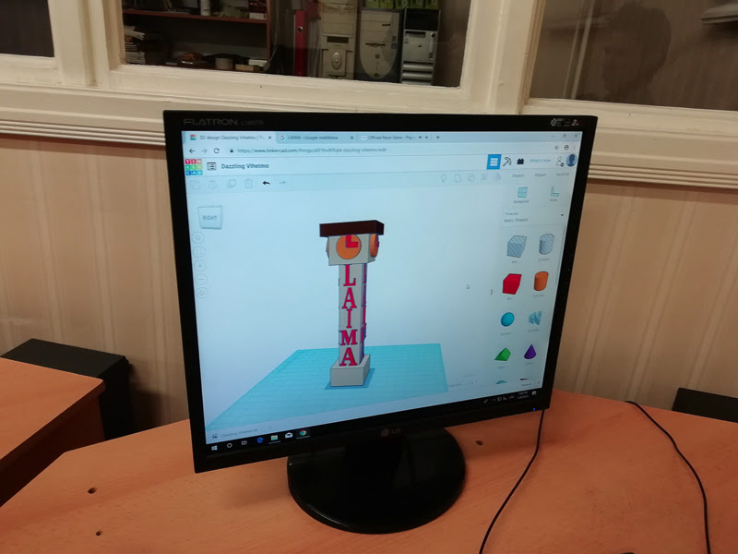
Favorite architectural objects of Riga

Slide 8
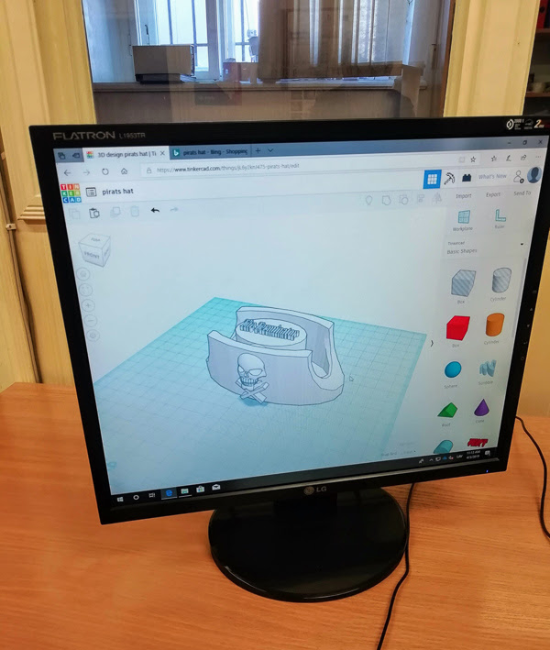
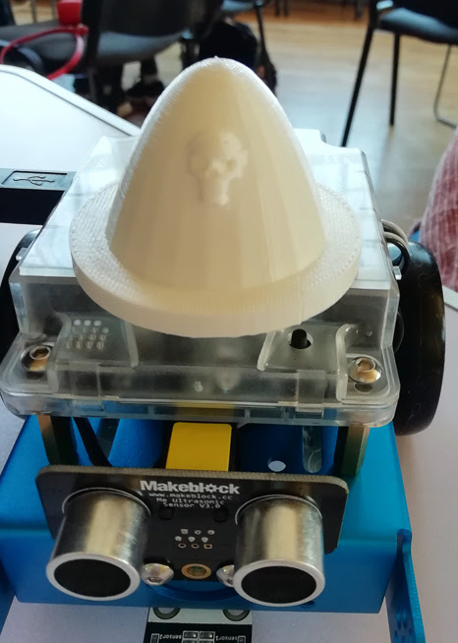
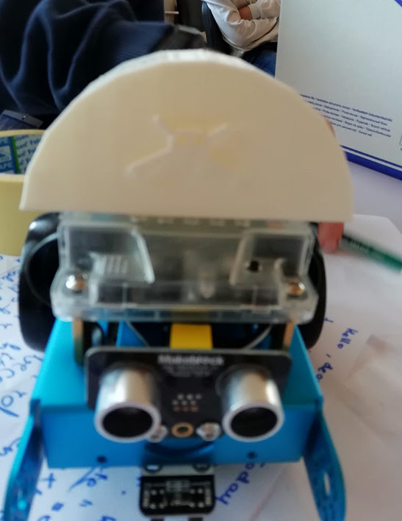
Pirates hats for mBot robots

Slide 9
Souvenirs for friends

Slide 10
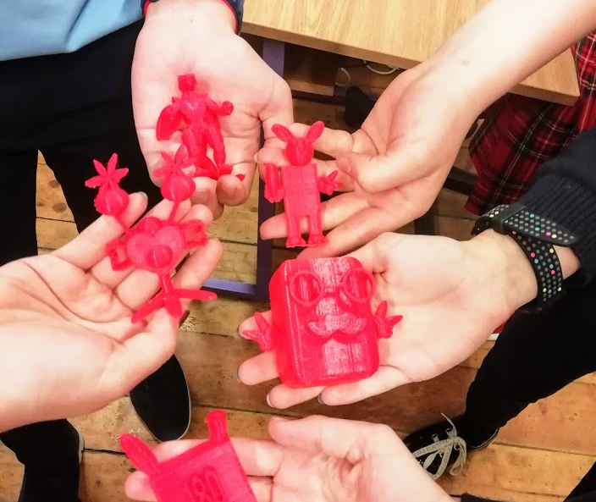
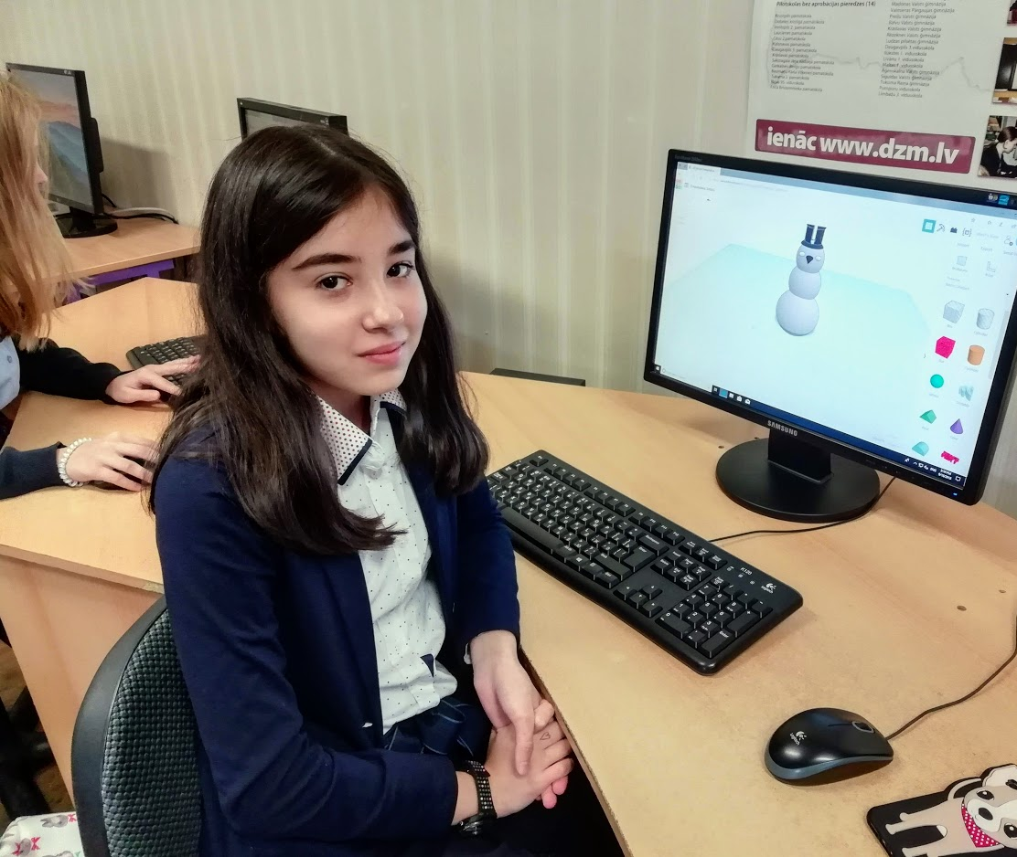
Souvenirs for friends

Slide 11
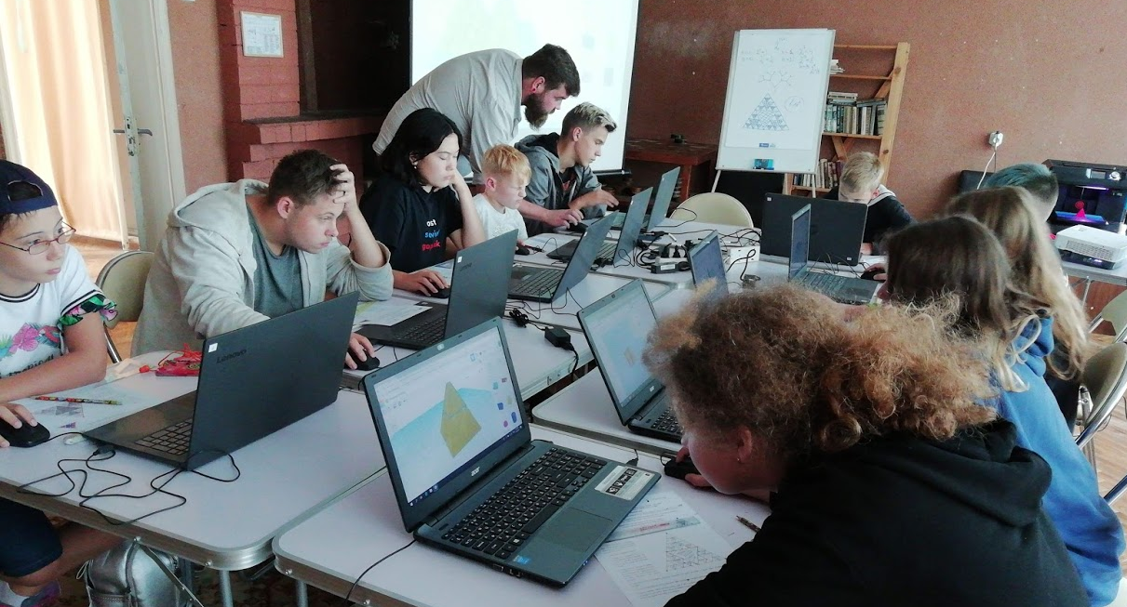
3D fractal - Sierpinski Triangle ( Tinkercad)

Slide 12
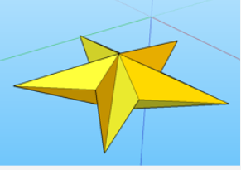
STAR TEAM contest (SketchUp )

Slide 13
Brandenburg Gate ( SketchUp)

Slide 14
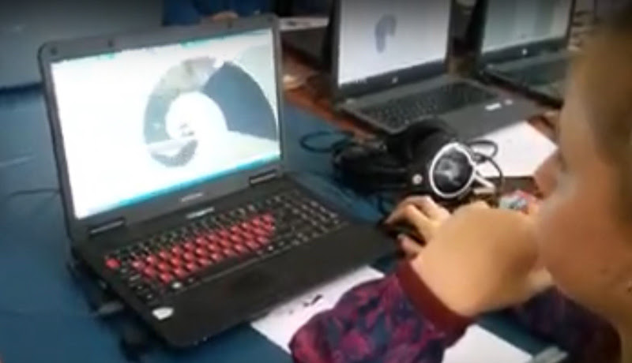
3D Fibonacci Spiral (SketchUp)

Slide 15
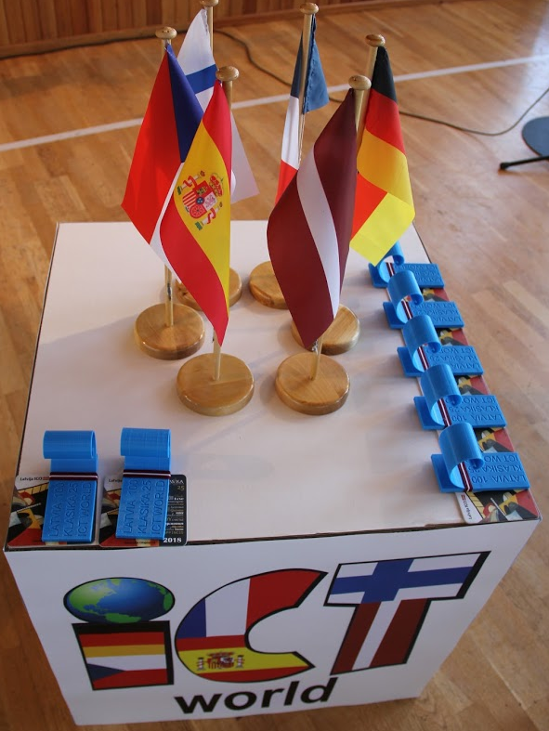
Practical use of the Fibonacci Spiral Gifts for guests and installation "Waves of the Baltic Sea"

