Slide 1
My presentation on Erasmus
Welcome to my presentation about our Erasmus project
From October 25th, 2021 to November 1st, 2021
In Valencia

Slide 2
Our partner schools
IES Monduver Lluis Vives, Xeraco Spain
Scuola secondaria di 1‘ Grado “Pirandedello“ Milena, Italy

Slide 3
Monday, October 25th, arrived in Valencia, first day at school and the first evening with the host family
We arrived in Valencia around 10am and drove from the airport to the youth hostel. Our Spanish exchange partners provided us with bed linen as well as 2 towels and a blanket. After we unpacked, we went to school. We were greeted in a friendly manner and got to know our partners for the first time and spoke to them for the first time. And after school we drove to the family.

Slide 4
Tuesday, October 26th,
z
We went to school in the morning and should go to the family in the afternoon. We decided together that we would do some kind of hike with everyone.
In the evening we went back to our host families.

Slide 5
Wednesday, October 27th
On the day we went on a boat tour by bus, we drove over a huge lake in a small motorboat. After the boat tour we took the bus to “Ciutat de les Arts” and had lunch there. In the afternoon we drove to downtown Valencia and visited an old church as a museum.

Slide 6
Thursday, October 28th,
Donnerstag morgen sind wir mit unseren Austauschpartnern in die Schule gegangen wir gingen. Wir gingen mit ihnen in die Stunden die sie haben. Nach der Schule sollten wir zu unseren Gastfamilien, doch wir entschieden als Gruppe das wir alle zum Strand gehen und den Nachmittag dort verbringen. Am Strand angekommen genossen wir alle den Strand und das Meer. Abends aßen wir wieder mit unseren Gastfamilien.

Slide 7
Friday, October 29th,
z
I'm going to Gandia on Friday. There we visited a museum and enjoyed the day in Gandia with shopping and eating. In the evening there was the big farewell party for the Italians, because they flew back to Italy on Saturday.

Slide 8
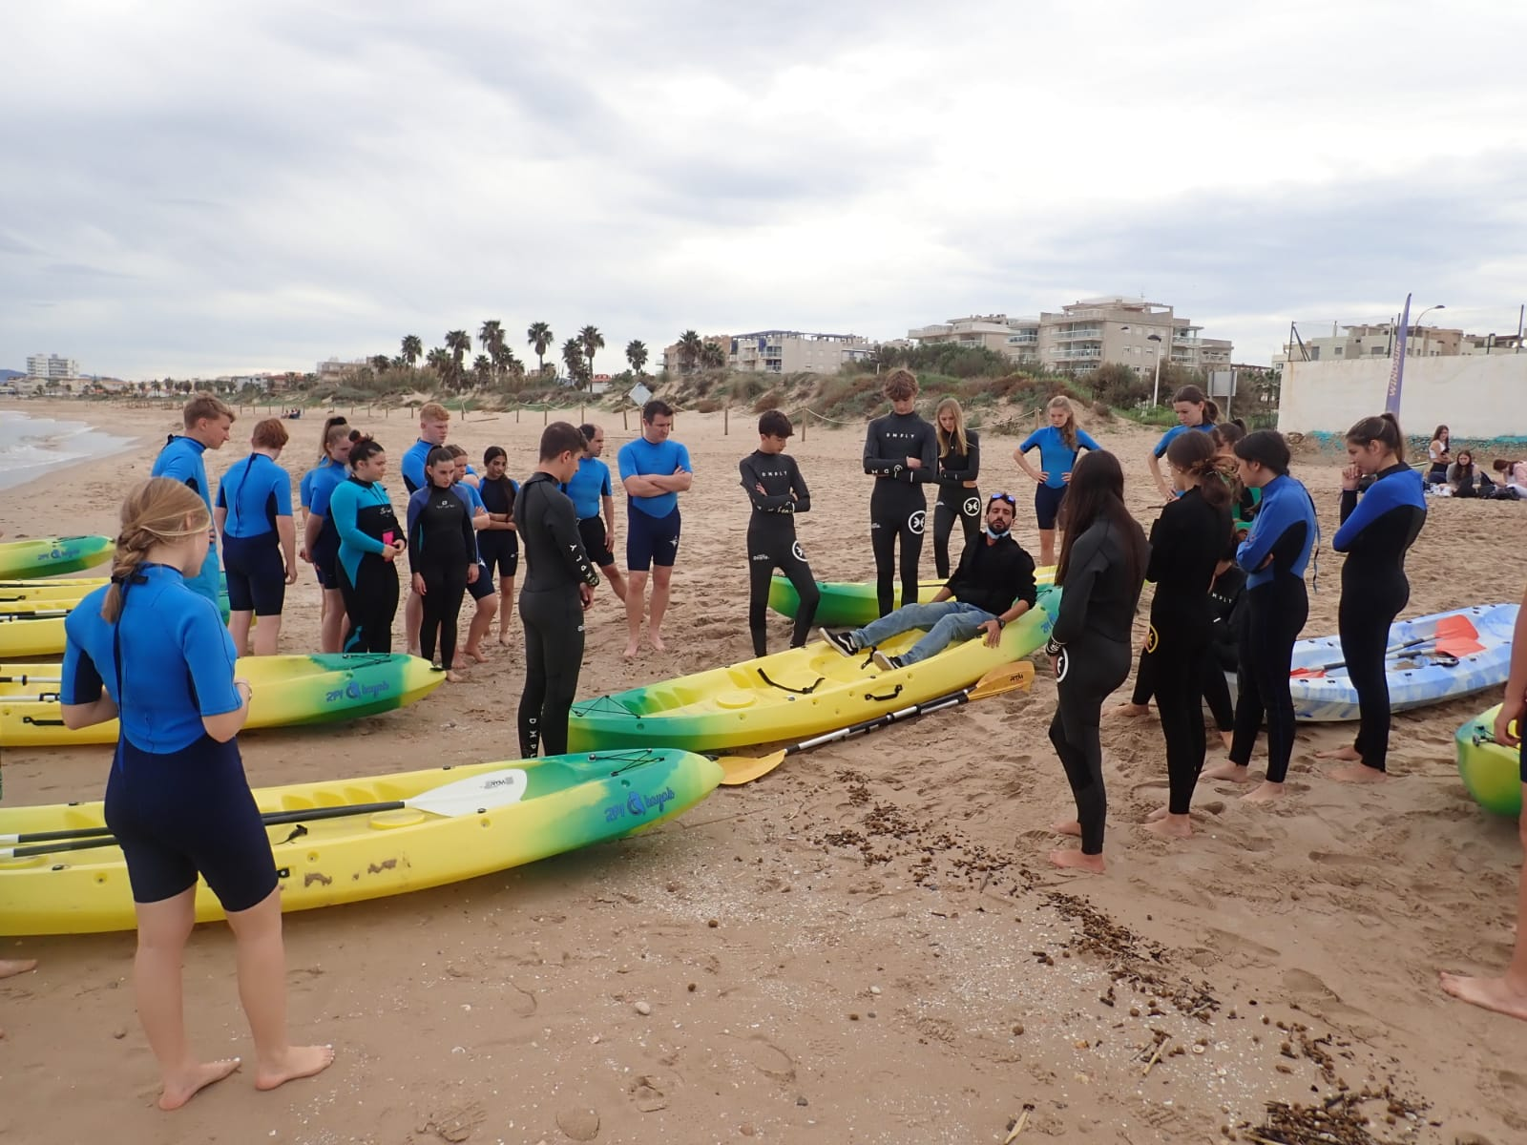
Saturday, October 30th,
z
On Saturday we first drove to a huge shopping center. After shopping we went straight to the beach to go kayaking.

Slide 9
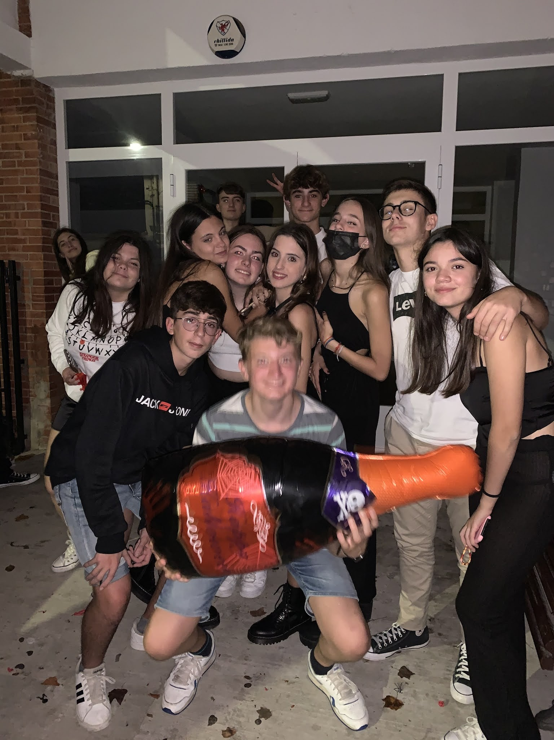
Saturday, October 30th,
z
But on Saturday it wasn't just the kayak trip but our big Halloween party in the evening.

Slide 10
Sunday, October 31th,
z
On Sunday we spent a whole day with our host families. They organized a very nice day for us. Some took a boat across the sea, toured the city, visited the beach, and much more

Slide 11
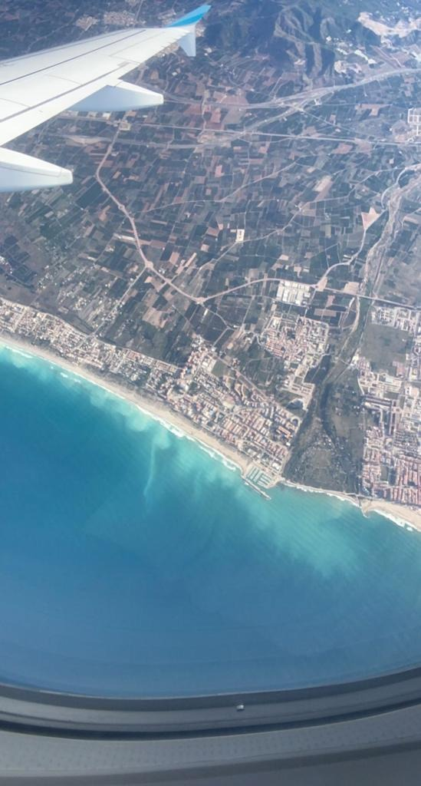
Monday, November 1^{st,}
Our farewell and the journey home to Germany.
z

Slide 12
That was our student exchange. It was an incredibly beautiful week with all students, parents, teachers and everyone involved. Thank you for Watching
z

