Slide 1
Three tins

Slide 2
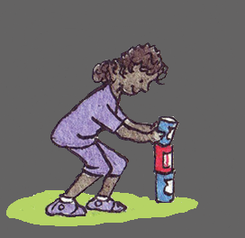
Basics
Aim of the Game: To knock the tins down.
Type of Game: Throwing Game
Age: 6 +
Charakter of the Game: Non-Competitive
Country of original: South Afrika
Number of players: Two equal teams with a minimum of five people
Difficulty: Medium
Area of play:8m x 4m
Equipment Three tins, plastic blocks or other stacking objects, A small ball

Slide 3
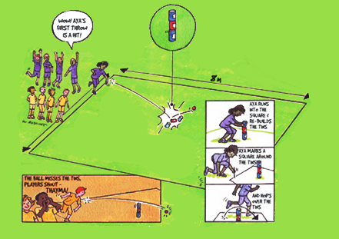
How to Play
Set up: 8m x 4m ground to play
Three tins are placed on top of each other
The first player has three attempts to knock the tins down
The player throws the ball from outside the marked playing area
If successful the player runs out, re-builds the tins, draws a square around the tins and hops over the tins three times.
If the ball misses or is thrown too far the players shout 'Thayma; until the ball is returned
If after three throws the player has been unsuccessful, the first player from the opposing team becomes the thrower.

