Slide 1
Burning Ball

Slide 2
Burning Ball is a game that combines running, throwing and catching. In Germany it is very popular with children and teenagers. The rules are simple and easy to learn.

Slide 3
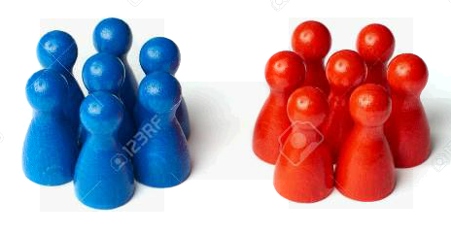
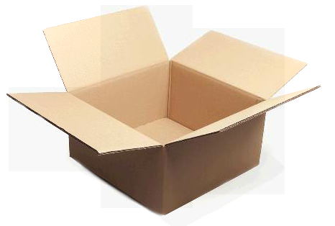
Equipment and Materials
To play Burning Ball you need:
2 teams
4 bases (e.g. gym mats)
1 container (e.g. box) and
1 ball (Volley- or Softball)
1 field
The field should correspondent roughly to a volleyball field (9 x 18 m). At each corner of the field you place 1 gym mat as base and now you define the start/finish point. Put the box next to this point. Divide the players into to 2 teams (the defending and the offensive team).

Slide 4
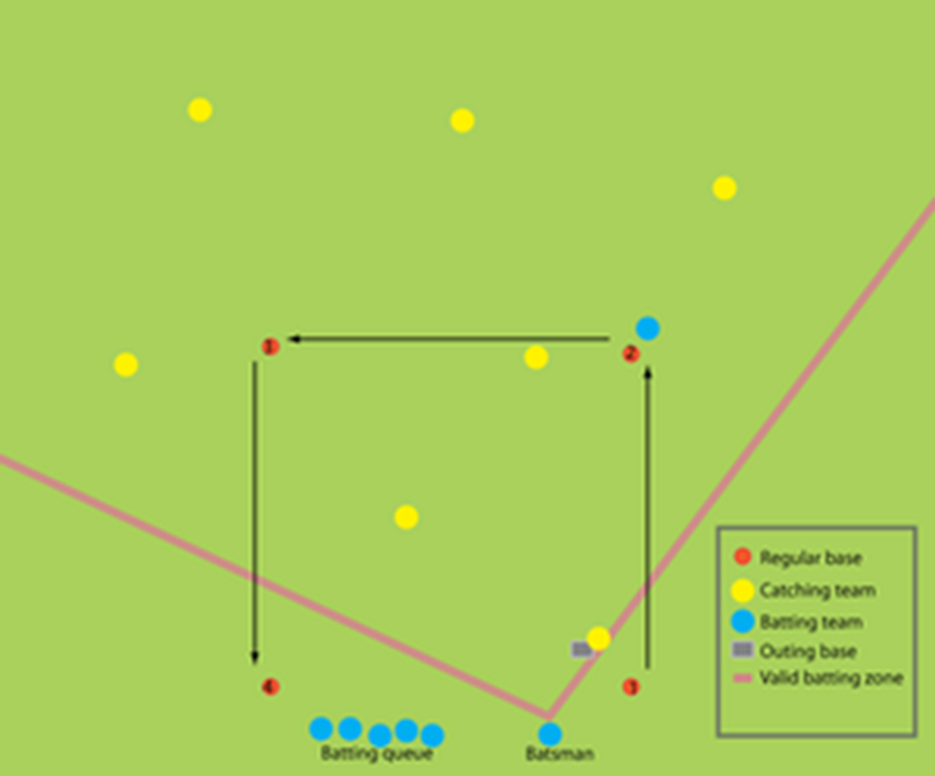
Rules
The defending team A is in the in-field, the team captain stands next to the „burning mark” (box).
The offensive team B stands in a line at the first base.

Slide 5
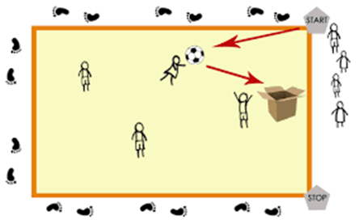
Rules
A player of team B throws the ball as far as possible. Afterwards he runs as fast and far as possible. At the same time team A tries to catch the ball and passes it to the captain as fast as possible. The captain throws the ball into the box and screams „burnt“.

Slide 6
Rules
If a player of team B manages to run around the in-field completely and gets to the finish, he gets 4 points (homerun). In the case he doesn‘t manage to run around the in-field but stops on one of the bases, he is safe and continues running when the next player of his team throws the ball. For reaching the finish with stops, the player gets 1 point .

Slide 7
Rules
If he is in between two mats during the captain’s scream, he‘s burnt (no points)..

Slide 8
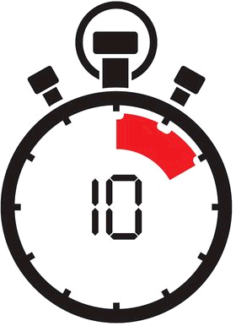
Rules
Change roles after a certain time (10 minutes) or after each offensive player had thrown the ball once..

Slide 9
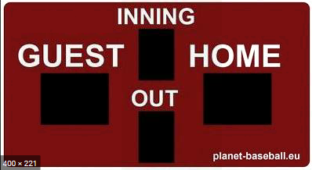
Aim of the game:
Try to do as many runs as possible…

