Slide 1
Brown Girl in the ring by Hannah

Slide 2
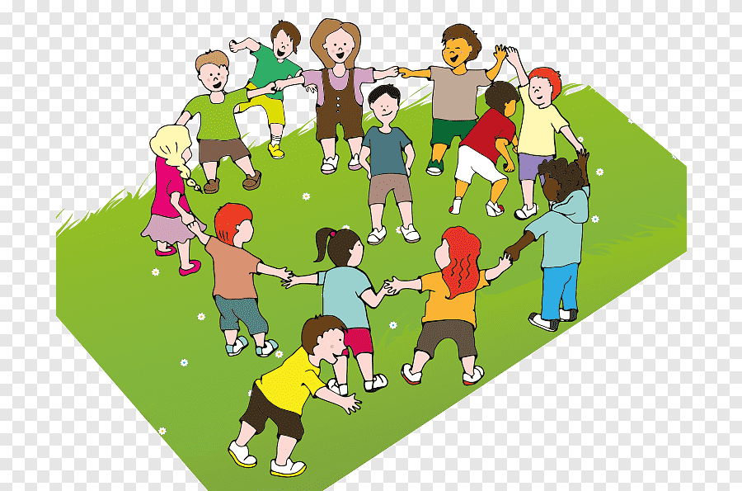
. The game was intvented on April 3, 1978 . This game is a lot of fun . I believe in photos you can see a lot

Slide 3
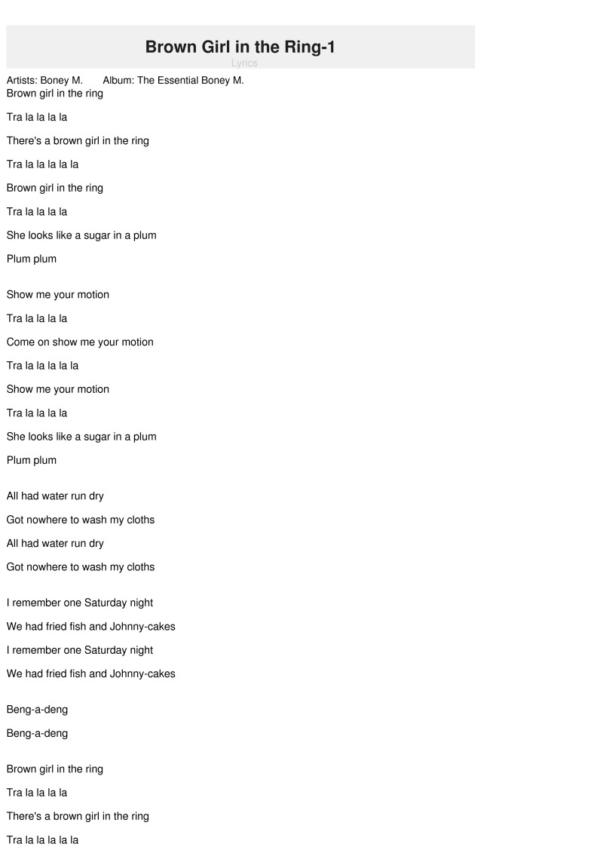
That`s the song for the game
A song was invented for this game

Slide 4
Game instructions : . The players from a circle. Then they sing the song and. A child goes to the center of the circle, During thr first verse, this child is dancing around inside the circle. In the 2nd verse beginning with „ Show me your movement“ , the child show his movements! In verse 3 the child chooses a partner to jump around the ring with. At the and of the song, that selected partner become the next „ brown girl in the ring „ and the song starts over.

Slide 5
Thanks for hearing my best regards from Germany

