Slide 1
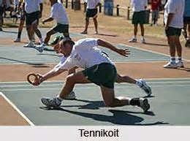
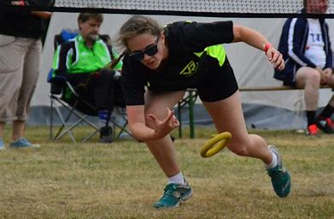
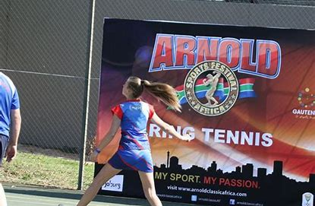
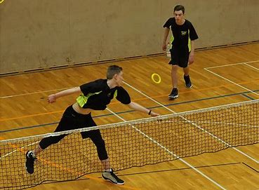
Tennikoit (Ringtennis)
Notes:
6/10/2020
1
1

Slide 2
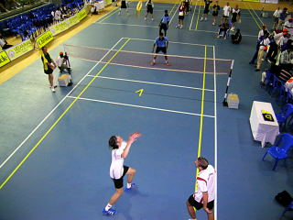
General facts
also called ring tennis or tenniquoits
is played on a tennis court
There is a net that separates the two players
a circular rubber ring is thrown over the net separating the two players
each player ties to catch the flung ring and bring it back to the opponent`s place
The game is particularly popular in
Germany
South Africa
Brazil
the Subcontinent nations of India
Pakistan
Bangladesh
Notes:
6/10/2020
2
2

Slide 3
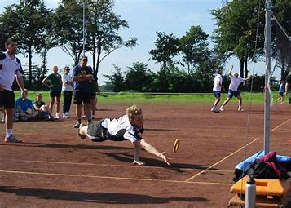
History
The origins of tennikoit are unclear
with some sources claiming a German
The ancestor of the game is likely the game of deck tennis
a recreation commonly played on cruise ships at the start of the 20th century, on smaller versions of tennis courts, with rings or rubber or another soft material
Notes:
6/10/2020
3
3

Slide 4
Rules
The game begins as one player serves the ring upwards over the net, diagonally into the opponents court
the opponent tries to catch the ring before it can land in their court, and if so throw it back
Each player takes five services in a row, regardless of whether they have scored points for a serve, and then the opponent serves for the following five turns
Each individual (or double) tries to score 21 points in order to be declared a winner, but the winner must maintain a lead of two points over the opponent to win
A game consists of 3 sets of 21 points; the winner of 2 sets wins the match
However, a time limit of 30 minute is in place per set. Thus a server should win a point within nine rallies; failing to do so will then result in a point for one's opponent
The game may be played in singles (one player per side) or doubles (a pair per side)
Faults include a koit hitting the net posts, leaving the court entirely (even if it eventually lands in the court) or striking or passing through the net, as well as wobbling or shaking of the koit.
Notes:
6/10/2020
4
4

Slide 5
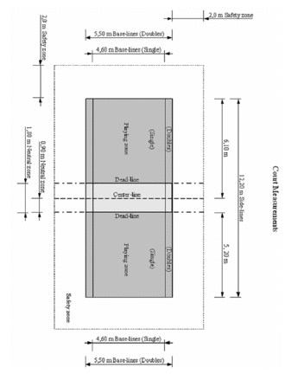
Court and equipment
Tennikoit can be played indoors or outside, on any surface which includes red sand, clay, and cement
Courts measure 12.2 by 5.5 metres, regardless of playing singles or doubles, and are divided by a centre line
Each playing zone is 5.2 by 2.75 metres
The height of the net that divides the court another direction is 1.8 metres
Notes:
6/10/2020
5
5

