Slide 1
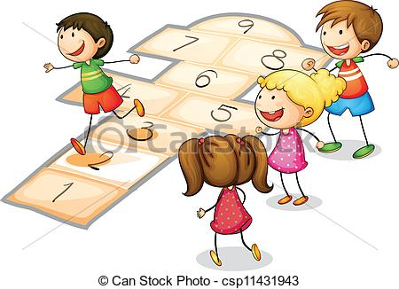
__La Marelle__ by Anastasia

Slide 2
What is ,,la marella”?
La marella is a funny ,sporty game that you can play with your friends.
You can play this game only outside.
This game is not for people how don’t go outside ;)

Slide 3
What kind of material do I need for this game ?
You need a smooth floor outside
you need chalk to draw the game on the floor and you need a small stone
This game you can play alone or with your friends it’s more funny when you play it with your friends
Make sure that outside is not raining:)

Slide 4
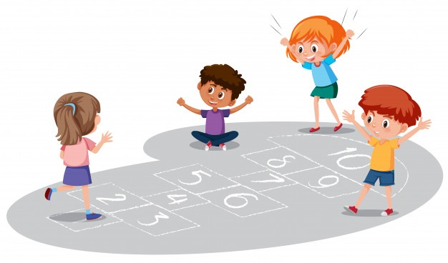
How I play this ,,la marella”?
First you draw squares and in the squares you draw numbers, for example, enter the numbers 1 to 10 make sure that the squares are side by side like this picture 👇🏻
Than you take a small stone
You then throw the stone at any number
Than you jump with one leg to the stone but watch out that you don’t jump out of the squars.
And than you take the Stone with one leg
When you have the stone in your hand you jump back to the start
and then it's your friends' turn;)

Slide 5
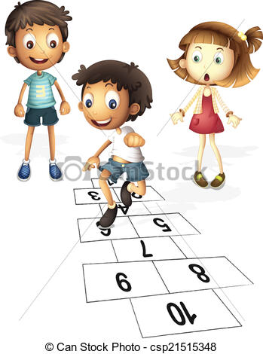
Why should I play this game?
You should play this game because it’s very funny and you spend time with your friends outside.

Slide 6
THE END
Thank you very much for reading my presentation I hope you like it
🇩🇪. 🇮🇹. 🇪🇸

