Slide 1
Ring Riding
Traditional Sport

Slide 2
History
Ring Riding is an exciting game for young and old held every Summer. This sport is done on a horse and its based on the military use of the lance by heavy cavalry. It transformed into a traditional sport during the late middle ages and remained popular with the nobility in England and Wales, Germany and other parts of Europe.
\

Slide 3
Some Probems
The game was forbidden for married people because of the rough treatment, later on ring riding was only allowed for unmarried people. Nowadays the game is mainly operated by the peasantry. Although farm work is done by tractors they still love to use their Belgian horses.

Slide 4
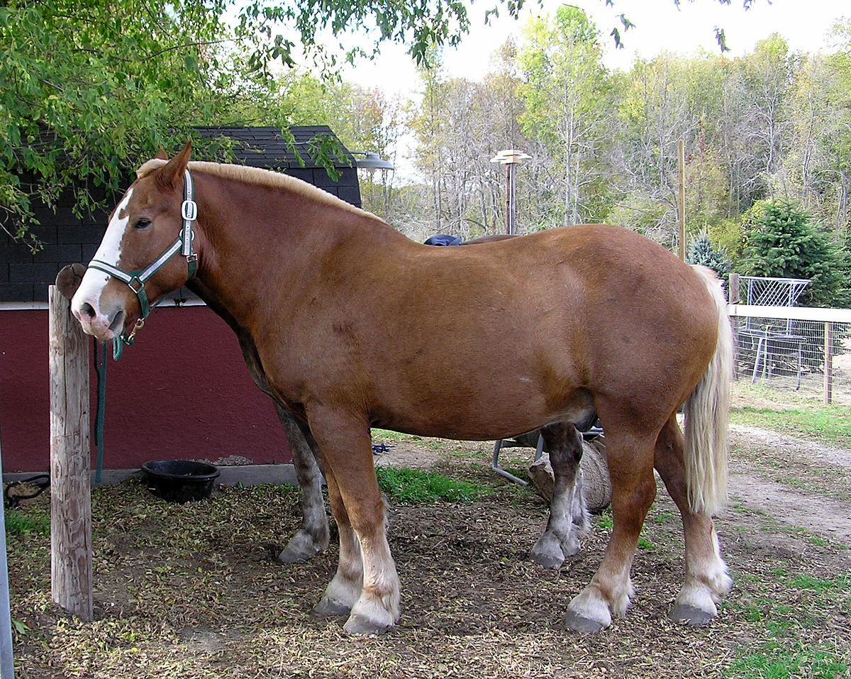
Belgian horse

Slide 5
Game play
According to the game rules the track should be 36m long. It is trimmed with poles which are at the bottom 1m apart from each other and at the top 1,65m. In length they are at both sides connected with ropes, while in the middle under a gate a line at about 2,20m height stretched across is, at what a holder for the ring attached is and this holder could be pushed back and forth. The participant could determine the place of the holder itself, depending he is left- or right-handed. The ring of 38mm average could be inserted into the holder with a feather. It is the intention to sting the ring of the holder with a spear, comparable with a wooden spear, anticipated at an iron tip. If the ring is stung at the spear but it is lost before the end of the track, it is counted as a miss. During this action the horse should be in gallop. If the horse is trotting, the participant should run over provided that he before overtaking the ring the spear has been held back. If the horse doesn’t gallop anymore, he should try it once again. If it don’t work again, the next participant is at turn.

Slide 6
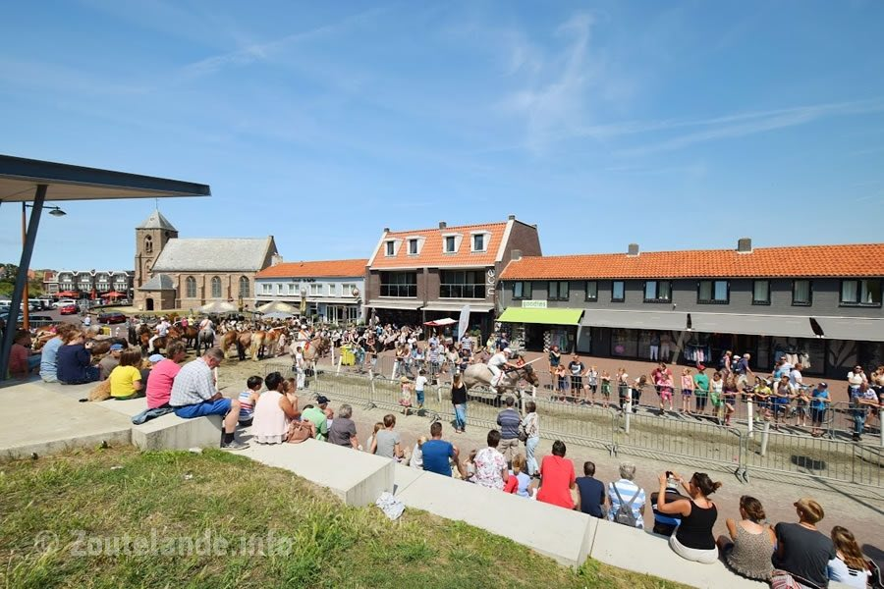
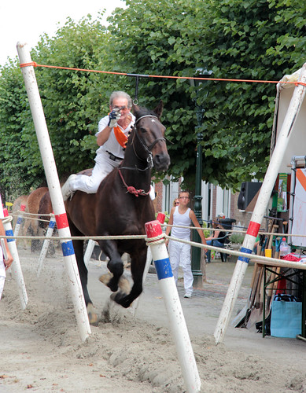
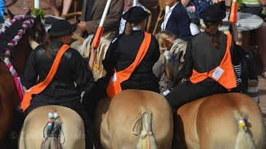

Slide 7
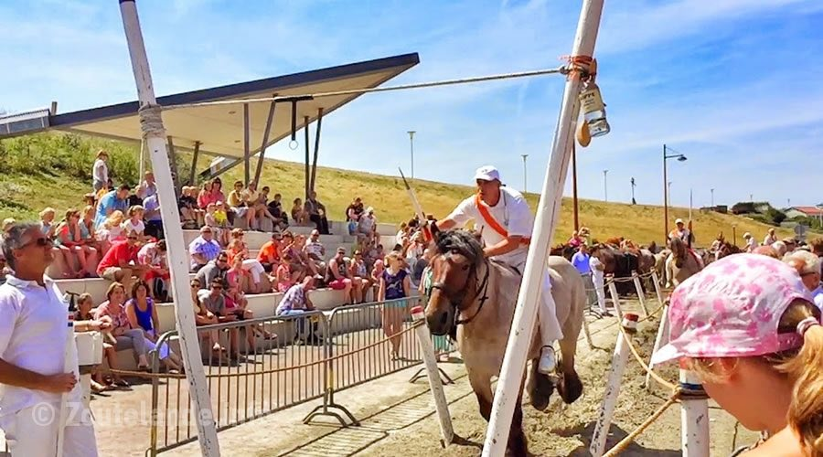
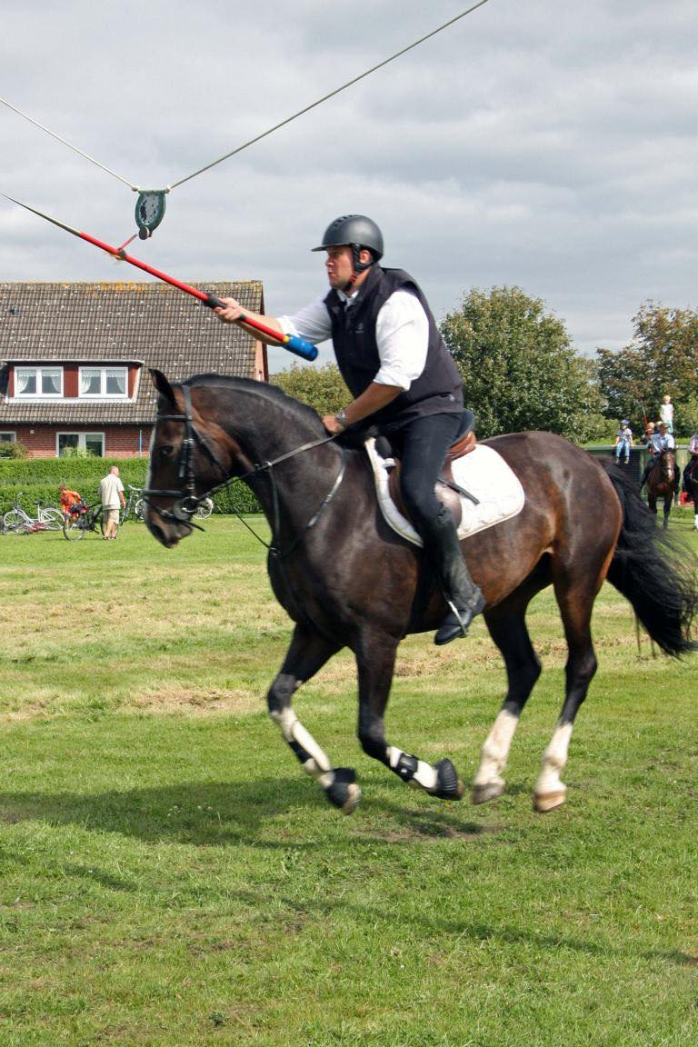
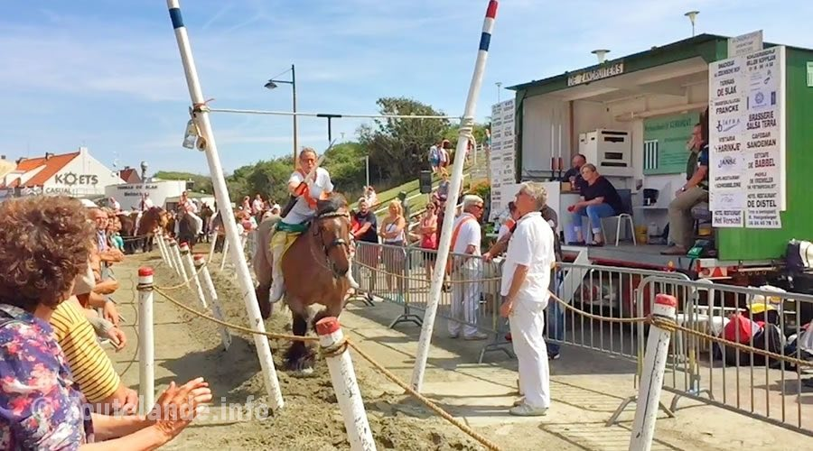

Slide 8
Clothes
Riders are required to dress formally in recognized competition. The dress code for all Dressage tests and classes through Fourth Level is a short riding coat of conservative color, with tie, choker or stock tie, white or light-colored breeches or jodhpurs, boots or jodhpur boots, and protective headgear. A cutaway coat (modified tailcoat) with short tails is permitted. Half chaps, gaiters and/or leggings are not allowed. Gloves of conservative color are recommended.
(But it also depends in which country you live, it can be different)

Slide 9
Horses
Horses are trained and ridden for practical working purposes, such as in police work or for controlling herd animals on a ranch. They are also used in competitive sports including dressage, endurance riding, reining, show jumping, tent pegging, vaulting, polo, horse racing, driving, rodeo...
For this competition excellent maintained horses are used, the manes are at this occasion entwined together and the small docked tail decorated with colorful snares and green branch. Many people are going close to the gates to see the play as close at they can.

Slide 10
Winner
The aim was when a man sitting at the back of a horse, was ensconced behind a shield and an armor. The winner of the tournament was the one who knew how to sting his opponent from his horse.

Slide 11
This was my presentation about the traditional sport Ring Riding. I hope you’ve liked it! ☺
Made by: Ivona T.
15.05.2020

