Slide 1
ℛ𝑜𝒶𝒹 𝒯𝑒𝓃𝓃𝒾𝓈

Slide 2
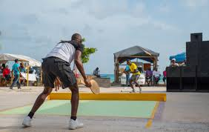
Road tennis is a variation of tennis invented in Barbados. It was created in the 1930s by those who could not afford lawn tennis. Though mainly concentrated in the island nation of Barbados, it has been introduced to the California and the Caribbean region. It is played in schools around the island.
Game – Road Tennis

Slide 3
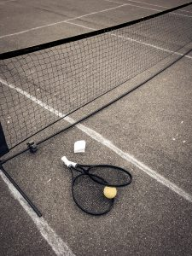
regulate the game
Search resultsHighlighted snippet from the webDepending on the type of tournament, a match is decided by two or three sets won. The team that first won six games in a set and is at least two games ahead wins the set.

Slide 4
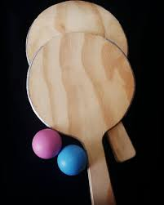
Equipment
2 wooden rackets
A eight inch high plank wood net
One tennis ball with the fur removed
A court- or road- about 21x10 feet

Slide 5
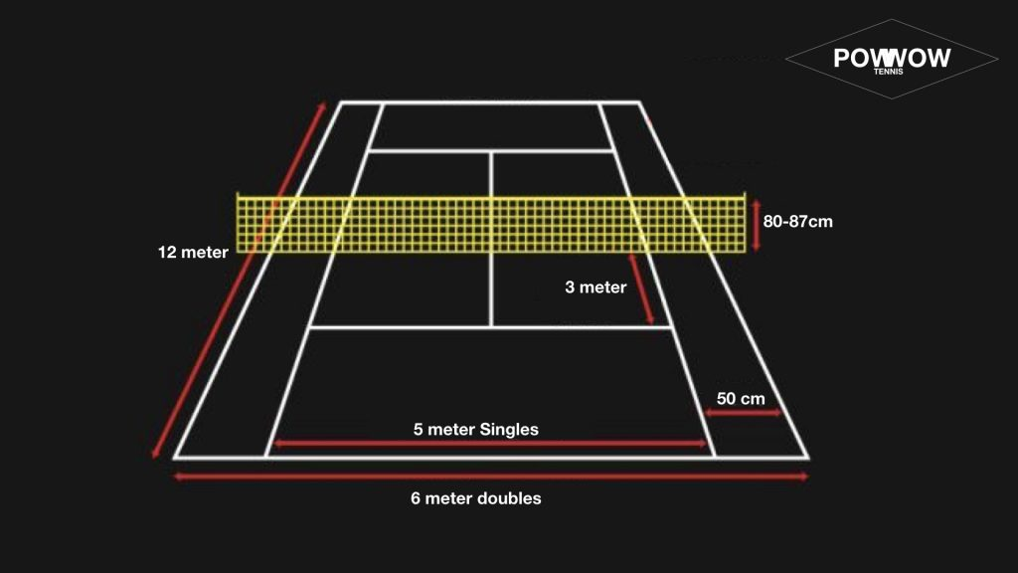
Matchfield

