Slide 1
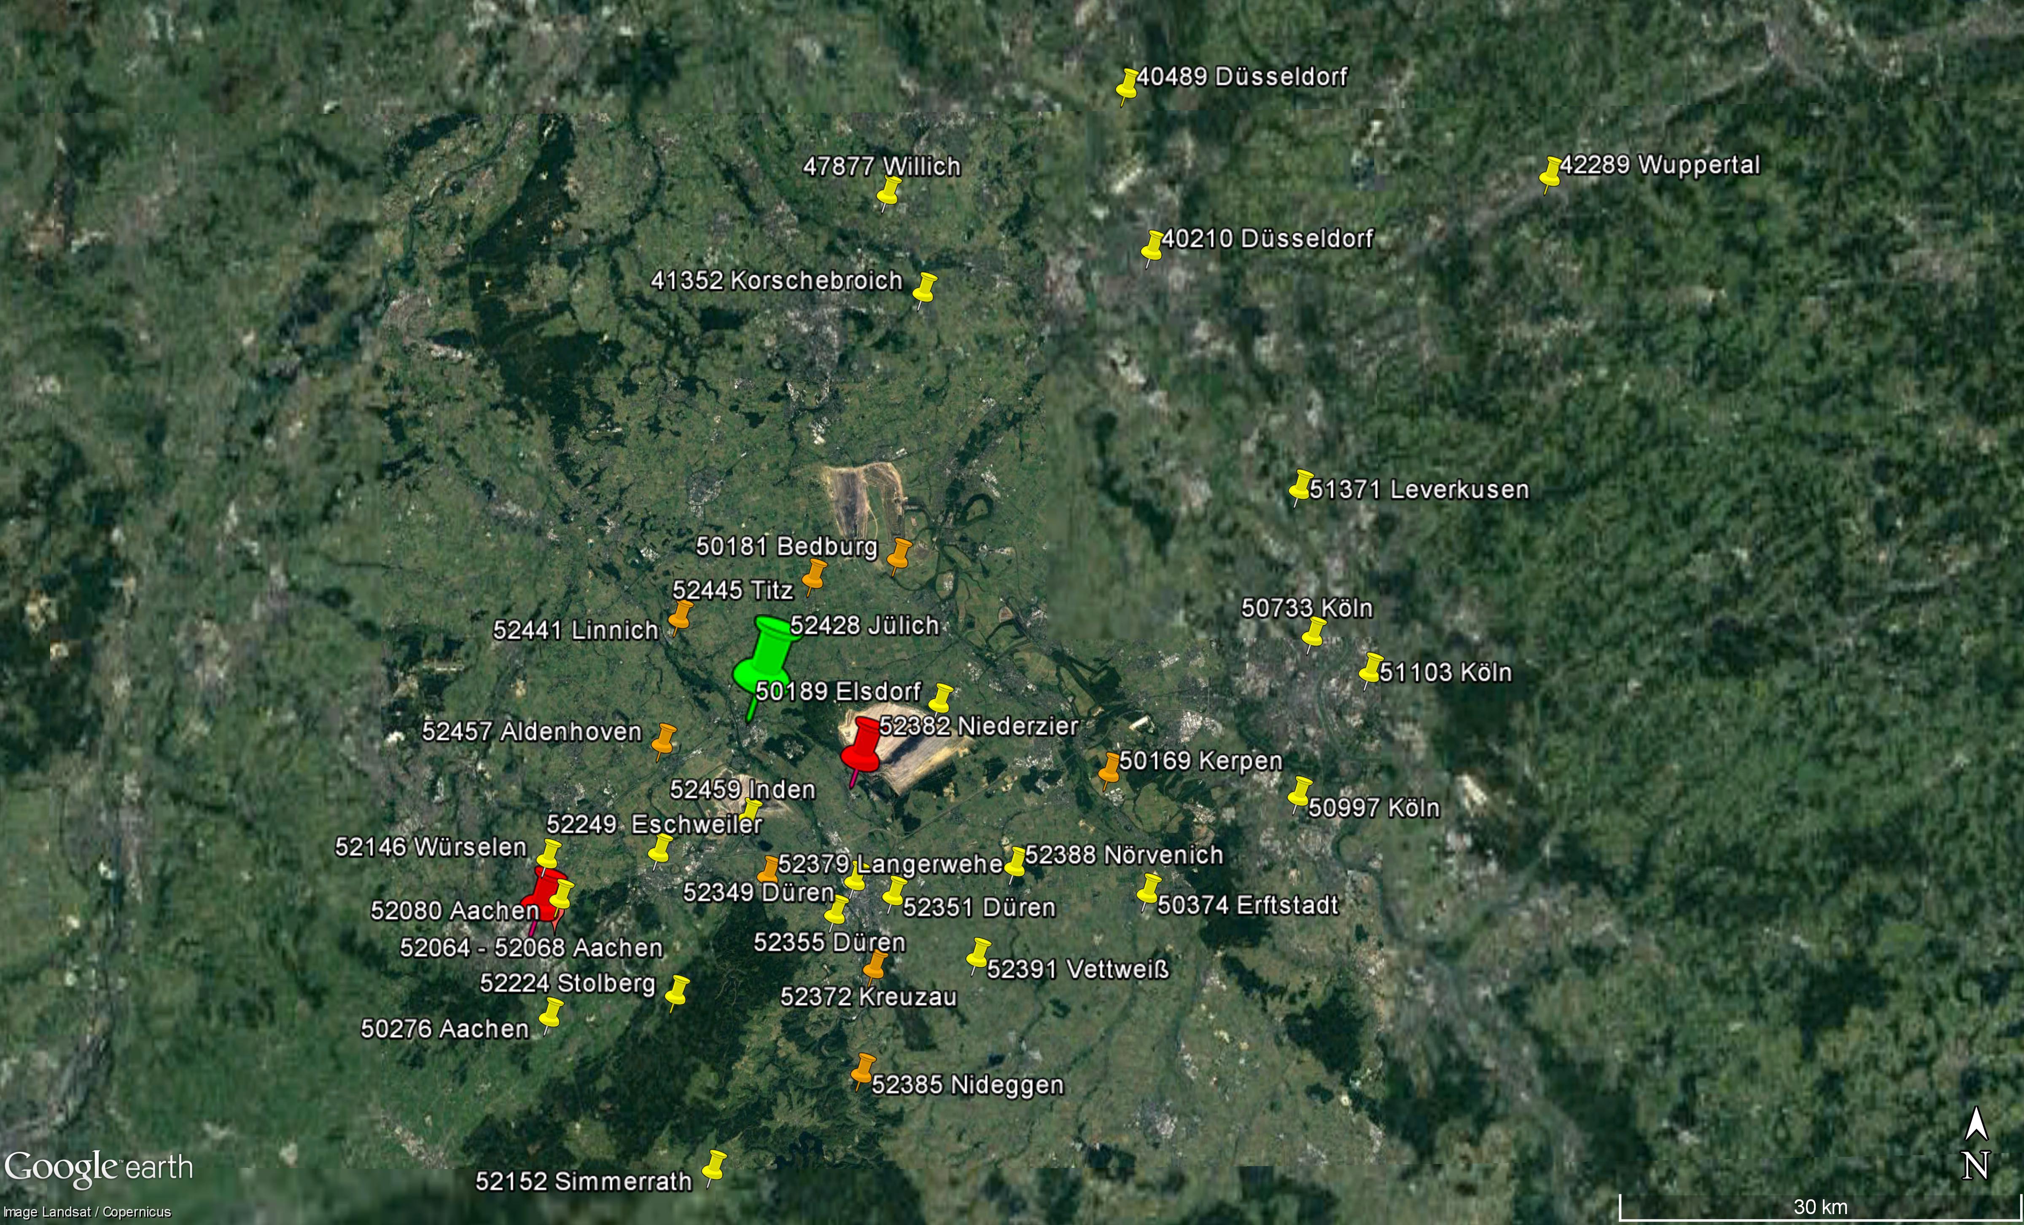
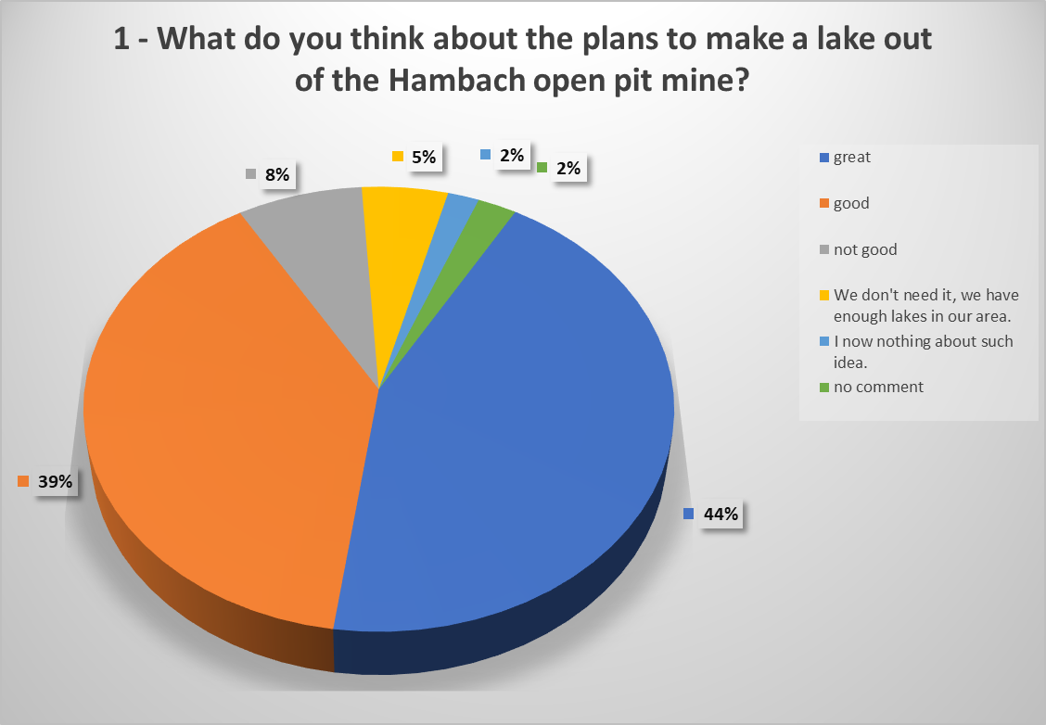
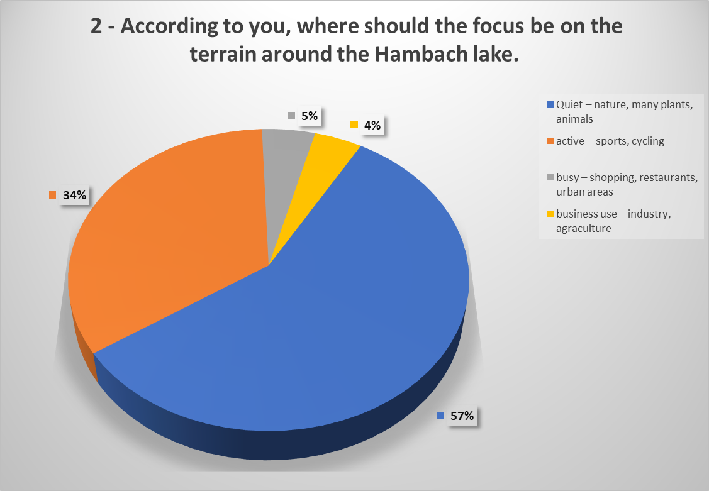
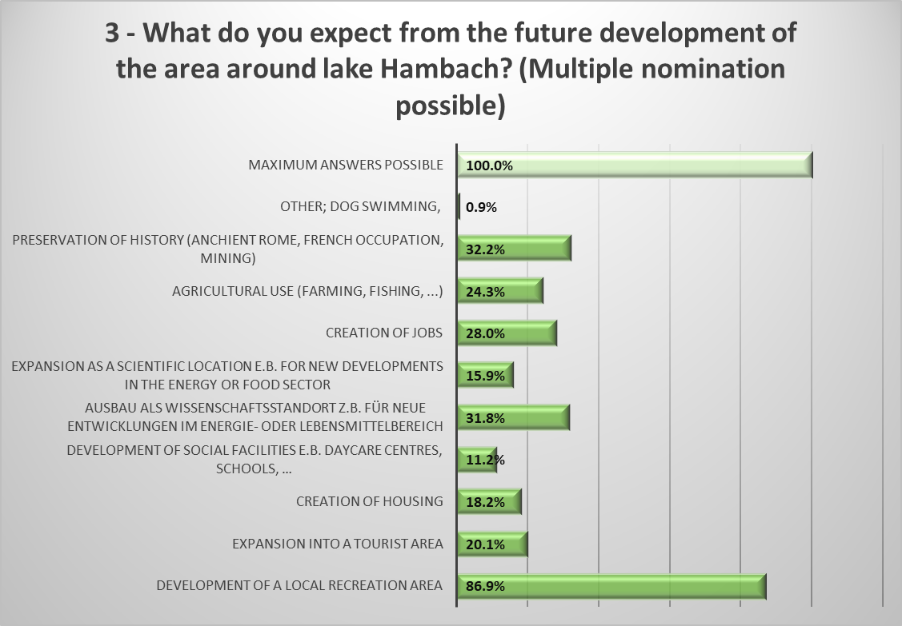
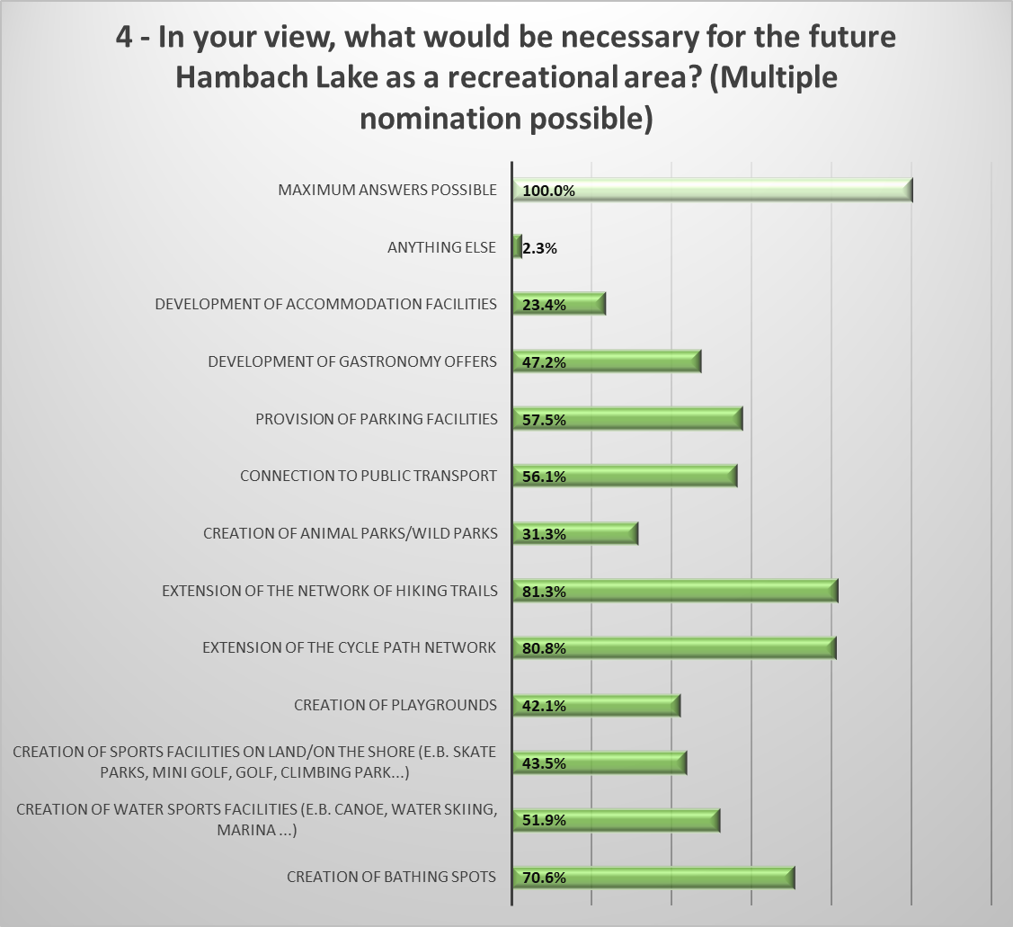
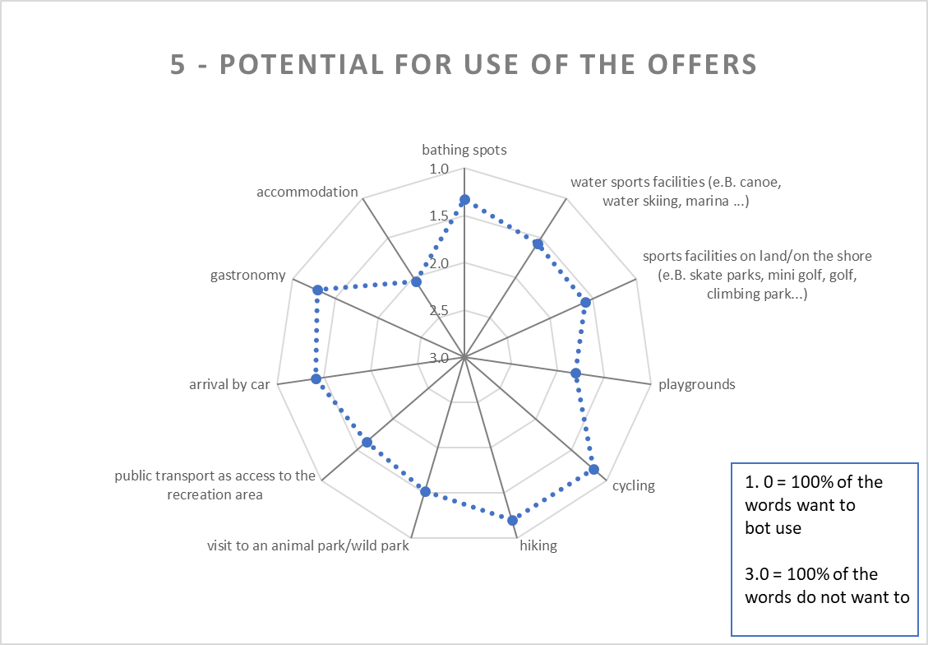
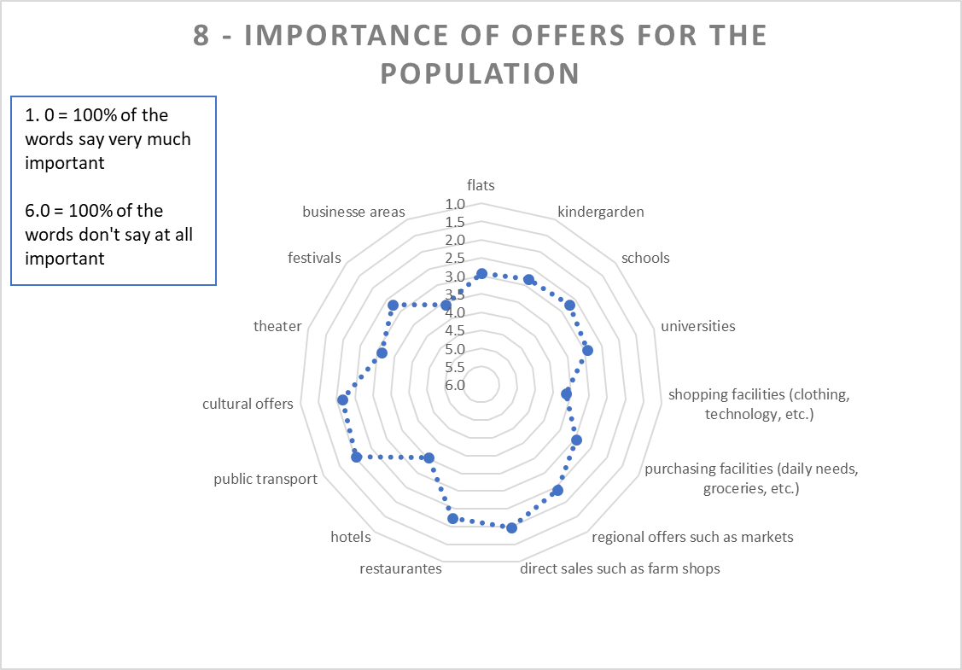
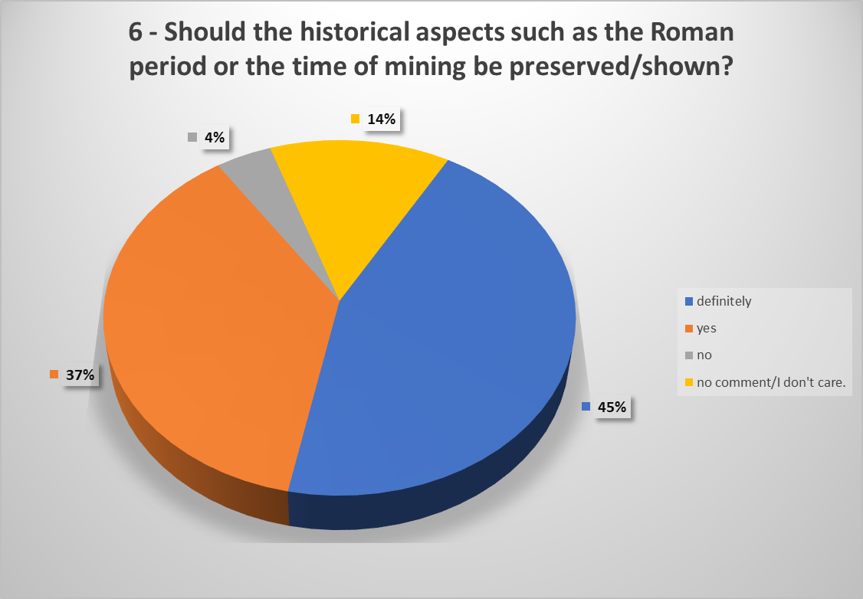
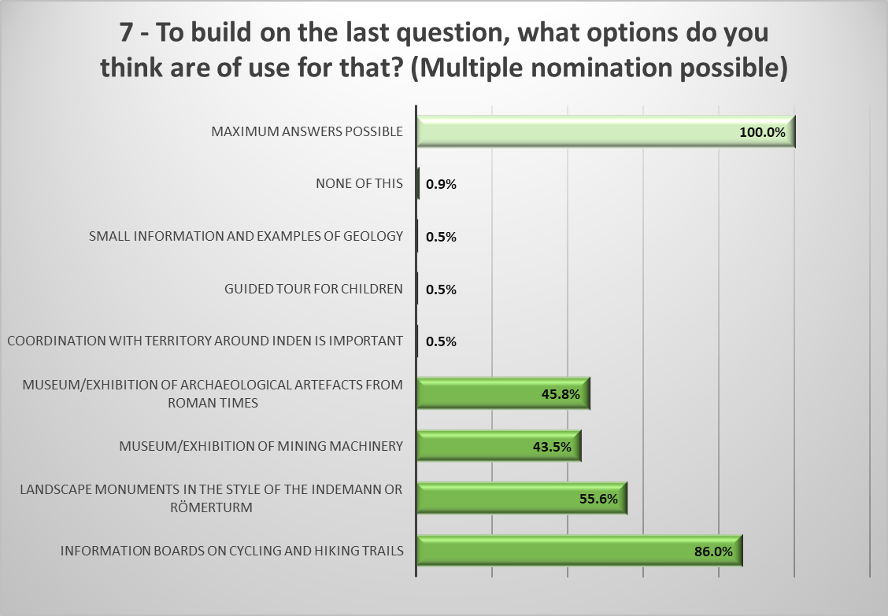
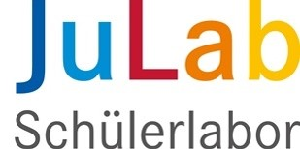
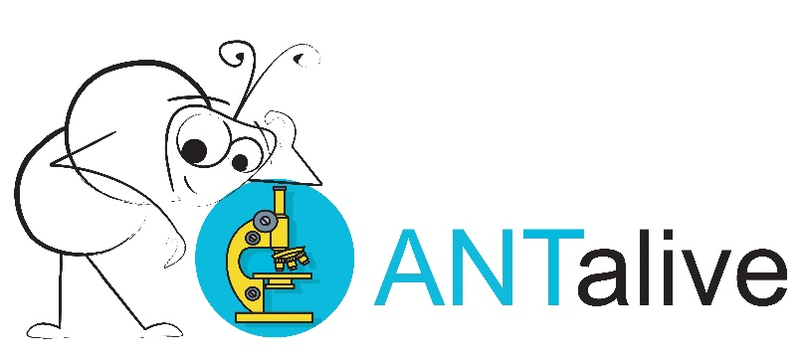
Project course "Bioeconomy in the Rhenish mining area"
Survey results
Rania Rosenbauer, Alexandra Nitzsche, Saba Waraich, Q1, 2020/2021
>50 Antworten
214 participants, wide spectrum (distribution) in
age
sex
Education
activity
Number of persons in the household
Only 4% of respondents are directly or indirectly involved in open pit mining.
>20 Antworten
>5 Antworten
< 5 Antworten
www.BiooekonomieREVIER.de/projektkurs

