Slide 1
Art meets science
Renewable energy
-To generate electricity with movement-
From Kristina & Aliya

Slide 2
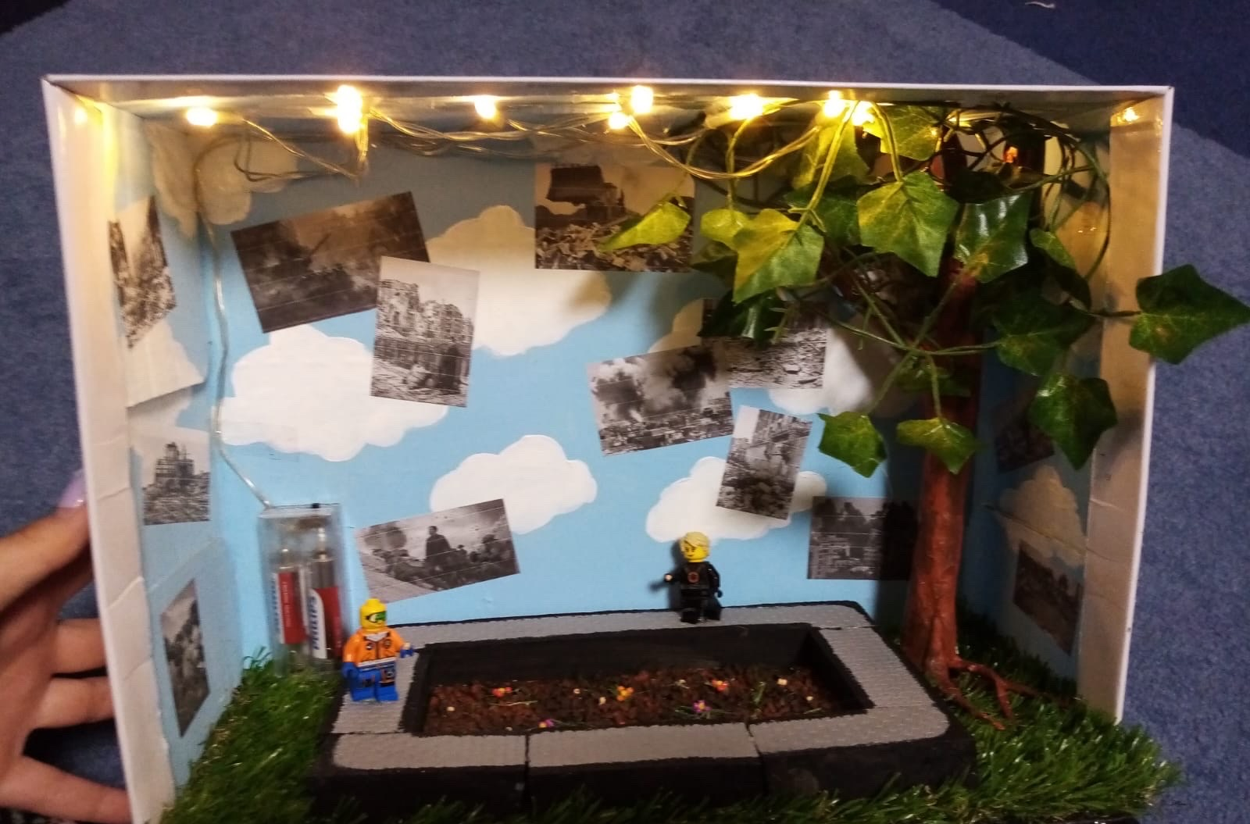
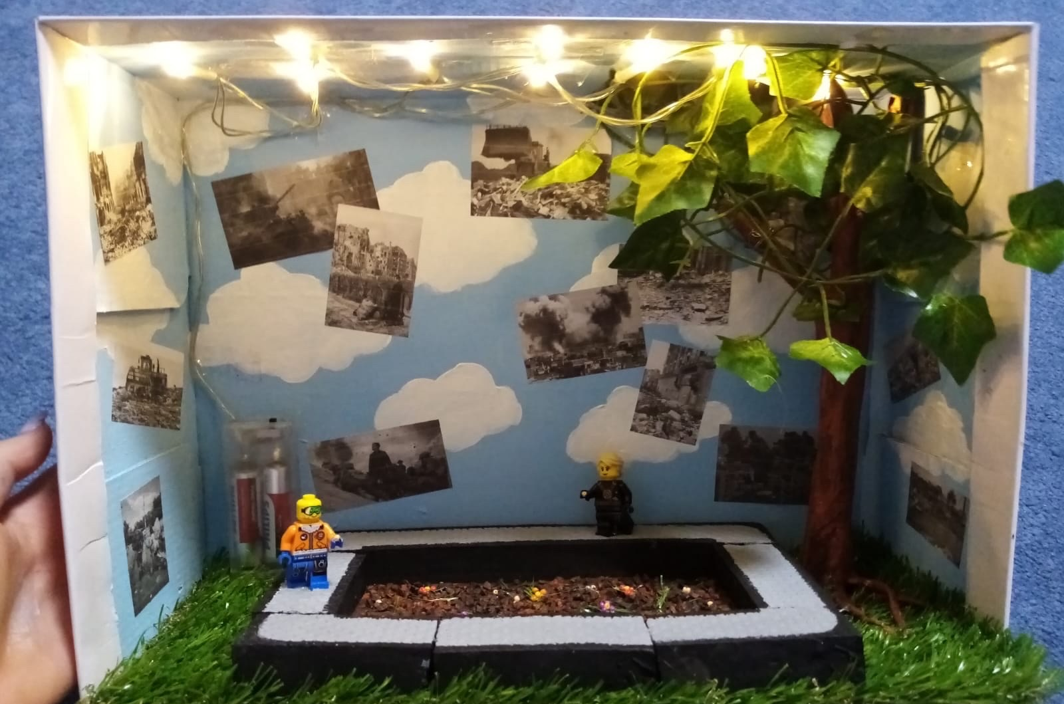
Our projekt

Slide 3
The main idea of our box
The box resembles a fitness studio in which the perfect case scenario is given, people use renewable energy and care for there environment
Electricity is generated by running on the treadmill
At the same time, plants can be seed while Walking/running on the treadmill
In contrast to that are the pictures on the wall/ in the sky, they remind of the sad reality

Slide 4
Picture description
You can see:
In the background is a nice looking blue sky, there are a few clouds but what is the most striking are the pictures on it
The picture are showing heaps of rubbish and a lot of ugly other things that threatens the world
There is a tree in the right corner of the box and grass on the bottom, it shows how the fitness studio trys to create this perfect atmosphere and shows how the world could look like while using renewable energy
The renewable energy is given here by the treadmill , which is used by the little figures
In the middle of the treadmill is a Flower beds ,in which you can seed flowers while walking

Slide 5
The materials we used
The background: was painted with acrylic paint
The tree was formed aout of a newspaper and was then coloured, the leaves are maid out of a festoon
The pictures in the back of the sky are printed out and purposely keeper in black and grey to mark a contrast
The treadmill is maid out of styrofoam
The flower bed is crumbled paper filled up with some fake flowers

Slide 6
For the future, we wish for
That more people or industry‘s use renewable energy and take an initiative for the environment

