Slide 1
Bioeconomy in the Rhenish mining area Project course: Bioeconomy 2020/2021
Q1, MGJ
Notes:
Saba

Slide 2
What is the project course?
A cooperation (Initiative BioökonomieREVIER of the institute of plant sciences & the student laboratory JuLab of the Forschungszentrum Jülich)
Youth shapes structural change → zdi-Zentrum ANTalive
Enterprise Revier → Federal Ministry for Economic Affairs and Energy
economic applications of algae

Slide 3
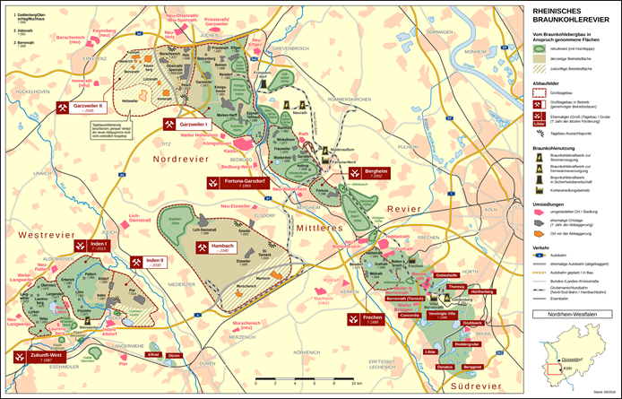
Project:Bioeconomy in the rhenish mining area Rhenish area? Bioeconomy?
Rhenish area?
A mining area, specifically used for the extraction of lignite/“brown coal“
Located in the triangle formed between Aachen, Mönchengladbach and Bonn
Area containts 2500 km² and multiple open-mining pits (Inden, Hambach, Garzweiler)
Bioeconomy
a modern and sustainable form of economic management based on the use of bio-based resources such as plants, animals and microorganisms
Algae play a major role in this (ecological pyramid)
Rheinisches Braunkohlerevier (Stand September 2018) (Wikipedia)

Slide 4
Start Projektkurs am 21.08.2020 (1. Treffen mit FZ Jülich)
Brainstorming procedures, methods and their objectives (interview, survey), timetable
Algea in Bioeconomy – Presentation of the FZ Jülich
Trip to the Forschungszentrum on the 28.08.2020 IGB -2
Research
Specifying each project idea
Evaluation in groups and with FZ
Helmholtz-student meet
Puplishing the survey
Interview 4.2.2021
ERASMUS-meet
Preparing the interview
Finalizing the presentations
Developing the survey
Final presentation
Technology… Corrections
Start
Research
Prossible projects
Ending
Planning
Preaparing
Evaluation
Developing a concept
August ´20
Sept./ Okt. ´20
Okt.´20
Mai-Jun. ´21
Nov.-Dez. ´20
Jan.-März ´21
März-Apr. ´21
Apr.-Mai ´21
Notes:
Interview vorbereiten (Anfrage bei Gemeinde Niederzier, Fragen vorbereiten, Technik klären

