Slide 1
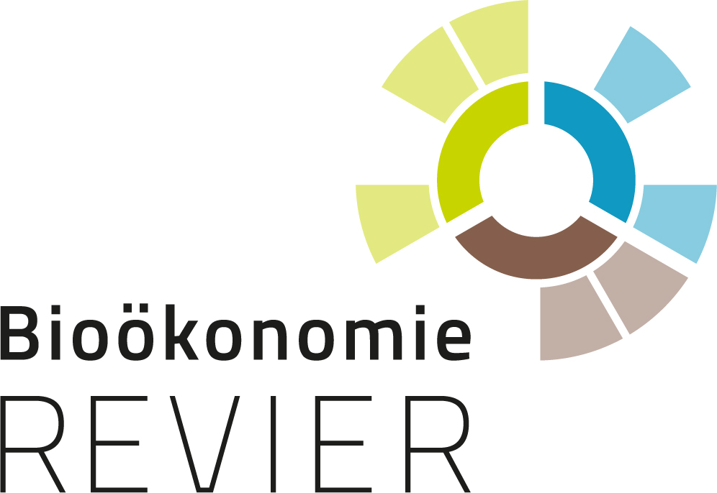
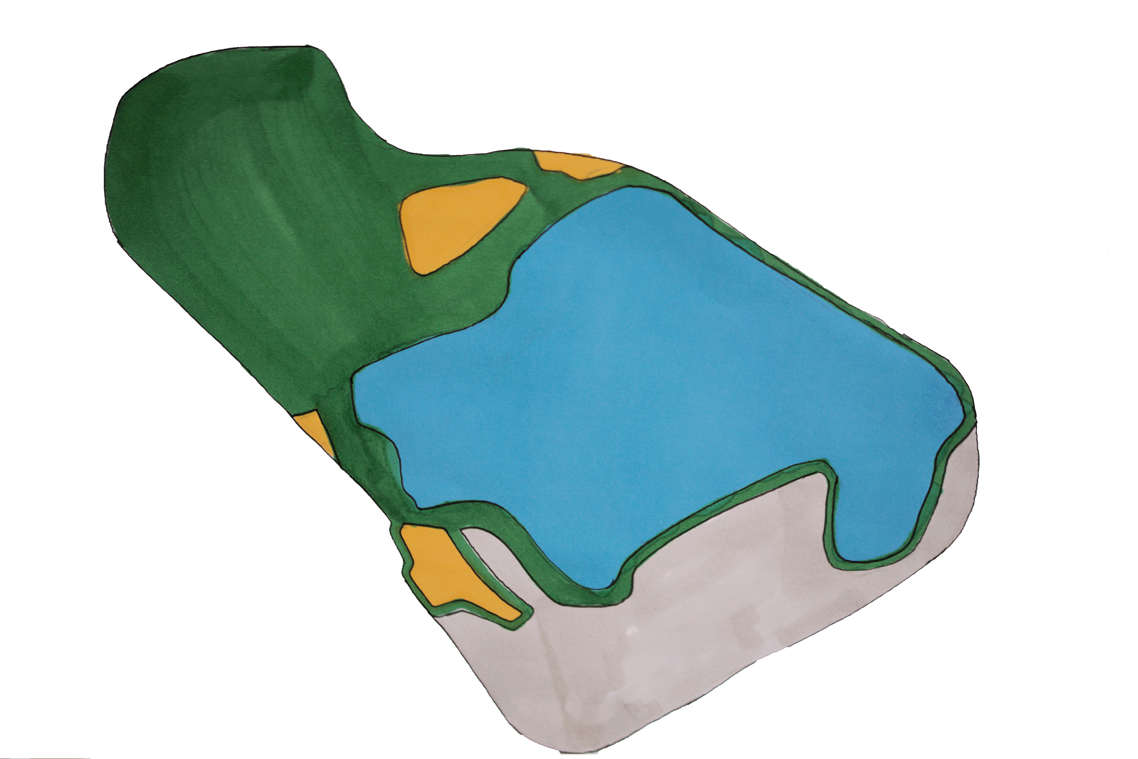
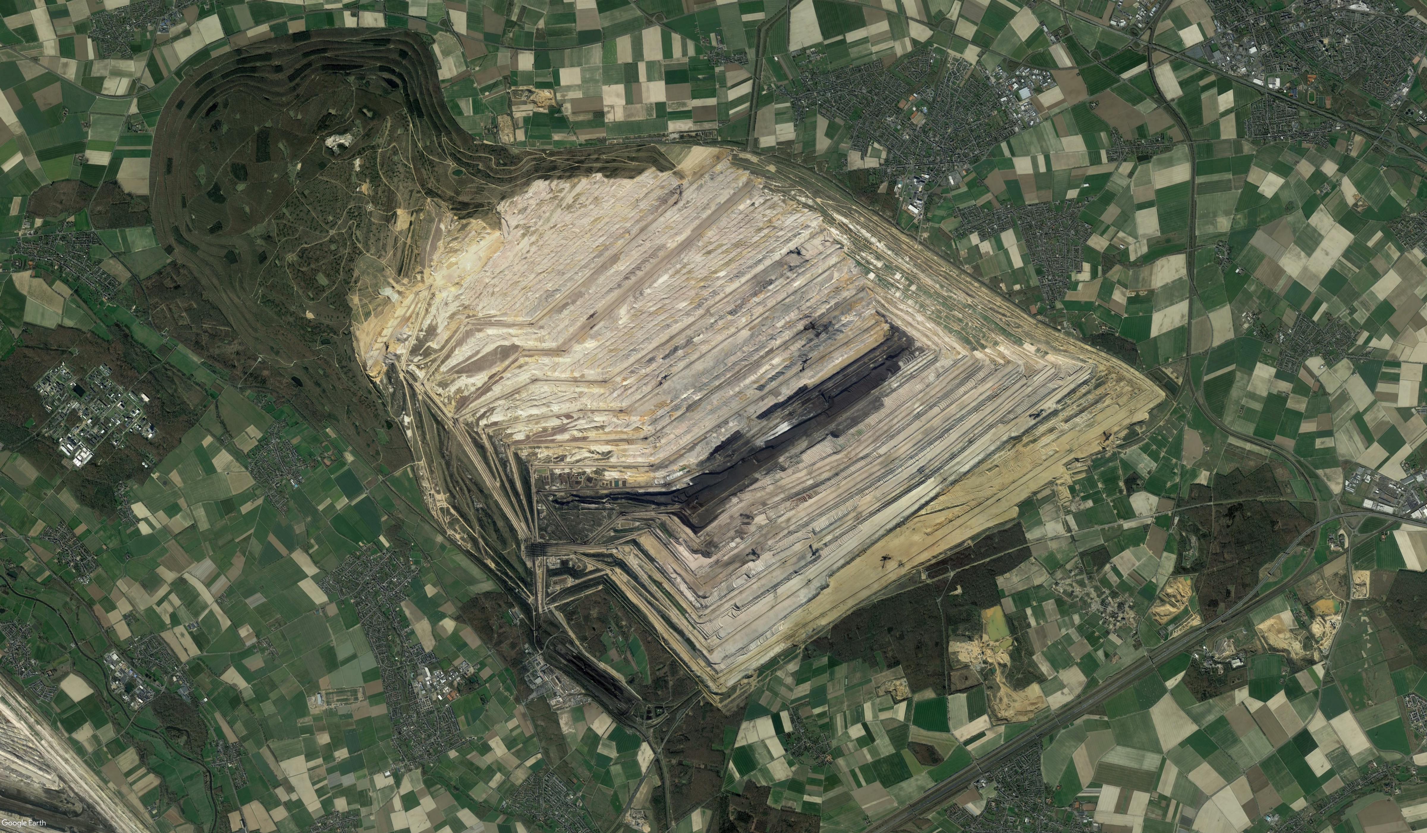
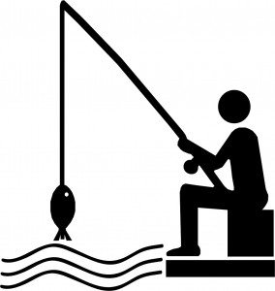
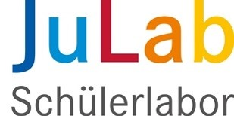
Project course "Bioeconomy in the Rhenish mining area "
Development of design ideas for the restoration of the natural and economic area around the "former" open pit mining hole Hambach, which takes into account the expectations of all interest groups.
Rania Rosenbauer, Alexandra Nitzsche, Saba Waraich, Q1, 2020/2021
Sophienhöhe
Hiking trails, cycle paths and waterways
Industry of the future
Water sports area
Yesterday - today - tomorrow
Hambacher Forst
Living the future
Traffic
design ideas:
Tourism / Local recreation / expansion of hiking trails, cycle paths and waterways
Guided tours – thematically, for children, hiking badges, geocaching – discover the open pit mining area
Tourism / Water sports area
Bathing beach, playgrounds, water skiing facilities, surfing, marina (piers), boating, fishing, restaurants
Yesterday – Today – Tomorrow
Information in form of museums, information boards, monuments that are visible from far away
New residential areas – residential ideas of the future
Linking sustainability, ecology and ideas for the future, living by the water
Algae as an integral part of living concepts (extraction of biomass, heat energy and reduction of CO₂)
Traffic routes – the connection in and around Lake Hambach
Former supply road, connection to the conurbations of Cologne, Aachen, Düsseldorf, The gateway to the Eifel, connection of the rivers and lakes by canals – shipping
Industry of the future – research / production / recycling
Energy production: photovoltaics, algae farms, algae as a source of energy or food, re-use of coal-fired power plants, bioreactors, biomass power plants
but also, in the field of electric flying (model region Aachen)
www.BiooekonomieREVIER.de/projektkurs

