Slide 1
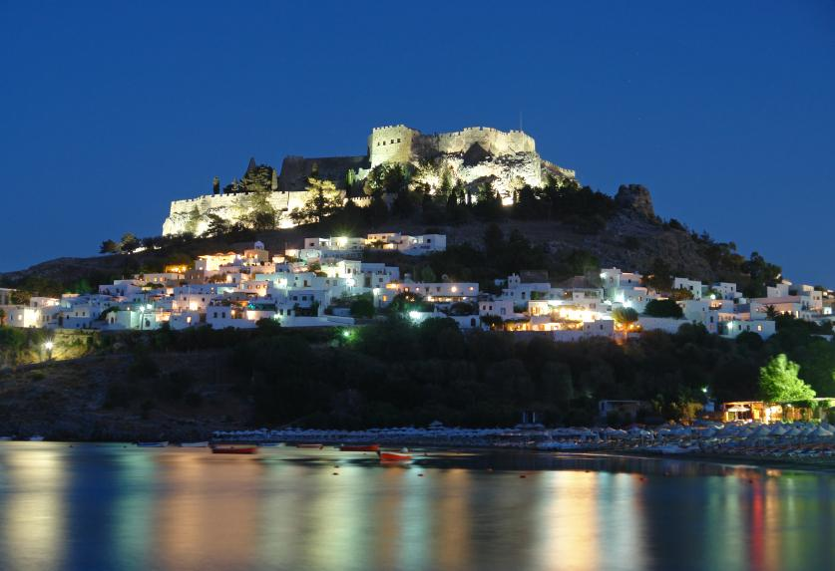
LINDOS OF RHODES
LINDOS A MAGICAL PLACE

Slide 2
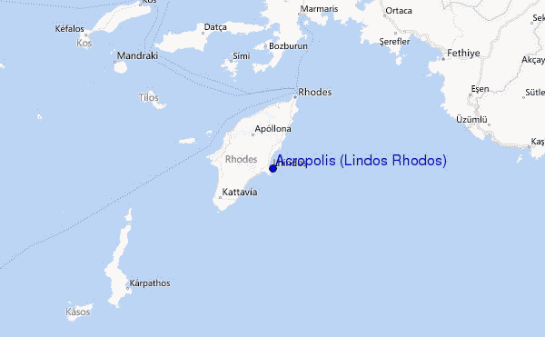
location
Lindos is an archaeological site, a town and a former municipality on the island of Rhodes, in the Dodecanese,Greece. Since the 2011 local government reform it is part of the municipality Rhodes, of which it is a municipal unit. It lies on the east coast of the island. It is about 50 km south of the town of Rhodes and its fine beaches make it a popular tourist and holiday destination. Lindos is situated in a large bay and faces the fishing village and small resort of Haraki.

Slide 3
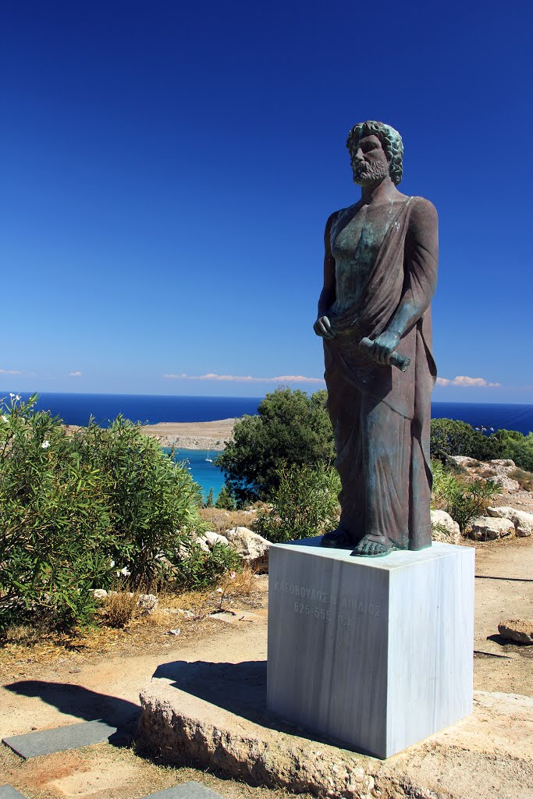
HISTORY
Lindos was founded by the Dorians led by the king Tlepolemus of Rhodes, who arrived in about the 10th century BC. It was one of six Dorian cities in the area known as the Dorian Hexapolis. The eastern location of Rhodes made it a natural meeting place between the Greeks and thePhoenicians, and by the 8th century Lindos was a major trading centre. In the 6th century it was ruled by Cleobulus, one of the Seven Sages of Greece. The importance of Lindos declined after the foundation of the city of Rhodes in the late 5th century.

Slide 4
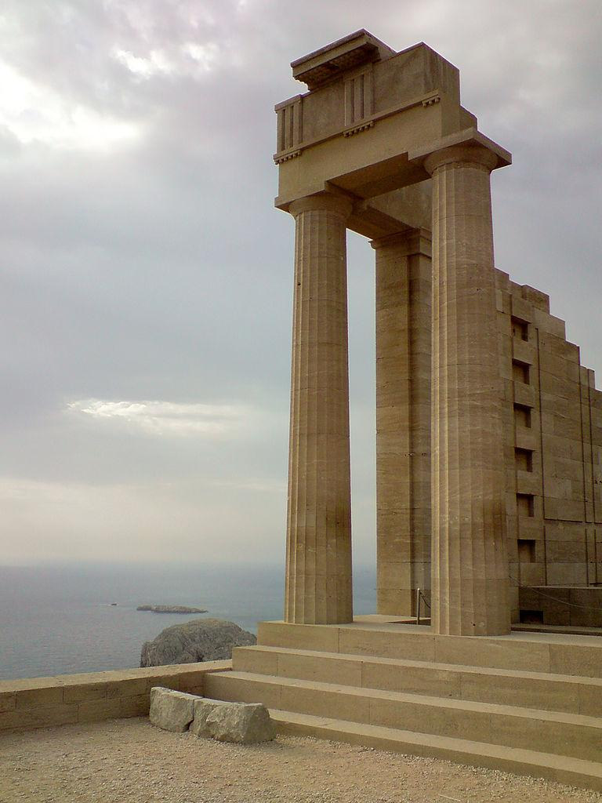
HISTORY
In classical times the acropolis of Lindos was dominated by the massive temple of Athena Lidian, which attained its final form in around 300 BC. In Hellenistic and Roman times the temple precinct grew as more buildings were added. In early medieval times these buildings fell into disuse, and in the 14th century they were partly overlaid by a massive fortress built on the acropolis by the Knights of St John to defend the island against the Ottomans.

Slide 5
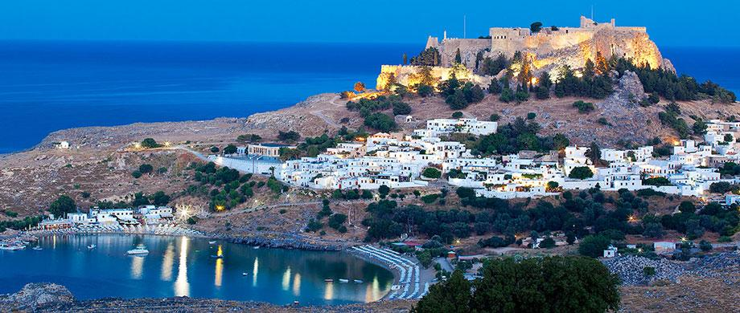
Acropolis
Above the modern town rises the acropolis of Lindos, a natural citadel which was fortified successively by the Greeks, the Romans, the Byzantines, the Knights of St John and the Ottomans. This makes the site difficult to excavate and interpret archaeologically. The acropolis offers spectacular views of the surrounding harbours and coastline.
On the acropolis of Lindos today parts of the following buildings may still be seen:

Slide 6
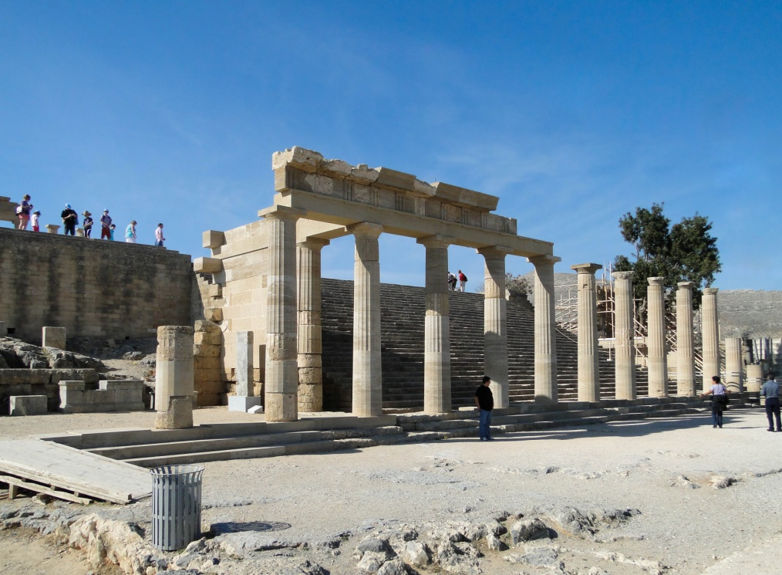
ACROPOLIS
The Doric Temple of Athena Lindia, dating from about 300 BC, built on the site of an earlier temple. Inside the temple is the table of offerings and the base of the cult statue of Athena.
The Propylaea of the Sanctuary, also dating from the 4th century BC. A monumental staircase leads to a D-shaped stoa and a wall with five door openings.

Slide 7
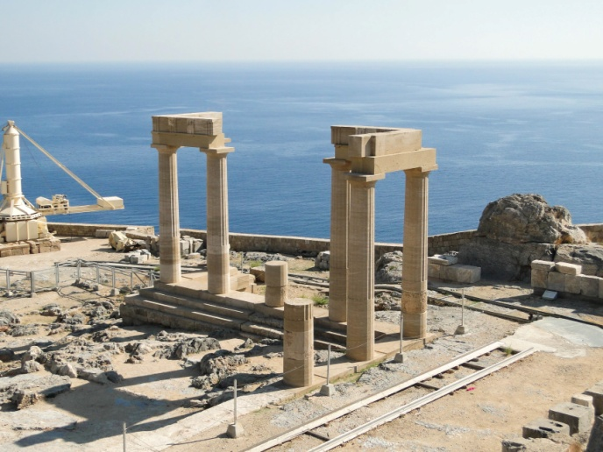
ACROPOLIS
The Hellenistic stoa with lateral projecting wings, dating from about 200 BC. The stoa was 87 metres long and consisted of 42 columns.
The well-known relief of a Rhodian trireme (warship) cut into the rock at the foot of the steps leading to the acropolis. On the bow stood a statue of General Hagesander, the work of the sculptor Pythokritos. The relief dates from about 180 BC.

Slide 8
ACROPOLIS
The Hellenistic staircase (2nd century BC) leading to the main archaeological area of the acropolis.
Remains of a Roman temple, possibly dedicated to the Emperor Diocletian and dating from about 300 AD.
The Acropolis is surrounded by a Hellenistic wall contemporary with the Propylaea and the stairway leading to the entrance to the site. A Roman inscription says that the wall and square towers were repaired at the expense of P Aelius Hagetor, the priest of Athena in the 2nd century AD.

Slide 9
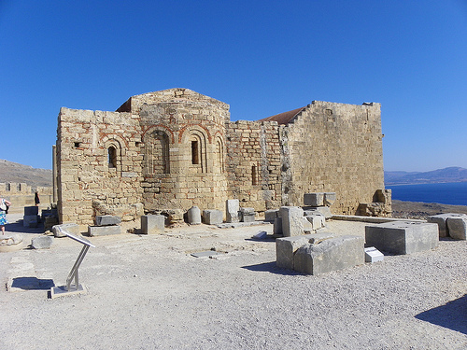
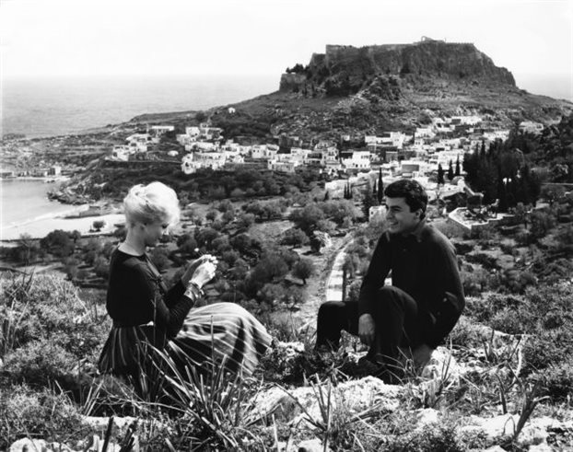
ACROPOLIS
The Castle of the Knights of St John, built some time before 1317 on the foundations of older Byzantine fortifications. The walls and towers follow the natural conformation of the cliff. A pentagonal tower on the south side commanded the harbour, the settlement and the road from the south of the island. There was a large round tower on the east facing the sea and two more, one round and the other on a corner, on the northeast side of the enceinte. Today one of the towers at the southwest corner and one to the west survive.
The Greek Orthodox Church of St John, dating from the 13th or 14th century and built on the ruins of a previous church, which may have been built as early as the 6th century.
Some scenes of the well-known film, The Guns of Navarone, were filmed here.

Slide 10
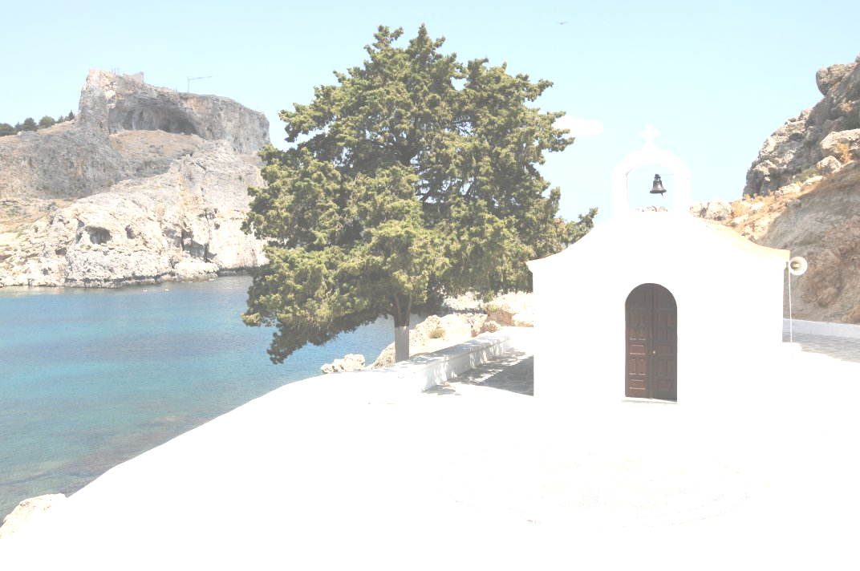
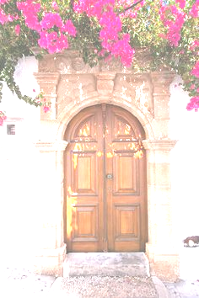
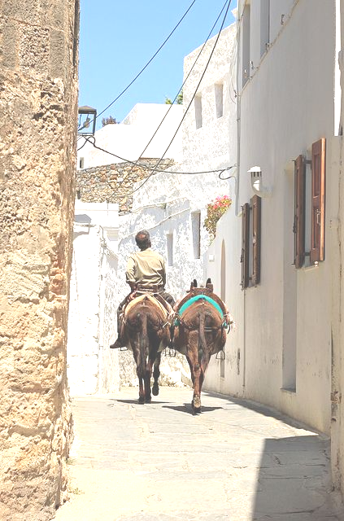
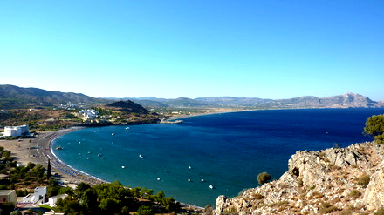
THINGS TO DO
There's are many monastery's around Lindos that you can visit and light a candle .
The main attraction of Lindos is the town itself, winding paths between small traditional whitewashed buildings.
Lindos is also famous for its donkeys the use them for bringing people up and down from the acropolis so how ever wants can rent one that’s lots of fun.
Lindos has some of the few sandy beaches on Rhodes. The beaches are very beautiful and have very clear crystallic water.

Slide 11
Project by :
Katerina Vola
Nena Gakoudi

