Slide 1
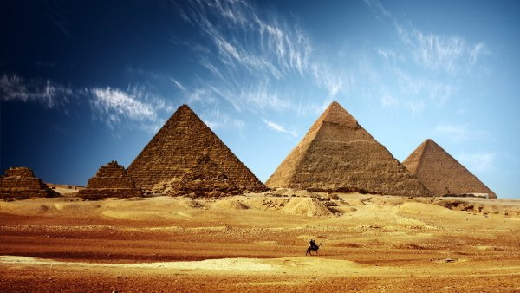
Pyramids of Giza

Slide 2
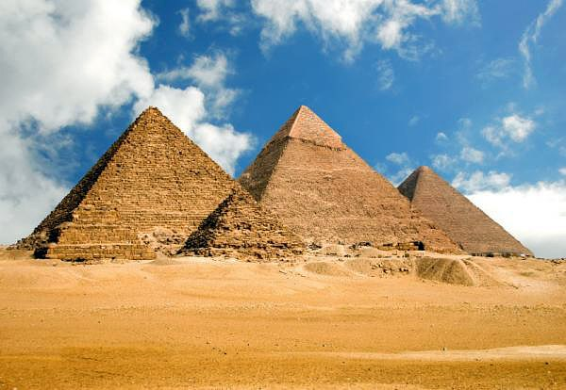
Have you ever heard about the Seven Wonders of the World? Pyramids of Giza are among them. These pyramids were built in ancient times. They were named in honor of the kings of the 4th dynasty. The three primary pyramids are the pyramids of Khufu, Khafre and Menkaure.

Slide 3
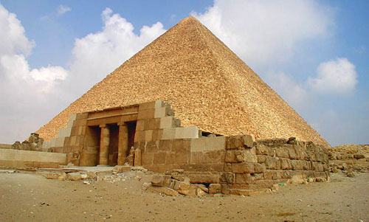
Khufu’s pyramid is perhaps the most colossal single building in the world. It rises to a height of 146 meters. The entrance to the Great Pyramid is on the north side, about 18 meters above ground level. Pyramid Khufu was built for Pharaoh Cheops by his slaves. It was the first and the biggest pyramid on the plateau of Giza. The place where pyramid is now situated was chosen by the Pharaoh. The base of it was built on the hill, which was smoothed out before building. At first pyramid was 146,7 meters height, but then the top was lost. Now Khufu is 137,3 meters height. It was the highest construction in the world until 1880.

Slide 4
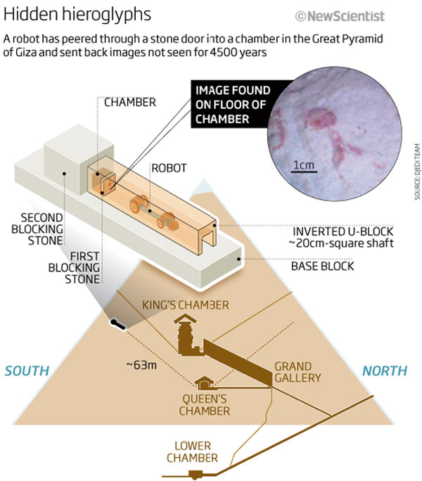
There are three cells inside this pyramid. One of them isn’t completed. One of completed cells is called “Queen’s Chamber”. Although this room is traditionally called “Queen’s Chamber”, but Pharaoh’s wives weren’t buried there. They were buried in separated small pyramids. Another one is called “King’s Chamber”. It has a flat roof and two narrow shafts in the north and south walls. The purpose of these shafts is unknown. Later these cells were robbed by ancient robbers.

Slide 5
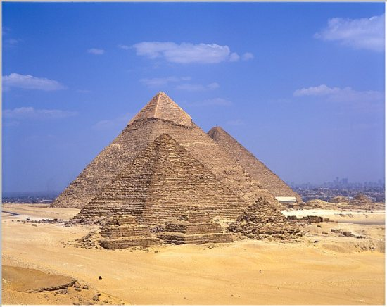
There are also two other pyramids .They are called “Khafre” and “Menkaure”. They are smaller then Khufu and were built for different queens and kings, too. Nobody certainly knows how the pyramids were built. According to the ancient Greek historian Herodotus the Great Pyramid had been built for more than 20 years and nearly 100000 men had worked there.

Slide 6
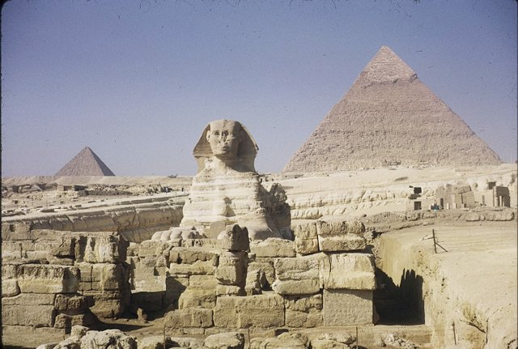
The great Sphinx is situated to the south of the Great Pyramid. It’s the most ancient monumental sculpture in the world. This strange creature has a human’s face and a lion’s body. The Sphinx is very big. It’s approximately 73 meters long and 20 meters high.

Slide 7
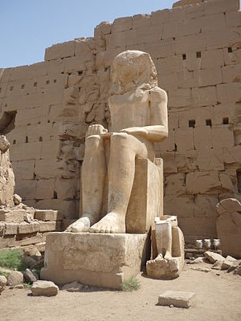
In the 20th century archaeologists found labourers’ districts in this area, which included bakeries, storage areas and workshops.

Slide 8
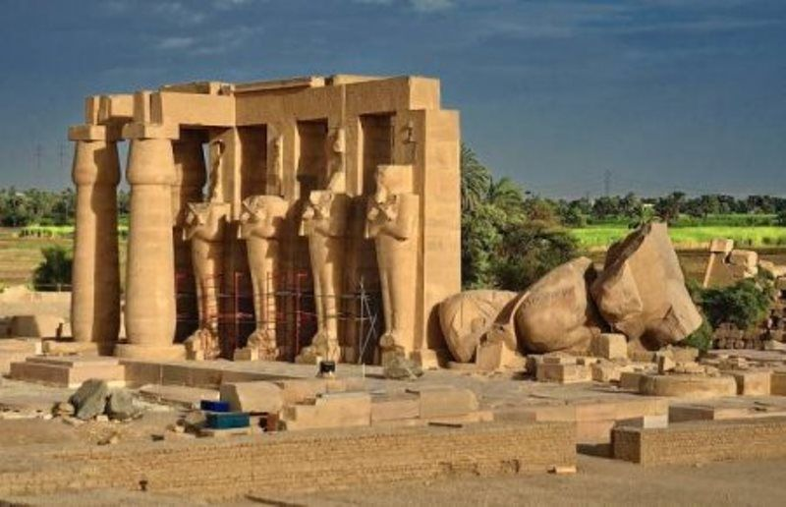
It seems to me that there will be more discoveries in the future, as ancient Egypt is still a very mysterious place for us.

