Slide 1
TAJ MAHAL
Made by the etwinning team of “Toma N. Socolescu”Technical College, Ploiesti, Romania

Slide 2
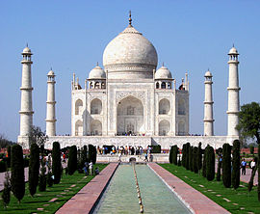
The Taj Mahal (/ˌtɑːdʒ məˈhɑːl/, more often /ˈtɑːʒ/; from Persian and Arabic, "crown of palaces", pronounced [ˈt̪aːdʒ mɛˈɦɛl]) is a white marble mausoleum located on the southern bank of the Yamuna River in the Indian city of Agra. It was commissioned in 1632 by the Mughal emperor Shah Jahan (reigned 1628–1658) to house the tomb of his favorite wife of three, Mumtaz Mahal.
Construction of the mausoleum was essentially completed in 1643 but work continued on other phases of the project for an additional ten years. The Taj Mahal complex is believed to have been completed in its entirety in 1653 at a cost estimated at the time to be around 32 million Indian rupees, which in 2015 would be valued at around 52.8 billion Indian rupees ($827 million US). The construction project employed around 20,000 artisans under the guidance of a board of architects led by Ustad Ahmad Lahauri. The domed marble tomb is part of an integrated complex consisting of gardens and two red-sandstone buildings surrounded by a crenellated wall on three sides.

Slide 3
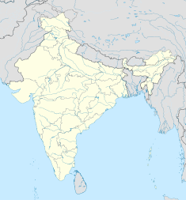
The Taj Mahal is regarded by many as the best example of Mughal architecture and is widely recognized as "the jewel of Muslim art in India". It is one of the world’s most celebrated structures and a symbol of India’s rich history. Designated a UNESCO World Heritage Site in 1983, the Taj Mahal attracts some 3 million visitors a year. On 7 July 2007 it was declared one of the Seven winners of New7Wonders of the World (2000–2007) initiative in Lisbon.

Slide 4
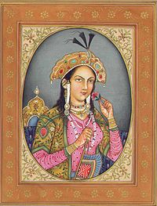
Inspiration
In 1631, Shah Jahan, emperor during the Mughal empire's period of greatest prosperity, was grief-stricken when his favorite of three wives and beloved companion, Mumtaz Mahal, a Persian princess, died during the birth of their 14th child, Gauhara Begum. Construction of the Taj Mahal began in 1632. The court chronicles of Shah Jahan's grief illustrate the love story traditionally held as an inspiration for Taj Mahal.The principal mausoleum was completed in 1643 and the surrounding buildings and garden were finished about five years later.

Slide 5
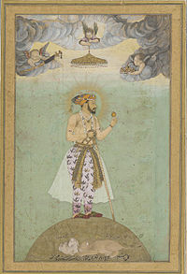
Architecture and design
The Taj Mahal incorporates and expands on design traditions of Persian and earlier Mughal architecture. Specific inspiration came from successful Timurid and Mughal buildings including; the Gur-e Amir (the tomb of Timur, progenitor of the Mughal dynasty, in Samarkand), Humayun's Tomb, Itmad-Ud-Daulah's Tomb (sometimes called the Baby Taj), and Shah Jahan's own Jama Masjid in Delhi. While earlier Mughal buildings were primarily constructed of red sandstone, Shah Jahan promoted the use of white marble inlaid with semi-precious stones. Buildings under his patronage reached new levels of refinement

Slide 6
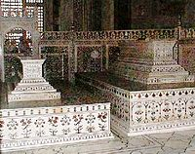
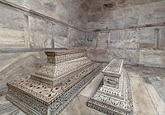
Tomb
The tomb is the central focus of the entire complex of the Taj Mahal. It is a large, white marble structure standing on a square plinth and consists of a symmetrical building with an iwan (an arch-shaped doorway) topped by a large dome and finial. Like most Mughal tombs, the basic elements are Persian in origin.
The base structure is a large multi-chambered cube with chamfered corners forming an unequal eight-sided structure that is approximately 55 metres (180 ft) on each of the four long sides. Each side of the iwan is framed with a huge pishtaq or vaulted archway with two similarly shaped arched balconies stacked on either side. This motif of stacked pishtaqs is replicated on the chamfered corner areas, making the design completely symmetrical on all sides of the building. Four minarets frame the tomb, one at each corner of the plinth facing the chamfered corners. The main chamber houses the false sarcophagi of Mumtaz Mahal and Shah Jahan; the actual graves are at a lower level.

Slide 7
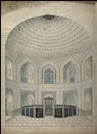
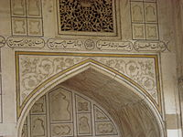
The most spectacular feature is the marble dome that surmounts the tomb. The dome is nearly 35 metres (115 ft) high which is close in measurement to the length of the base, and accentuated by the cylindrical "drum" it sits on which is approximately 7 metres (23 ft) high. Because of its shape, the dome is often called an onion dome or amrud (guava dome).[11] The top is decorated with a lotus design which also serves to accentuate its height. The shape of the dome is emphasized by four smaller domed chattris (kiosks) placed at its corners, which replicate the onion shape of the main dome. Their columned bases open through the roof of the tomb and provide light to the interior. Tall decorative spires (guldastas) extend from edges of base walls, and provide visual emphasis to the height of the dome. The lotus motif is repeated on both the chattris and guldastas. The dome and chattris are topped by a gilded finial which mixes traditional Persian and Hindustani decorative elements.

Slide 8
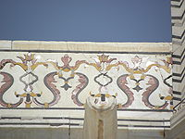
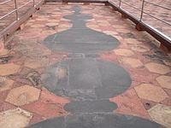
The main finial was originally made of gold but was replaced by a copy made of gilded bronze in the early 19th century. This feature provides a clear example of integration of traditional Persian and Hindu decorative elements. The finial is topped by a moon, a typical Islamic motif whose horns point heavenward

Slide 9
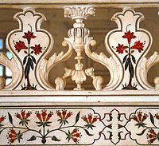
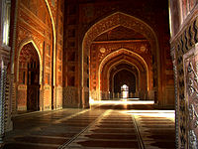
The minarets, which are each more than 40 metres (130 ft) tall, display the designer's penchant for symmetry. They were designed as working minarets—a traditional element of mosques, used by the muezzin to call the Islamic faithful to prayer. Each minaret is effectively divided into three equal parts by two working balconies that ring the tower. At the top of the tower is a final balcony surmounted by a chattri that mirrors the design of those on the tomb. The chattris all share the same decorative elements of a lotus design topped by a gilded finial. The minarets were constructed slightly outside of the plinth so that in the event of collapse, a typical occurrence with many tall constructions of the period, the material from the towers would tend to fall away from the tomb.

Slide 10
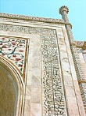
Exterior decorations
The exterior decorations of the Taj Mahal are among the finest in Mughal architecture. As the surface area changes, the decorations are refined proportionally. The decorative elements were created by applying paint, stucco, stone inlays or carvings. In line with the Islamic prohibition against the use of anthropomorphic forms, the decorative elements can be grouped into either calligraphy, abstract forms or vegetative motifs. Throughout the complex are passages from the Qur'an that comprise some of the decorative elements. Recent scholarship suggests that the passages were chosen by Amanat Khan.

Slide 11
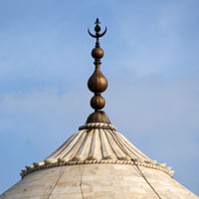
Abstract forms are used throughout, especially in the plinth, minarets, gateway, mosque, jawab and, to a lesser extent, on the surfaces of the tomb. The domes and vaults of the sandstone buildings are worked with tracery of incised painting to create elaborate geometric forms. Herringbone inlays define the space between many of the adjoining elements. White inlays are used in sandstone buildings, and dark or black inlays on the white marbles. Mortared areas of the marble buildings have been stained or painted in a contrasting color which creates a complex array of geometric patterns. Floors and walkways use contrasting tiles or blocks in tessellation patterns.

Slide 12
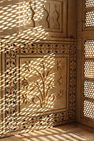
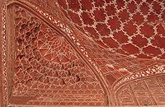
Interior decoration
The interior chamber of the Taj Mahal reaches far beyond traditional decorative elements. The inlay work is not pietra dura, but a lapidary of precious and semiprecious gemstones.[17] The inner chamber is an octagon with the design allowing for entry from each face, although only the door facing the garden to the south is used. The interior walls are about 25 metres (82 ft) high and are topped by a "false" interior dome decorated with a sun motif. Eight pishtaq arches define the space at ground level and, as with the exterior, each lower pishtaq is crowned by a second pishtaq about midway up the wall.[18] The four central upper arches form balconies or viewing areas, and each balcony's exterior window has an intricate screen or jali cut from marble. In addition to the light from the balcony screens, light enters through roof openings covered by chattris at the corners. The octagonal marble screen or jali bordering the cenotaphs is made from eight marble panels carved through with intricate pierce work. The remaining surfaces are inlaid in delicate detail with semi-precious stones forming twining vines, fruits and flowers. Each chamber wall is highly decorated with dado bas-relief, intricate lapidary inlay and refined calligraphy panels which reflect, in miniature detail, the design elements seen throughout the exterior of the complex

Slide 13
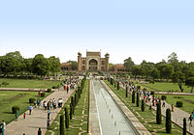
Garden
The complex is set around a large 300-metre (980 ft) square charbagh or Mughal garden. The garden uses raised pathways that divide each of the four quarters of the garden into 16 sunken parterres or flowerbeds. Halfway between the tomb and gateway in the center of the garden is a raised marble water tank with a reflecting pool positioned on a north-south axis to reflect the image of the mausoleum. The raised marble water tank is called al Hawd al-Kawthar in reference to the "Tank of Abundance" promised to Muhammad.

Slide 14
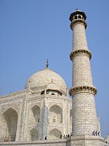
Outlying buildings
The Taj Mahal complex is bordered on three sides by crenellated red sandstone walls; the side facing the river is open. Outside the walls are several additional mausoleums, including those of Shah Jahan's other wives, and a larger tomb for Mumtaz's favourite servant.
The main gateway (darwaza) is a monumental structure built primarily of marble, and reminiscent of the Mughal architecture of earlier emperors. Its archways mirror the shape of the tomb's archways, and its pishtaq arches incorporate the calligraphy that decorates the tomb. The vaulted ceilings and walls have elaborate geometric designs like those found in the other sandstone buildings in the complex

Slide 15
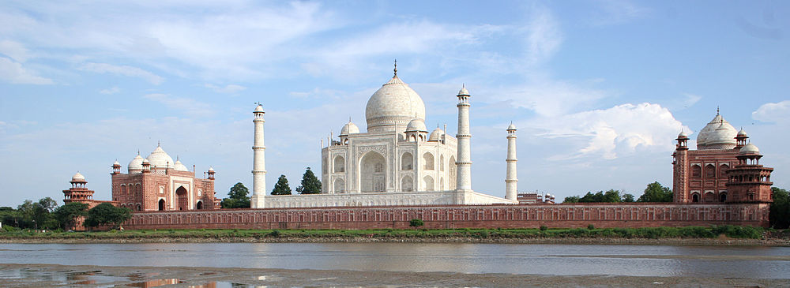
At the far end of the complex are two grand red sandstone buildings that mirror each other, and face the sides of the tomb. The backs of the buildings parallel the western and eastern walls. The western building is a mosque and the other is the jawab (answer), thought to have been constructed for architectural balance although it may have been used as a guesthouse. Distinctions between the two buildings include the jawab's lack of a mihrab (a niche in a mosque's wall facing Mecca), and its floors of geometric design whereas the floor of the mosque is laid with outlines of 569 prayer rugs in black marble. The mosque's basic design of a long hall surmounted by three domes is similar to others built by Shah Jahan, particularly the Masjid-i Jahān-Numā, or Jama Masjid, Delhi. The Mughal mosques of this period divide the sanctuary hall into three areas comprising a main sanctuary and slightly smaller sanctuaries on either side. At the Taj Mahal, each sanctuary opens onto an expansive vaulting dome. The outlying buildings were completed in 1643.

Slide 17
Construction
The Taj Mahal is built on a parcel of land to the south of the walled city of Agra. Shah Jahan presented Maharajah Jai Singh with a large palace in the center of Agra in exchange for the land.[29] An area of roughly three acres was excavated, filled with dirt to reduce seepage, and leveled at 50 metres (160 ft) above riverbank. In the tomb area, wells were dug and filled with stone and rubble to form the footings of the tomb. Instead of lashed bamboo, workmen constructed a colossal brick scaffold that mirrored the tomb. The scaffold was so enormous that foremen estimated it would take years to dismantle.[30]
The Taj Mahal was constructed using materials from all over India and Asia. It is believed over 1,000 elephants were used to transport building materials. The translucent white marble was brought from Makrana, Rajasthan, the jasper from Punjab, jade and crystal from China. The turquoise was from Tibet and the Lapis lazuli from Afghanistan, while the sapphire came from Sri Lanka and the carnelian from Arabia. In all, twenty eight types of precious and semi-precious stones were inlaid into the white marble.

Slide 18
Later days
Abdul Hamid Lahauri in his book Badshahnama refers to Taj Mahal as rauza-i munawwara, meaning the illumined or illustrious tomb. Soon after the Taj Mahal's completion, Shah Jahan was deposed by his son Aurangzeb and put under house arrest at nearby Agra Fort. Upon Shah Jahan's death, Aurangzeb buried him in the mausoleum next to his wife. In the 18th century, the Jat rulers of Bharatpur invaded Agra and attacked the Taj Mahal, the two chandeliers, one of agate and another of silver, which were hung over the main cenotaph, were taken away by them, along with the gold and silver screen. Kanbo, a Mughal historian, said the gold shield which covered the 15-foot high finial at the top of the main dome was also removed during the Jat despoliation
By the late 19th century, parts of the buildings had fallen into disrepair. During the time of the Indian rebellion of 1857, the Taj Mahal was defaced by British soldiers and government officials, who chiselled out precious stones and lapis lazuli from its walls. At the end of the 19th century, British viceroy Lord Curzon ordered a sweeping restoration project, which was completed in 1908. He also commissioned the large lamp in the interior chamber, modelled after one in a Cairo mosque. During this time the garden was remodelled with British-style lawns that are still in place today.

