Slide 1
The History of Ebooks
Written by:
Avlogiari Dimitra-Maria,
Eleni Gkoura, 3rd Gymnasium of Charilaou Thessaloniki and 32nd General High School of Thessaloniki

Slide 2
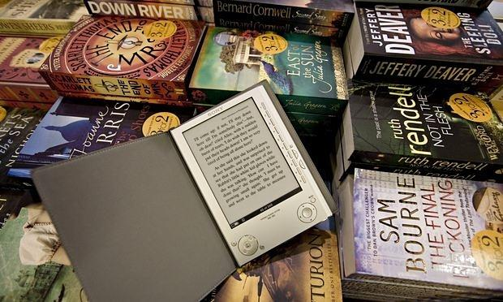
When was the first e-book invented and who was the inventor?
The first creator of the e book is widely questioned upon
Roberto Busa (late 1940s) is considered to be one of the inventors as well as Ángela Ruiz Robles (1949) and Doug Engelbart, Andries van Dam (1960s) and Michael S. Hart (1971)

Slide 3
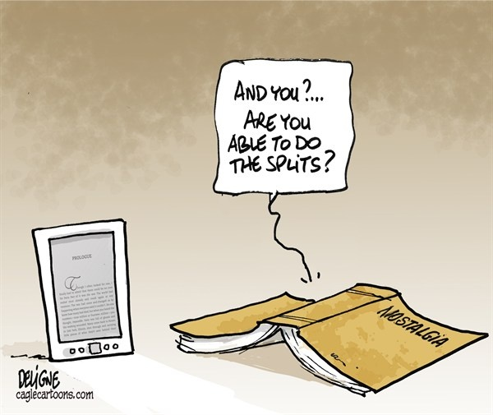
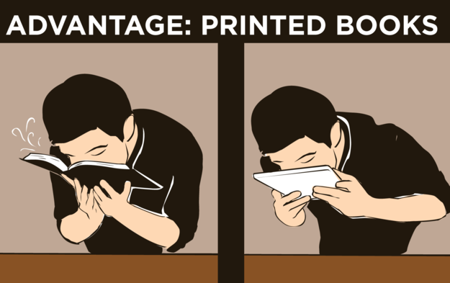
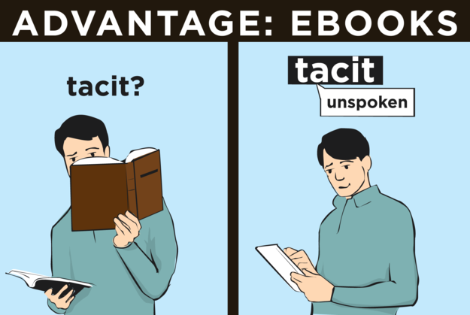
Comic strips about e-books

Slide 4
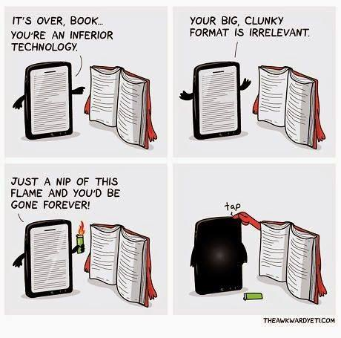
Times change..

Slide 5
E-books do not need a lot of space..

Slide 6
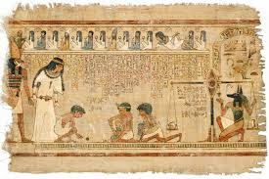
A short history calendar of traditional books.
In Mesopotamia clay tablets were used in order to store data such as the wealth of the kings and the traded means. Ancient Egyptians used papyrus. Writing on bone, shells, wood and silk existed in China long before the 2nd century BC. Paper was invented in China around the 1st century AD. The invention of the printing press by Gutenberg around 1440 marks the entry of the book into the industrial age.

Slide 7
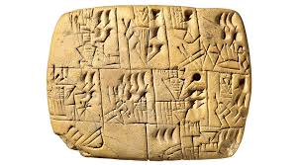
Which was the first form of written texts?
Cuneiform
Mycenaean Greek
Egyptian hieroglyphs
Linear B
And the list goes on…

Slide 8
But now all of these belong to the past…The trend of eBooks is threatening to eliminate the existence of traditional-printed books. However, the staggering proliferation of the usage of eBooks has risen questions troubling book lovers worldwide regarding piracy and the ability to enjoy the look and smell of all your time-worn books.
So, after all, whose side are YOU on?

