Slide 1
Ukrainian wedding traditions

Slide 2
The Ukrainian Wedding is one of the most symbolic celebrations of Ukraine culture. Traditions and customs for Ukrainian weddings are numerous and have evolved through the ages. National traditions are dominant in Ukrainian wedding ceremonies. Some of them are very old and hard to explain. Over time things change, people and their preferences change, lifestyles and of course - one of the most important events in life "marriage" will change as well.
In Ukraine, a wedding was a three-day celebration.

Slide 3
The most important wedding customs and rituals that were honored by our ancestors are still in use. Some customs, such as "matchmaking" and "buying out the bride" are heavily modified in order to adjust to modern couples' abilities. Other wedding rituals, such as the "betrothal" are performed strictly because of the religious connection to the wedding ceremony.

Slide 4
There a lot of different wedding customs in Ukraine. The main parts of them are:
Matchmaking
Engagement
Invitation
Loaf
Hen-party
Suffusion
Marriage ceremony

Slide 5
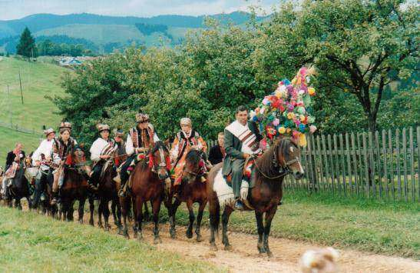
Matchmaking

Slide 6
Engagement

Slide 7
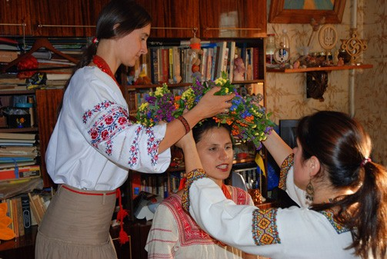
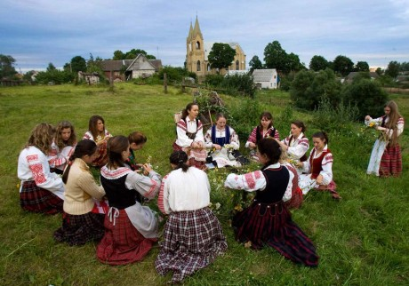
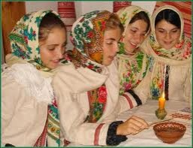
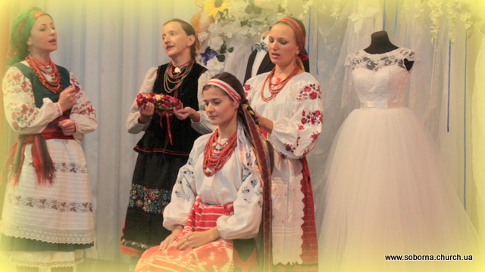
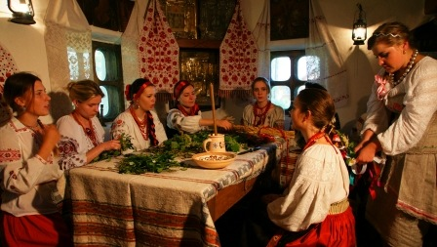
Hen-party

Slide 8
Invitation

Slide 9
Wedding bread
The baking and decorating of the ritual bread from flour donated by all the wedding participants

Slide 10
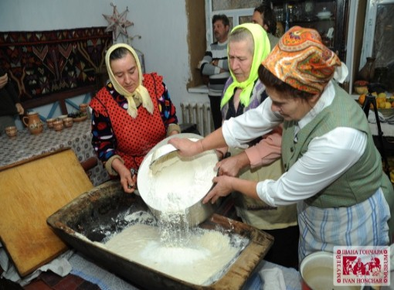
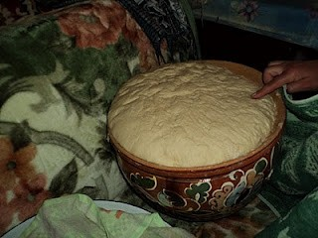
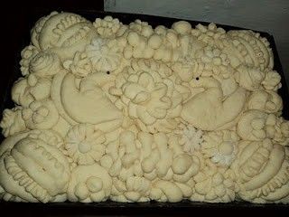
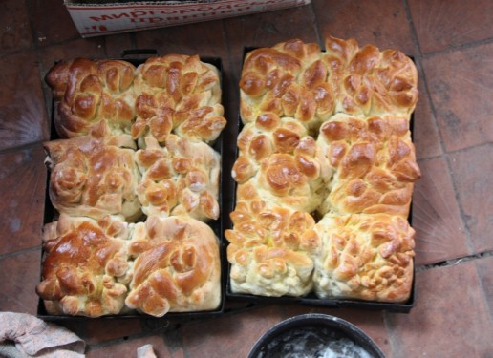
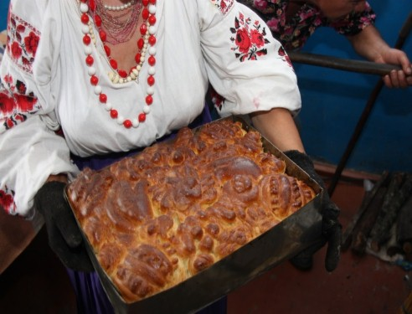
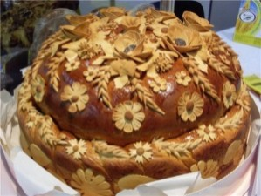
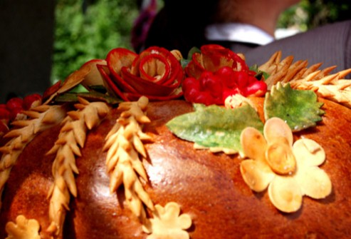
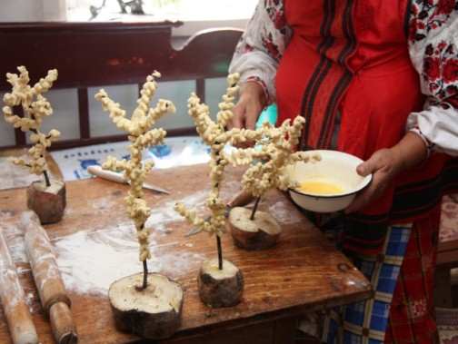

Slide 11
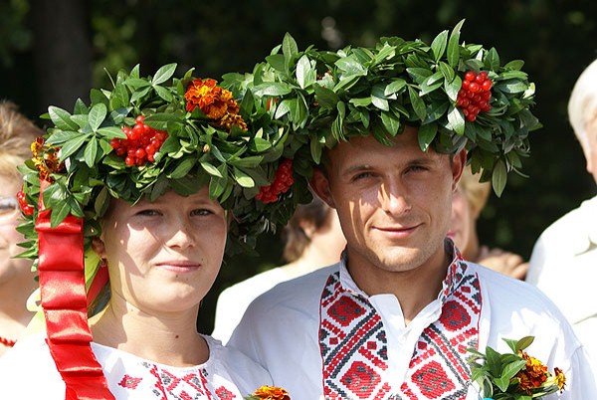
Marriage ceremony
The marriage ceremony in church, usually on a Sunday.
Most wedding ceremonies involve an exchange of wedding vows by the couple, presentation of a gift (offering, ring(s), symbolic item, flowers, money), and a public proclamation of marriage by an authority figure. Special wedding garments are often worn, and the ceremony is sometimes followed by a wedding reception.

Slide 12
And then there are simple competitions, dances and other entertainments…

Slide 13
Thanks for your attention

