Slide 1
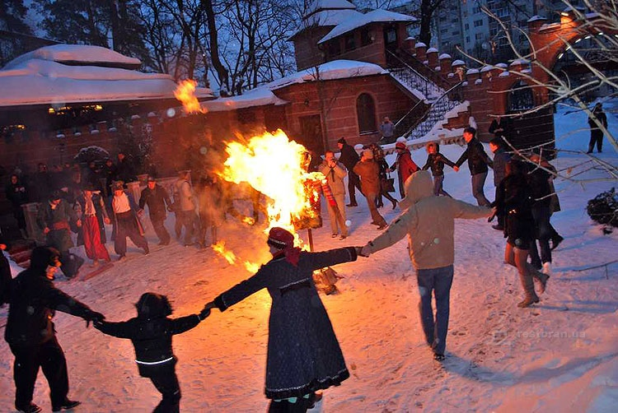
Shrovetide
by Valeriya Burnakova

Slide 2
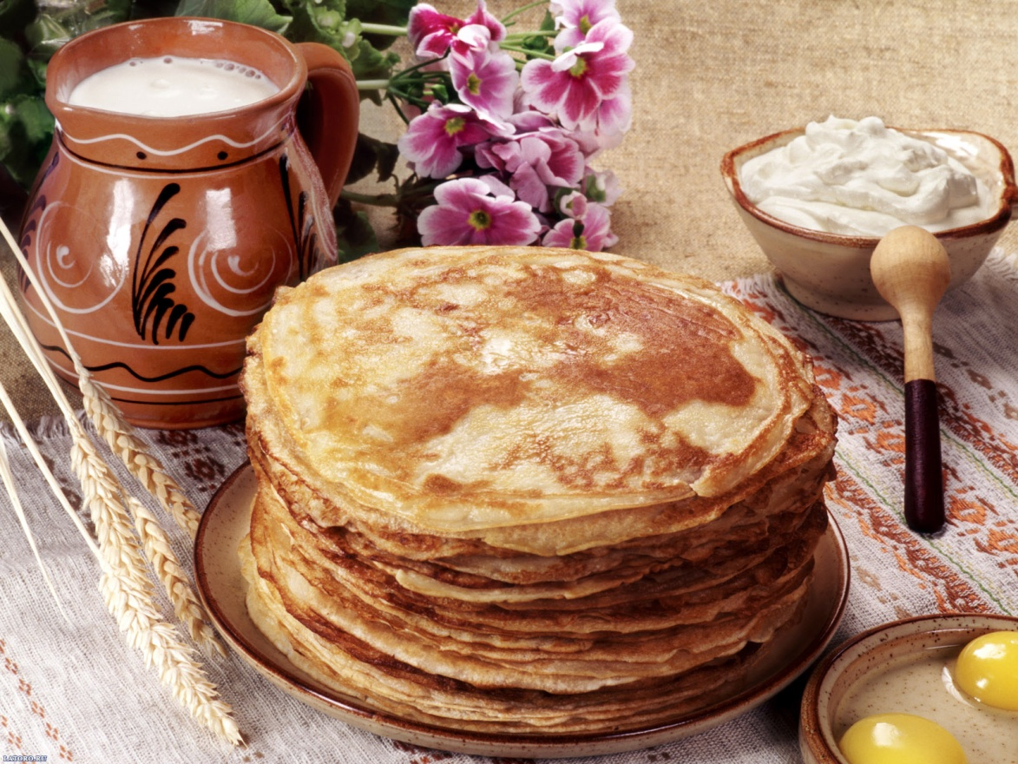
Shrovetide is an Ukrainian holiday, which people celebrate in February or March. On Shrovetide people help to chase the winter away. Shrovetide is a sign, that means the winter comes to the end and spring knocks to the door

Slide 3
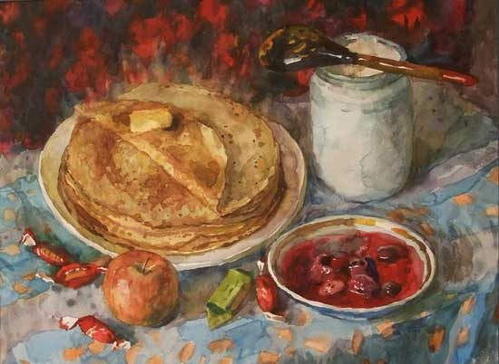
Each day of Shrovetide week has its own name, which refers to what you are mean to do on that particular day .

Slide 4
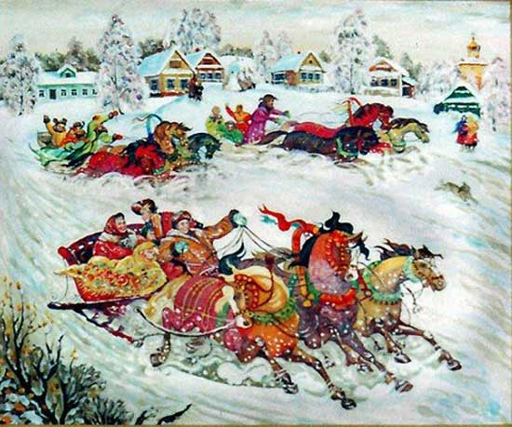
Monday is “the meeting”
On this day people usually set up ice slides. The louder noise and laughter over the ice slide is, the more productive harvest will be. Also on this day people play different games and simple have fun.

Slide 5
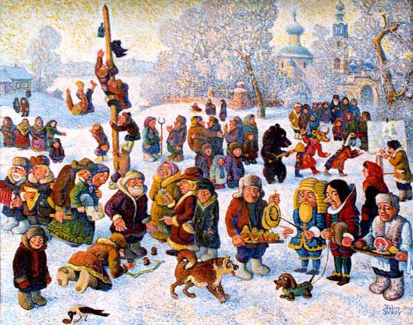
Tuesday is «gaming day »
The big scarecrow is put to the middle of town. All games begin, also people offer pancakes to everyone. The very popular game is when men climb on the large post, the one, who climb on the top first, is the winner.

Slide 6
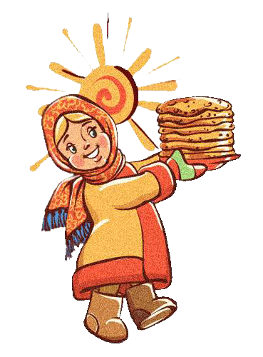
«The lover of good food»
The name speaks for itself. In that day hostesses offer their guests everything they have .

Slide 7
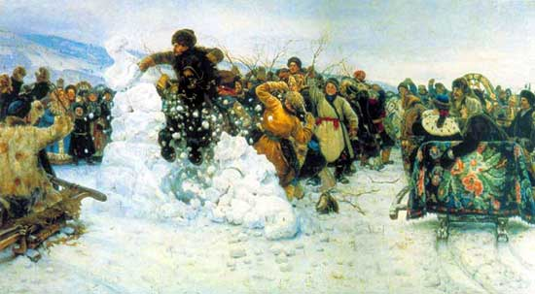
«The day for going wild»
In this day people ride on horses around the village along the line of the sundial to help the sun chase away the winter. Also people play different games, ride on sleds, have fun

Slide 8
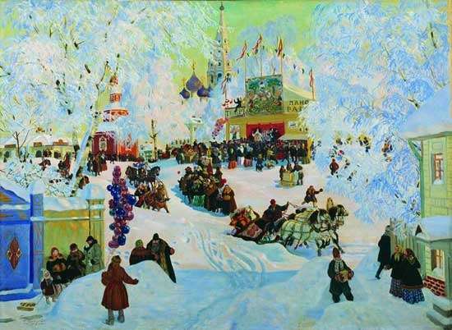
«Mother-in-law’s Evening»
Sons-in-law go to see their mothers-in-law, and the mothers-in-law offer them pancakes. If man do not have wife ,his friend try to find girl for him.

Slide 9
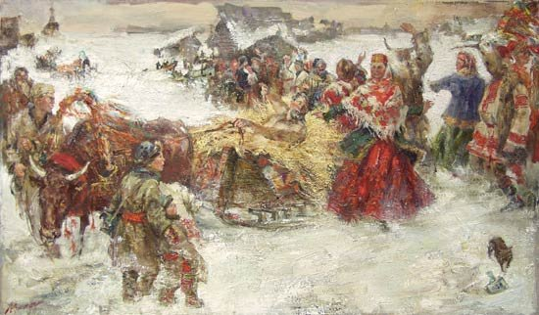
Saturday
On Saturday people go round to see their relatives, and once again they are offered an endless number of pancakes.
As far as the recipe is concerned, the preparation of the pancakes used to be a genuine ritual: the ladies of the house would make everything in secret, so that they could surprise everyone in the morning.
For this they would go out in the evening to prepare the sponge dough by the light of the moon shining off the river, the lake or the courtyard.

Slide 10
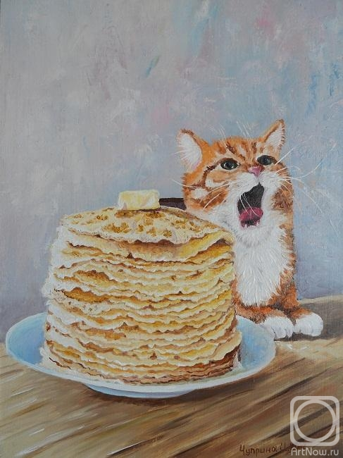
Pancakes
As everyone is aware, on that day people always cook and eat pancakes. It can be with cottage cheese, different fruits, berries, meat and even with caviar.

Slide 11
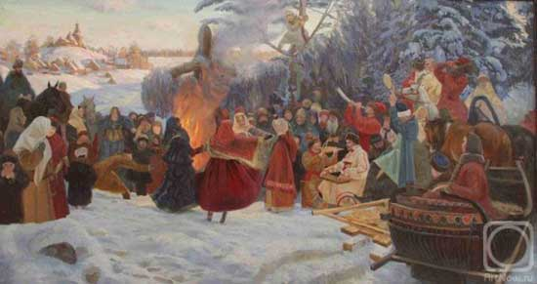
The last day is Shrove Sunday
Everyone says sorry to others, gaining forgiveness for their sins before Lent. And in reply people say : «God will forgive you»

Slide 12
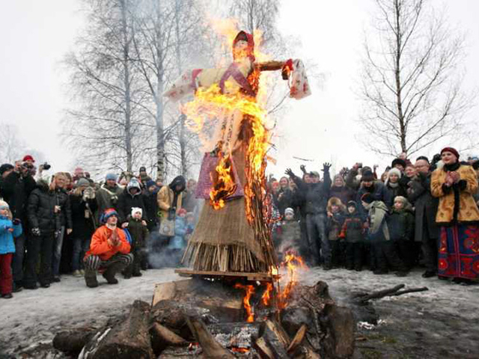
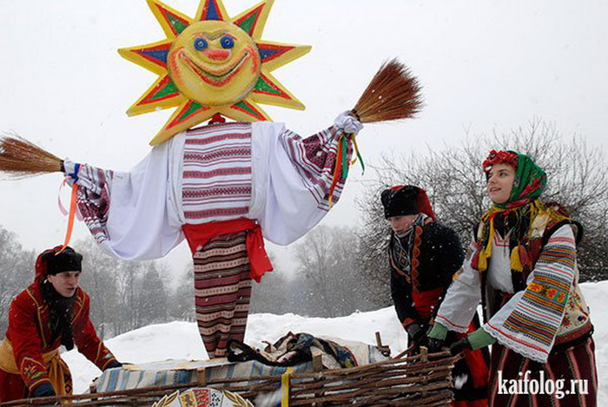
The most interesting part of celebrating Shrovetide is burning the doll. Usually some people fill the huge straw woman's dress, especially made for this. But after that, go to the area and bred there big fire. The flames drawn up, throwing the pole on which stands with outstretched hands of an effigy of Shrovetide . Young people and older people begin to dance around the fire-pit. At this time they humorously criticize winter for being "endowed" with frosty days, but then they thank her for the opportunity to play in the snow and slide downhill. Flames continue to consume the doll, and here it was all in flames. When the burning of effigies is completed, it is removed from the pole and small fire

