Slide 1
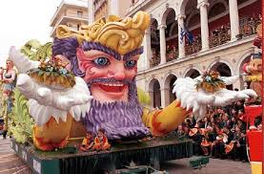
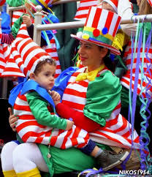
Dear Jane,
Thanks for your last e-mail.I would like to tell you about the Carnival that takes place in my country every year.
Carnival is a festive season that occurs before the Christian season of Lent.

Slide 2
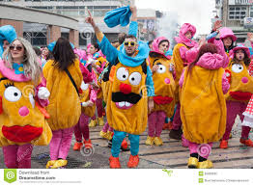
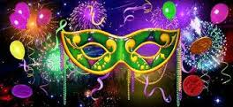
The main events typically occur during February or early March.Carnival involves a public celebration and parade combining some elements of a circus ,masks and public street party.People wear masks during these celebrations ,an overturning of life’s normal things..

Slide 3
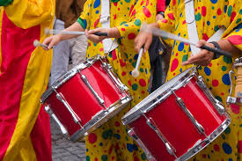
From an anthropological point of view,carnival is a reverse ritual ,in which social roles are reversed and norms about desired behaviour are suspended.
Carnival can,thus, be regarded as a rite of passage from darkness to light,from winter to spring, a fertility celebration ,the first spring festival of the new year.
I look forward to your visiting my country ,so we can go to the carnival together.See you soon,
Love,Miropi

