Slide 1
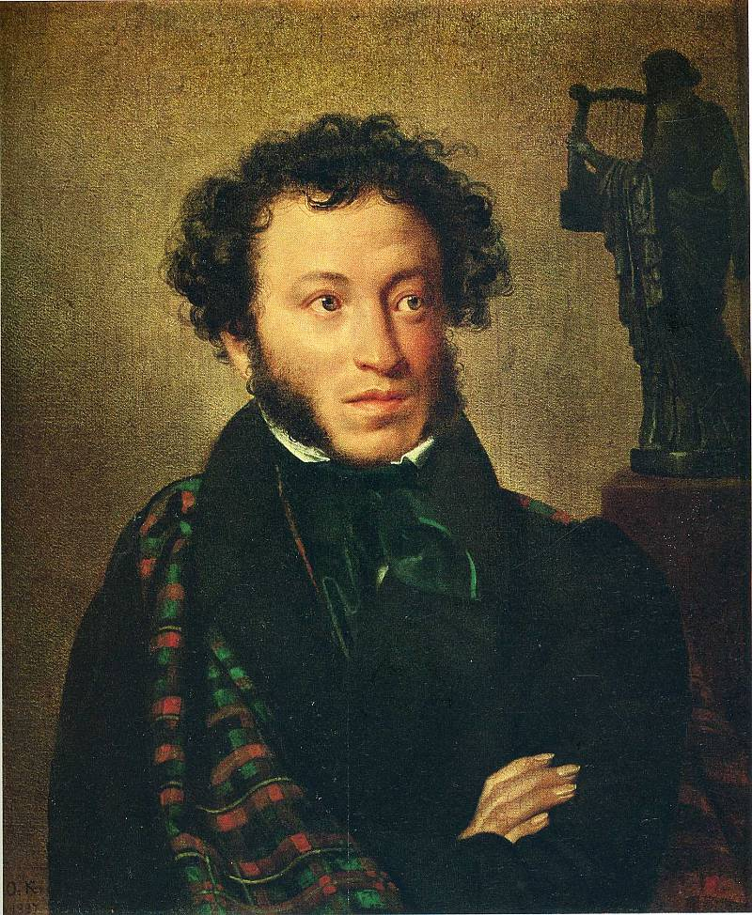
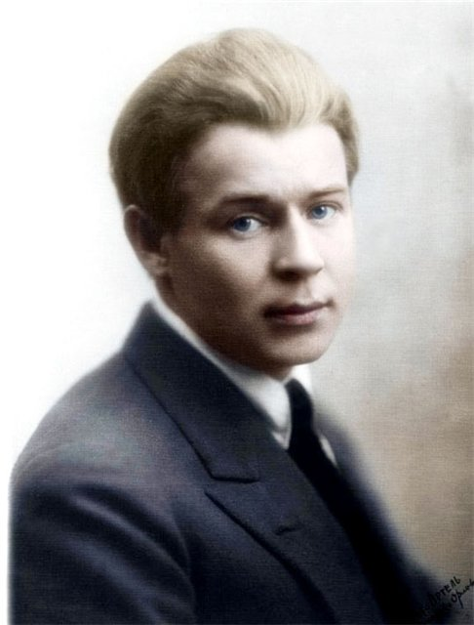
Russian poetry
By Marina Zaytseva

Slide 2
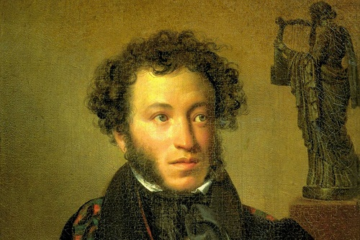
The greatest Russian poet Alexander Sergeyevich Pushkin was born in Moscow on 26 May 1799 and died on 29 January 1837 in St. Petersburg. He was not only the poet, but also dramatist, novelist and writer of short stories.

Slide 3
Pushkin’s contribution in literature
The most famous works of Alexander Pushkin are ‘Yevgeny Onegin’, ‘Boris Godunov’, ‘The Captain’s Daughter’, ‘The Queen of Spades’, ‘Ruslan and Ludmila’ and many others.
Pushkin started the great tradition of Russian literature. He wrote his works the way no one else had done before – using the current language, Russian language as it was spoken instead of using style of old church books. His style had enormous influence on other Russian writers, some of his poems and stories were set to music by Russian composers.

Slide 4
Alexander Pushkin: “The wondrous moment of our meeting...”
The wondrous moment of our meeting...
I well remember you appear
Before me like a vision fleeting,
A beauty's angel pure and clear.
In hopeless ennui surrounding
The worldly bustle, to my ear
For long your tender voice kept sounding,
For long in dreams came features dear.
Time passed. Unruly storms confounded
Old dreams, and I from year to year
Forgot how tender you had sounded,
Your heavenly features once so dear.
My backwoods days dragged slow and quiet -
Dull fence around, dark vault above -
Devoid of God and uninspired,
Devoid of tears, of fire, of love.
Sleep from my soul began retreating,
And here you once again appear
Before me like a vision fleeting,
A beauty's angel pure and clear.
In ecstasy the heart is beating,
Old joys for it anew revive;
Inspired and God-filled, it is greeting
The fire, and tears, and love alive.

Slide 5
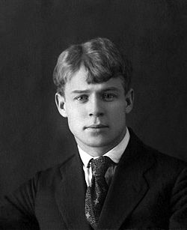
Sergei Еsenin
Еsenin was born on the third of October in the village of Konstantinovo – Ryazan province. This great day you should, for sure, remember, if you forget it, you will "commit an offense".
Sergei Еsenin is a great poet-lyricist.The whole world knows about him!He was a real emotional artist.
He embodied in poems his own dream.We feel Esenin's love to the Motherland.
In his poems all is steeped with the Russian spirit.You even do not need to strain to understand his thoughts, his sincere feelings, his real esprit.I like Sergei Esenin's poetry very much! It ignites the fire in me, and it doesn’t go out ever –you immediately begin to be proud of your country.
That is why Esenin will remain in our hearts forever!

Slide 6
See you later, friend mine, see you later
See you later, friend mine, see you later.
Darling, you are always in my soul.
Destined in the heaven, our breakup
Promises reunion down the road.
Bye with not a hand touch, not a farewell,
Don’t lament, quit saddening your eyes, –
In this province, death is nothing rare. Well,
Nor is living any more untried.

