Slide 1
Nikola tesla
Antonio Korza, Vedran Gusković, Tonko Horvat
4. B1

Slide 2
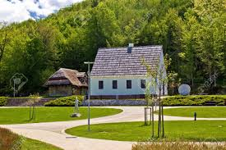
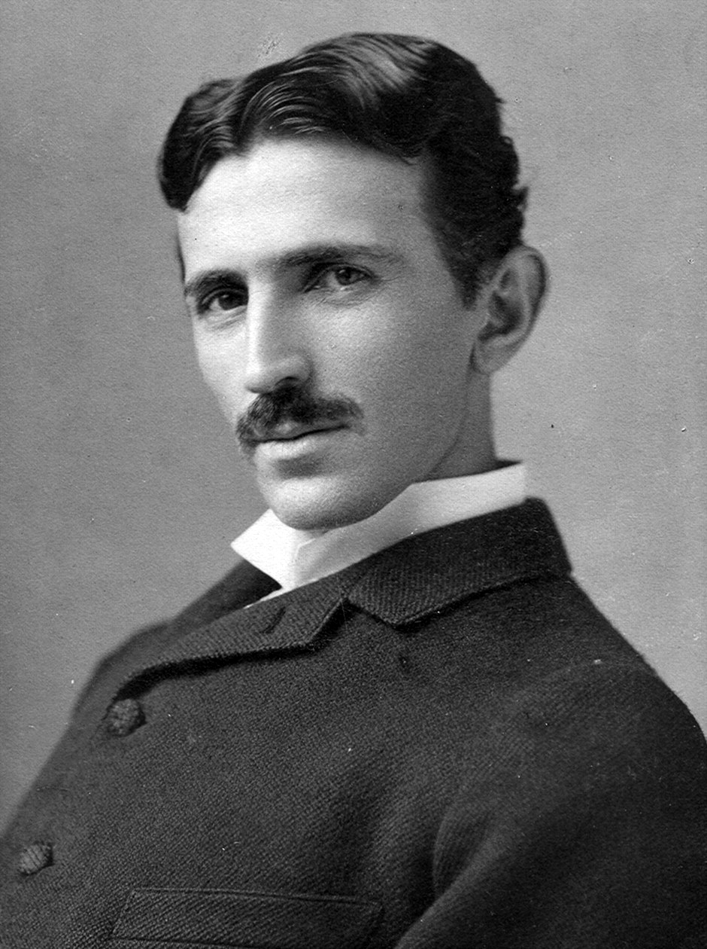
birth
Born July 10th, 1856
Smiljan, Croatia

Slide 3
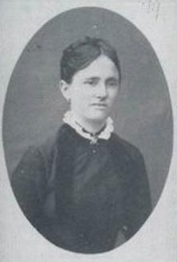
Family
Father: Milutin Tesla
Mother: Duka Mandić
Sisters: Milka, Angelina and Marica

Slide 4
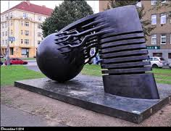
Early life
1875 starts tehnical school in Graz, Austria for three years
quits school and moves to Maribor, Slovenia
1880 starts Charles-Ferdinand University in Prague

Slide 5
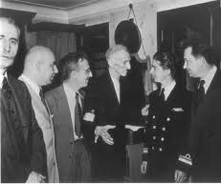
USA
6 June 1884 first arrived in the US in New York city
Edinson hires Tesla to work for his Edison Machine Works
quits working for Edison and begins to dig in ditches

Slide 6
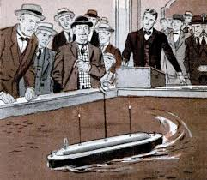
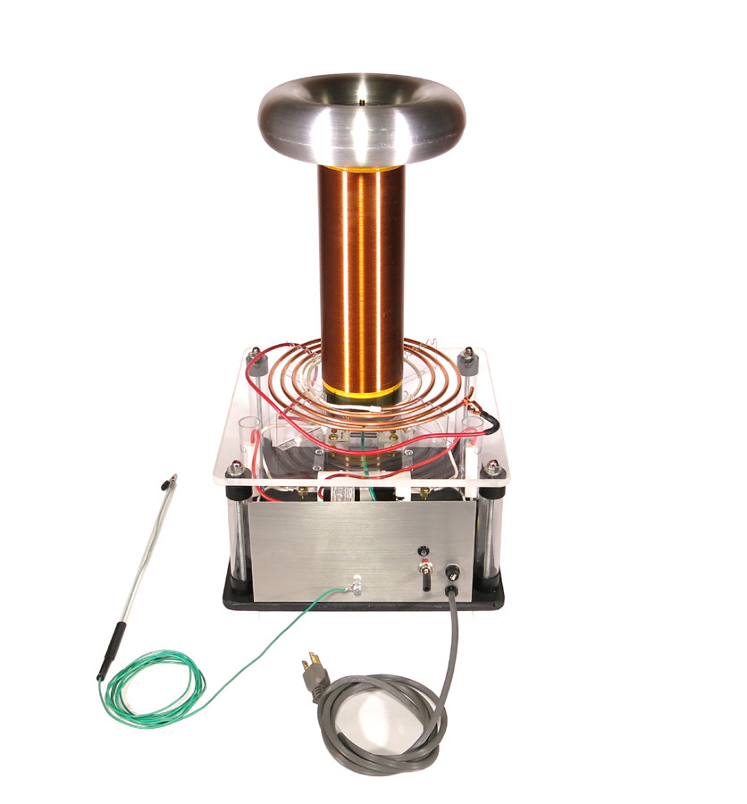
New ideas
1880 constructs alternating current induction motor and the Tesla coil
Begins working with George Westinghouse at Westinghouse Electric and Manufacturing Company´s
Experiments with X-rays, mechanical resonance, radio tehnology, radio controlling with boat

Slide 7
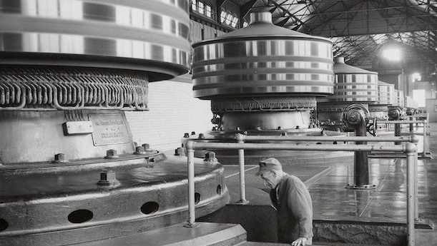
Niagara falls
Wins the contract to light Niagara Falls with AC electricity
November 16,1896 first power reaches Buffalo

Slide 8
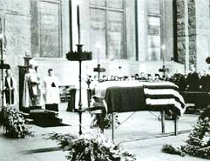
dEATH
died some time between the evening of 5 January and the morning of 8 January 1943, at the age of 86
his was cremated and his ashes taken to Belgrade, Serbia in 1975
the urn was placed in Nikola Tesla museum

Slide 9
End

