Slide 1
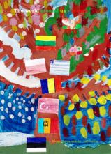
Curiosities of March
Project: The world around us – season.
2016r.

Slide 2
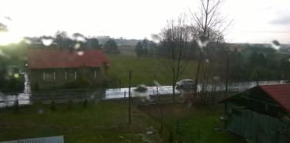
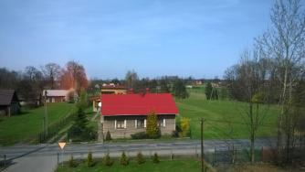
SZKOŁA PODSTAWOWA W POGWIZDOWIE, POGWIZDÓW POLSKA
the highest temperature
30 III 16r.
- 14*C -
March 21
the first day of spring
lowest temperature
15 III 16r.
- 1*C -
snow
rain
sun

Slide 3
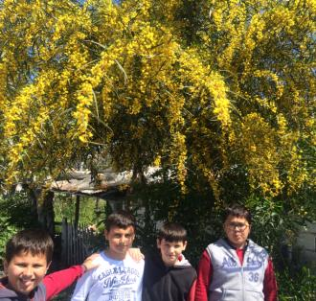
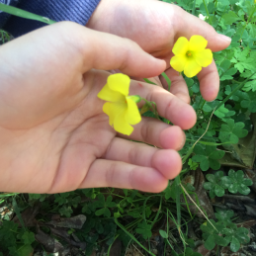
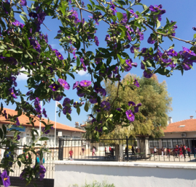
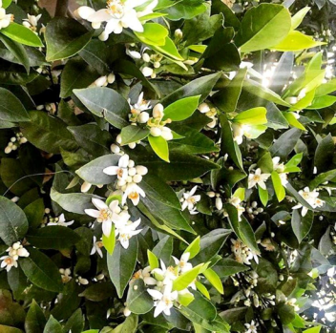
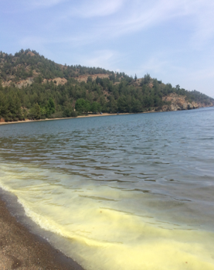
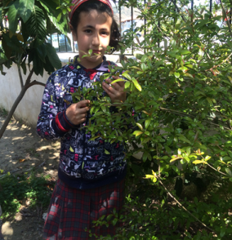
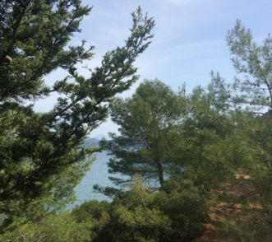
HURRIYET ILKOKULU, DALAMAN, MUĞLA TURCJA

Slide 4
RASEINIŲ ŠALTINIO PROGIMNAZIJA, RASEINIAI LITWA

Slide 5
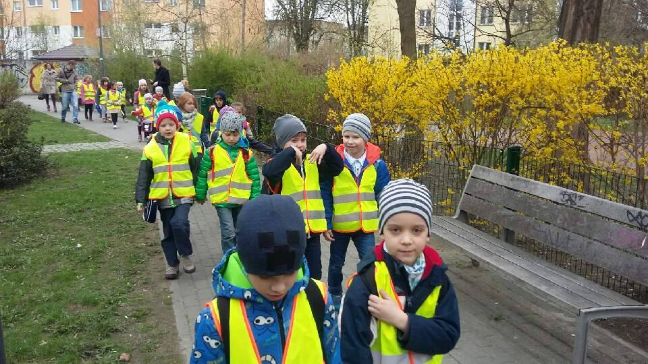
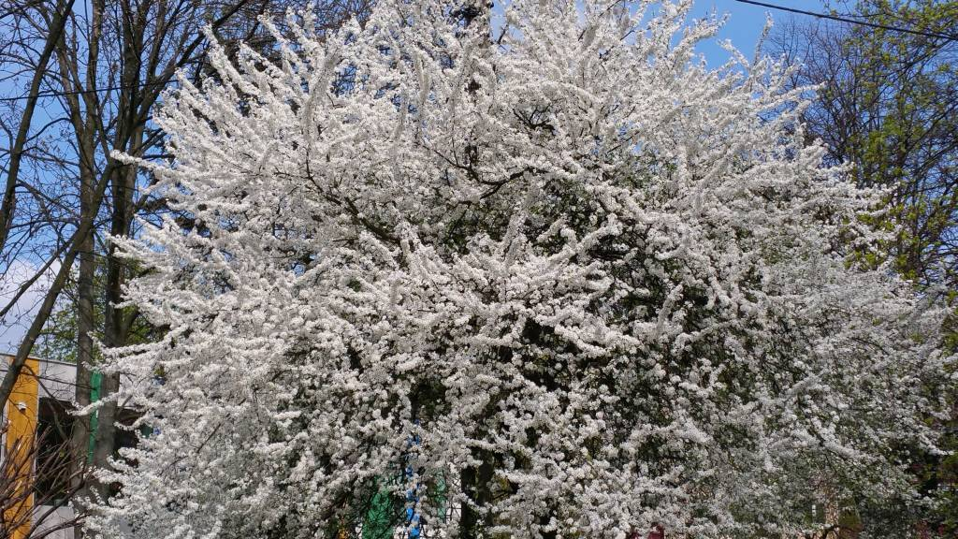
SZKOŁA PODSTAWOWA NR 4 IM. WŁADYSŁAWA BRONIEWSKIEGO W WARSZAWIE, POLSKA
Marzanna (in Polish) is a Baltic and Slavic goddess associated with seasonal rites based on the idea of death and rebirth of nature. Today Marzanna is often perceived as a personification of winter and the symbolic drowning ends this season and returns life.
One of the old Polish custom is custom Drowning Marzanny. Currently, it takes place on March 21 which is the first day of the calendar spring. Students on Warsaw school annually create their Marzanna and then go to the surrounding pond.
2.03.2016 5°C
the lowest temperature
the highest temperature
19 III 2016 16ºC

Slide 6
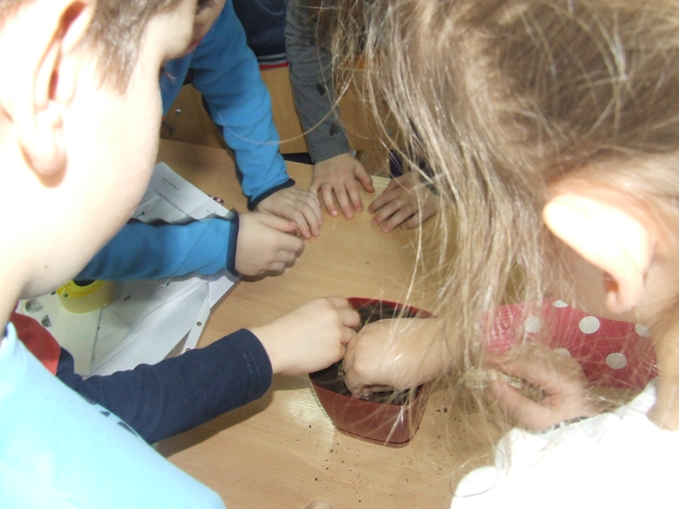
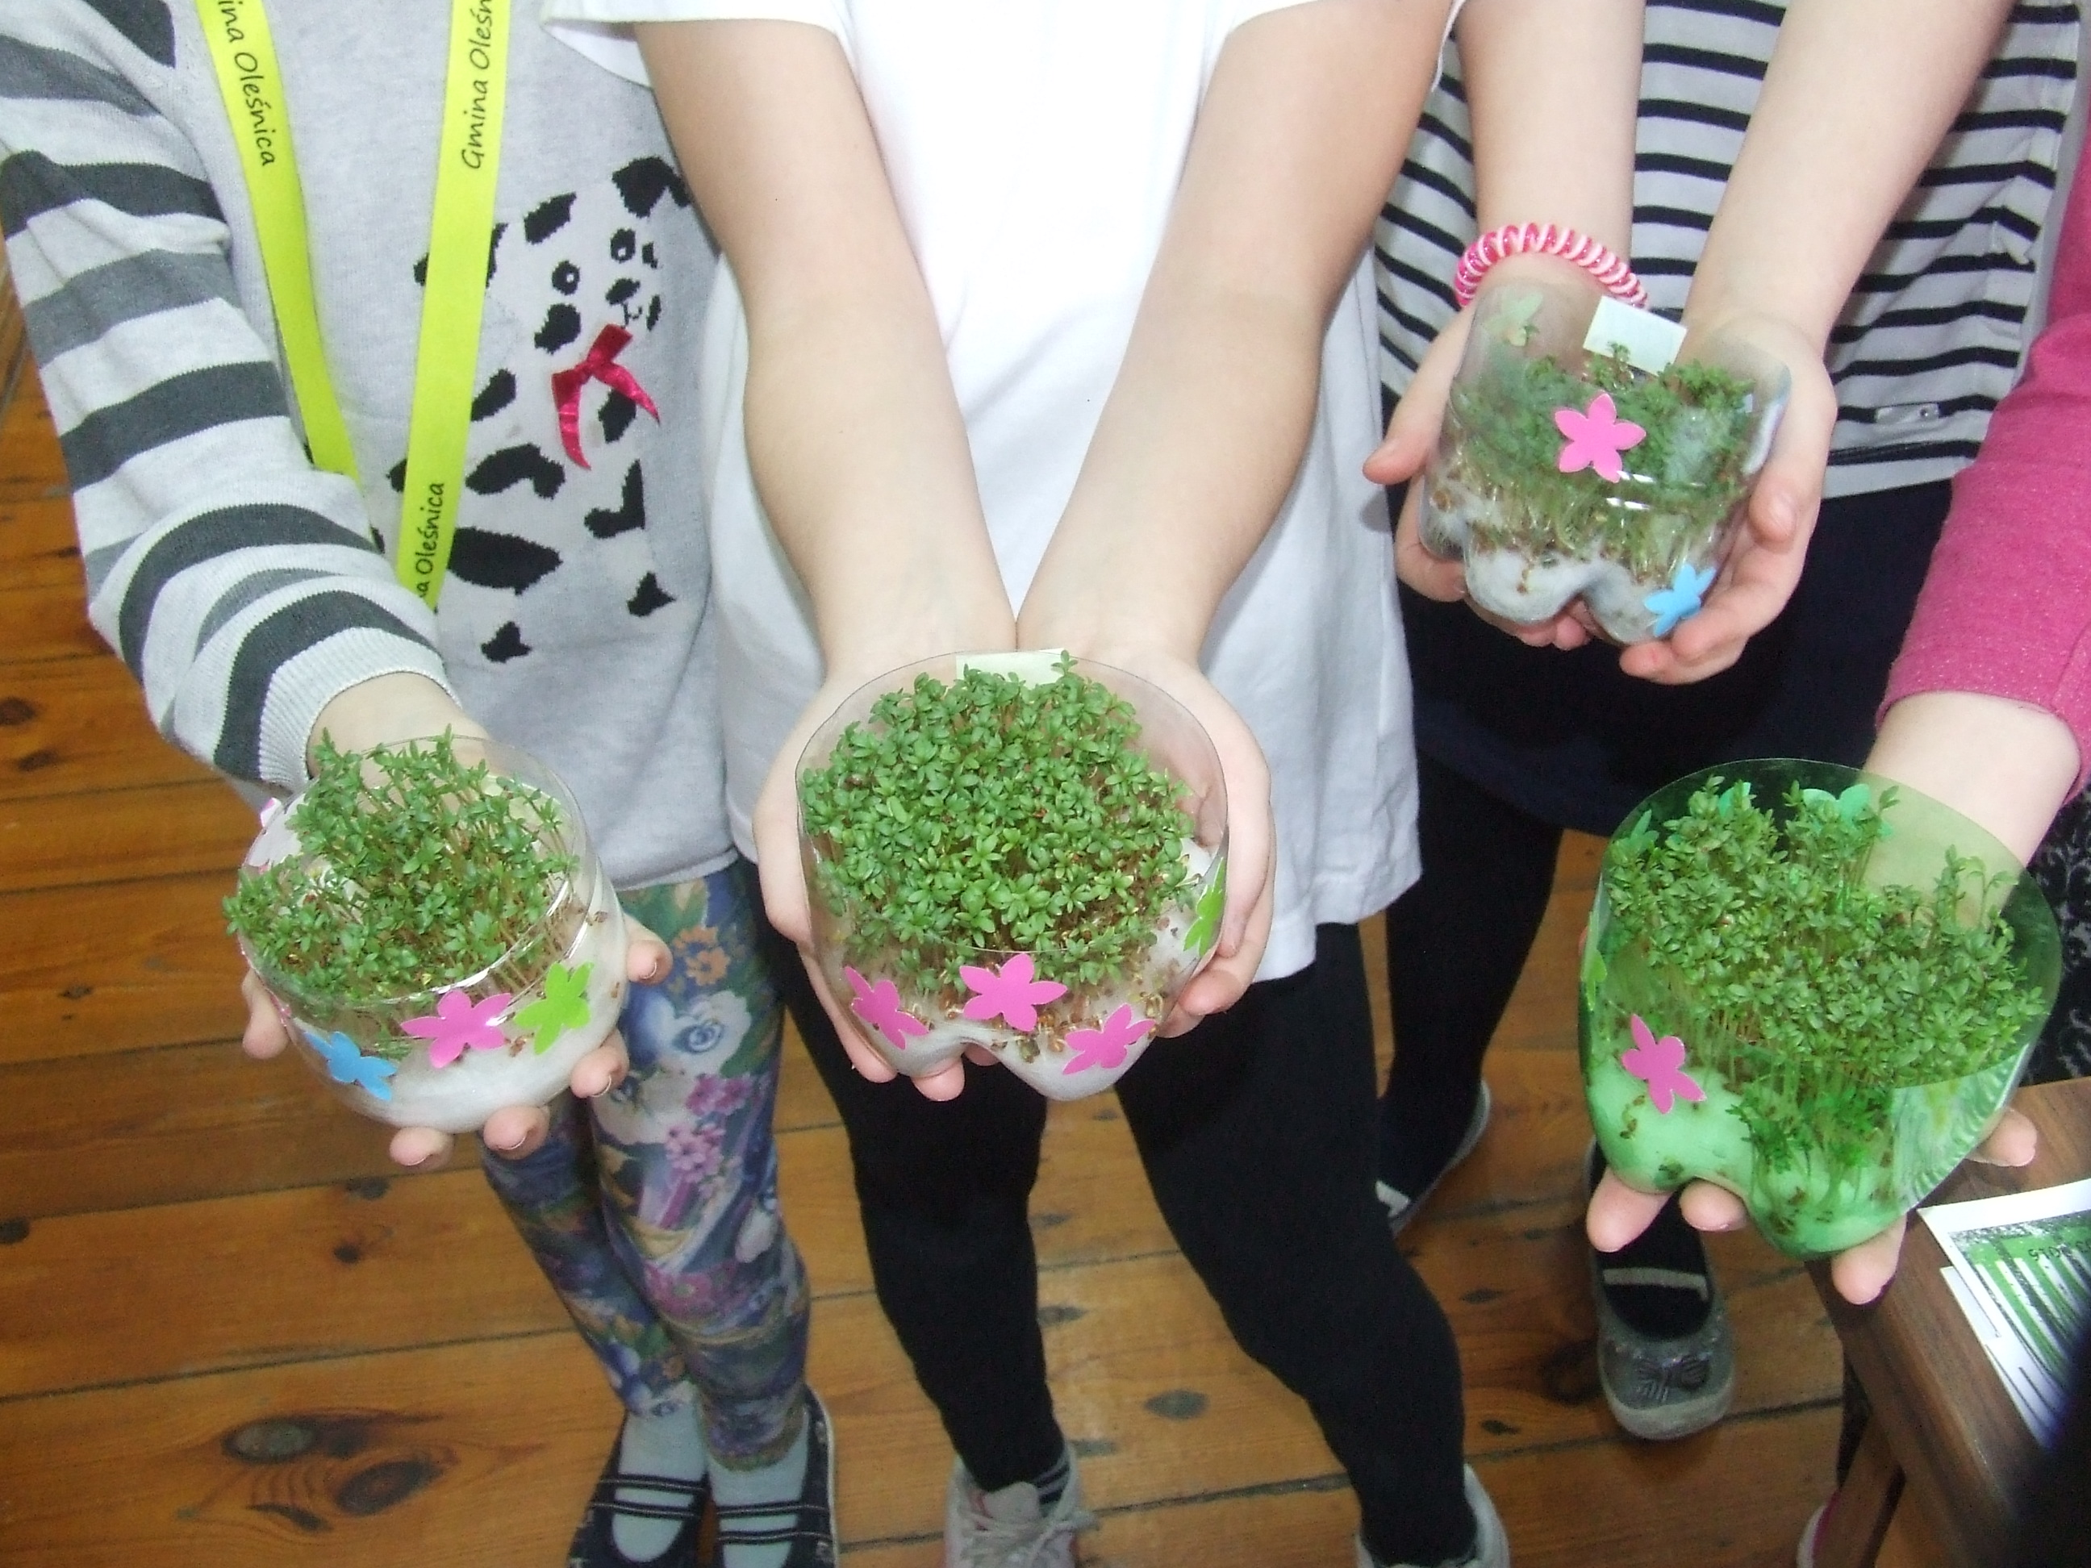
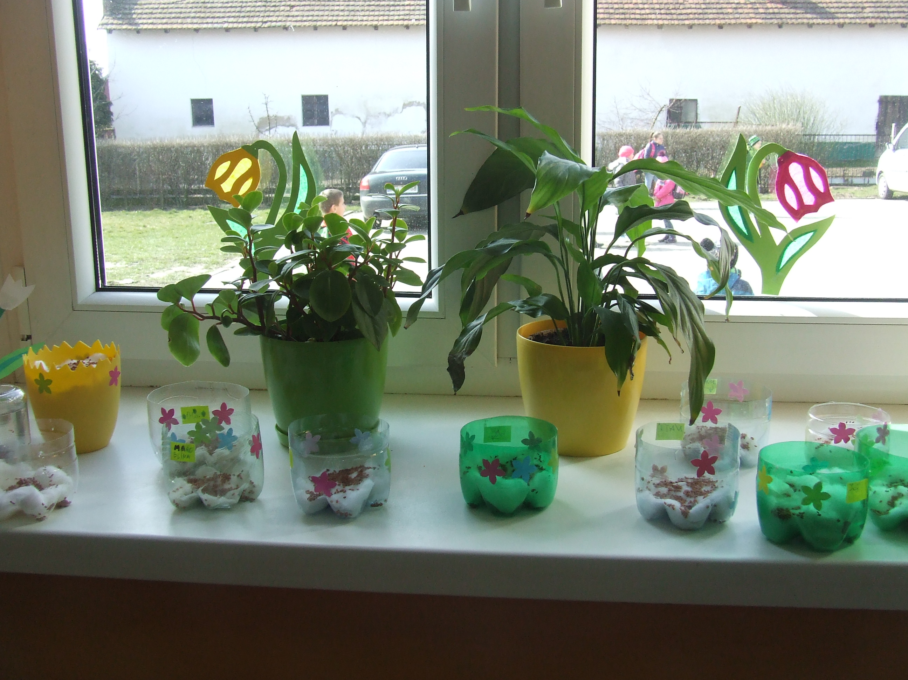
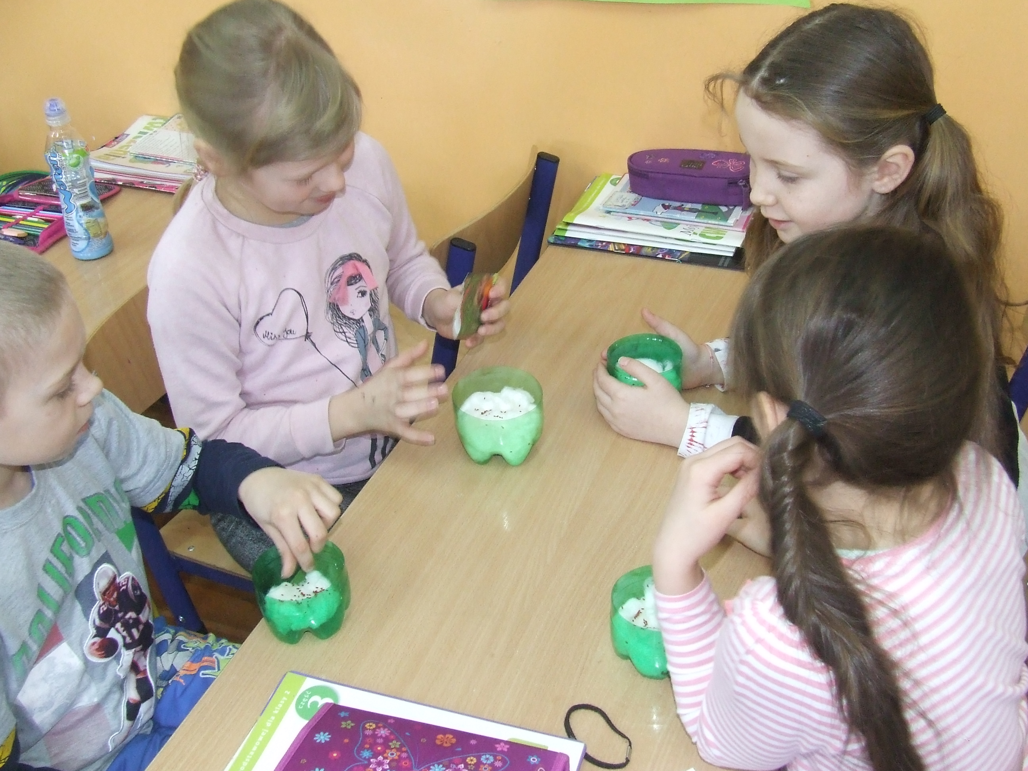
SZKOŁA PODSTAWOWA W SOKOŁOWICACH, POLSKA
16°C
the highest temperature
0°C
the lowest temperature

Slide 7
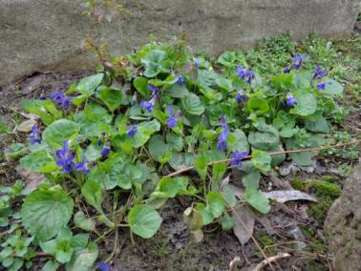
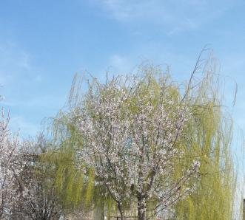
ȘCOALA GIMNAZIALĂ NR. 29 GALAȚI, ROMÂNIA
Highest temperature 16°C
1st of March – the “Mărțișor”
Romanians celebrate the beginning of spring by offering a gift made of a red and white string.
Lowest temperature 6°C
1st of March – 9th of March – the “Babe” days
The first 9 days of spring in Romania are called “Babe”. We believe that spring succeeds winter in a battle that lasts 9 days.

