Slide 1
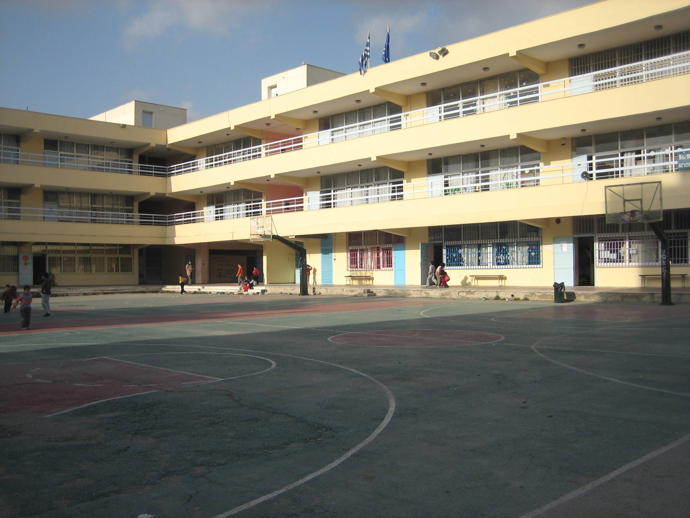
OUR CLASSmates
Welcome to our class!
We will show you our classmates!
Our classmates are very good at all the lessons and
are great at sports!

Slide 2
Nasos: HE LIKES playing playstation 4 AND PLAYING BASKETBALL JOHN:HE LIKES PLAYING FOOTBALL AND PLAYSTATION 4 SOFIA: HER BEST FRIEND IS IRENE AND SHE LIKES DANCING TO pop music. RANIA:HER BEST FRIEND are marina and magdalini AND SHE LIKES dancing. IRENE:HER BEST FRIEND IS sofia and she likes doing rhythmic gymnastics. MAGDALINI: her twin sister is marina and she likes swimming and playing with her cats MARINA:HER best friend is vasiliki and she likes animals.
OUR CLASSMATES!

Slide 3
OUR CLASSMATES
VASILIKI:HER BEST FRIEND IS ELEKTRA AND SHE LIKES BASKETBALL
KYRIAKOS:HE LIKES PLAYING HANDBALL,FOOTBALL AND WITH HIS BEST FRIEND JOHN.
KOSTAS:HIS FAVOURITE SPORT IS BASKETBALL AND HE LIKES TENNIS
PAUL:HE LIKES FOOTBALLL AND HANDBALL
GEORGE:HE LIKES PLAYING FIVE NIGHTS AT FREDYS AND HE LIKES BASKETBALL
NICK :HE LIKES PLAYNIG FIVE NIGHTS AT FREDDY’S AND HE LIKES KARATE
MIKE:HE LIKES ALL THE SPORTS AND HIS BEST FRIEND IS PAUL
PARIS:HIS BEST FRIEND IS TASOS AND HE LIKES PLAYING LEGO DIMENSIONS IN PLAYSTATION 3
TASOS:HIS BEST FRIEND IS PARIS AND HE LIKES PLAYING LEGO DIMENSIONS IN PLAYSTATION 3
ELEKTRA:HER BEST FRIEND IS VASILIKI AND SHE LIKES FIGHTING.
JOHN M.:HIS BEST FRIEND IS KYRIAKOS AND HE LIKES PLAYING WITH HIS CAT
Made by: Paul and George

