Slide 1
Watch closely!
Answer the questions
Write to us through his teacher.

Slide 2
Greece
landscape photos

Slide 3
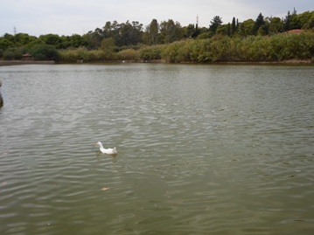
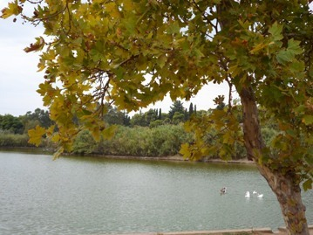

Slide 4
wea
t
he
r
map

Slide 5
Lithuania
landscape photos

Slide 6
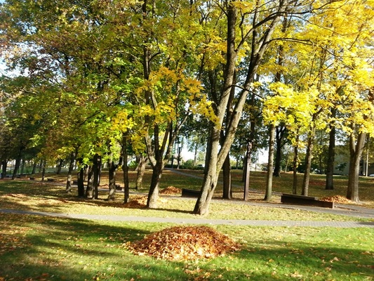
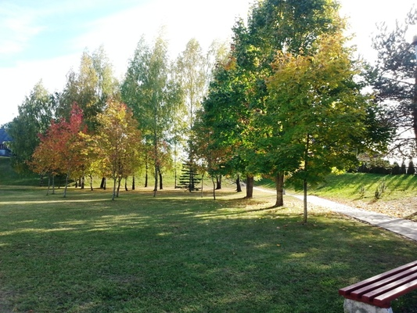
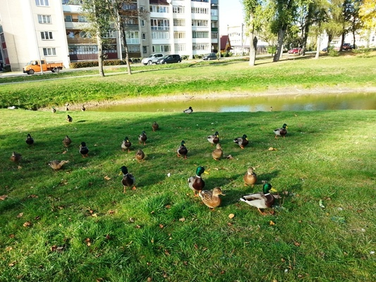

Slide 7
w
e
a
t
h
e
R
m
a
p

Slide 8
Moldova
landscape photos

Slide 9
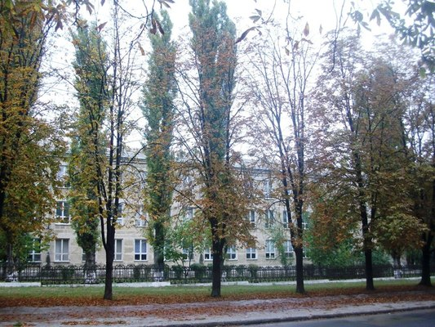
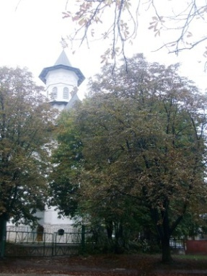
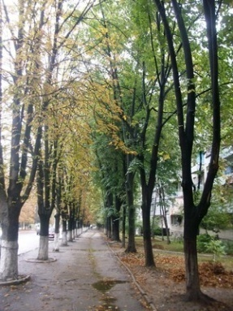
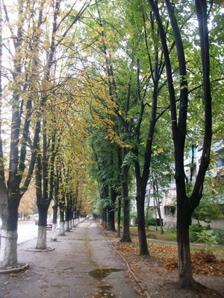
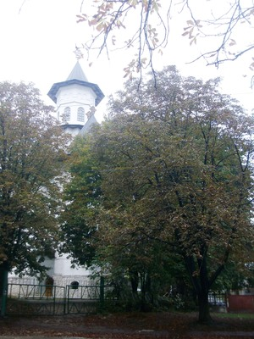

Slide 10
w
e
a
t
h
e
r
m
a
p

Slide 11
Poland Oleśnica
landscape photos

Slide 12
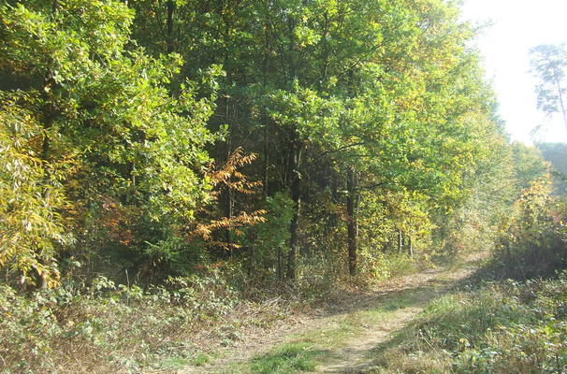
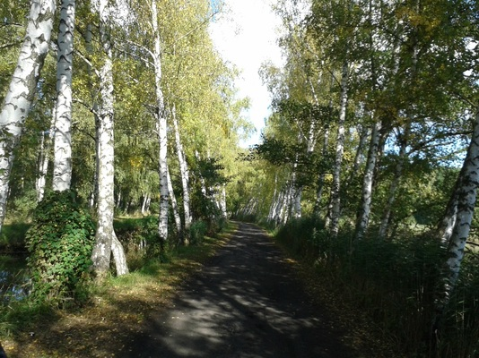
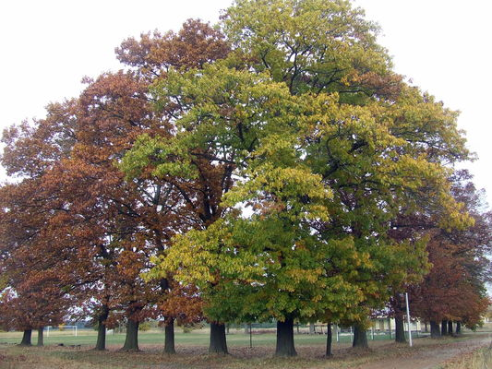

Slide 13
w
e
a
t
h
e
r
m
a
p

Slide 14
Poland Pogwizdów
landscape photos

Slide 15
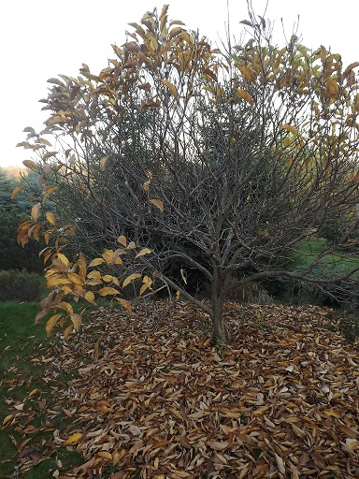
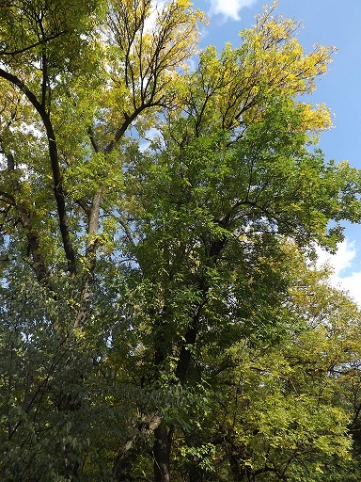
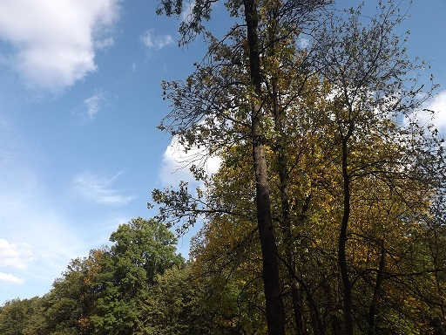

Slide 16
w
e
a
t
h
e
r
m
a
p

Slide 17
Romania
landscape photos

Slide 18
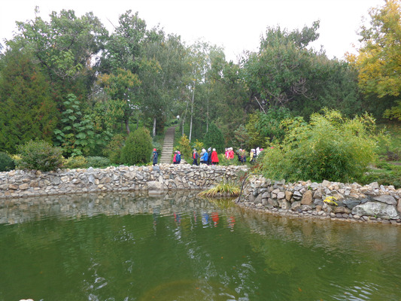
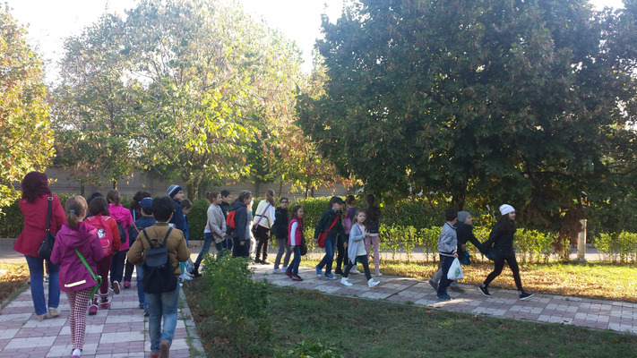

Slide 19
w
e
a
t
h
e
r
m
a
p

Slide 20
Turkey (Necla)
landscape photos

Slide 21
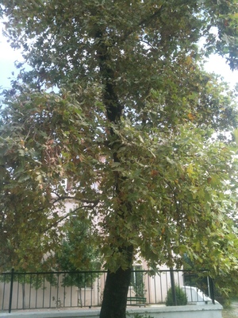
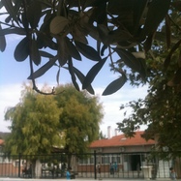

Slide 22
w
e
a
t
h
e
r
m
a
p

Slide 23
Poland Warszawa
landscape photos

Slide 24
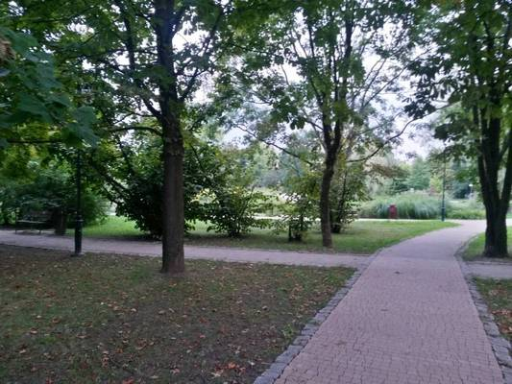
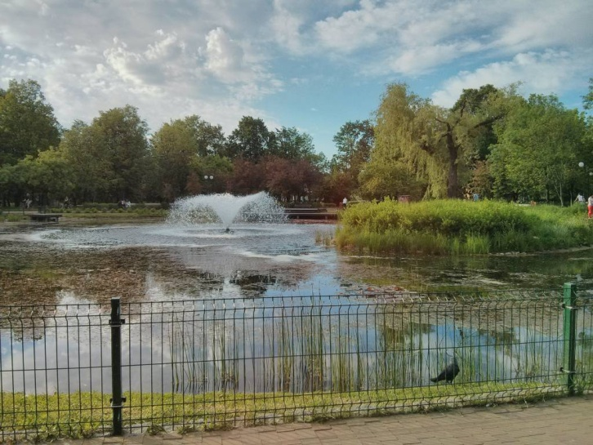

Slide 25
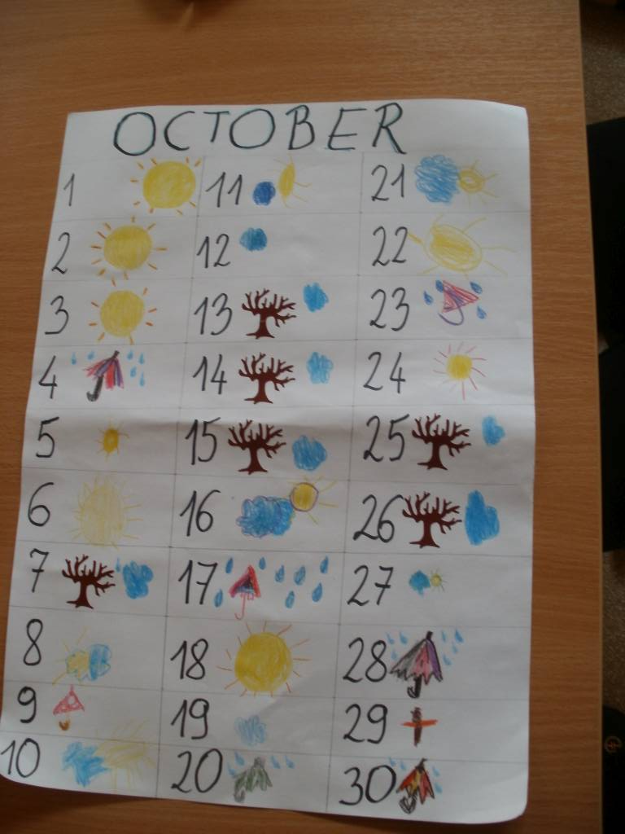
w
e
a
t
h
e
r
m
a
p

Slide 26
Turkey (Sevil)
landscape photos

Slide 27
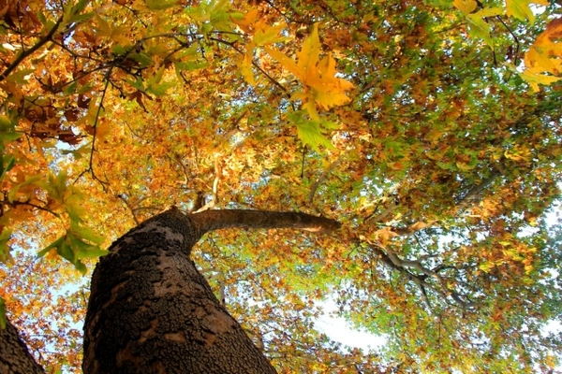
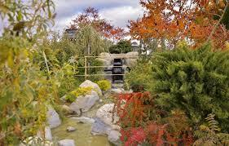

Slide 28
w
e
a
t
h
e
r
m
a
p

Slide 29
Answer the questions:
1.How many photographs are the ducks?
2.Where is the monument of Chopin? (country, city)
3.Where it is most of the fallen leaves under the tree? (country, city)
4.Where are the birches along the way? (country, city)
5.Where was the highest temperature? (country, date)
6.Where was the lowest temperature? (country, date)
7.Where most of the sun was shining? (country, number of days)
8.Where it was raining? (countries)
9.Where most windy? (country, number of days)
For the 3 best students from each country - the diplomas :)

