Slide 1
LOGO – 8 COUNTRY, 8 OPTIONS
The children in your schools vote for one logo

Slide 2
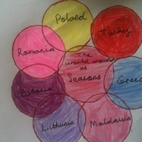
A)

Slide 3
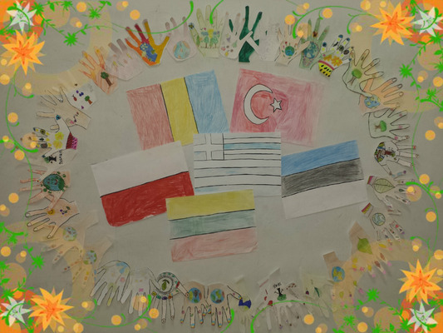
B)

Slide 4
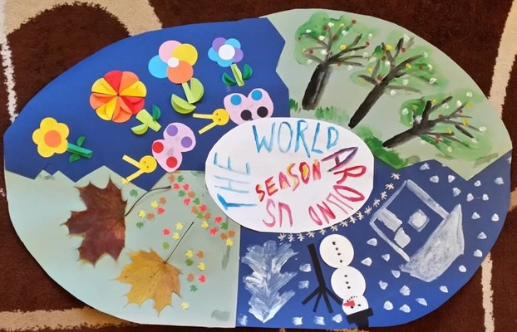
C)

Slide 5
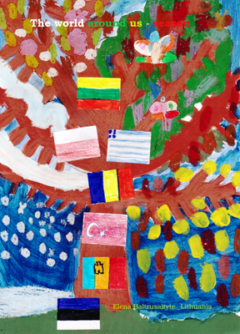
D)

Slide 6
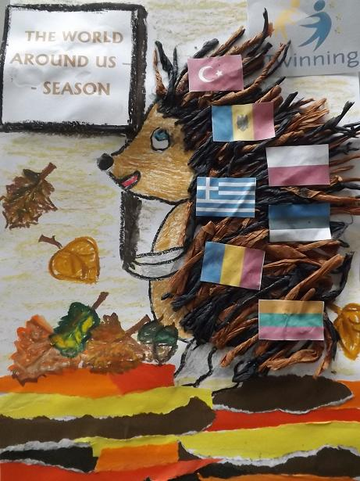
E)

Slide 7
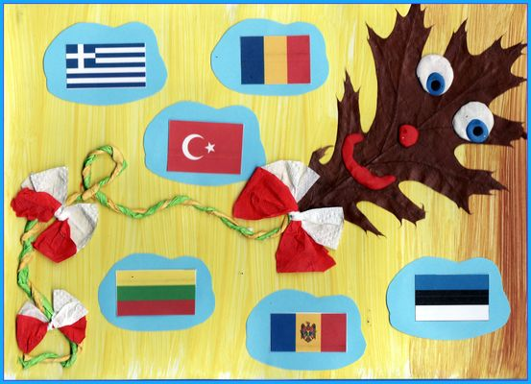
F)

Slide 8
G)

Slide 9
H)

