Slide 1
Dalaman Hurriyet Primary School
Making Origami-Origami Fox

Slide 2
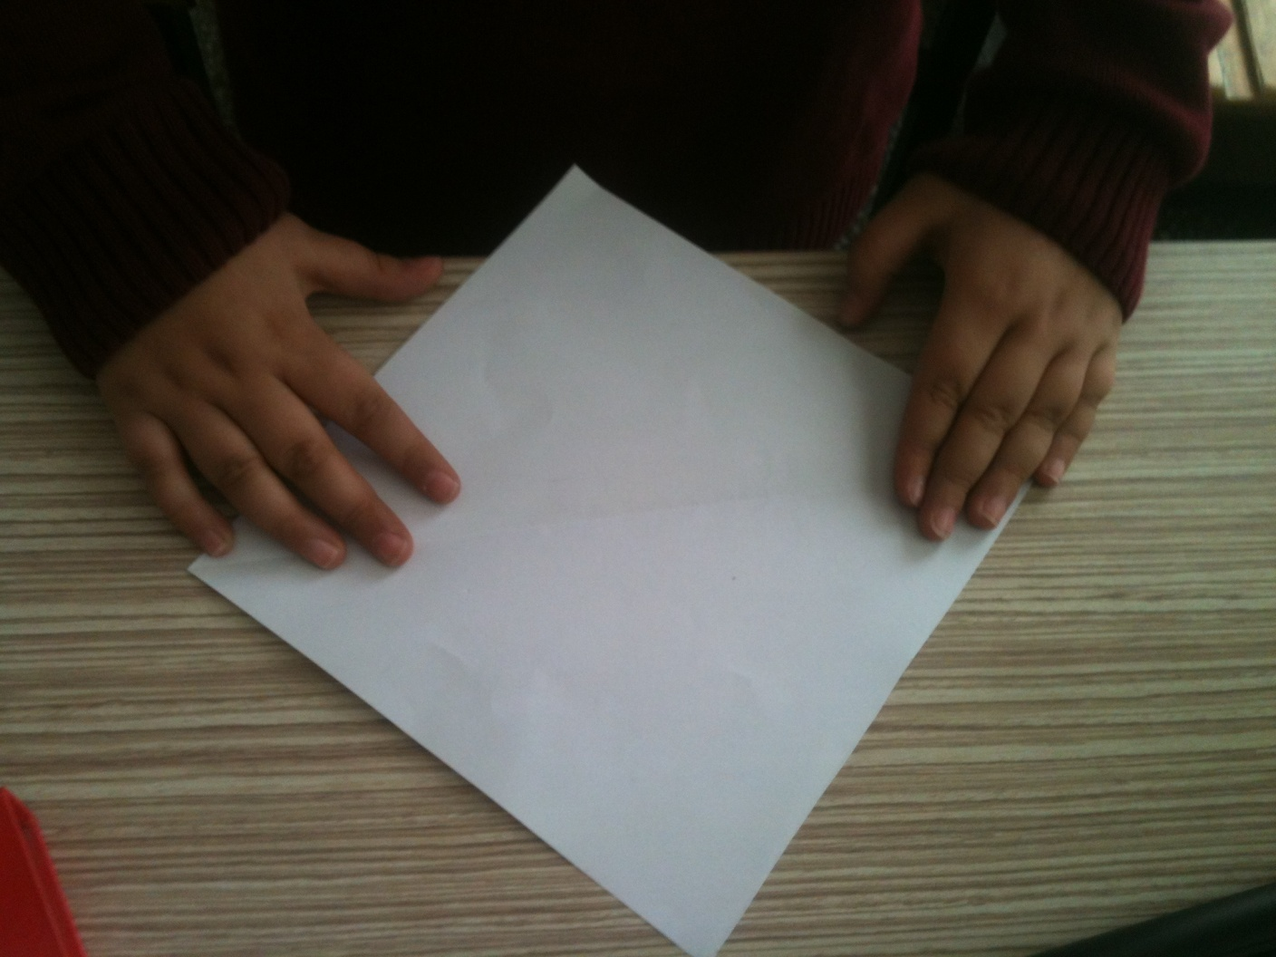
My name is Bayram Anıl.This is my origami fox.We need a paper.

Slide 3
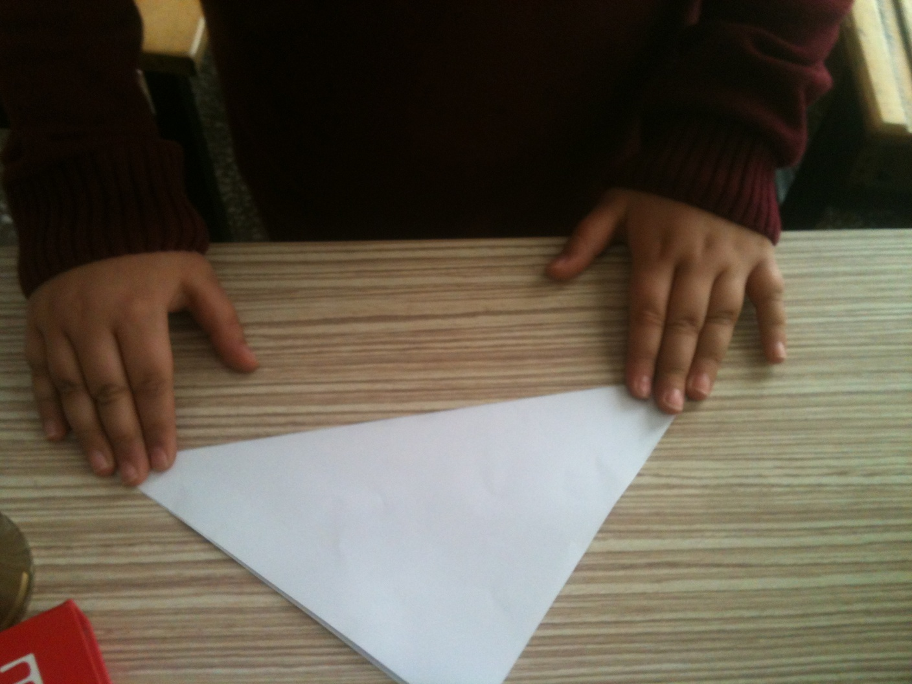
Fold up it from the corners and create a triangle.

Slide 4
Then open it..

Slide 5
Abd do the same one to other part of paper..You will have a certain lines on the paper.

Slide 6
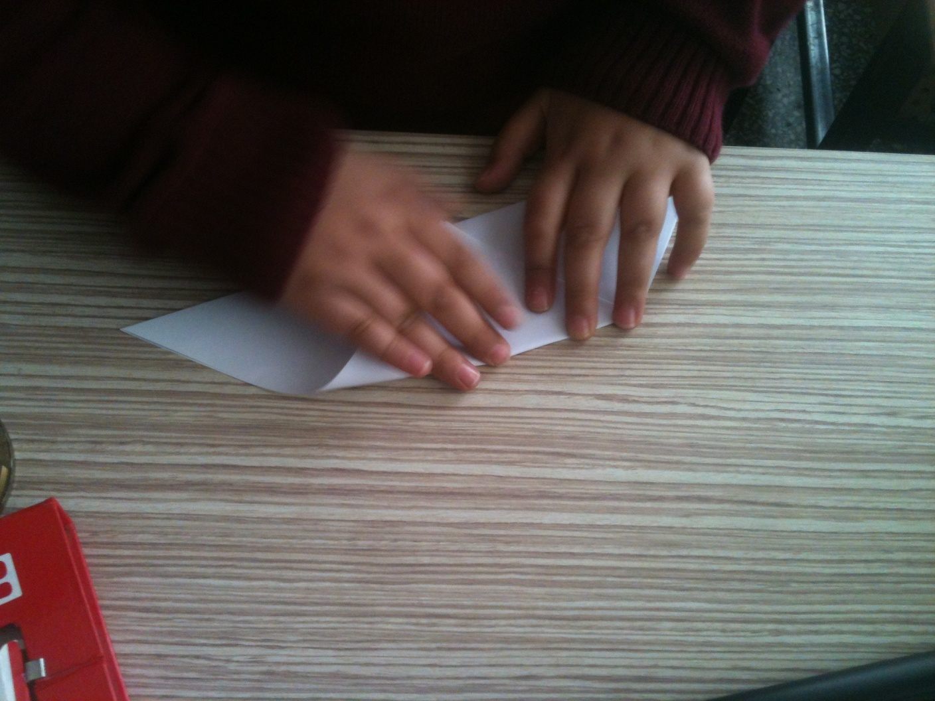
Fold the triangle as in the picture.

Slide 7
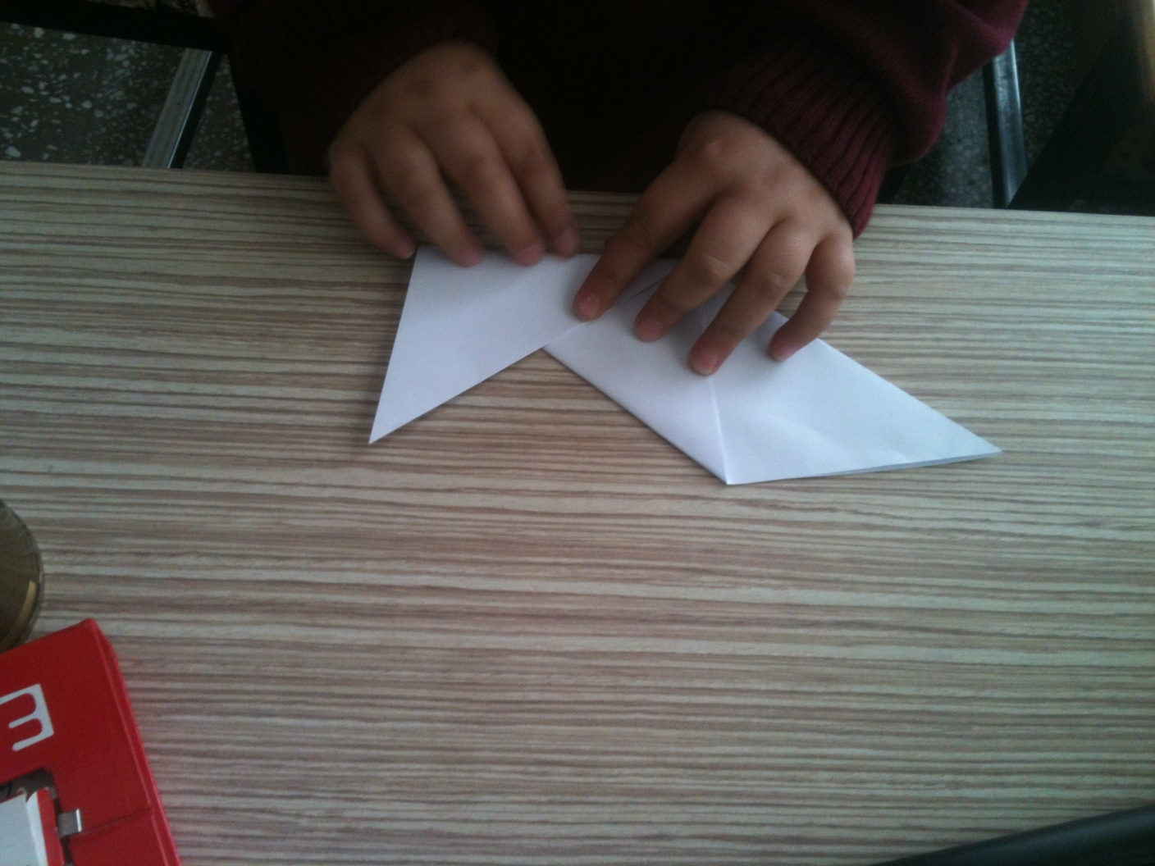
And fold the corner of triangle like the picture.

Slide 8
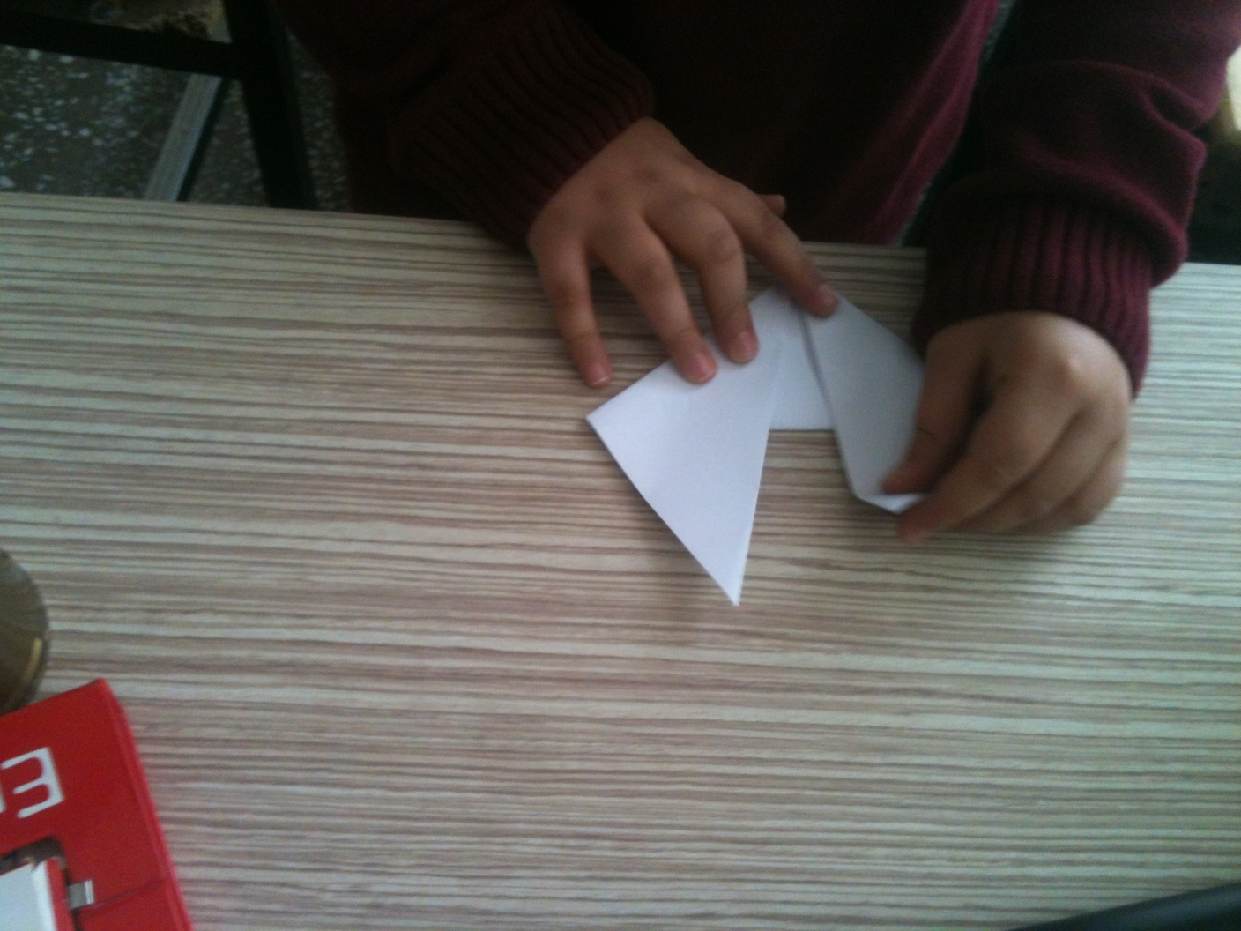
And do the same one again to other side.

Slide 9
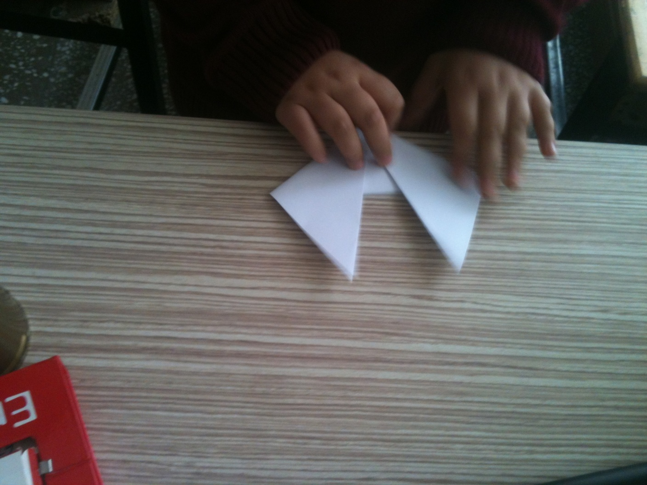
You will have a shape like this.

Slide 10
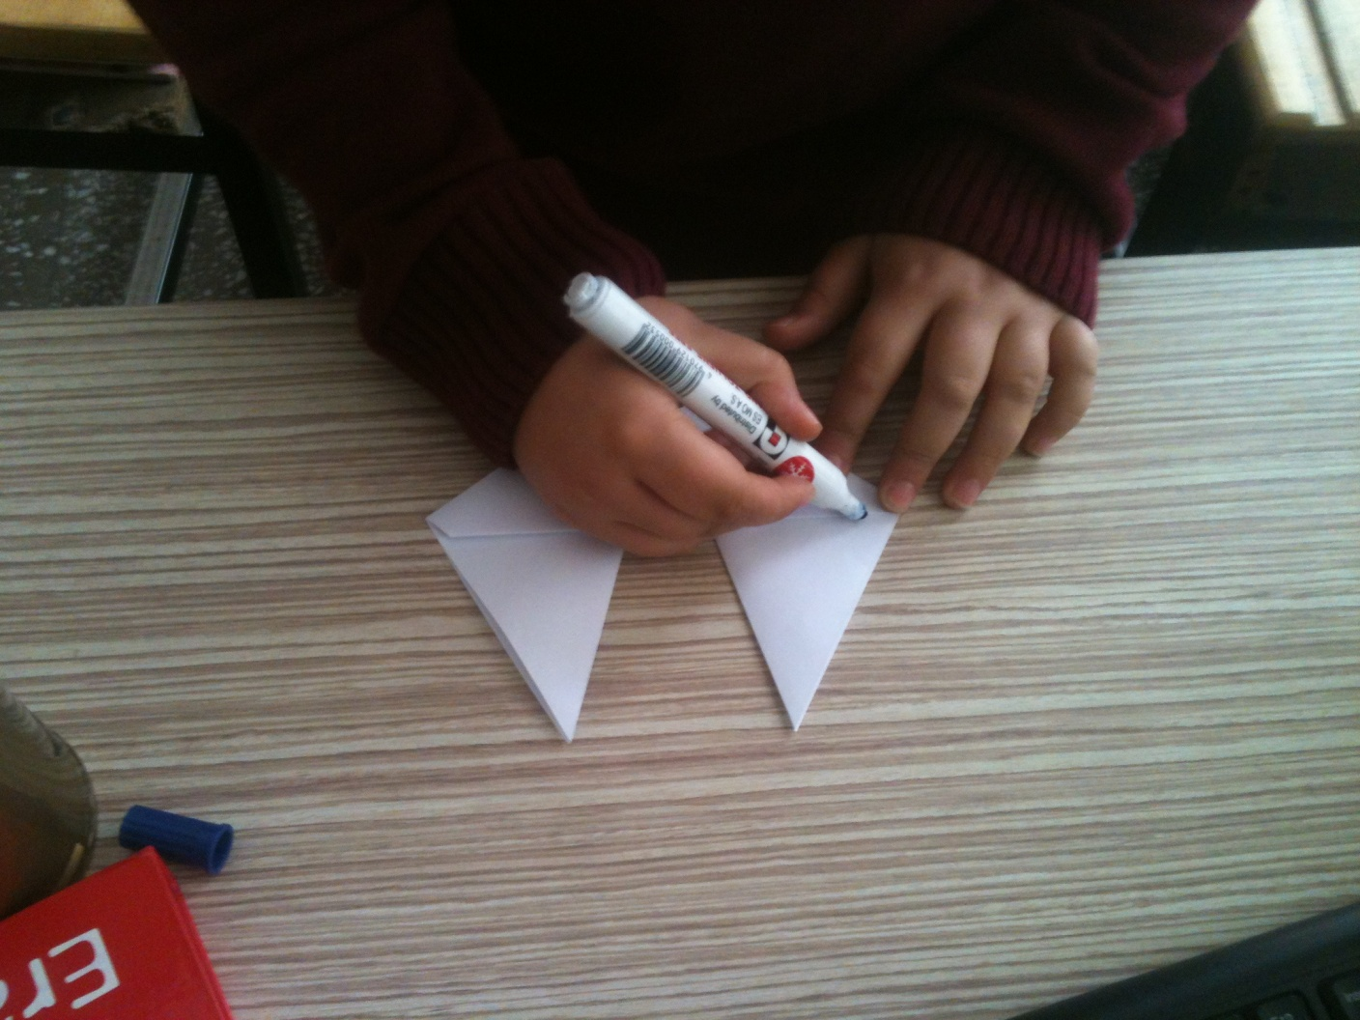
Then draw ear,mouth and eyes on it ..

Slide 11
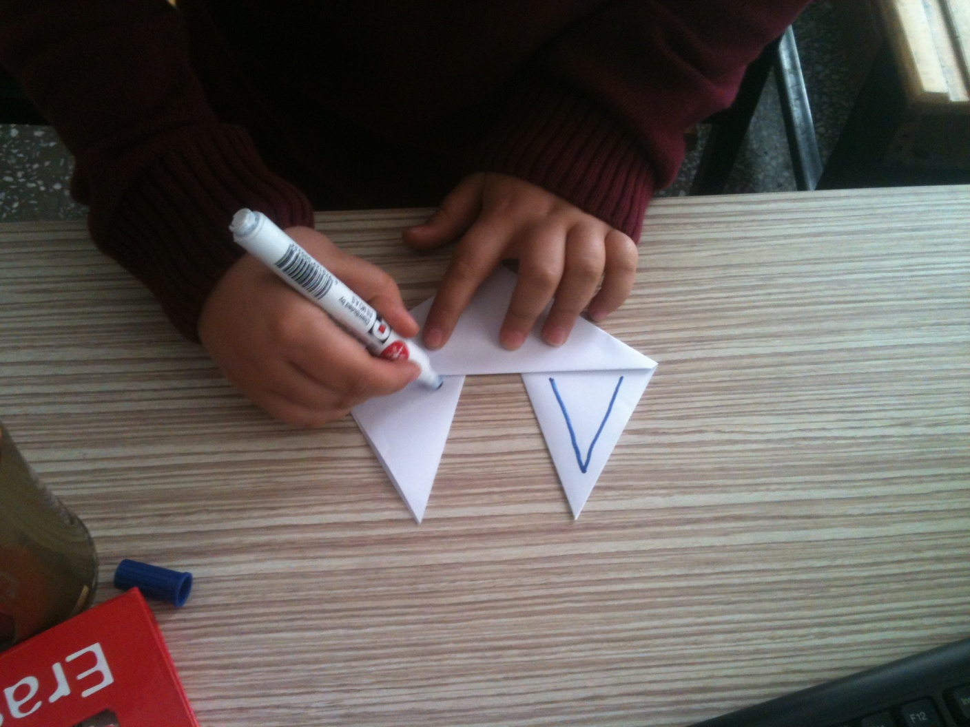
First ears..

Slide 12
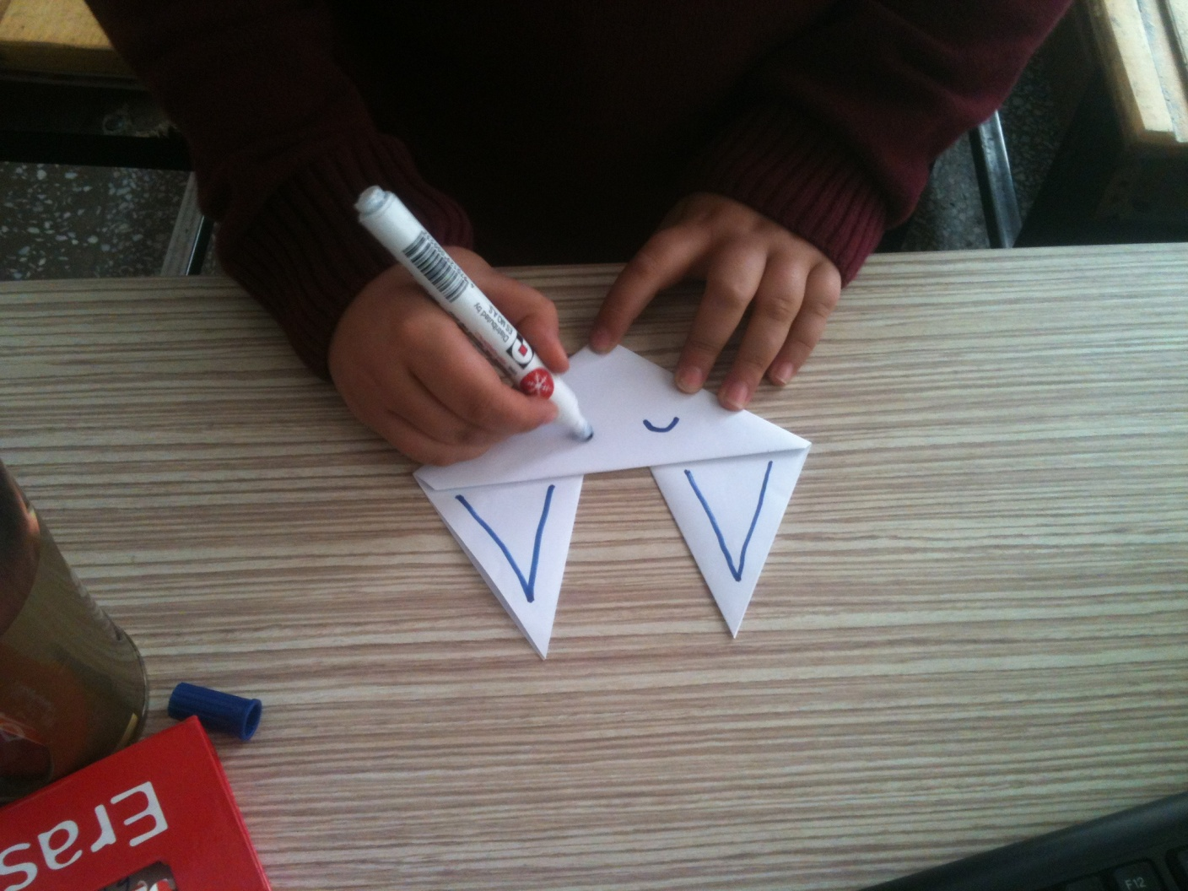
Draw two little eyes..

Slide 13
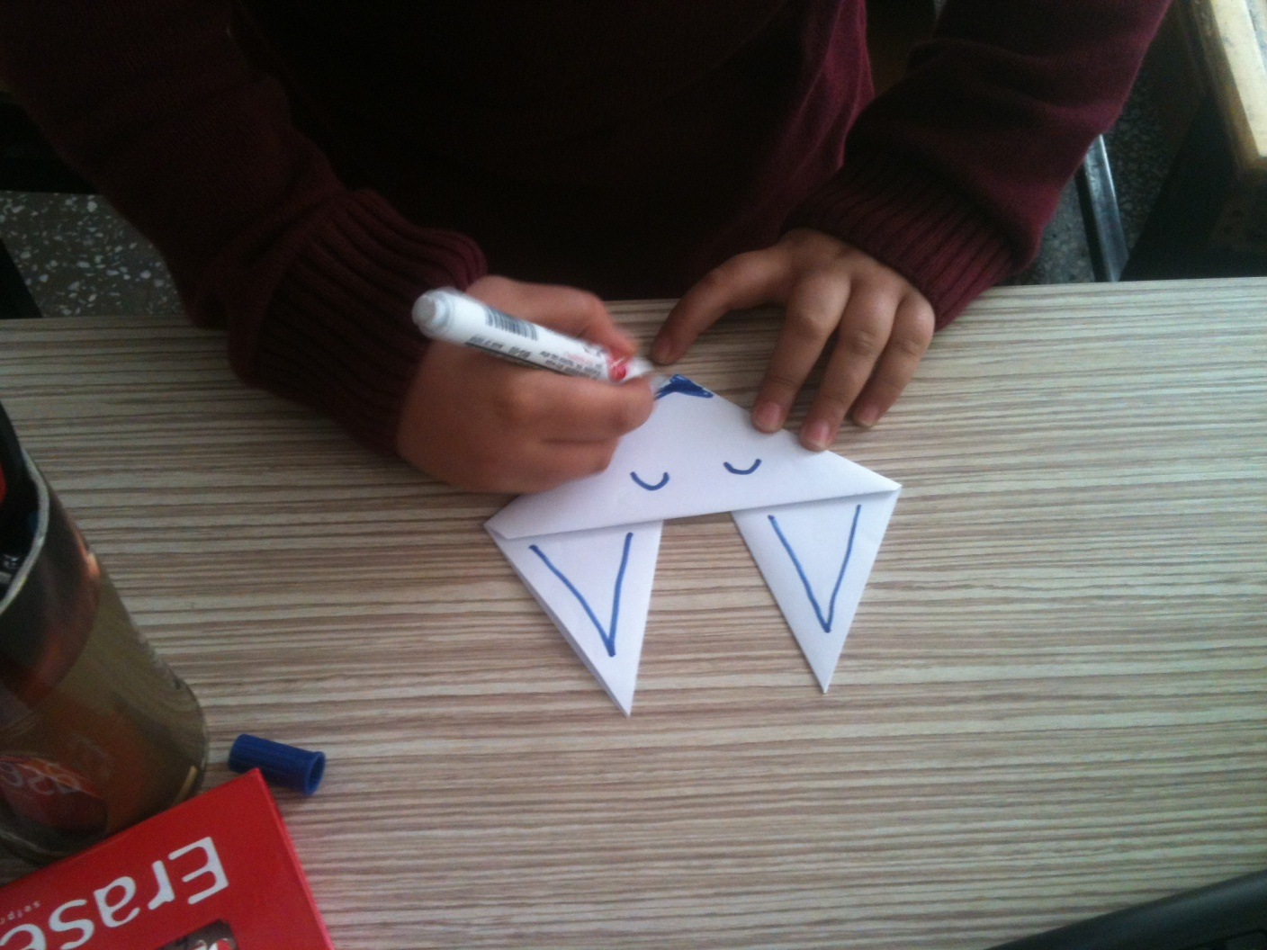
Add mouth to fox..

Slide 14
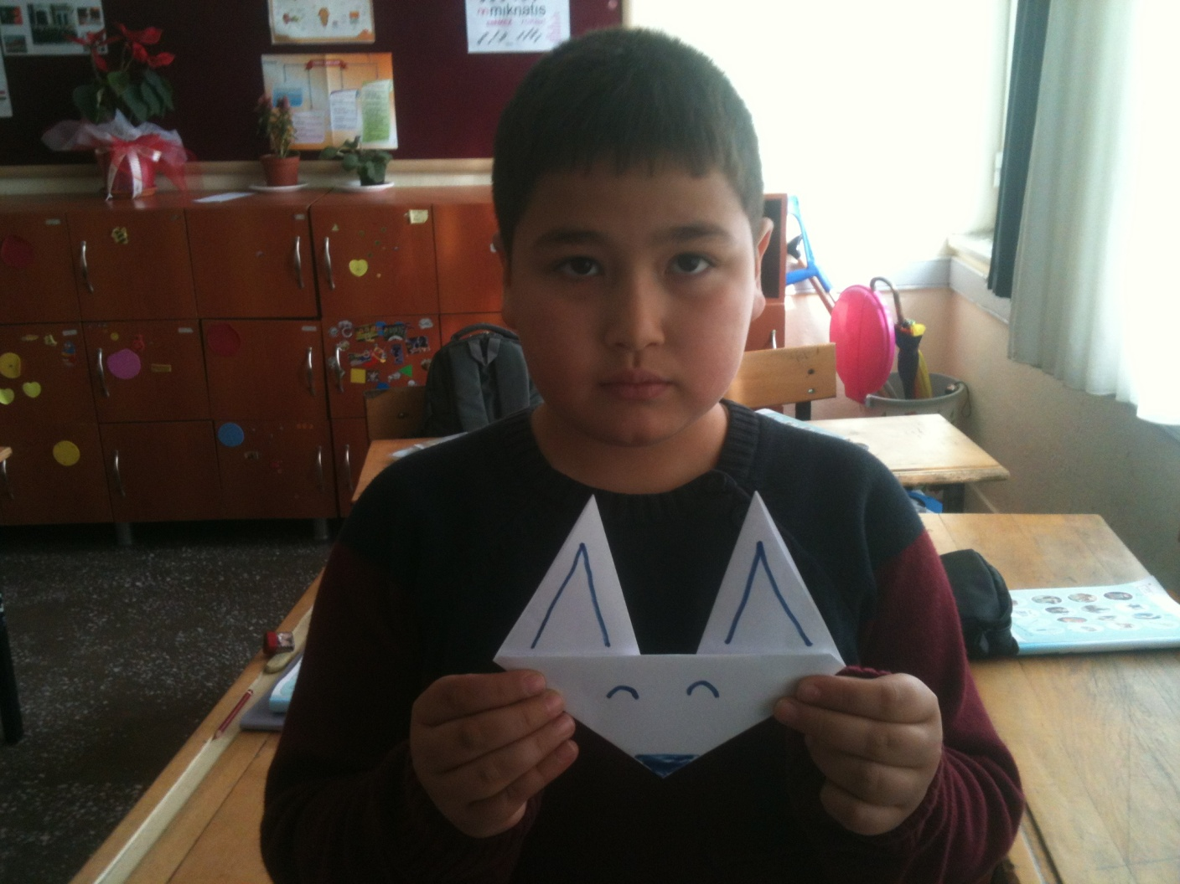
fox origami is ready..

Slide 15
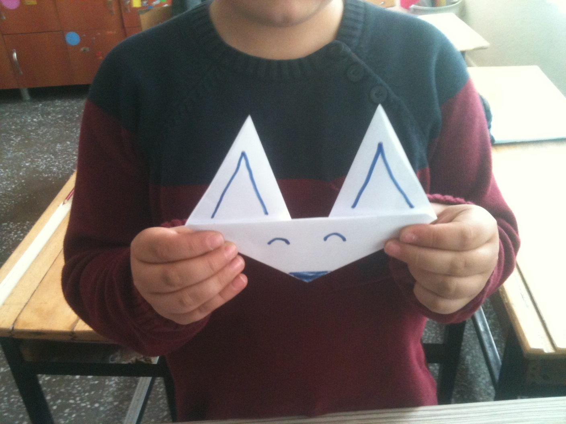
Thank you…

