Slide 1
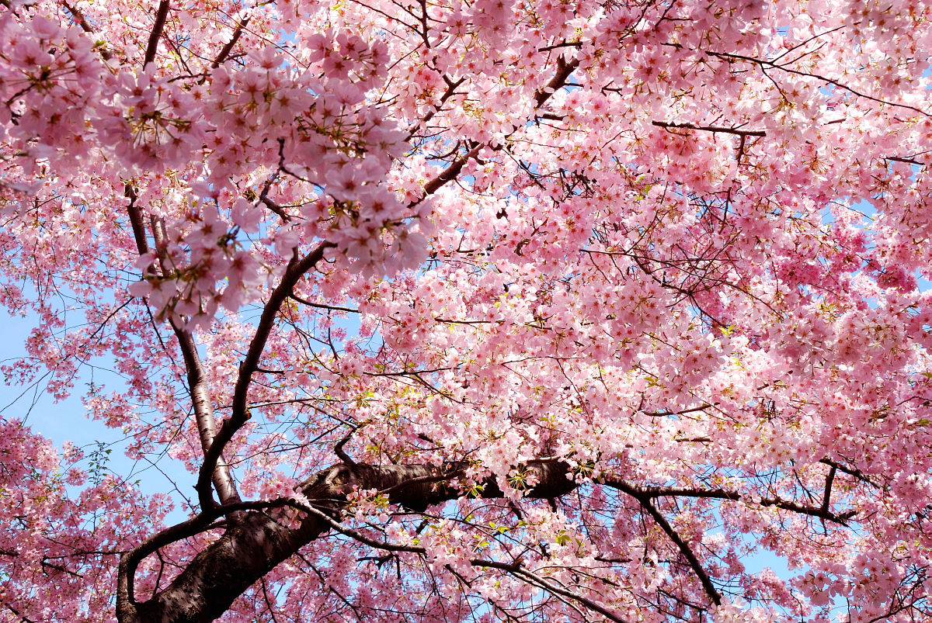
Spring Flowers

Slide 2
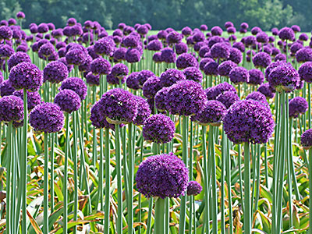
Allium
The generic name of Allium is the Latin word for garlic and there are hundreds of distinct species. As quite a hardy flower, it is popular with gardeners as it grows quite well by itself, as long as it doesn’t become water-logged. Some species are even said to have medicinal properties and are often used in home remedies.

Slide 3
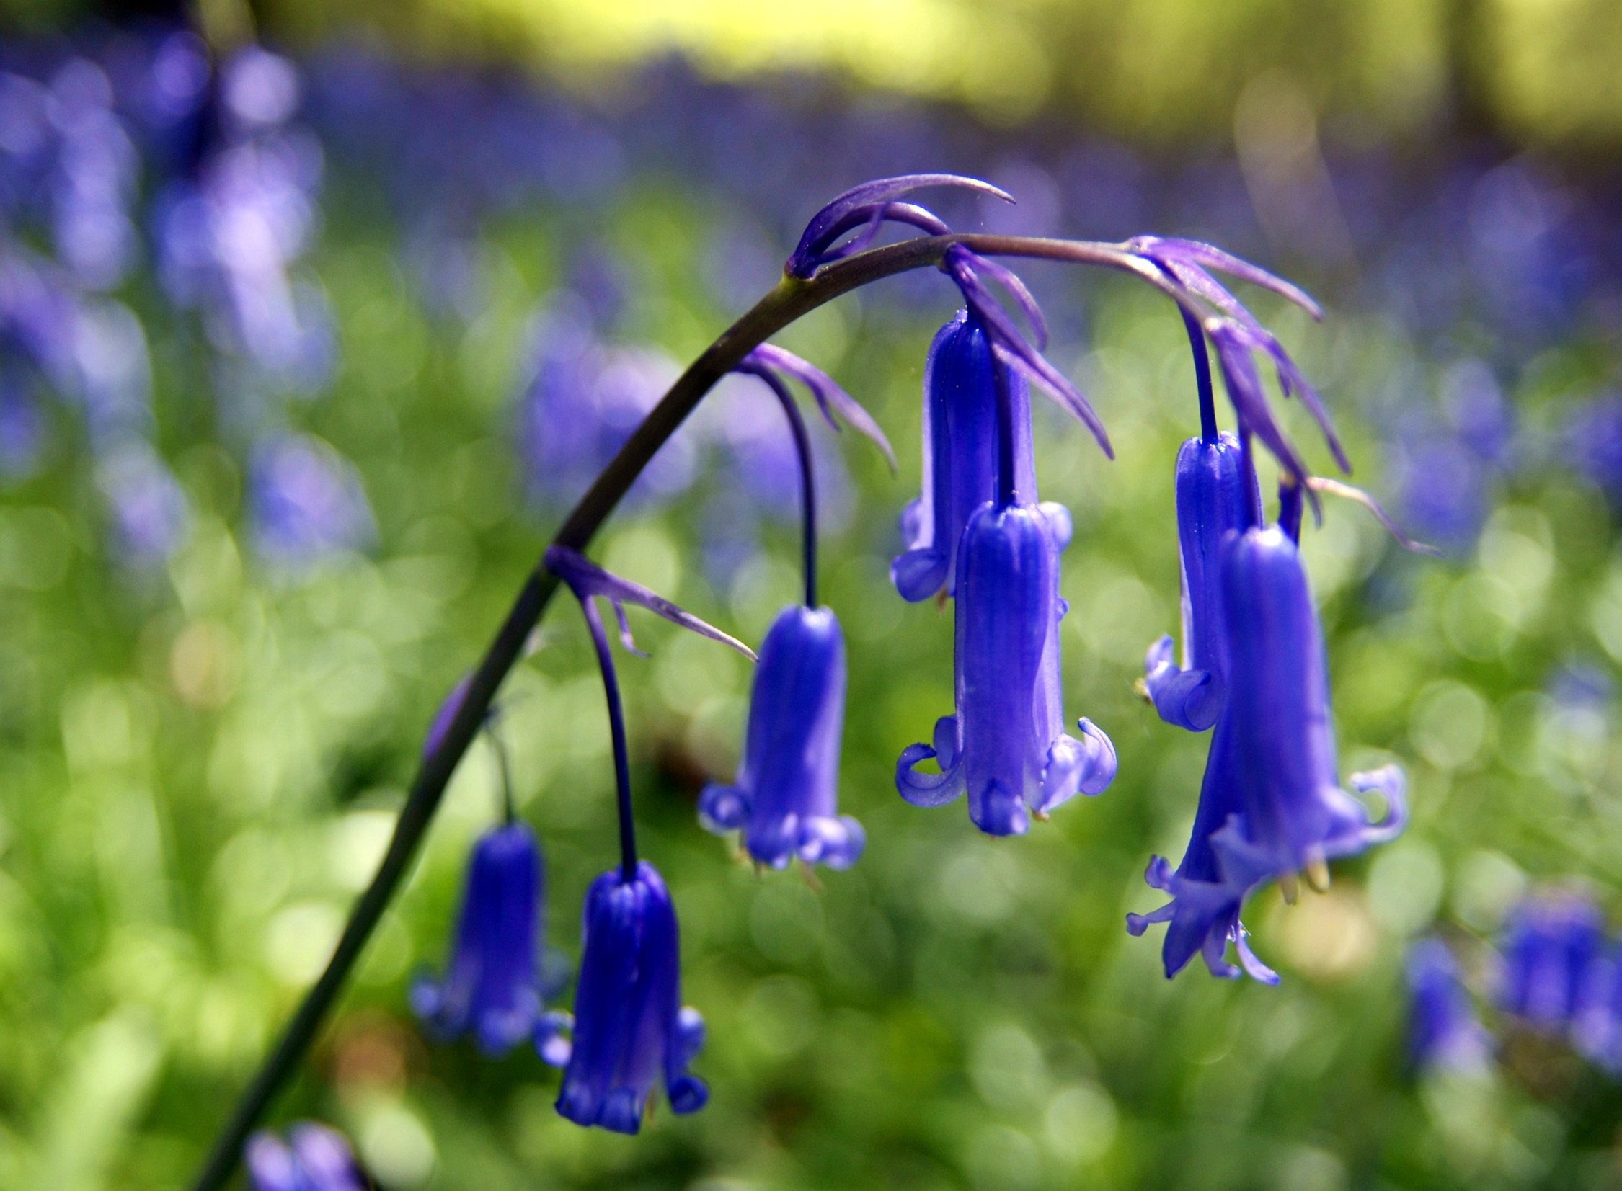
Bluebell
Bluebell flowers are dainty bulbous perennials that provide a profusion of color ranging from deep purple to pinks, whites and blues from April to mid May. Although some confusion may arrive from various English and Latin names, most bluebells are also known as wood hyacinths.

Slide 4
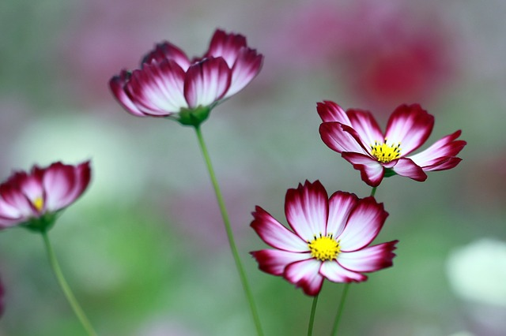
Cosmos
Cosmos are annuals, grown for their showy flowers. The flower heads may be bowl– or open cup–shaped and are atop of long stems. Cosmos are easy to grow and make good border or container plants. They make for good decorations in flower arrangements and also attract birds, bees, and butterflies to your garden.

Slide 5
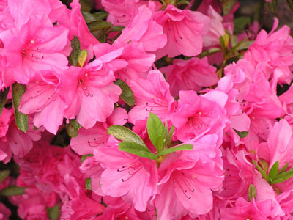
Azalea
Azaleas are flowers that grow on bushes belonging to the class of plants called rhododendrons, which consist of a variety of trees and shrubs. Azalea bushes are smaller in size than other plants in this class and azalea flowers bloom in an assortment of colors.

Slide 6
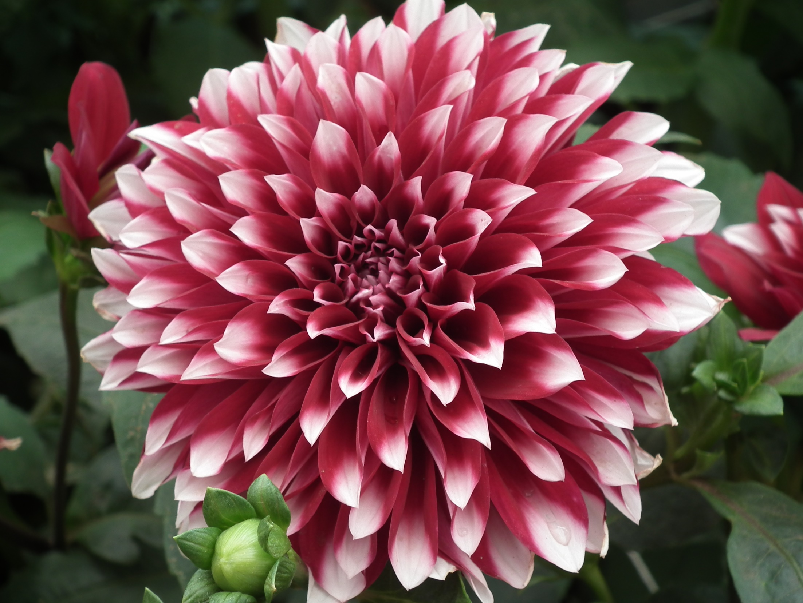
Dahlia
The dahlia hybrids are most often seen as garden plants. Anders Dahl was an 18th-century Swedish botanist for whom the Dahlia flower is now named after.

Slide 7
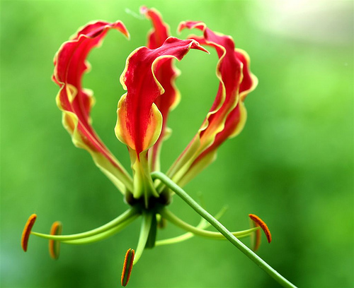
Glory Lilies
Known in Hindi as Kalihari, the glory lily (Gloriosa superba L.) is a vine that blossoms with exotic, patterned flowers. It thrives in U..S. Department of Agriculture Plant Hardiness Zones 8 through 9, though you can grow it in other zones if you bring the tuberous roots indoors during the winter.

Slide 8
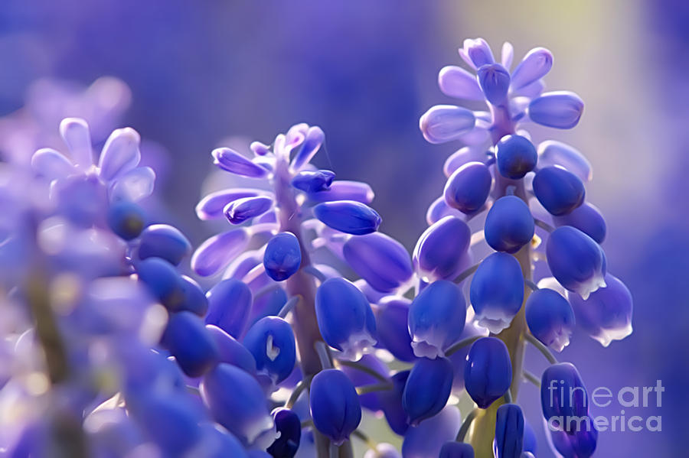
Grape Hyacinth
I learned that the original title-holders of that property tried to oust the beautiful but poisonous bulbs from their cow pasture, even to the point of stripping the field of turf, apparently without much success. So the present display, embroidering several acres, has been colonizing unchallenged for only about 25 years.

Slide 9
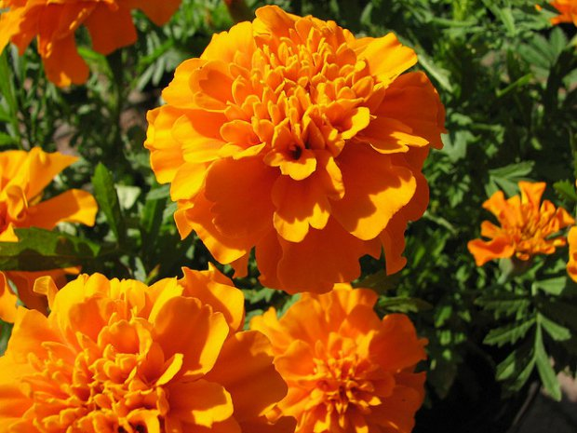
Marigolds
Marigolds are one of the most beautiful flowers in the plant kingdom. They can be grown easily and have the distinct reputation of blossoming all round the summer.

Slide 10
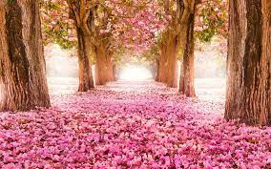
The project done by : TASO PLAFOYTZI KONSTANTINO STATHOPOYLO

