Slide 1
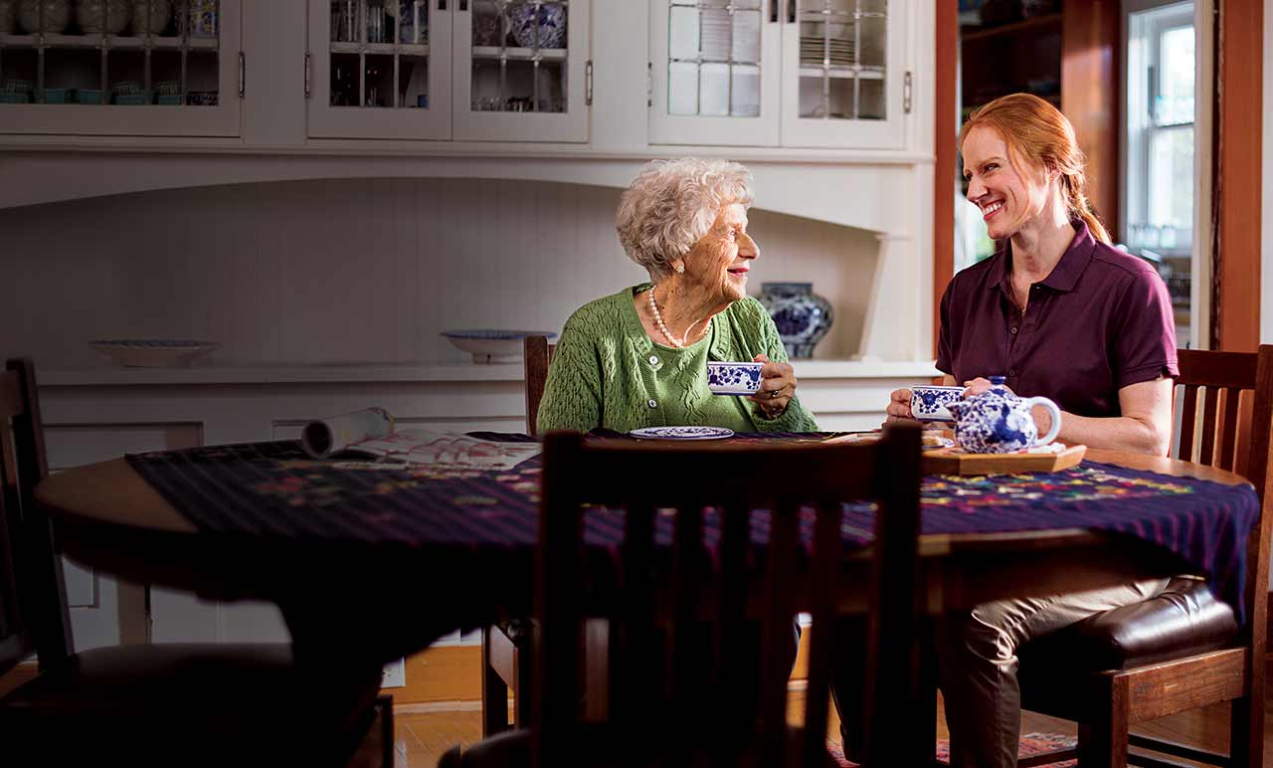
Our visit to nursing home
Prepared by: Jonava Senamiestis Gymnasium, 2d, LT
Rusanda Užalovičiūtė & Dovilė Bagočiūnaitė

Slide 2
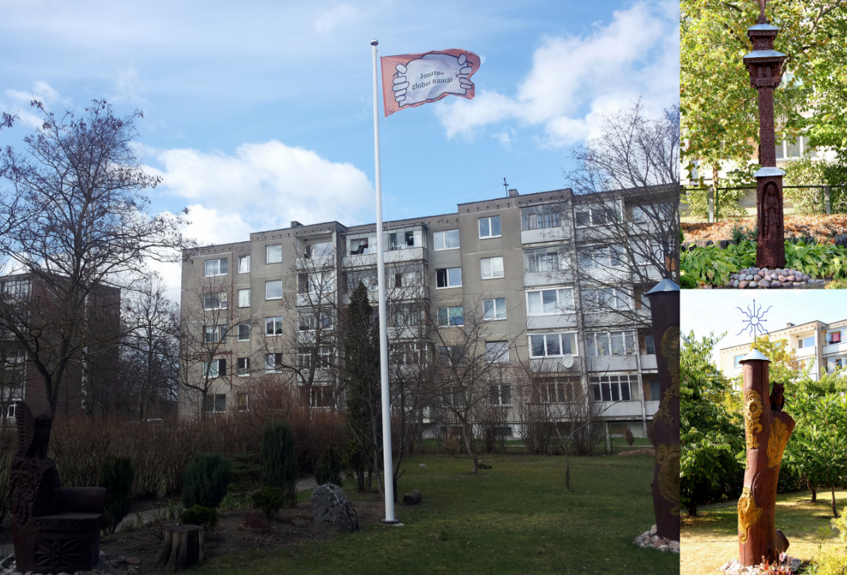
On 2016, May 10th we went to nursing home in Jonava.

Slide 3
Firstly me and Dovile met Vytautas Vilutis resident of Jonava nursing home.
Althought he is got disabled but he draw very beautiful paintings!

Slide 4
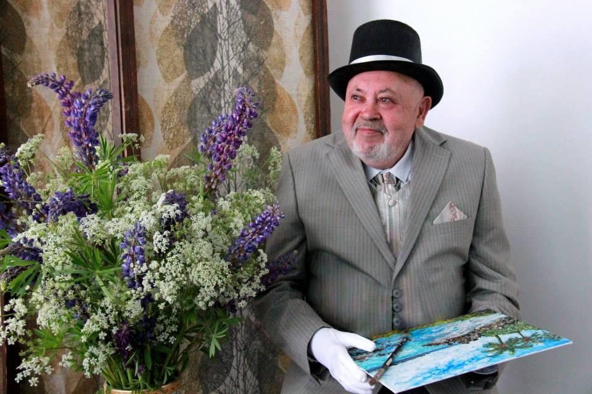
Vytautas Juozas Vilutis:

Slide 5
In 1948, when he was 5 years old, he, his mother, sister and grandmother were exiled to Siberia.
He doesn’t remembers that much, but he said that it was a very long trip to Siberia on the train for the transportation for the animals full of poor people.
However, after 7 years of exile Vytautas finally got back home to Lithuania.
When he returned to Lithuania he got married and got 2 children.

Slide 6
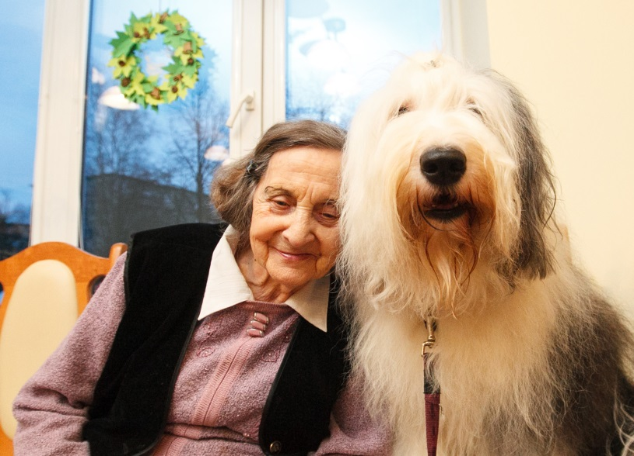
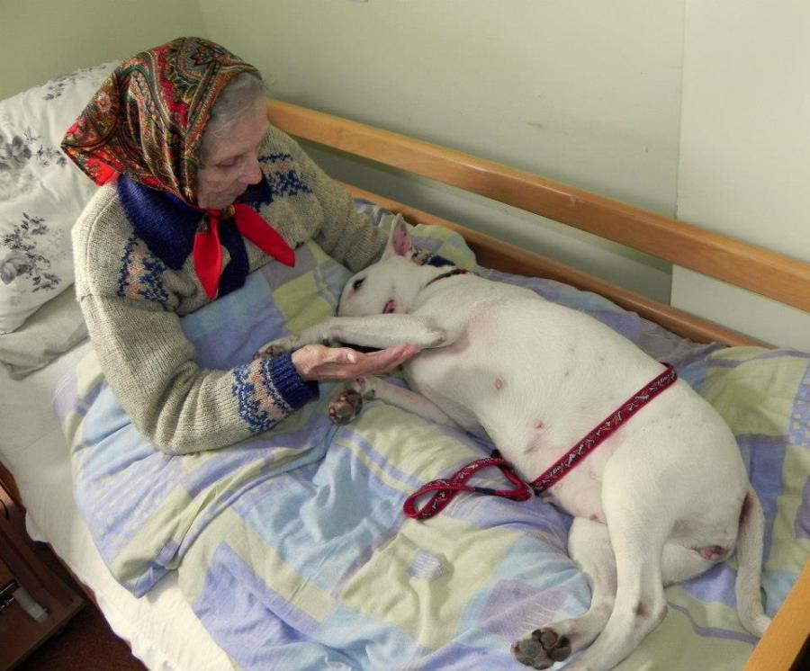
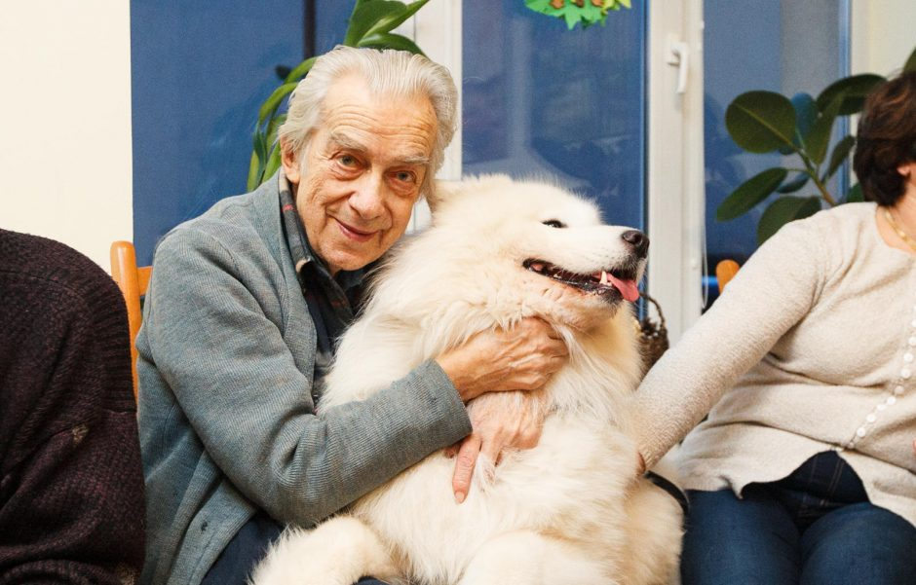
We saw a picture with him and about 6 dogs in it on his wall and asked about it.
He told us that every monday they haves dog therapy in nursing home.
He also told us that he really loves animals especially dogs but he doesn't likes cats that much.

Slide 7
When Vytautas was young man he loved singing and playing with wind instrument.
But his passion of life is drawing.
Cruelly arosed destiny sometimes takes away important things from us, but reward with something else.

Slide 8
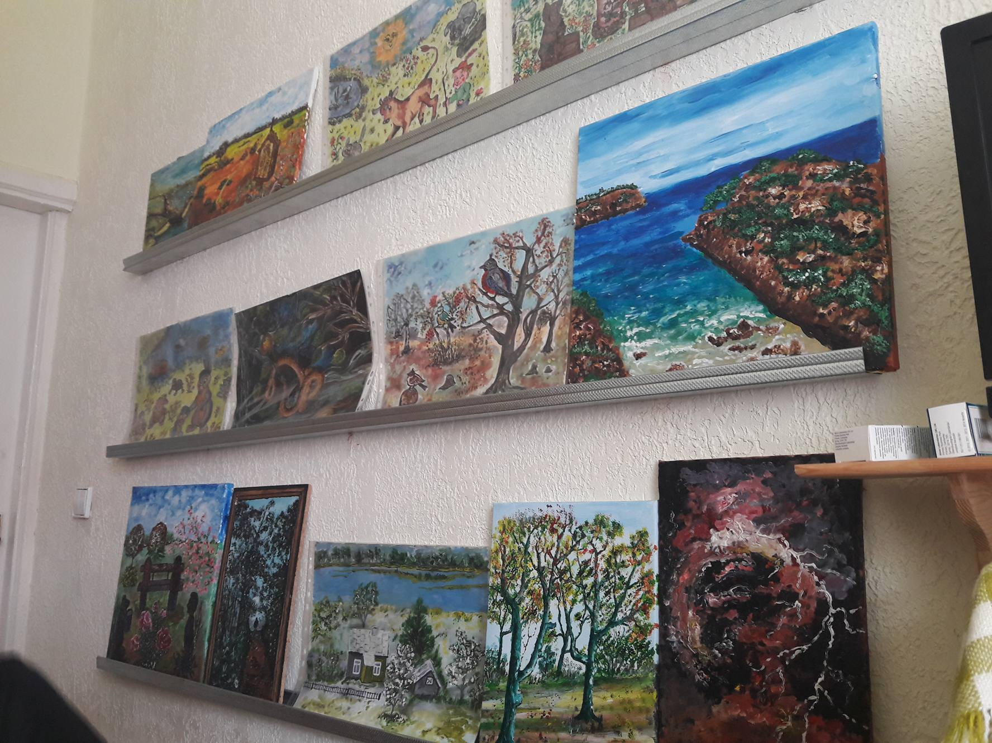
When we came to Vytautas room we saw a lot of his beautiful drawings.

Slide 9
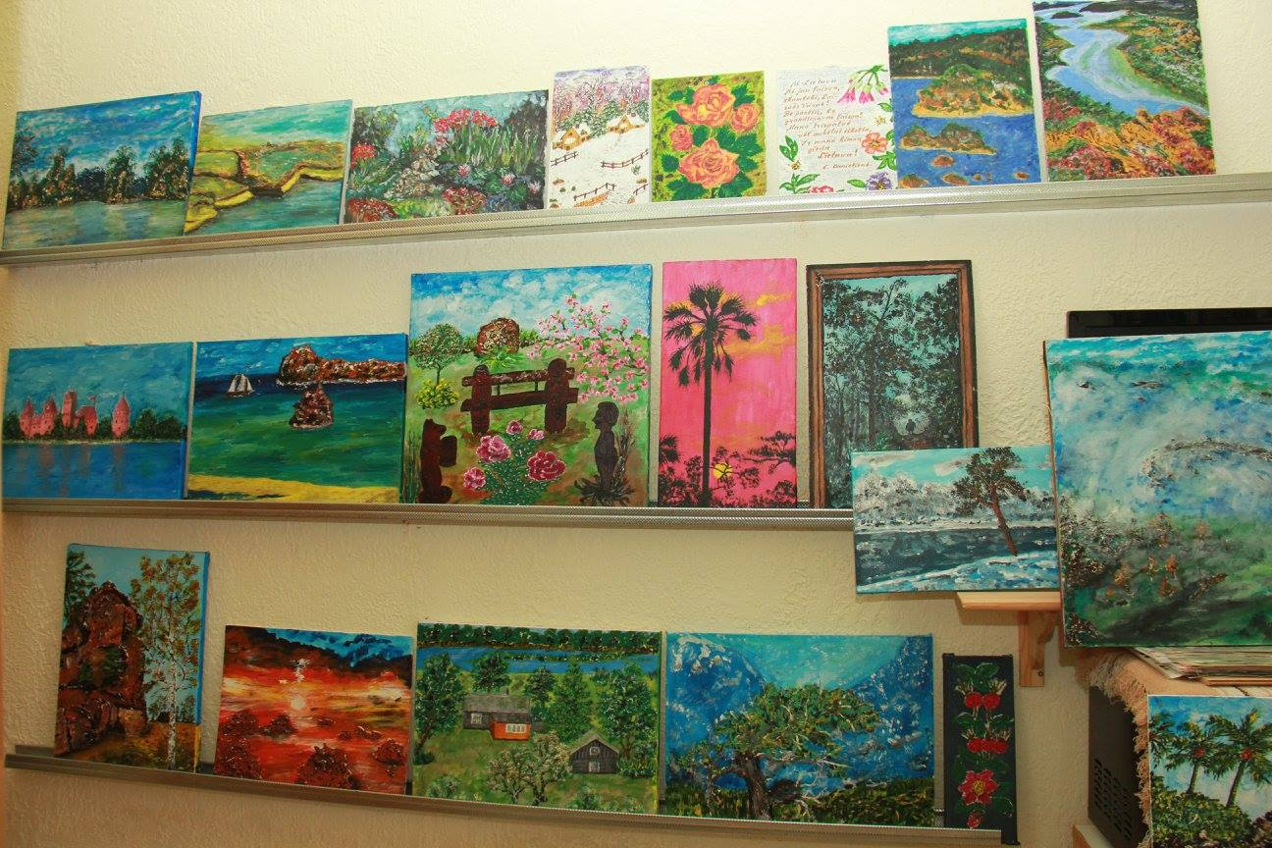

Slide 10
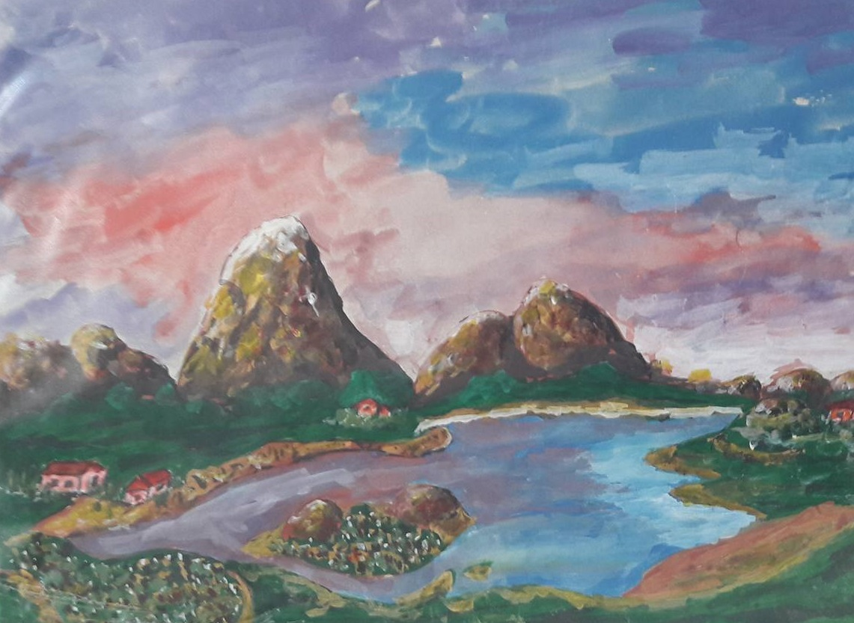

Slide 11
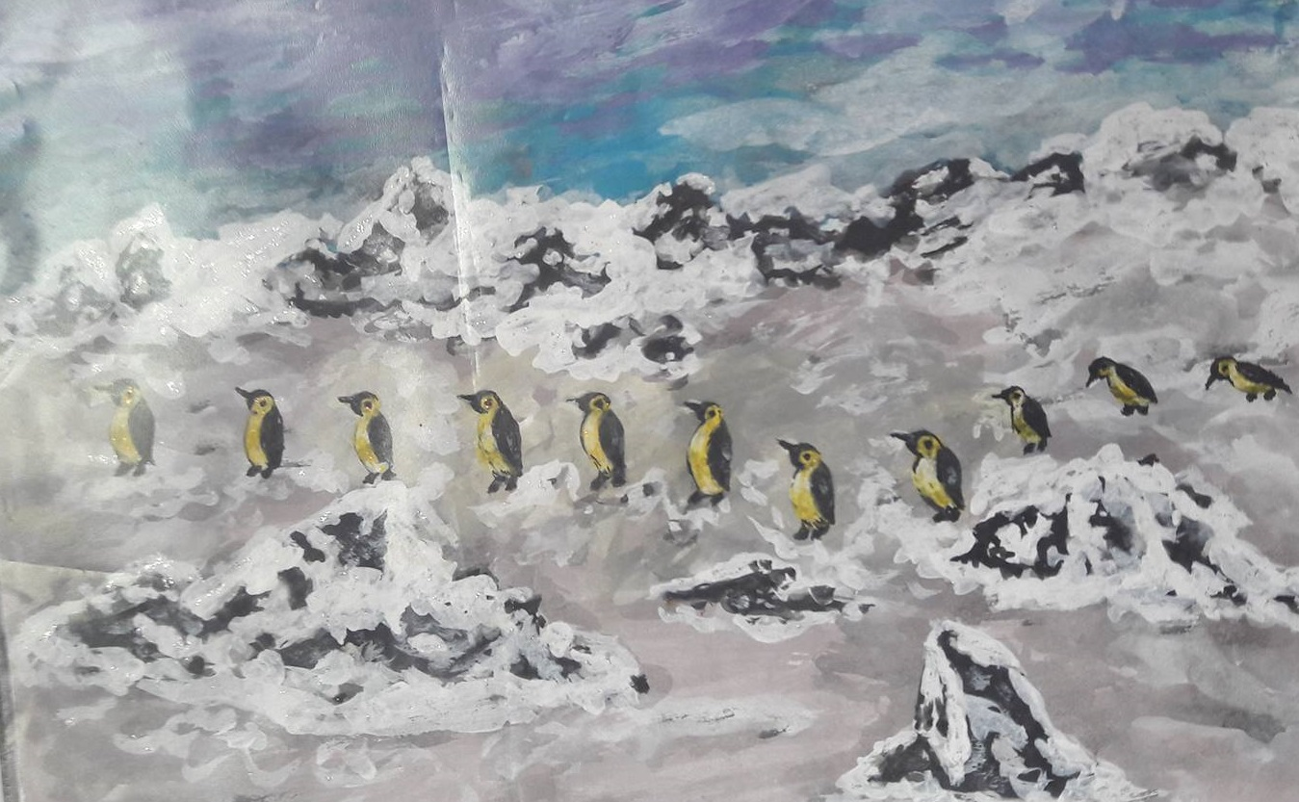

Slide 12
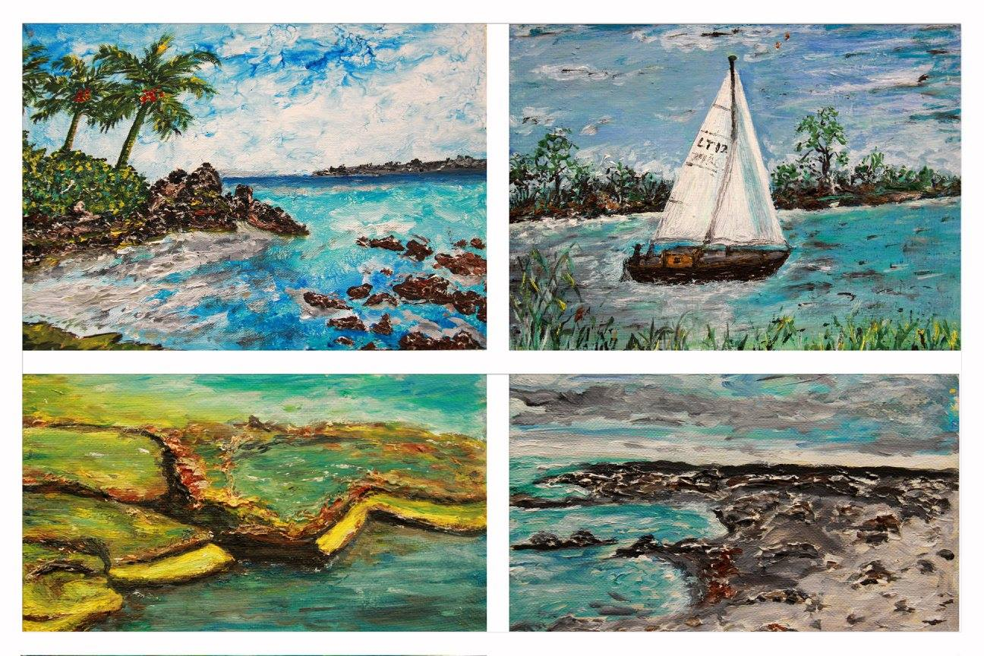

Slide 13
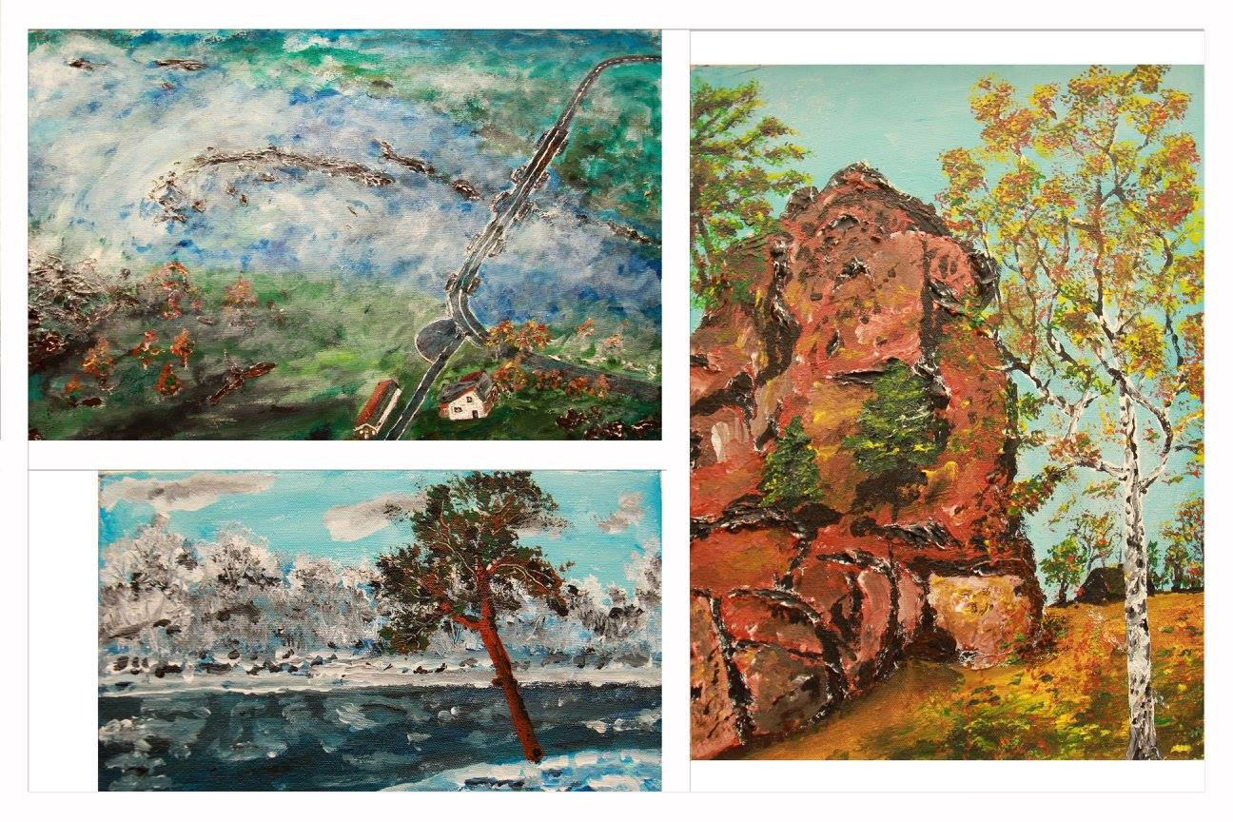

Slide 14
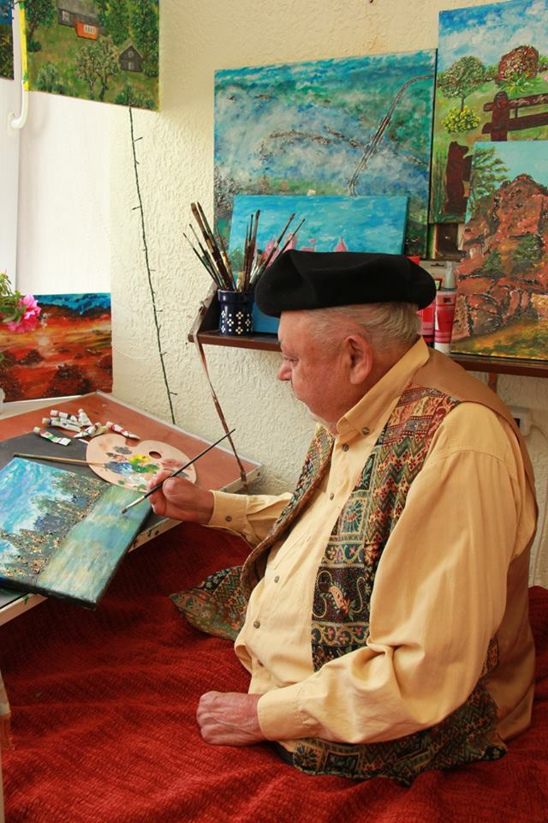
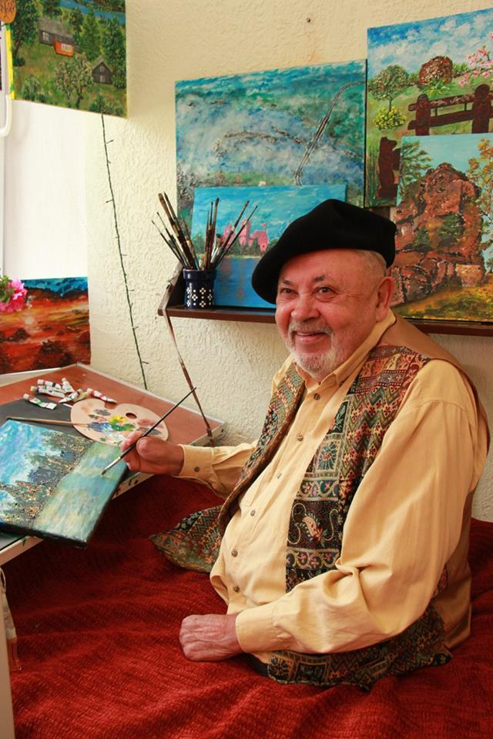

Slide 15
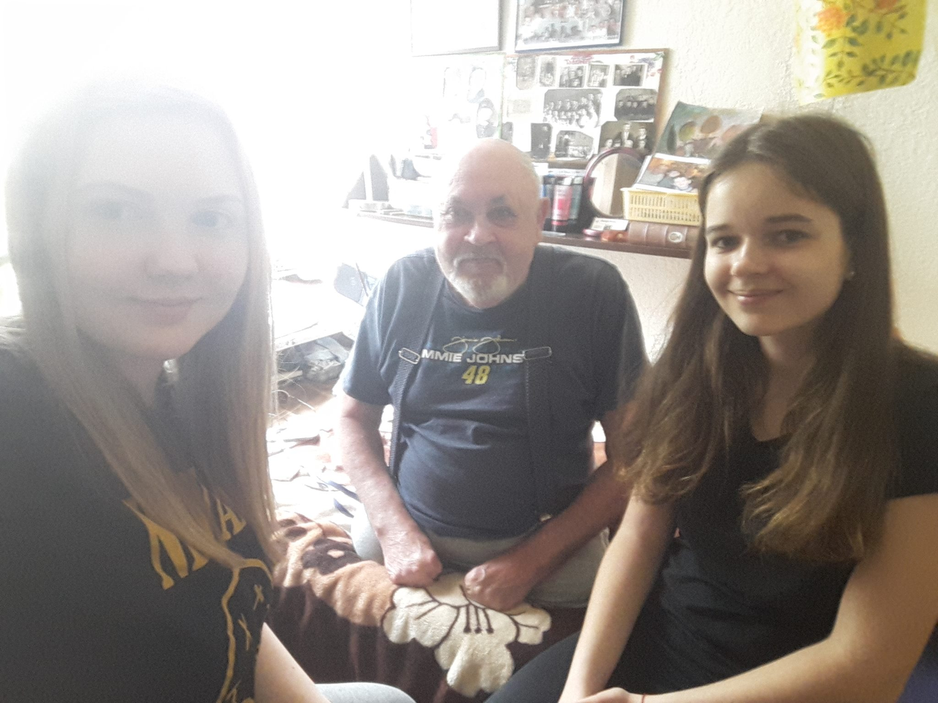

Slide 16
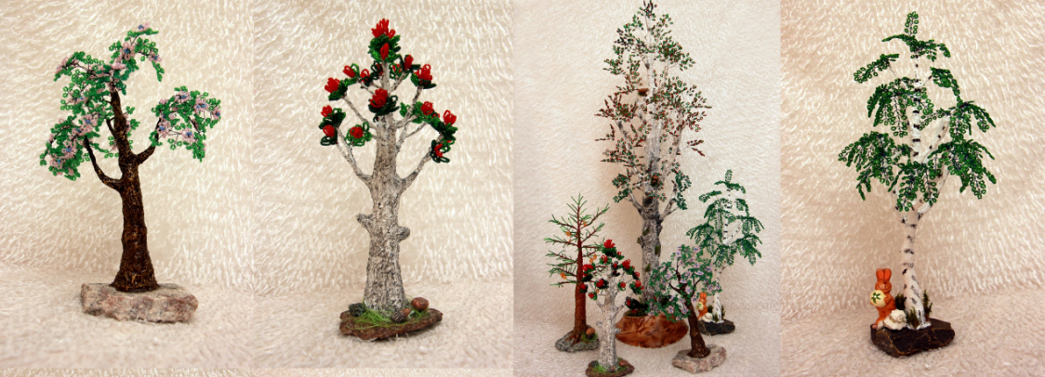
In nursing home we saw beautiful handmade trees
(they were made from beads, wire, wood and paint).
We asked nurse who made those beautiful trees and she told us that in nursing home there's a woman who made all kinds of handicrafts.

Slide 17
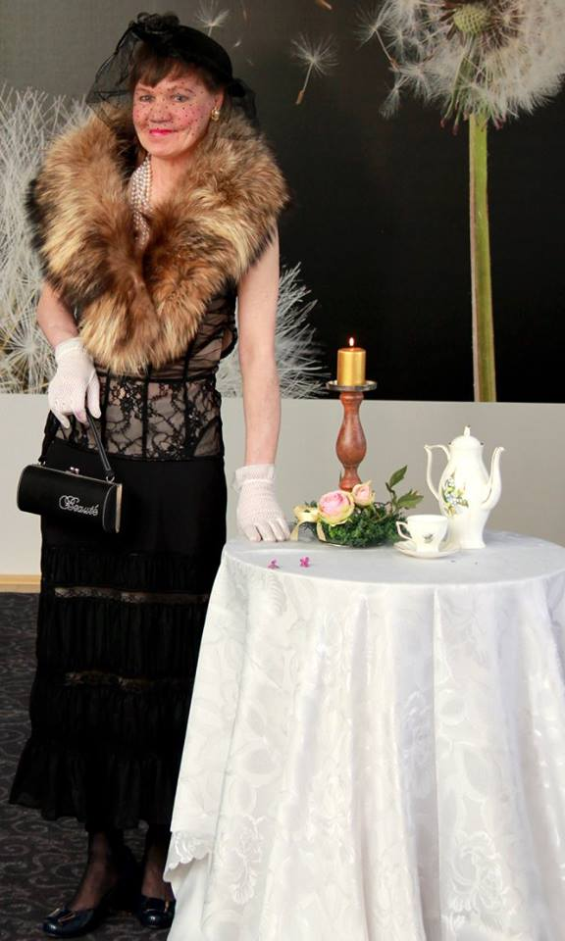
Her name is Zita and she is 53 years old.
She told us her hobby requires a lot of patience and time, but she really likes it.

Slide 18
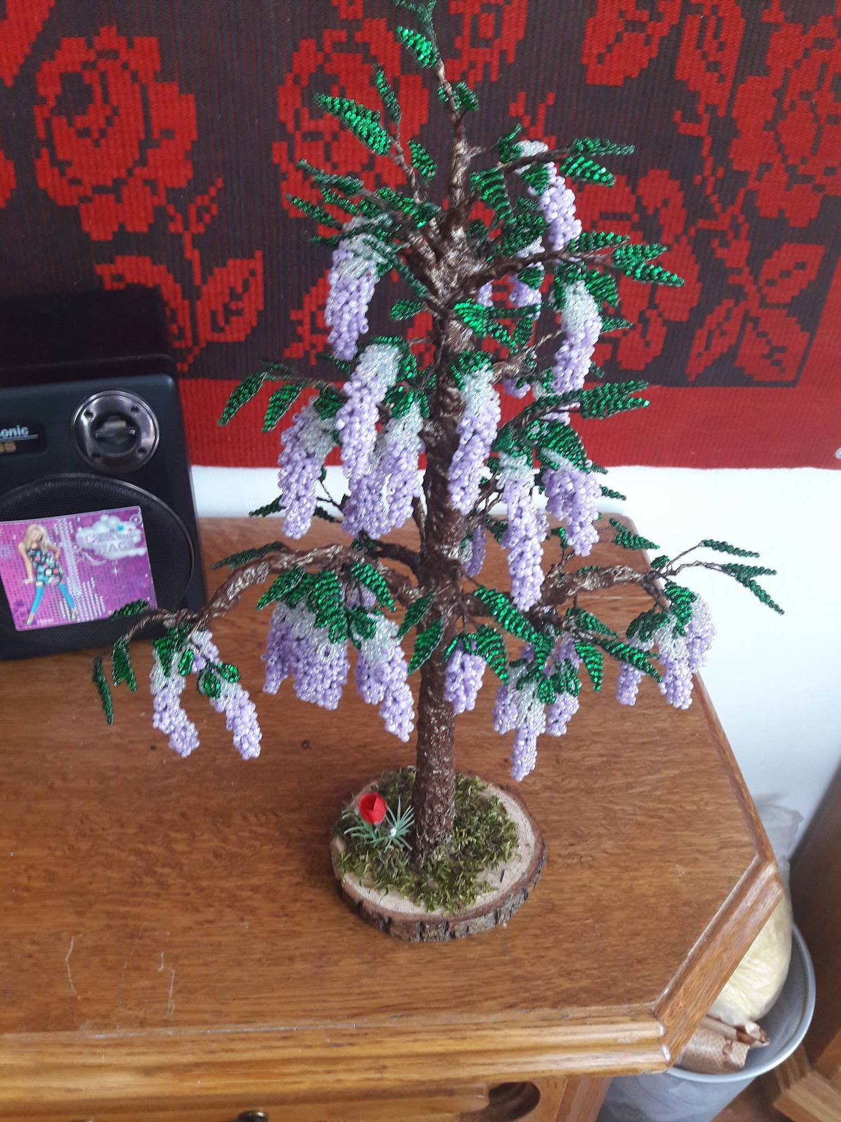
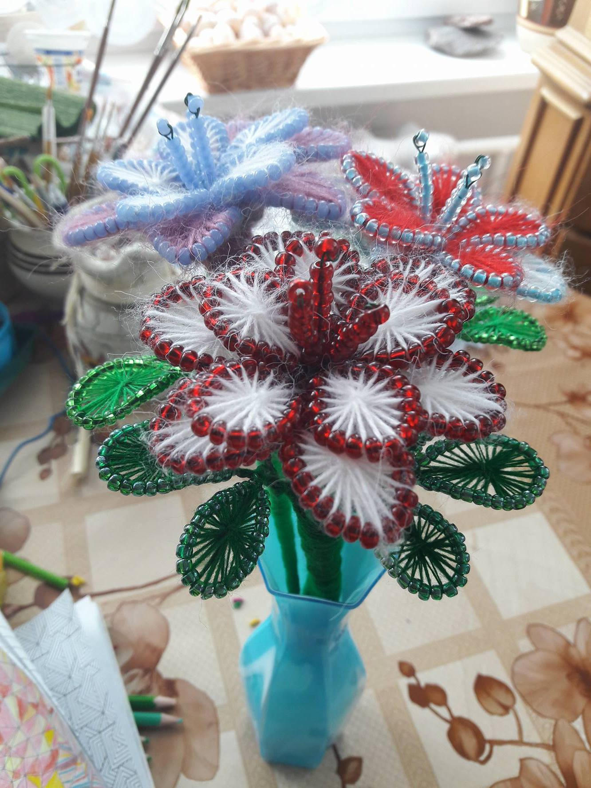
Her works:

