Slide 1
Dog shelter
Vytvořila: 2.AL OACB

Slide 2
On May 18th our class with the teacher Daniela Pokorná visited the dog shelter.

Slide 3
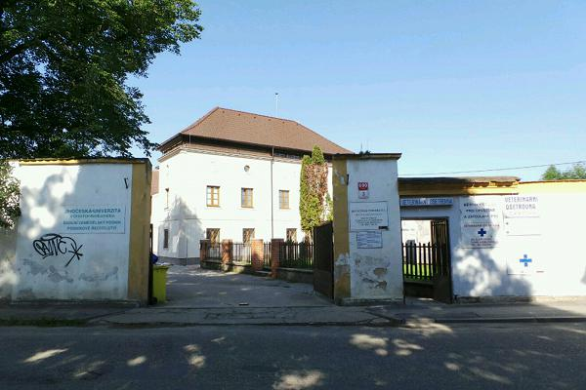

Slide 4
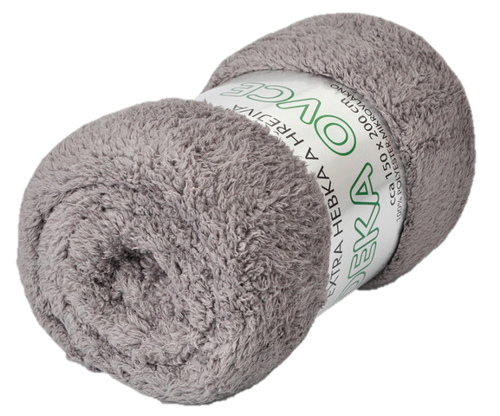
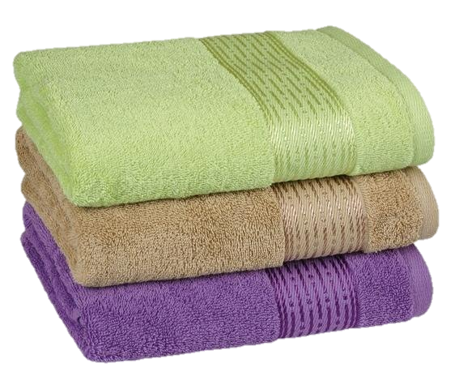
Before we went there, we bought dog granules
and took any blankets
and old towels from home.

Slide 5
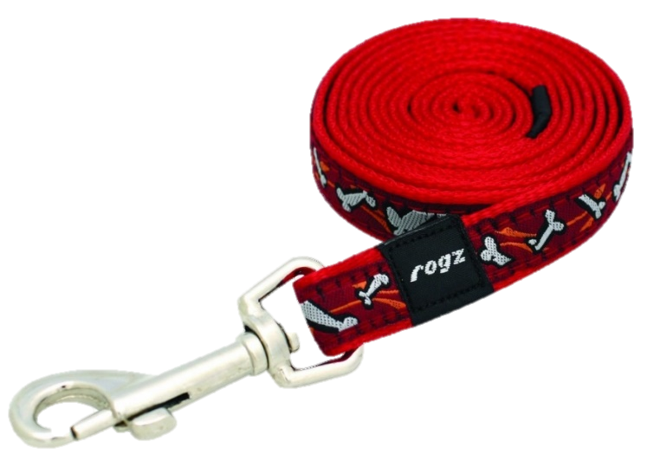
When we got there, the dog breeder assigned us the dogs and we went with them for a walk to the park.

Slide 6
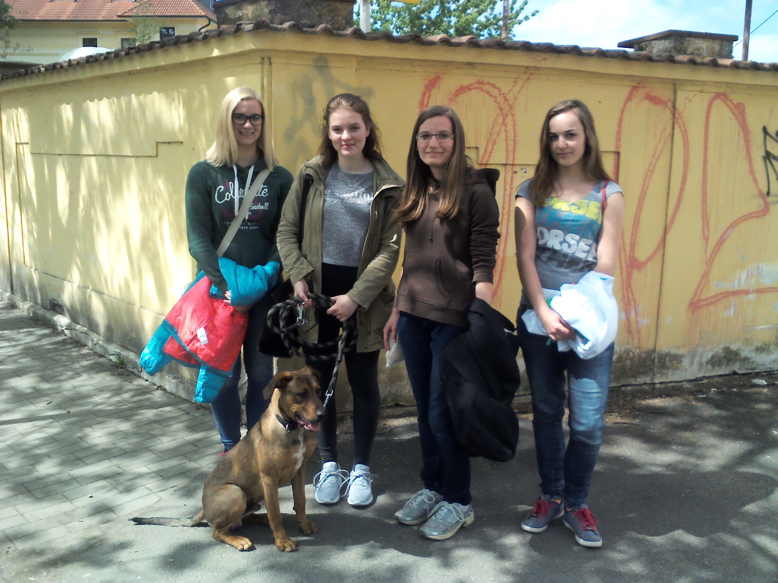

Slide 7
We had to have them on a leash, but we think that they enjoyed it.

Slide 8
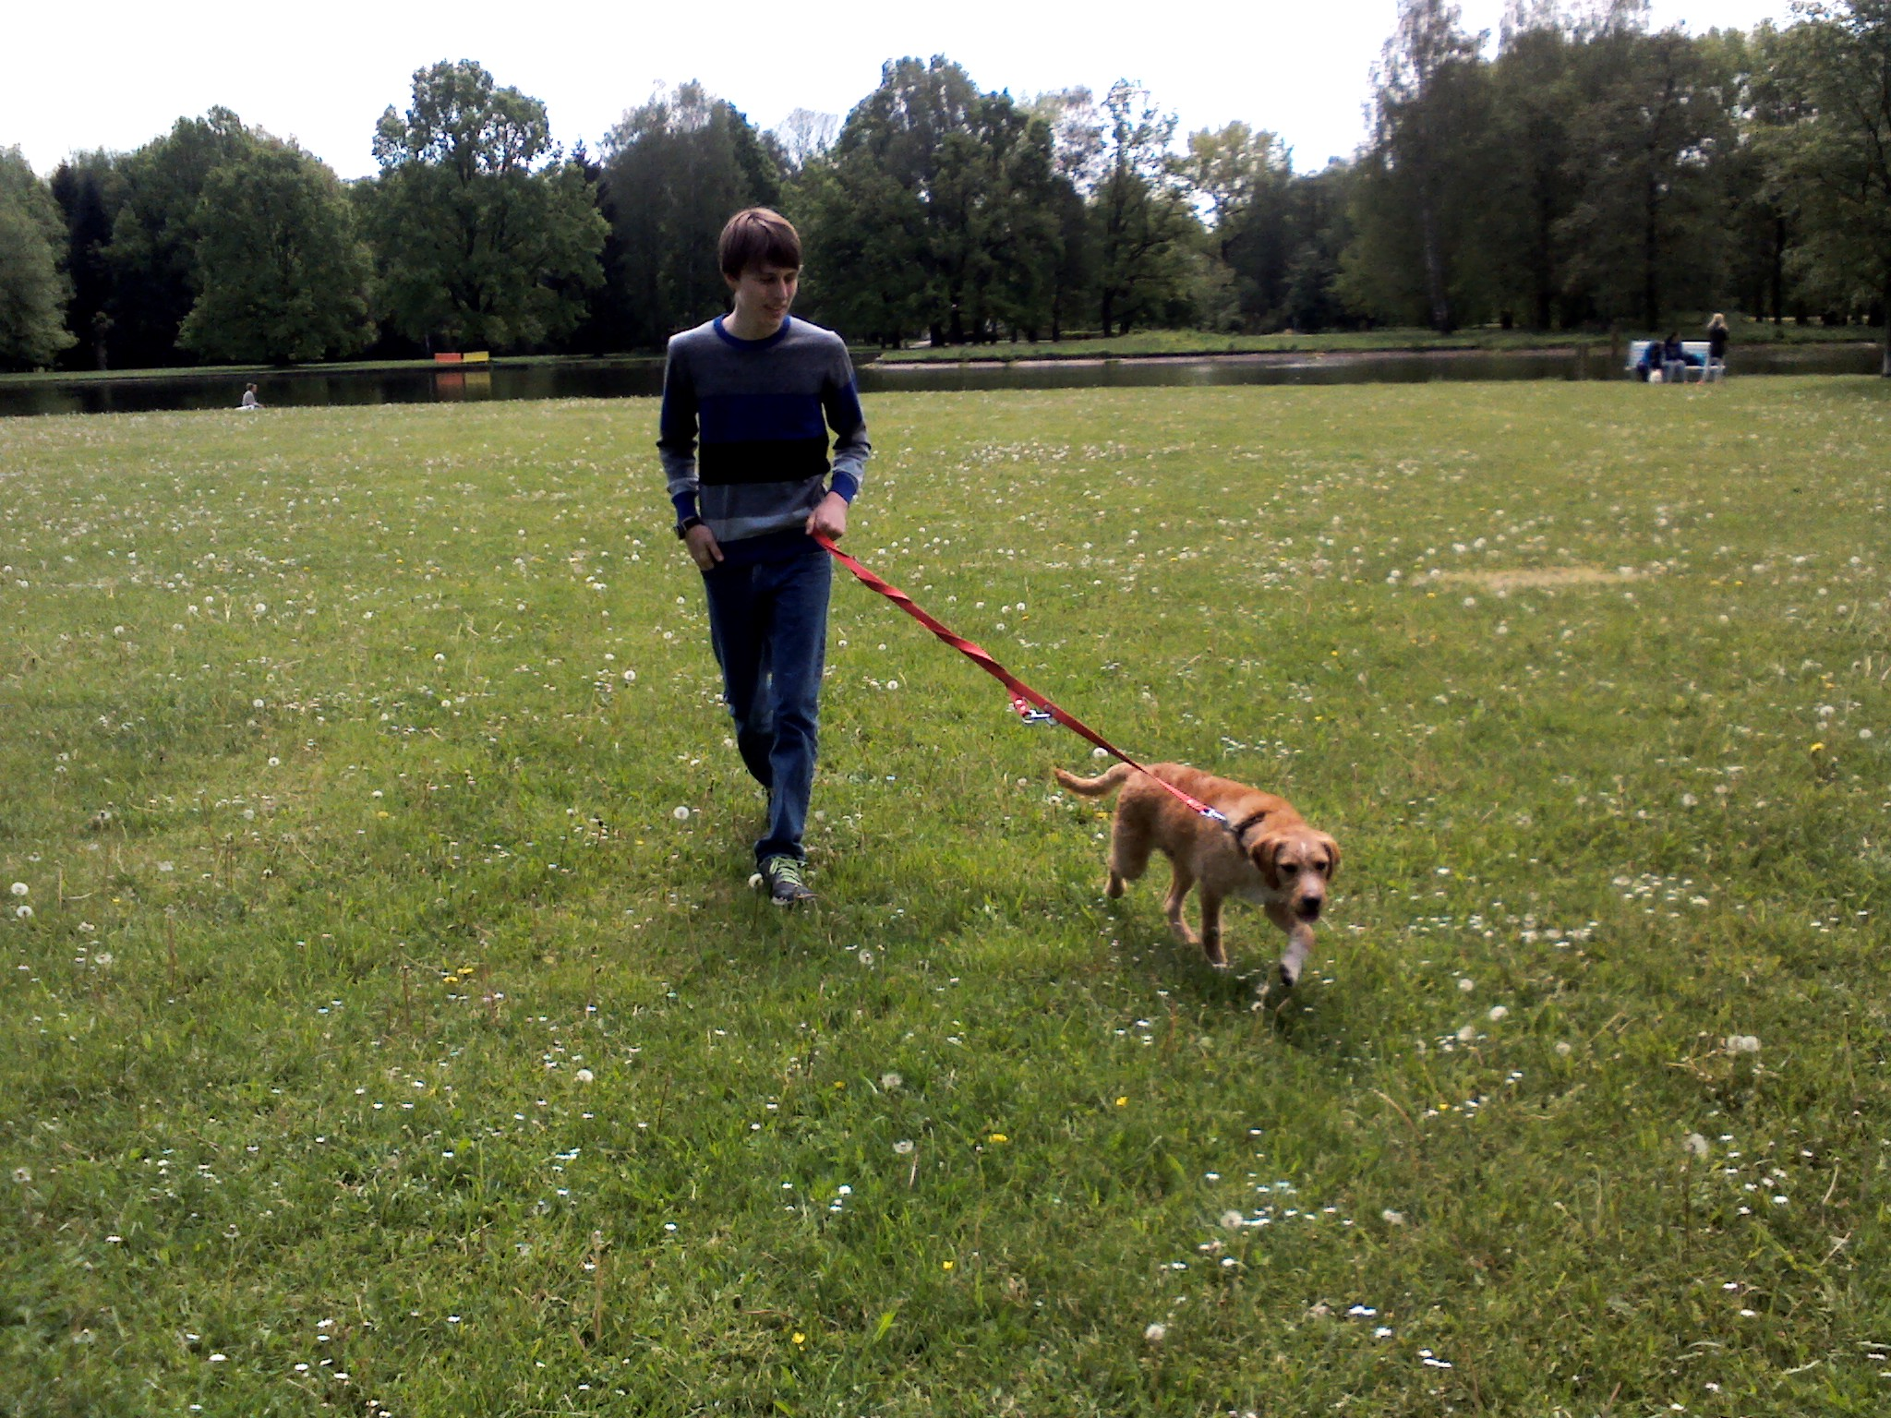

Slide 9
After almost one hour we gave them back so we were sad but it could be a motivation to visit them more often.

Slide 10
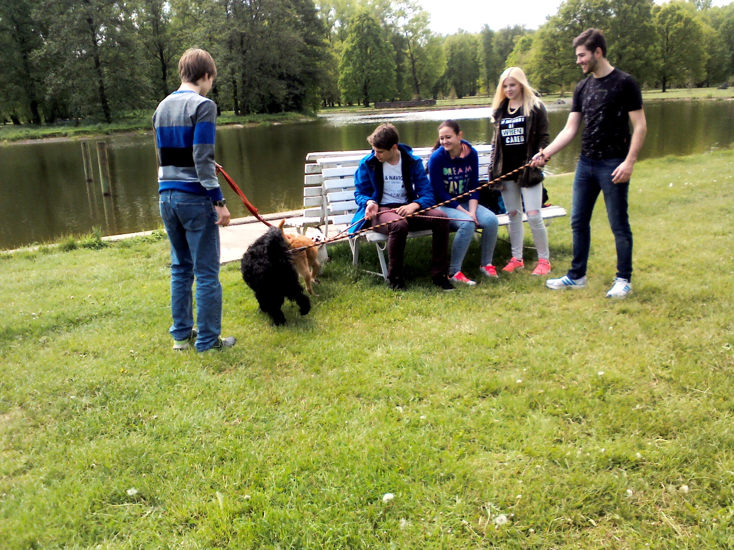

Slide 11
We are looking forward to the next visit of the dog shelter.

