Slide 1
Good deeds for my family
eTwinning project:
Make the world better
Aneta, Obchodní akademie,
České Budějovice

Slide 2
Good deed
I decided to help my family with housework. I asked them, what good deed could I do for them. I think it is good to help our parents with housework and make them happier.

Slide 3
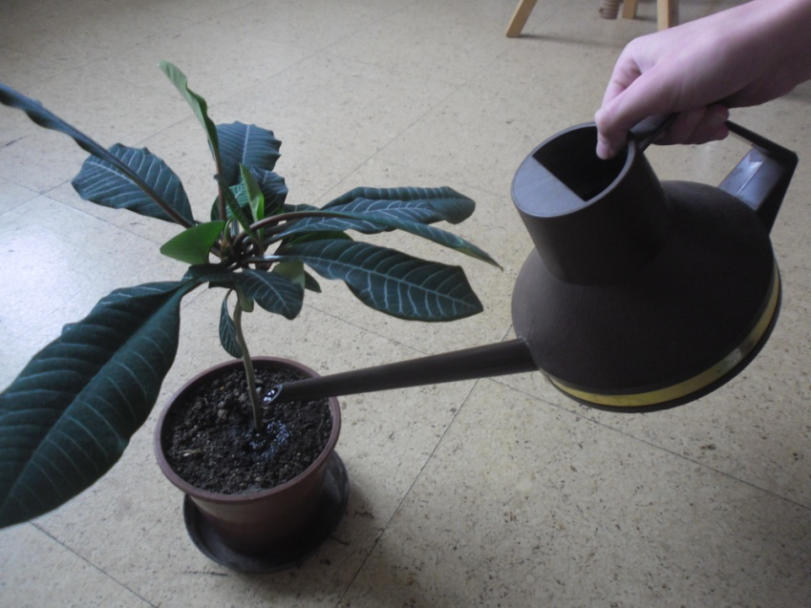
My mother
I asked my mother, what could I do for her. She told me I could water all the flowers in the house. At first, I thought it will be easy, but I calculated about 40 flowers. I was glad that I finished it.

Slide 4
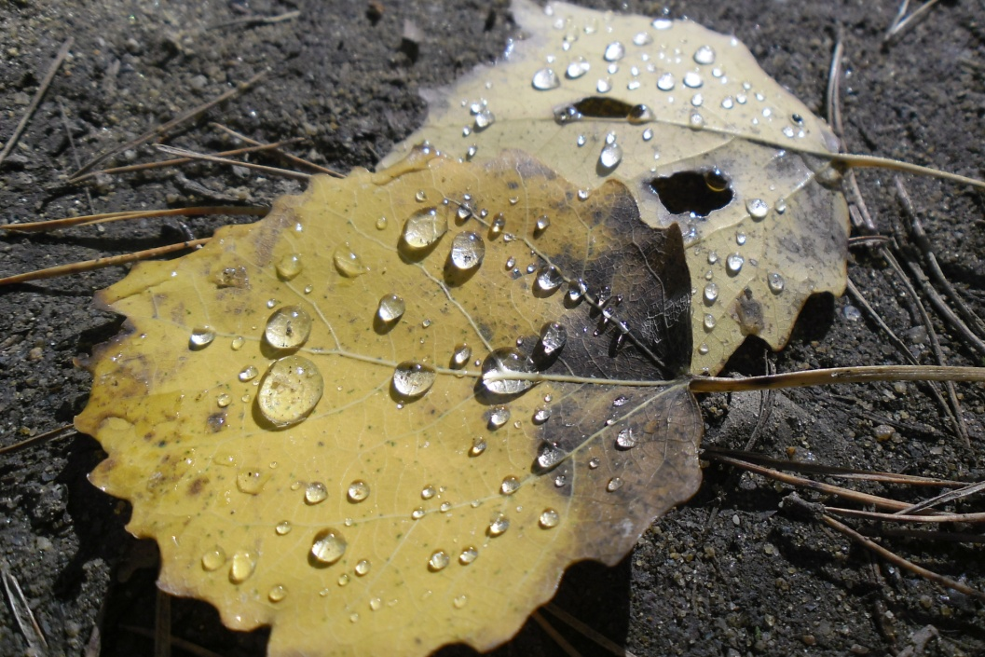
My father
When I asked my father, what good deed could I do for him, he answered me I could rake leaves in the garden. He told me that he had no time to do that.

Slide 5
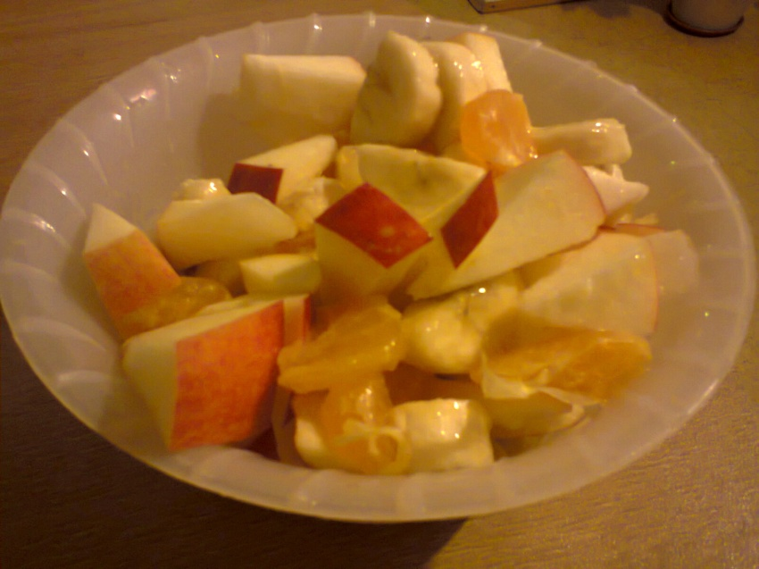
Idea
I had the idea to make a fruit salad for my parents. They were delighted and they told me it was delicious.
I also washed a dishes for a week.

Slide 6
Problems I have faced
I did not faced any problems. Maybe were my biggest problems laziness and a little time.

Slide 7
Feelings and emotions
I was happy from good deeds which I did for my parents. They were thankful for the help, so I was happy too. I think that if people were nice and helpful, life would be better. ☺

Slide 8
Thanks for watching ☺
…and have a nice day

