Slide 1
Good deeds for my family
Tereza Krejčí, 2.Al

Slide 2
This is my mum. Her name‘s Radka and she‘s 44 years old.
She wished I helped her more often at home.
So at the weekened I cleaned the whole house and tried to cook lunch and she was thankful for it.

Slide 3
This is my dad. His name is Tomáš. He‘s 46 years old.
He wished I told him good night before I go to sleep.
So I started to tell him a good night in the evening and he thinks it‘s better this way.

Slide 4
This is my sister Kateřina, she‘s 14 years old.
She wished I was nicer to her and spent more time with her.
So one afternoon I went shopping with her and went for a dinner and she was happy.

Slide 5
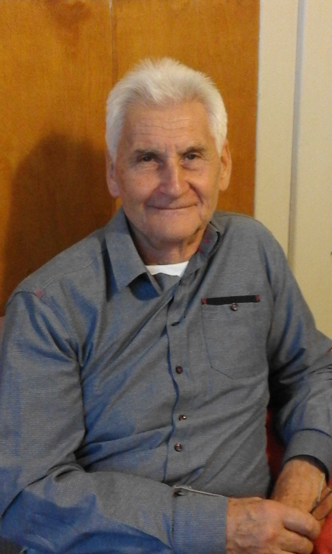
On the left is my grandma. Her name‘s Božena and on the right is my grandpa Josef. They wished I visited them more often.
So I decided to go to them and play the guitar for them. They were grateful for it.

