Slide 1
Good deeds for my family
Martina Hamerníková

Slide 2
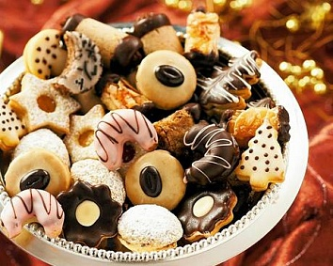
Mum
Her name is Lada. She is 42 years old.
My mom wanted me to bake Christmas sweets.
When I baked Christmas sweets I was glad that I can help.
She said: „Oh, that is excellent!“

Slide 3
Dad
His name is Jiří. He is 46 years old.
My dad wanted me to teach him to work on computer.
It was hard to teach him it but I managed this task.
He is glad that he can search for something on the computer.

Slide 4
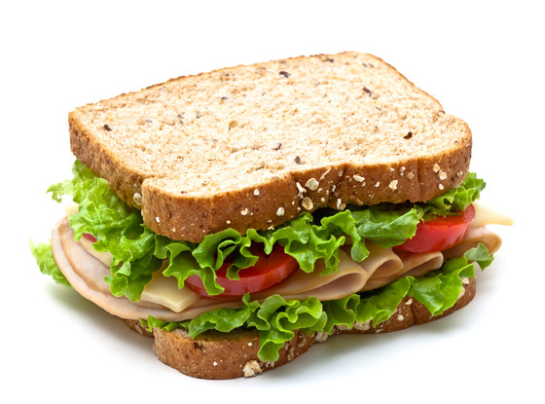
Sister
Her name is Soňa. She is 16 years old.
She wanted me to make sandwiches for her every day.
I make sandwiches glad so I don't mind.
She is glad that she doesn't have hunger.

Slide 5
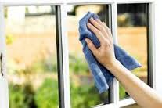
Grandpa
His name is František. He is 74 years old.
My grandpa wanted me to help him with cleaning windows.
I was glad that I could help him.
When I washed the windows he was very happy.

