Slide 1
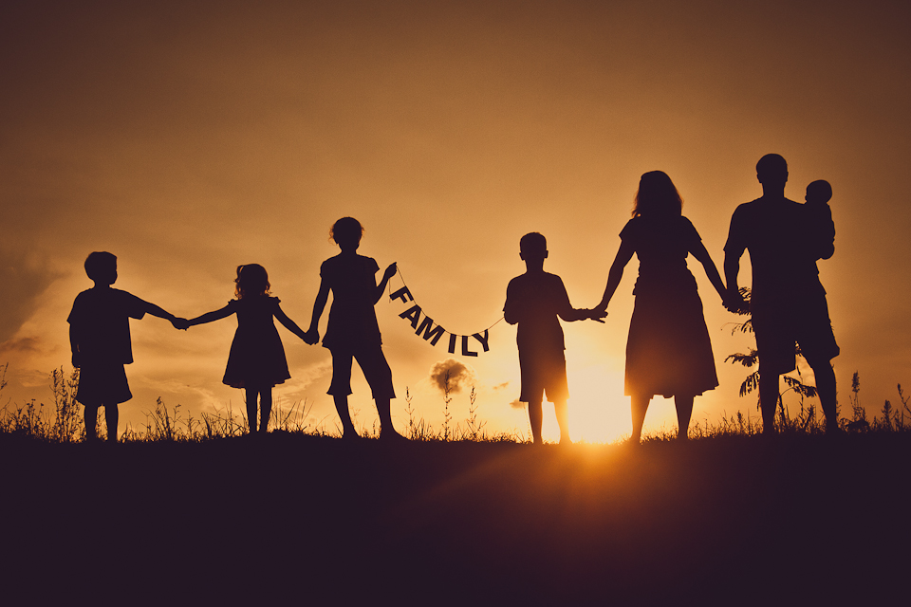
Good deeds for my family
Lucie kLásková

Slide 2
MOTHER
My mother‘s name is Blanka.
She is 47 years old.
Good deed: She wanted me to help her with cleaning windows at home, so I cleaned all windows.
Reaction: My mom was very happy for my help.

Slide 3
FATHER
My father‘s name is Ladislav.
He is 50 years old.
Good deed: He wanted me to help him with improving his English. I helped him with grammar and pronunciation.
Reaction: He was thankful.

Slide 4
sister
My sister‘s name is Nikola.
She is 13 years old.
Good deed: She wanted me to help her with shopping Christmas presents. We chose together great presents.
Reaction: She said: „Thank you. If you need something, I‘ll help you, too.“

Slide 5
Grandmother
My grandmother‘s name is Blanka.
She is 73 years old.
Good deed: She wanted me to help her with raking leaves in the garden, because she has got a big garden. I helped her.
Reaction: My grandma said: „Thank you for your help.“

