Slide 1
Good deeds for my family
Ariana Studená

Slide 2
My mother
Hana
49 year old
hobby - painting, watching on TV and making selfie
working as a laborer
studied from medical school
divorced

Slide 3
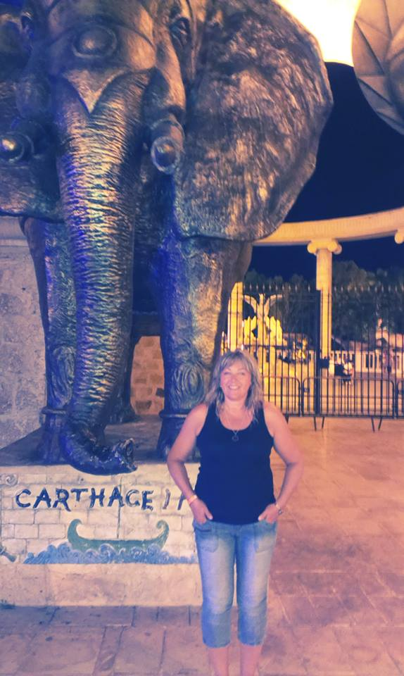
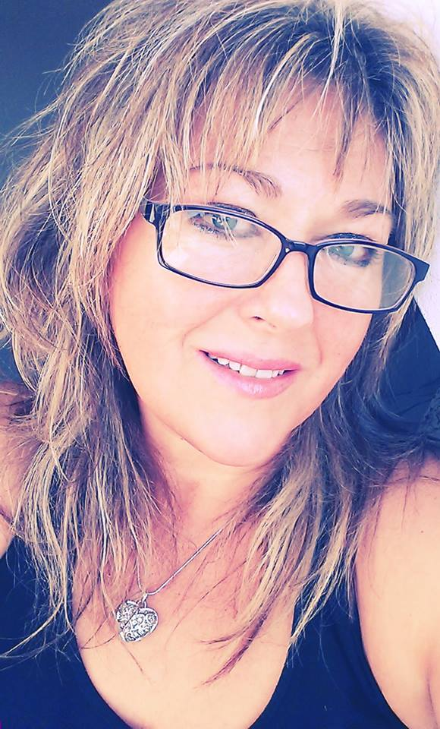
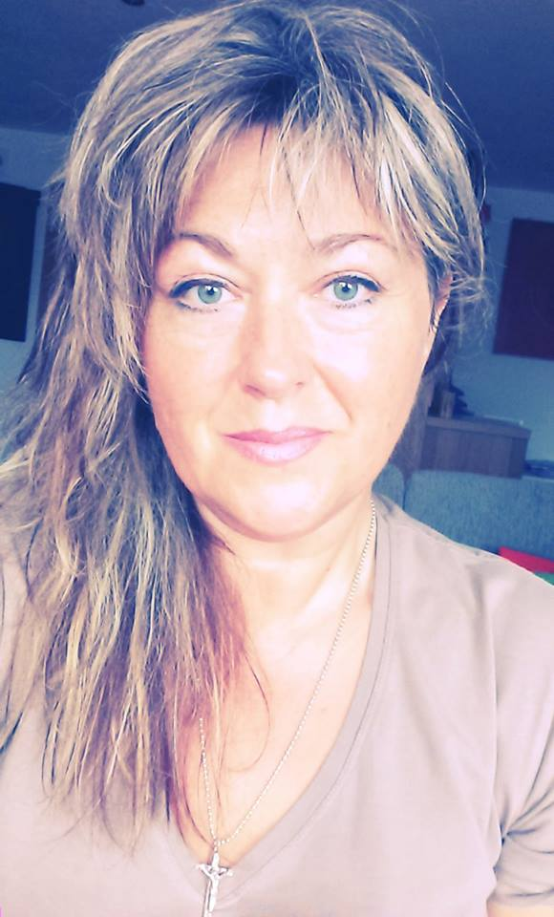
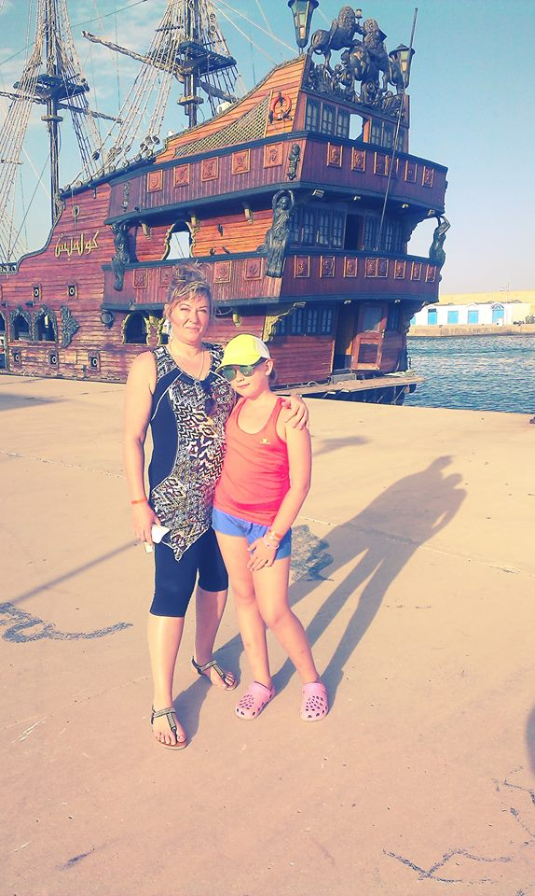
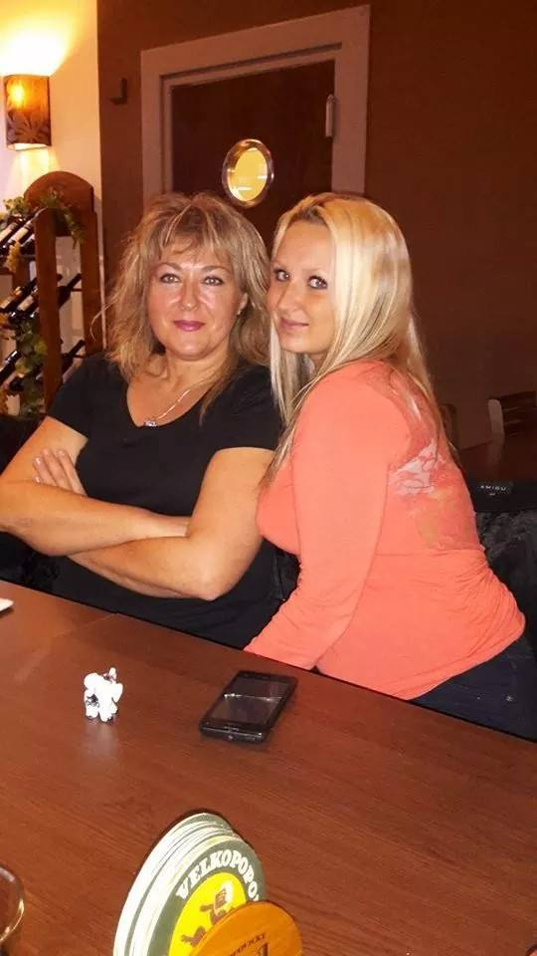
Mom would be pleased if someone had cleaned the all flat. I cleaned it and she was happy.

Slide 4
My father
Karel
43 years old
working as a joiner and carpenter, but now working in Germany
again married
hobby - hockey because he formerly played

Slide 5
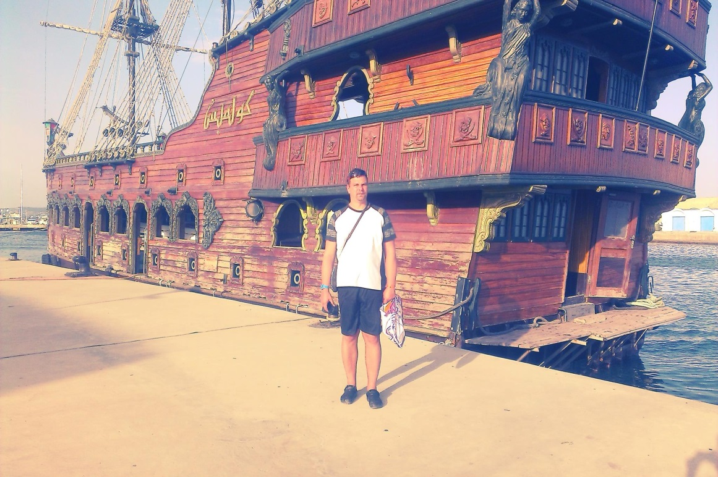
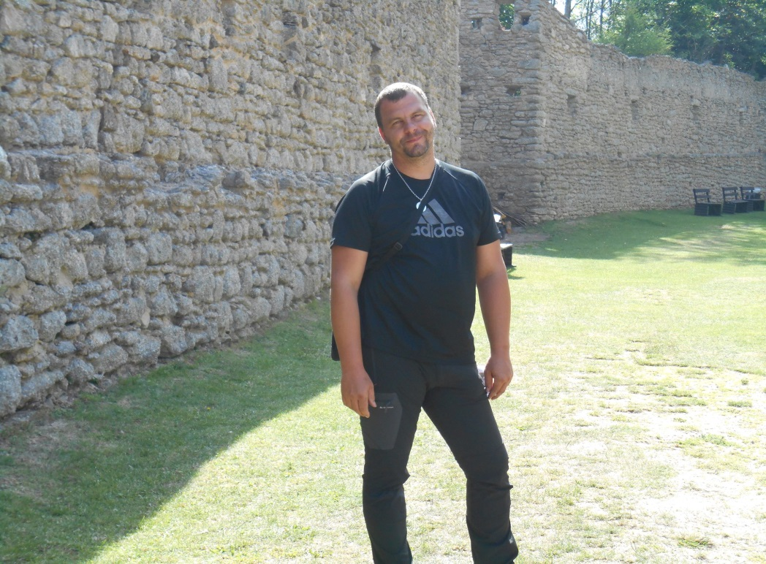
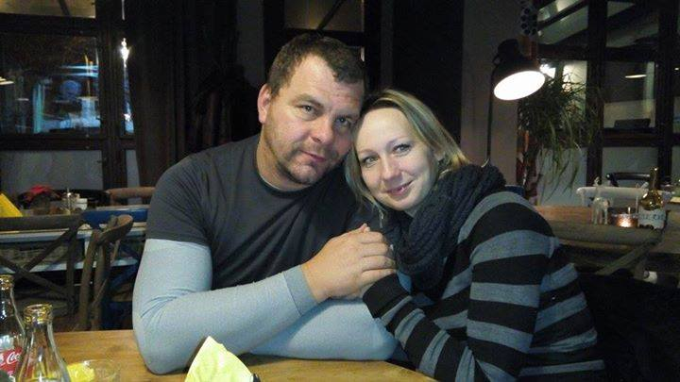
Dad would be pleased if someone cooked the dinner. I was making dinner and he was pleased.

Slide 6
My sister
Sára
11 years old
He loves to play the piano and singing
is a little bit crazy,still she wants to have fun

Slide 7
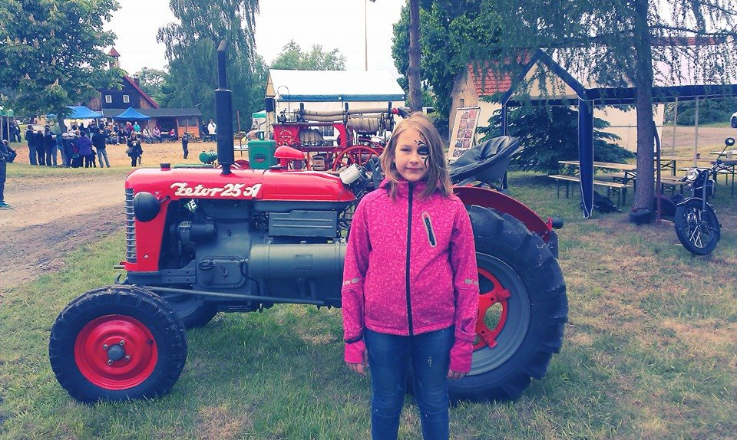
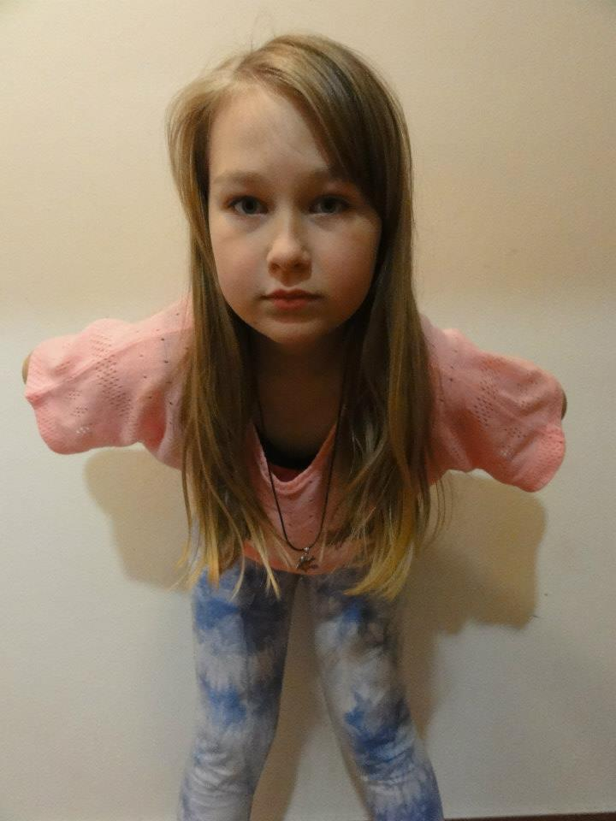
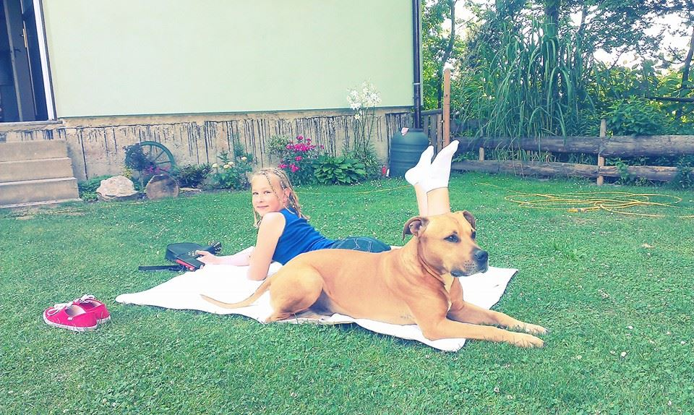
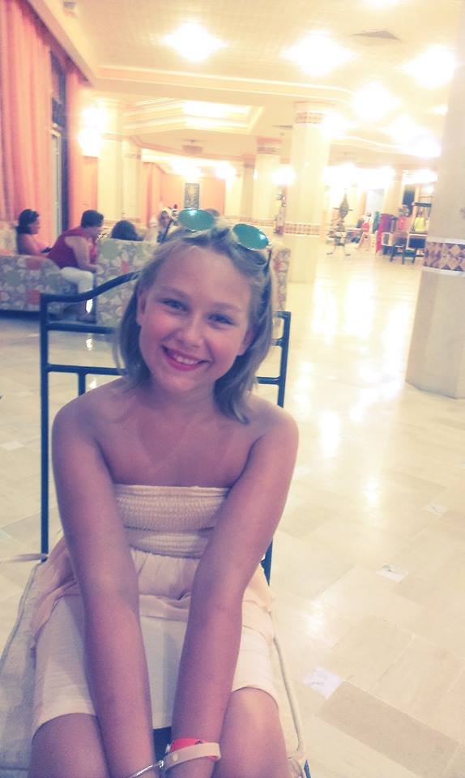
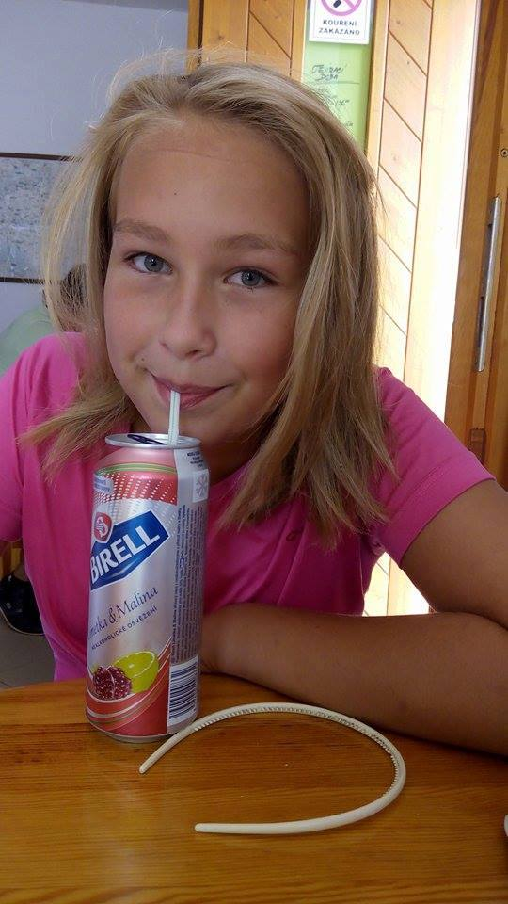
Sarah would be pleased if I let her play in our common room on the piano. I left her class and she was happy because she learned a new song.

Slide 8
My brother
Mario
29 years old
working at Temelin
married
his hobby is photography and drawing

Slide 9
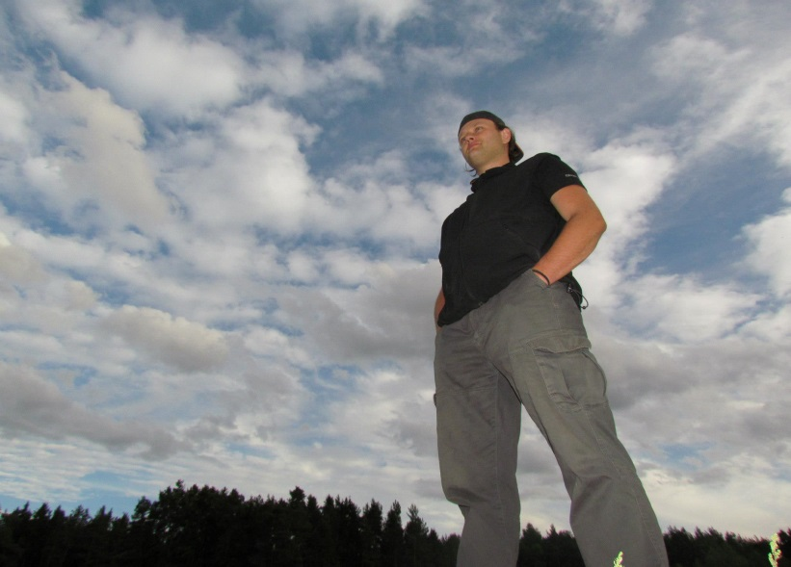
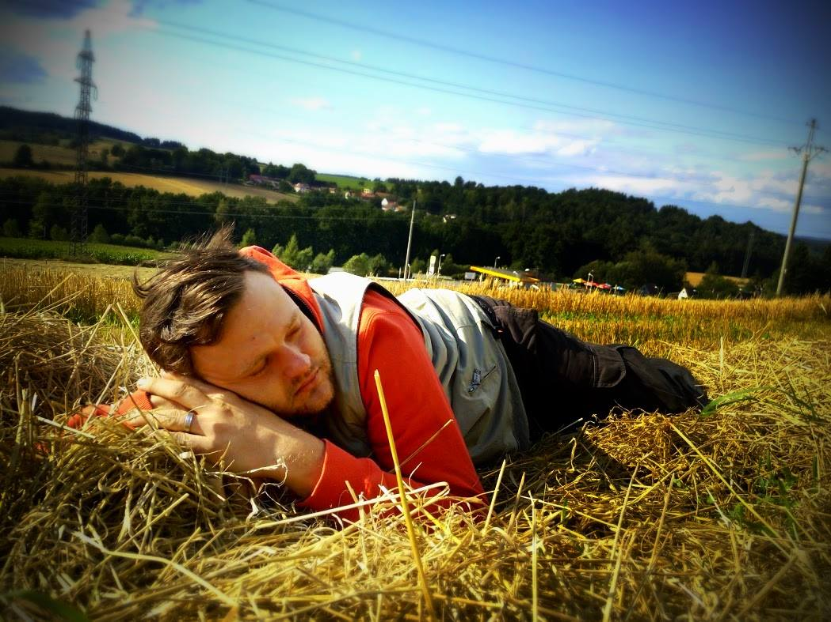
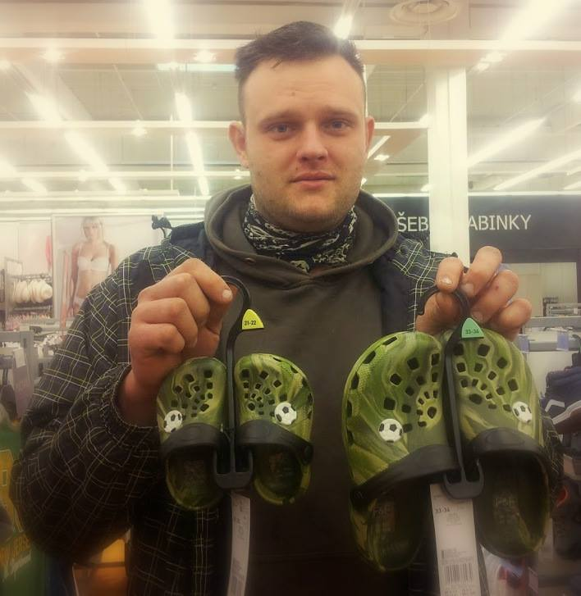
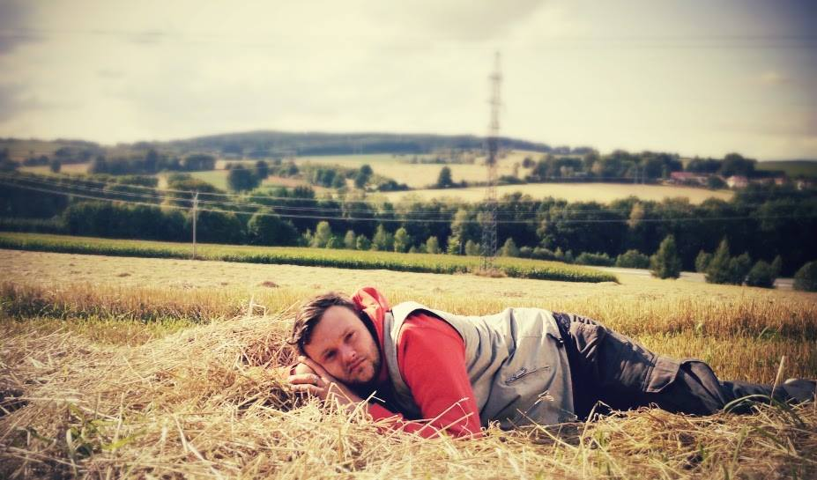
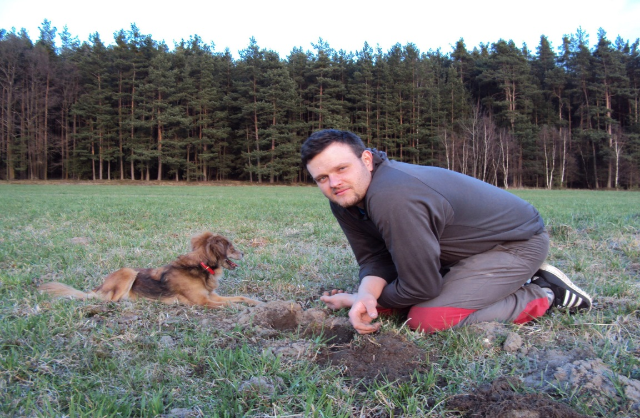
My brother would be pleased if someone helped finish the house. brother, it would have pleased him to spend more time. I did it and he will teach me to drive.He was happy.

