Slide 1
Civitavecchia’s history
The most important peoples and cultures who have made great Civitavecchia

Slide 3
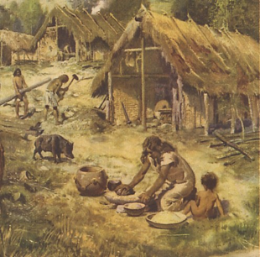
4.000 b.c.
Early human settlements in the Neolithic

Slide 4
Early human settlements in the Neolithic
4.000 b.c.

Slide 5
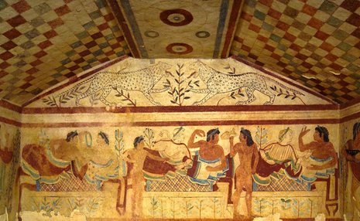
900 b.c.
Foundation of Etruscan cities

Slide 6
Early human settlements in the Neolithic
4.000 b.c.
900 b.c.
Foundation of Etruscan cities

Slide 7
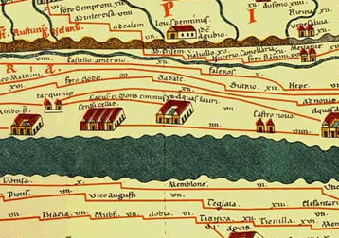
I sec. b.c.
Aquae Tauri passes from the Etruscan to the Roman domination

Slide 8
Early human settlements in the Neolithic
Aquae Tauri passes from the Etruscan to the Roman domination
I sec. b.c.
4.000 b.c.
900 b.c.
Foundation of Etruscan cities

Slide 9
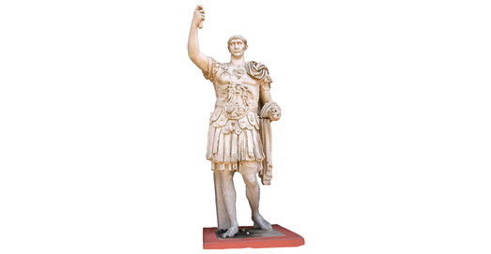
103-107 a.c.
The emperor Trajan founded Centum Cellae

Slide 10
Early human settlements in the Neolithic
Aquae Tauri passes from the Etruscan to the Roman domination
I sec. b.c.
4.000 b.c.
900 b.c.
103-107 a.c.
The emperor Trajan founded Centum Cellae
Foundation of Etruscan cities

Slide 11
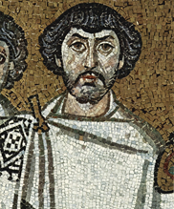
538 a.c.
Centum Cellae is occupied by the Byzantines

Slide 12
Early human settlements in the Neolithic
Centum Cellae is occupied by the Byzantines
Aquae Tauri passes from the Etruscan to the Roman domination
I sec. b.c.
4.000 b.c.
538 a.c.
900 b.c.
103-107 a.c.
The emperor Trajan founded Centum Cellae
Foundation of Etruscan cities

Slide 13
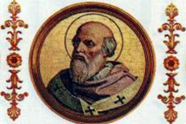
VIII sec. a.c.
Centum Cellae becomes part of the State of the Church

Slide 14
Early human settlements in the Neolithic
Centum Cellae is occupied by the Byzantines
Aquae Tauri passes from the Etruscan to the Roman domination
I sec. b.c.
4.000 b.c.
538 a.c.
900 b.c.
103-107 a.c.
VIII sec. a.c.
Centum Cellae becomes part of the State of the Church
The emperor Trajan founded Centum Cellae
Foundation of Etruscan cities

Slide 15
854 a.c
Centum Cellae is abandoned due to the continuous Saracen assaults and its inhabitants found in the hinterland Leopoli

Slide 16
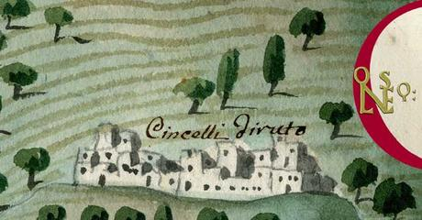
Early human settlements in the Neolithic
Centum Cellae is occupied by the Byzantines
Aquae Tauri passes from the Etruscan to the Roman domination
Centum Cellae is abandoned due to the continuous Saracen assaults and its inhabitants found in the hinterland Leopoli
I sec. b.c.
4.000 b.c.
538 a.c.
854 a.c.
900 b.c.
103-107 a.c.
VIII sec. a.c.
Centum Cellae becomes part of the State of the Church
The emperor Trajan founded Centum Cellae
Foundation of Etruscan cities

Slide 17
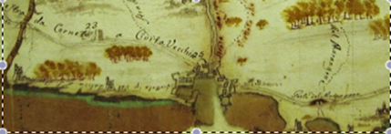
1000 a.c.
The citizens of Centum Cellae return to their "old city", giving it the name of Civitas Vetula

Slide 18
Early human settlements in the Neolithic
Centum Cellae is occupied by the Byzantines
Aquae Tauri passes from the Etruscan to the Roman domination
Centum Cellae is abandoned due to the continuous Saracen assaults and its inhabitants found in the hinterland Leopoli
I sec. b.c.
4.000 b.c.
538 a.c.
854 a.c.
900 b.c.
103-107 a.c.
VIII sec. a.c.
1000 a.c. the citizens of Centum Cellae return to their "old city", giving it the name of Civitas Vetula
Centum Cellae becomes part of the State of the Church
The emperor Trajan founded Centum Cellae
Foundation of Etruscan cities

Slide 19
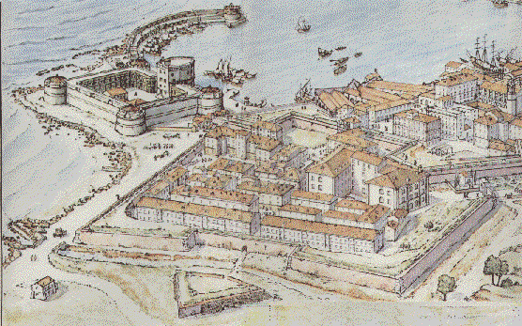
From 1133 Civitavecchia became one of the most important centers of the Papal States, until 1861 when it became part of the Kingdom of Italy

Slide 20
Early human settlements in the Neolithic
Centum Cellae is occupied by the Byzantines
Aquae Tauri passes from the Etruscan to the Roman domination
Centum Cellae is abandoned due to the continuous Saracen assaults and its inhabitants found in the hinterland Leopoli
From 1133 Civitavecchia became one of the most important centers of the Papal States, until 1861 when it became part of the Kingdom of Italy
I sec. b.c.
4.000 b.c.
538 a.c.
854 a.c.
900 b.c.
103-107 a.c.
VIII sec. a.c.
1000 a.che citizens of Centum Cellae return to their "old city", giving it the name of Civitas Vetula
Centum Cellae becomes part of the State of the Church
The emperor Trajan founded Centum Cellae
Foundation of Etruscan cities

Slide 21
