Slide 1
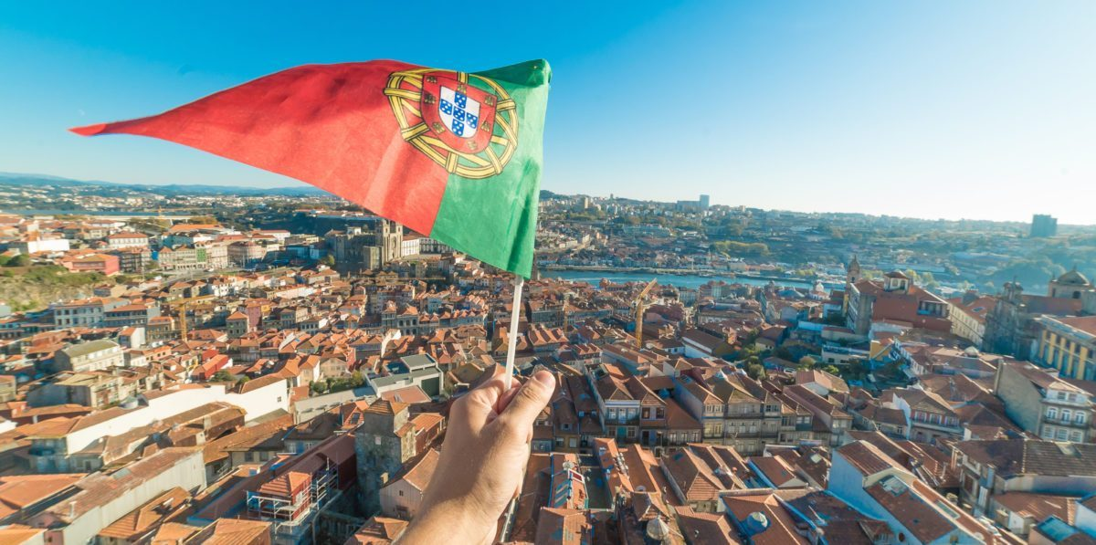
Welcome to Portugal

Slide 2
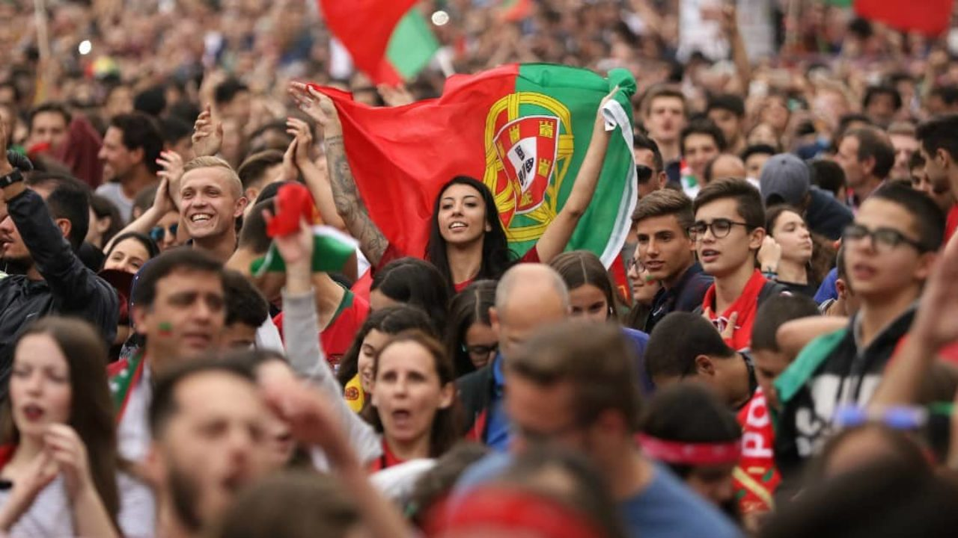
The Portuguese people
Portuguese people are somewhat peculiar, no doubts about that. We are a people of contradictions.
We do have our Latin blood but we also have a melancholic temperament unlike any other Latin countries. In fact, we are probably more similar to the people of northern Europe in that sense.
We are capable of great deeds and our history is made of several episodes that have changed the world!
We are also a people of strange, peculiar and even funny habits.

Slide 3
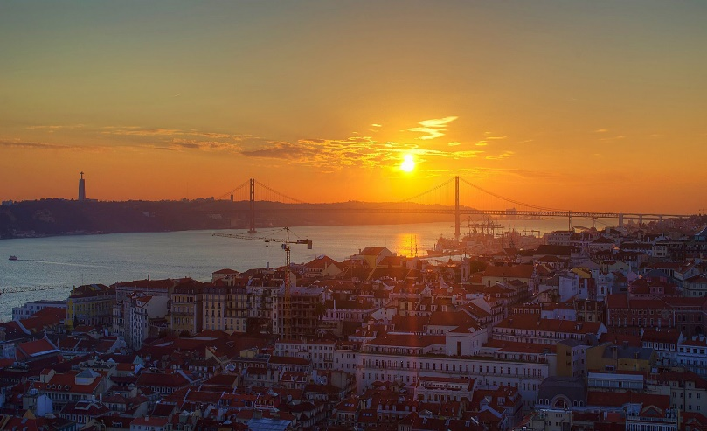
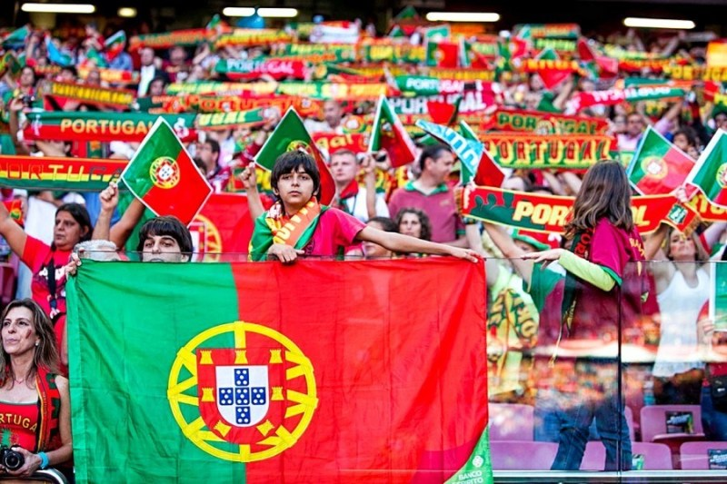
The Portuguese people
Some of our funny habits and traits...
Usually, kissing in the face is normal when we meet someone.
Men greet each other with a handshake.
The Portuguese are addicted to the Sun. Whether on the beach, the city, the countryside, the terraces or in the parks, the Portuguese always enjoy the sunny days and get a little depressed when rainy days come.
We like to criticize our country for everything and nothing, but we are extremely angry and strongly defend our homeland when it is criticized by foreigners. Yes, Portugal is a bit like our wives or husbands: only we can complain about them, nobody else.

Slide 4
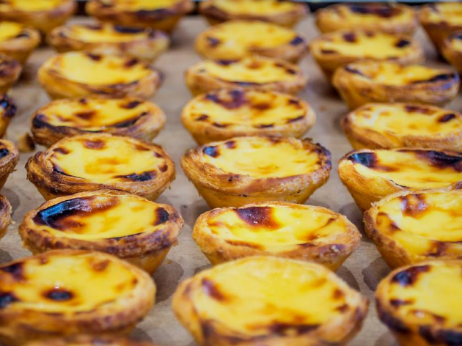
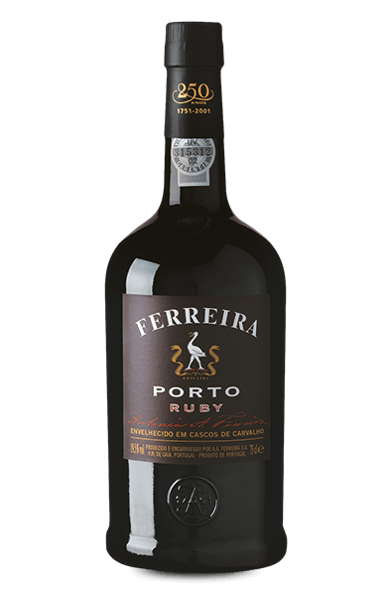
The Portuguese people
Some of our famous drinks and food...
Port wine
Portugal is famous for the production of wine and the most famous is probably the Port Wine, which is produced in the Douro Valley in northern Portugal. Although some other countries produce a port-style wine, only port wine produced in Porto can be called Port..
Pastéis de nata
Pastéis de nata or Portuguese custard tarts as many people like to call them, is Portugal’s biggest gift to the culinary world. Crunchy, soft, and gooey – they’re the perfect complement to a cup of black coffee.

Slide 5
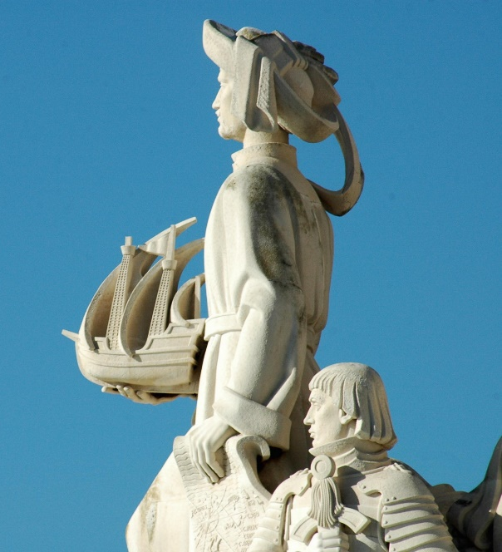
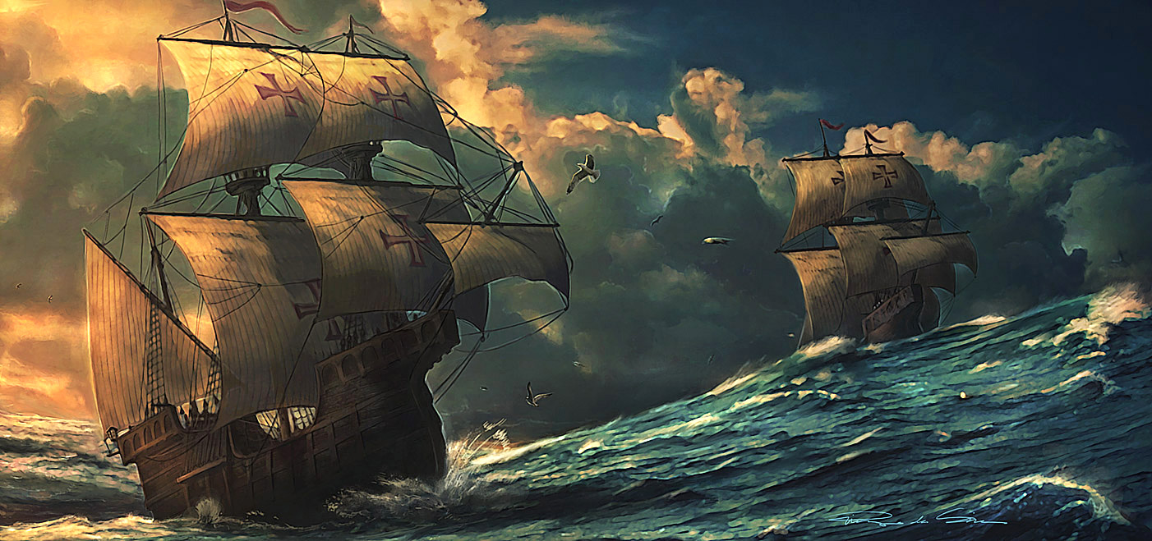
The Portuguese people
We have a very special bond with the sea...
Discovering the world
Portugal was once one of the biggest empires in the world. Portugal was also the first country to go in search of the new world and if that had not happened, the world would be a very different place today.
The Portuguese were the first to round the tip of Africa, make it to India by sea, and to discover Brazil. Many Portuguese people also believe that Christopher Columbus came from Portugal, possibly from Madeira.

Slide 6
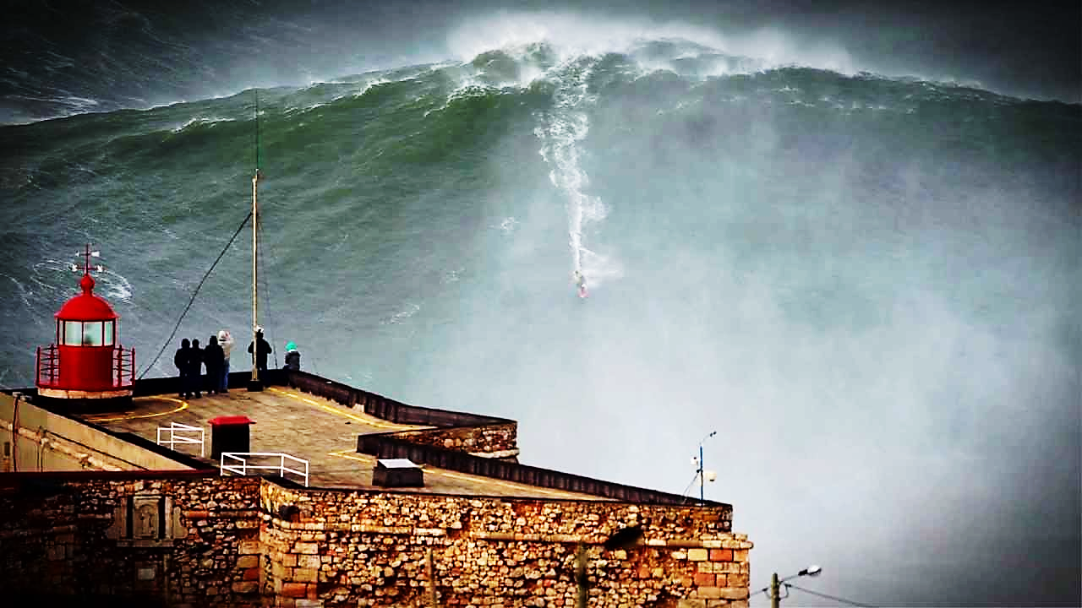
The Portuguese people
We have a very special bond with the sea...
Surfing
Portugal is one of Europe’s top surfing destinations, and every year thousands of wave-lovers flock to destinations like Sagres in the Algarve, Peniche, Nazaré, and Matosinhos near Porto to put board to water on Portugal’s Atlantic coast. But Portugal isn’t just another surfing destination, it’s where some of the top surfing records have been broken.
In 2012, Garrett McNamara entered the Guinness Book of Records for surfing the highest wave ever recorded. The Hawaiian surfer managed to catch a 78-foot wave just outside of Nazaré, around 90 minutes north of Lisbon.
.

Slide 7
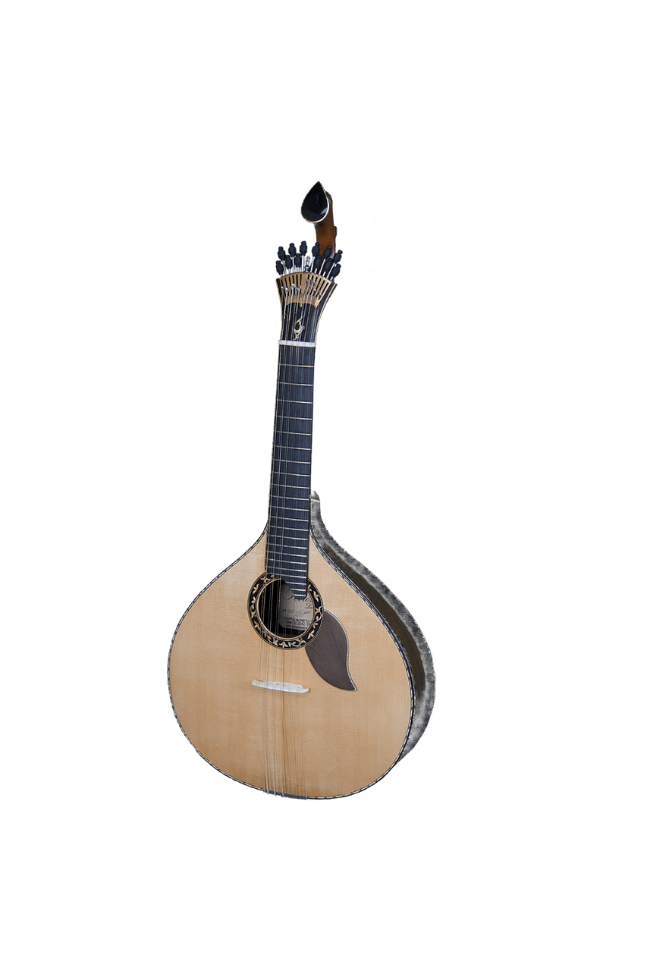
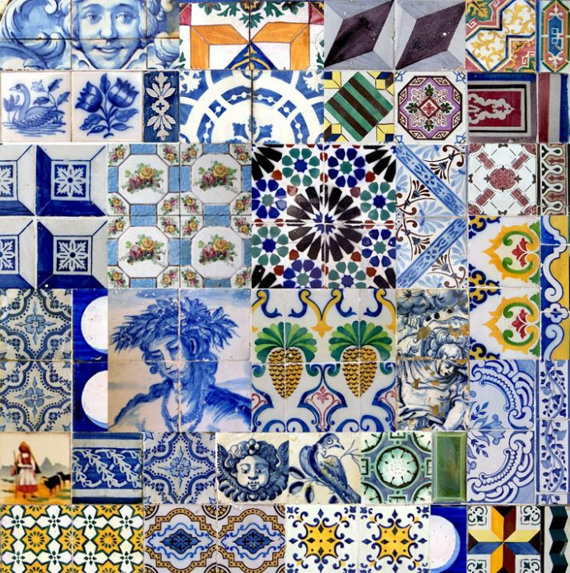
The Portuguese people
Portugal – The country of Fado and tiles
Fado
It is a distinctively Portuguese style that expresses saudade, a longing for something or someone distant, absent, or maybe even never encountered. Sung, usually solo, with guitar accompaniment. Amália Rodrigues is considered the best fadista ever.
Tiles
Portuguese buildings, particularly those in Lisbon, are incredibly photogenic thanks to the beautiful tiles that line the outside.
Tiles are used to regulate heat in the buildings, and the concept was introduced into Portugal when Portugal was under Moorish rule. When Portugal regained control, it kept the tiles but with one slight change.
Painting people is prohibited under Islam, and the early Moorish azulejos used geometric shapes as their designs. This rule doesn’t exist in Catholicism, and so tile makers began painting elaborate scenes often of the Portuguese explorers going around the world, daily life in Portugal, religious scenes, and pictures of royalty and rulers.

Slide 8
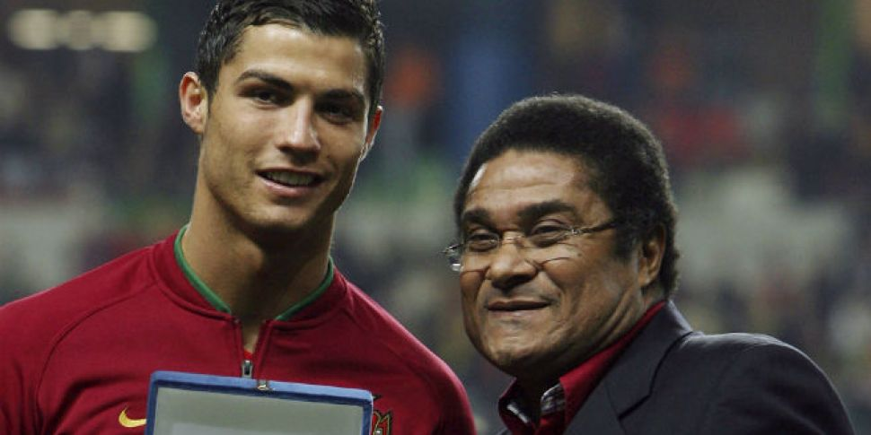
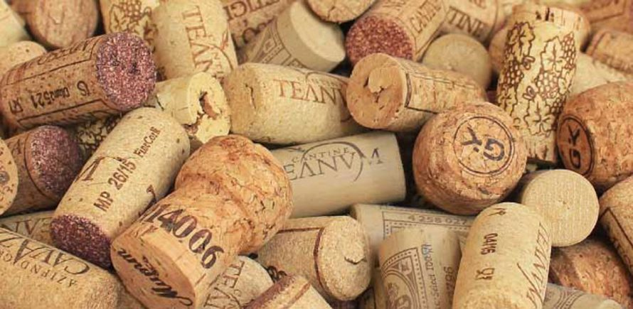
The Portuguese people
Portugal is also known for its football players. And we are also the world’s biggest producer of cork!
Football
Football is very important for most portuguese people!
It’s impossible not to think of football when you think of Portugal. Most of Portugal’s most famous celebrities are footballers, for example Cristiano Ronaldo, Luís Figo, and Eusébio.
Cork
It grows on trees (the cork oak or sobreiro in portuguese), in Portugal! It is made into bottle stoppers, pads to put under hot pots or plates, or bowls; also, shoe soles. Sliced thinner for surface decoration or trim on bags, belts, etc.

Slide 9
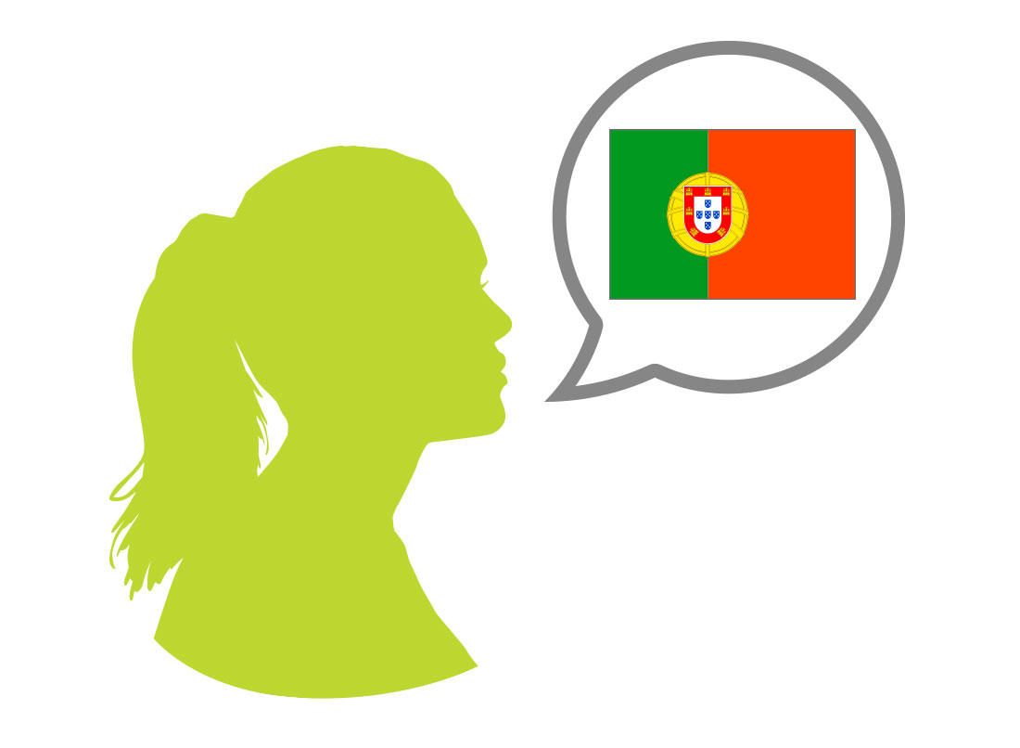
The Portuguese people
A few useful portuguese expressions you should learn
Bom dia! – Good morning
Boa tarde! – Good afternoon / good evening
Boa noite!- Good night
Obrigado! – Thank you
Adeus! – Goodbye/Bye
Até logo! – See you
Por favor! – Please
Vens comigo/connosco?- Do you come with me/with us?
Um copo de água, por favor! – A glass of water,please!
Chamo-me …/o meu nome é…. – My name is……
Não gosto de……. – I don’t like……

Slide 10
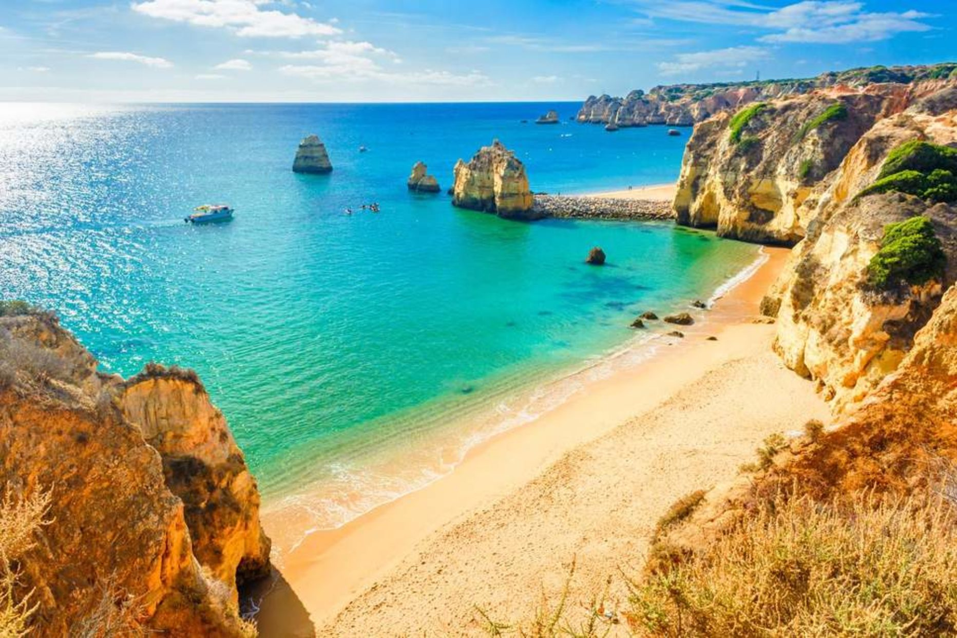
The Portuguese people
If you would like to learn more about Portugal, here are a few interesting reads:
www.geekyexplorer.com/reasons-visit-portugal/
https://gotoportugal.eu/en/portuguese-traditions/
https://gotoportugal.eu/en/pictures-of-portugal/
https://gotoportugal.eu/en/top-10-of-the-best-portuguese-beaches/
https://gotoportugal.eu/en/portuguese-summer-festivals/
https://viagens.sapo.pt/viajar/viajar-portugal/artigos/o-que-e-que-os-estrangeiros-pensam-dos-portugueses

