Slide 1
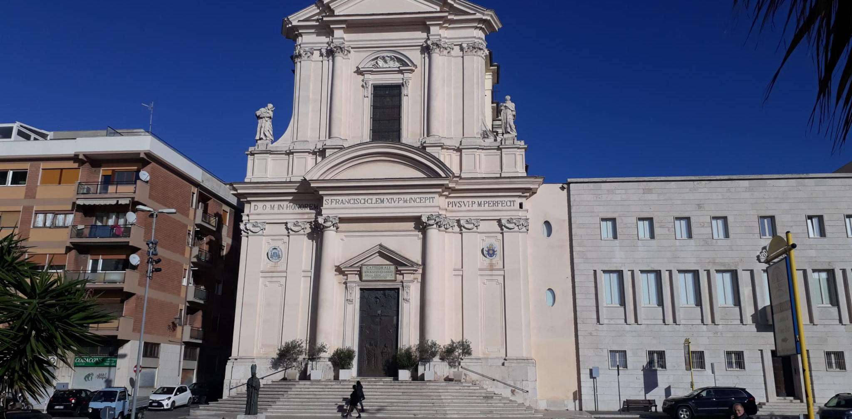
CIVITAVECCHIA
AND
ITS FAMOUS PEOPLE…

