Slide 1

DICTIONARY OF LOCALISM…
IN CIVITAVECCHIA!!!!!!!!!!!!

Slide 2
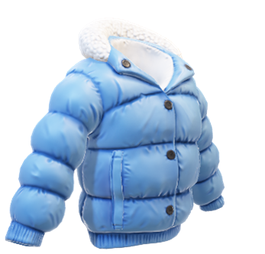
PRONCHISE
A very large coat

Slide 3

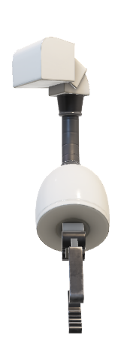

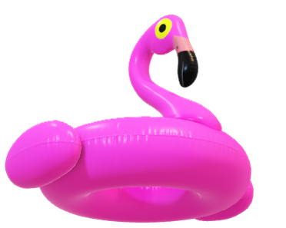
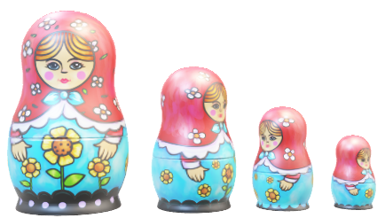
CIANFRUSAJE
A lot of useless objects

Slide 4
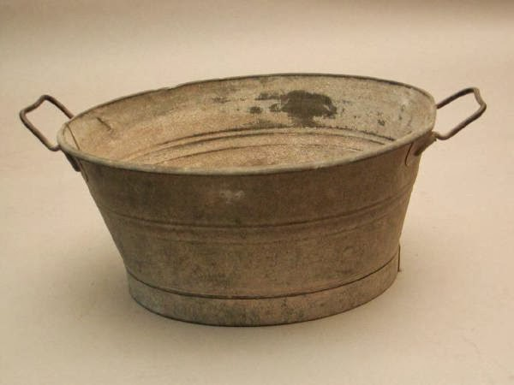
cunculina
A small container used in the toilet to wash hands and face

Slide 5

APO’
An expression used to point to a person

Slide 6

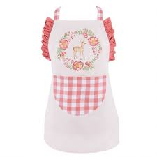
PARANNANZA
An apron used by people working in the kitchen

Slide 7
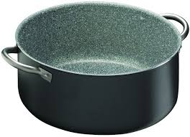
CALLARO
A very big pot

Slide 8

SCESCIO
A person…a bit silly!

Slide 9
CARZOLARO
A man who repairs shoes or boots

Slide 10

CIAPPOLE
A pair of slippers

Slide 11
FOCHE
Fireworks

Slide 12

SUMMARY
1) PRONCHISE: a very large coat
2) CIANFRUSAJE: a lot of useless objects
3) CUNCULINA: a small container used in the toilet to wash hands and face
4) APO’ : an expression used to point to a person
5) PARANNANZA: an apron used by people working in the kitchen
6) CALLARO: a very big pot
7) SCESCIO: a person….a bit silly!
8) CARZOLARO: a man who repairs shoes or boots
9) CIAPPOLE: a pair of slippers
10) FOCHE: fireworks

