Slide 1
Jobs that are disappearing
In the last few years, with the development of the technology, some jobs are disappearing like the graver, the cashier, the carpenter and all the work of the craftsmanship’s works in general.
Questa foto di Autore sconosciuto è concesso in licenza da CC BY-SA-NC

Slide 2
Recently with the advent of Amazon the manual jobs and the activities related to these jobs are failing and disappearing, because using the phone to order something is easier than taking the car and go to the shop.
The world population is unconsciously becoming lazy, in these times of Pandemic too, with the quarantine, some activities in general started to fail, because with the total closure of the stores the people locked in their houses were forced to buy on the online stores, for example Amazon or Ebay.
Questa foto di Autore sconosciuto è concesso in licenza da CC BY-NC-ND

Slide 3
Some other jobs are slowly disappearing too because the men are replaced by robots.
For example, in New York there is a supermarket called Amazon Go, were there aren’t operators, there are only a lot of cameras that see what you take from the shelves and a system charges it on your Amazon account with the other products you have taken.When you decide to go out the system take your money from your account.
This is very innovative but this steals a lot of jobs.
Now there are only two supermarket like this in New York but, surely in few times these shop’s will increase and maybe they will arrive in Europe, in Asia, in short all over the world.
Amazon now is developing some drones who will be able to deliver packages in the world, obviously to improve the delivery times of the normal couriers.
Questa foto di Autore sconosciuto è concesso in licenza da CC BY-SA

Slide 4
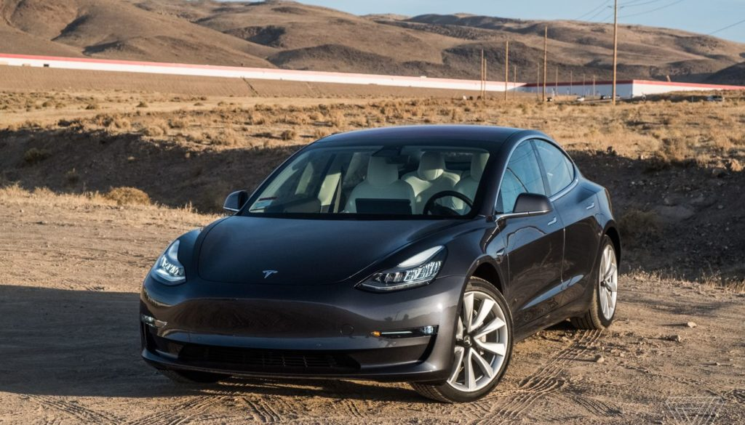
Another technologic discovery maybe can be the Tesla, we are talking about an innovative electric car that can resolve the problem of the pollution, but there is one model, the Model S that has a peculiar detail, this car has the automatic pilot, so you can sleep while you are in a highway.
This technology is not legal in Italy for other logistic problems but this car can take the works of taxi driver, a truck driver and the other works related to driving.
Now this technology is only at the beginning, surely in the years it can replace a lot of people.
But if we analyze this situation maybe the only works that we will do is the fix- man, because all the technological devices can break and we must fix them, because we know how this devices works.
But at the same time we can’t be only fix-men, so the unemployment will go up.
Questa foto di Autore sconosciuto è concesso in licenza da CC BY-SA

Slide 5
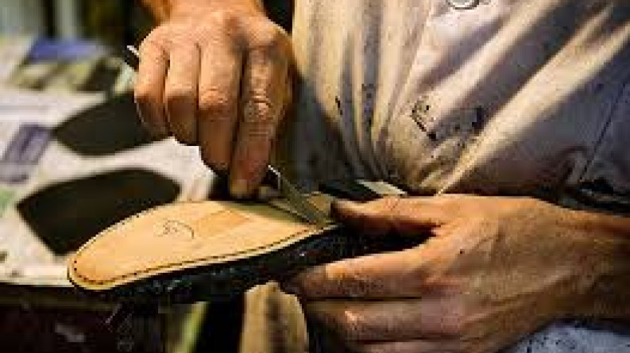
Some other jobs that are disappearing are the traditional jobs:
Firstly I want to talk about the seamstress, the purpose of this work is that of repair or modify items of clothing, like a pair of trousers that are long. Now this jobs is disappearing because it is very simple to find the clothes that you want . Example: if you needed an embroidery on your trousers, 40 years ago you had to go to the seamstress, now with the technology and the resource that internet gives us it is very simple to find the trousers that you want with the embroidery already made… so now the figure of the seamstress has become useless.
Another job that I want to mention is that of chimney sweeper. This is a very rare job , because now the most of our houses are heated by a boiler or radiators. Obviously in a city like Rome there are more flats than villas with a chimney so, surely, if you live in a flat you don’t need a chimney sweeper.
Now I want to talk about the shoemaker, a job spread some years ago. This job was diffused because, before, the shoes were made of leather and you changed them only after a long period of time so the shoemaker was a very popular job: he was the only person that could repair your shoes.
But now the shoes are made of plastics and it is easier to change them than to repair them. The shoemaker now is useless, the shoes now are more economic, so it is easier to buy another pair of them.
Questa foto di Autore sconosciuto è concesso in licenza da CC BY-NC-ND

Slide 6
This was my research about the works that are disappearing for the Erasmus Eritage.
I hope that you enjoy this mine little research.
Miele Mattia 3°CTTL 2020|2021
Sunday 14 March 2021

