Slide 1
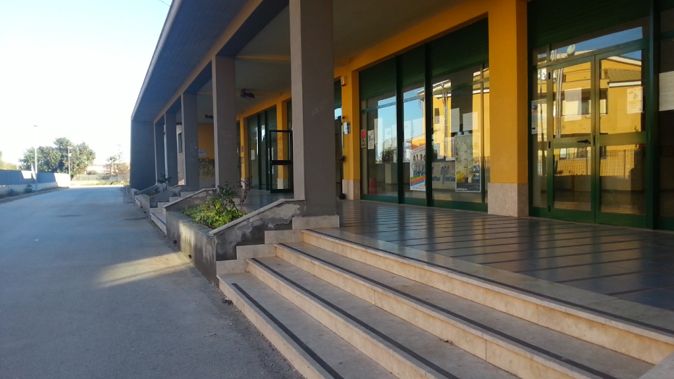
Our School
11°I.C.”ARCHIA” Siracusa

Slide 2
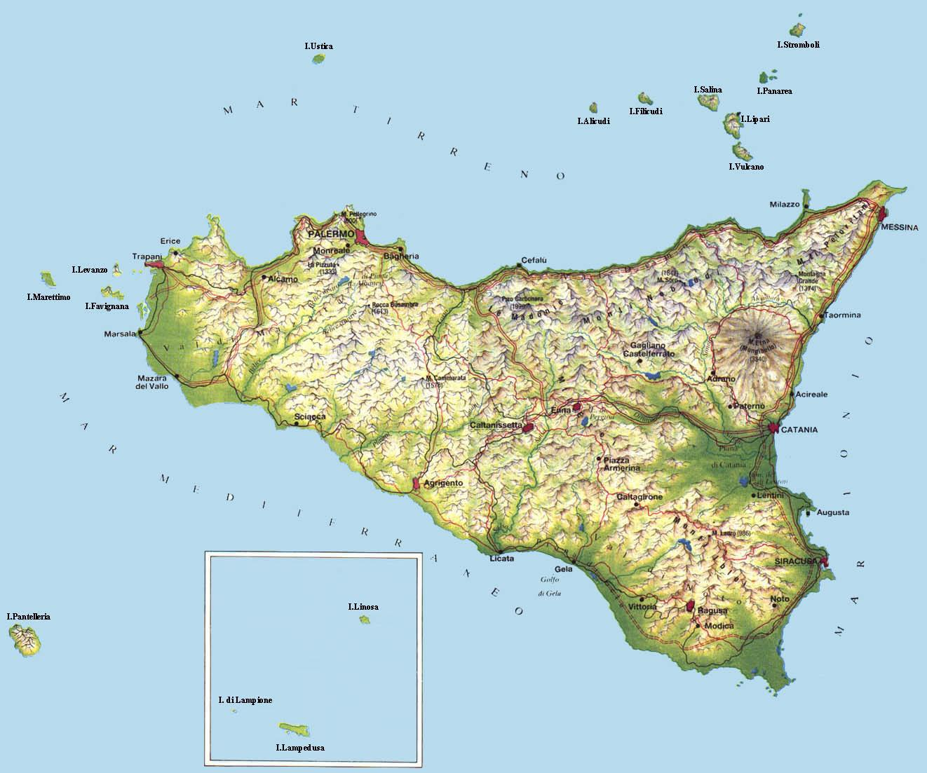
My region!
Sicily is an island, south of Italy and if you look at a world map, you can see that Syracuse, the town where we live, is south of Tunis!

Slide 3
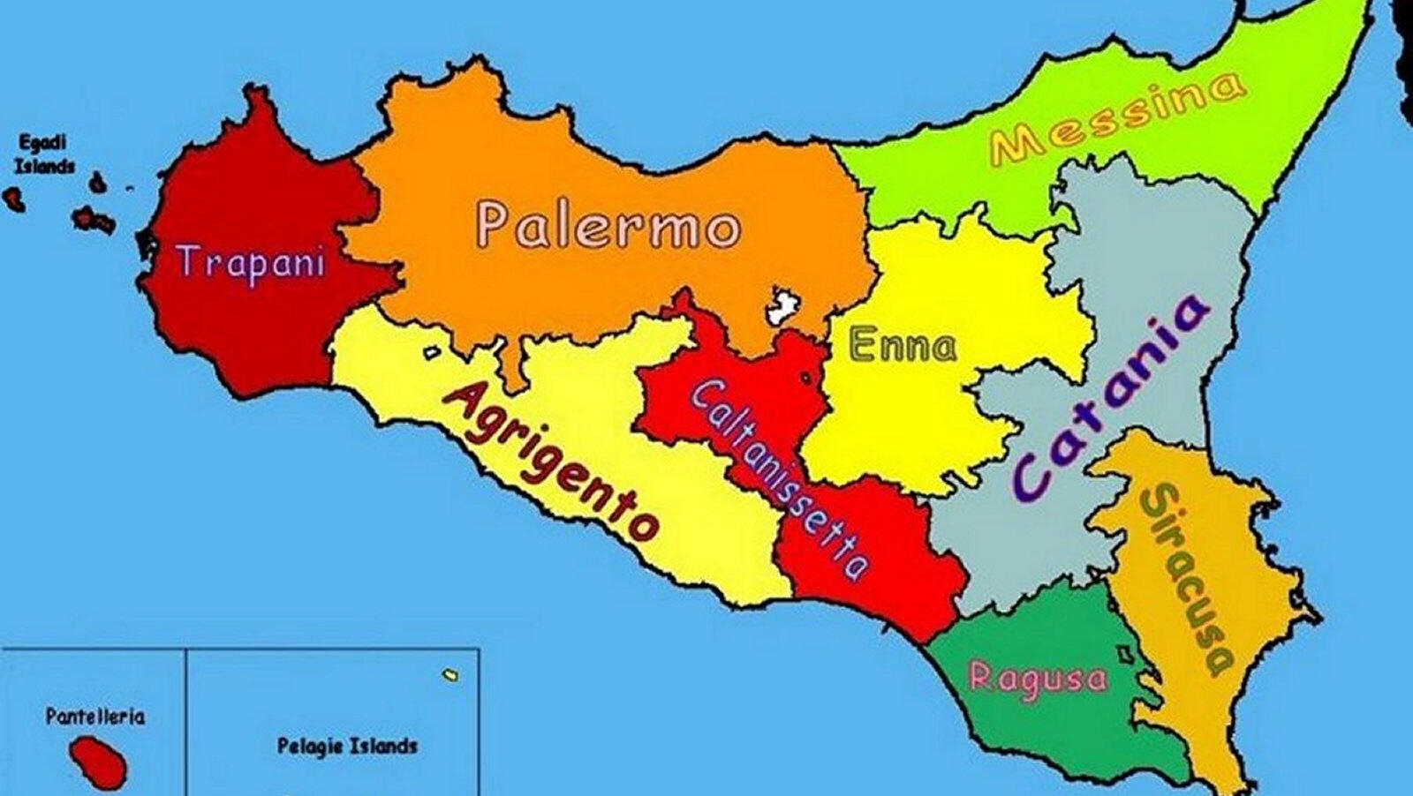
It is divided into nine provinces and we live in Syracuse

Slide 4
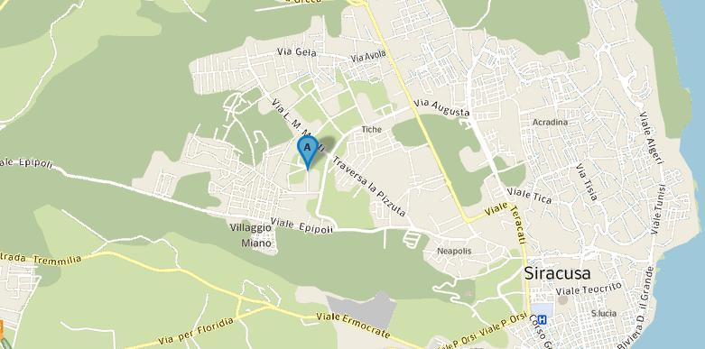
We are here!

Slide 5
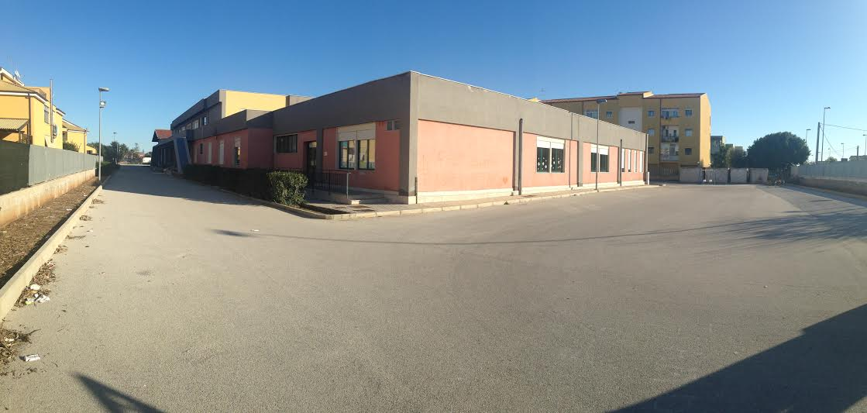
Our school is a Comprehensive Institute:
It includes three different levels:
Kindergarden (3 to 5 years old children)
Primary School (6 to 10 years old pupils)
Middle School (11 to 14 years old students)

Slide 6
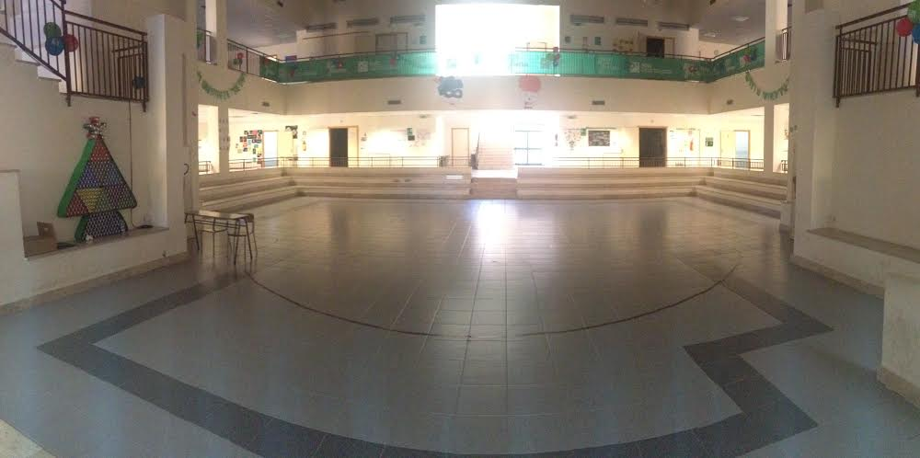
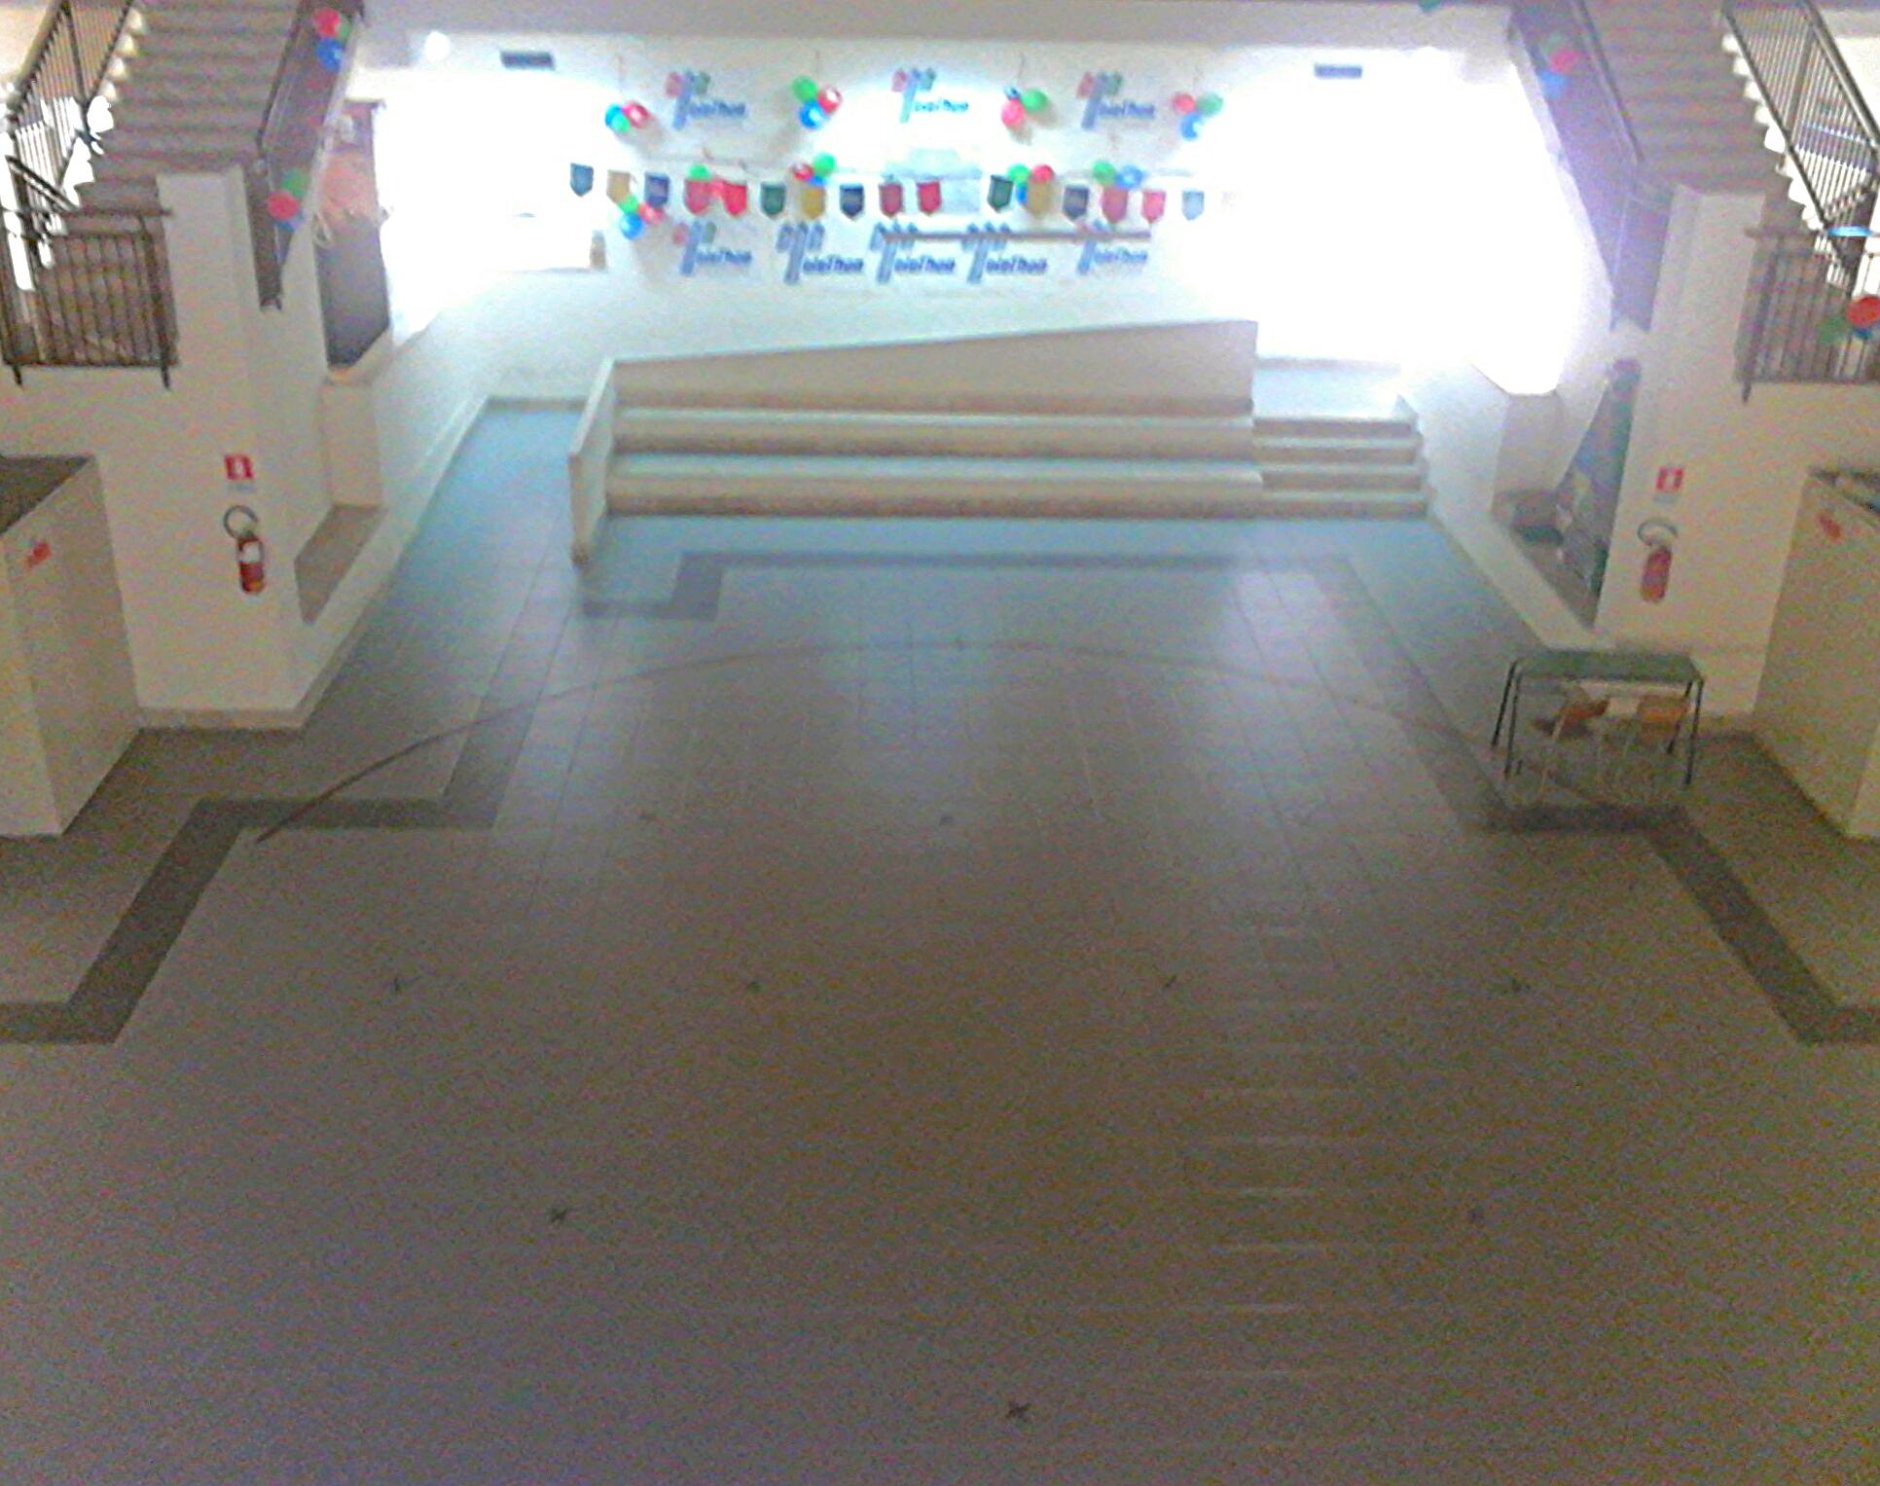
The Entrance Hall

Slide 7
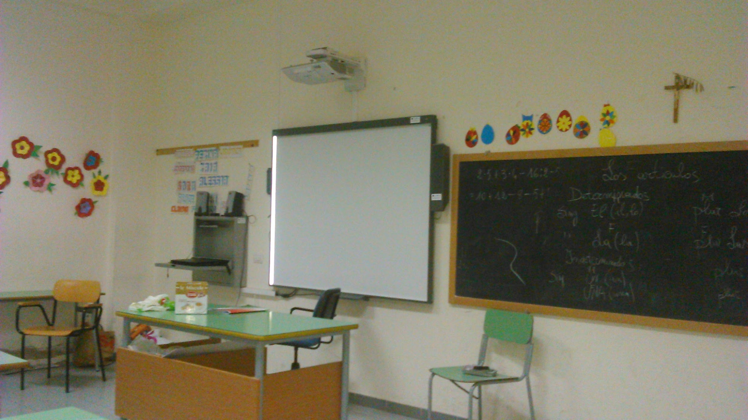
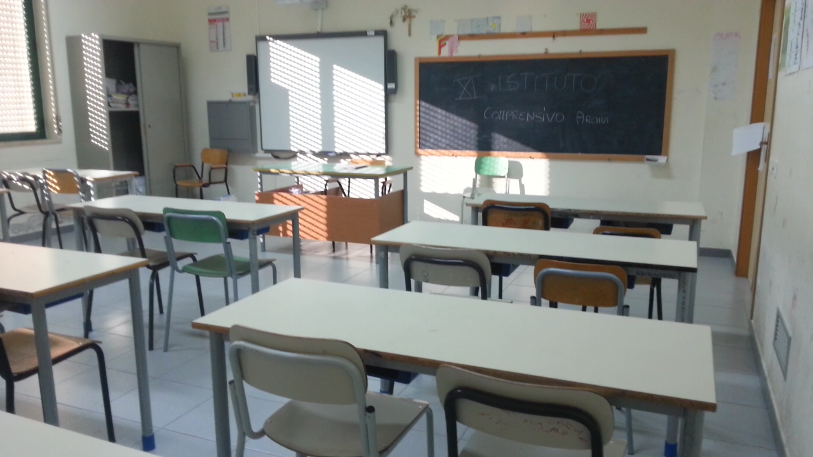
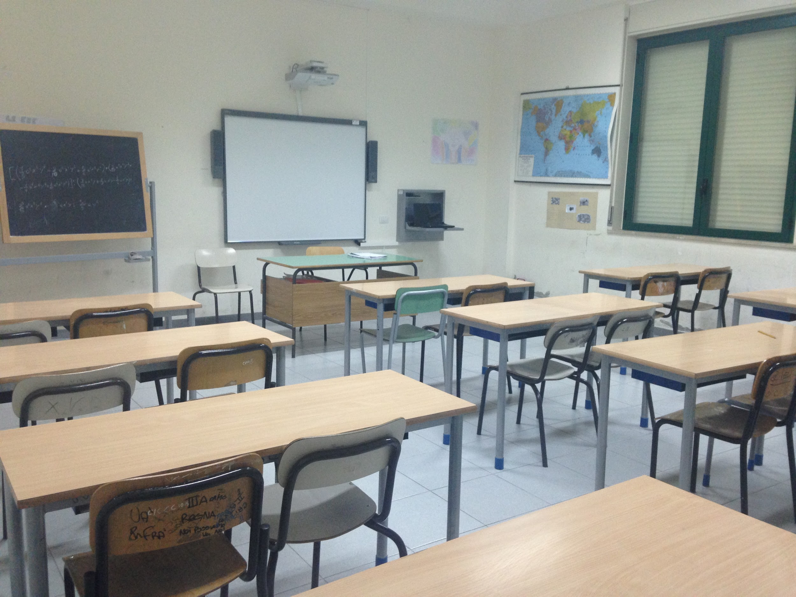
Our classrooms...

Slide 8
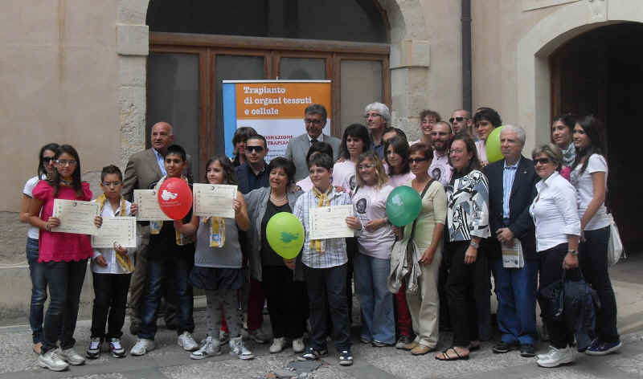
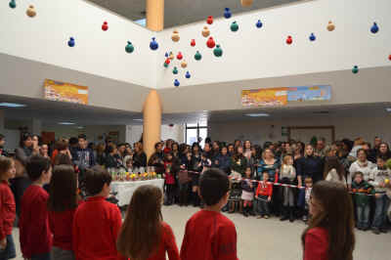
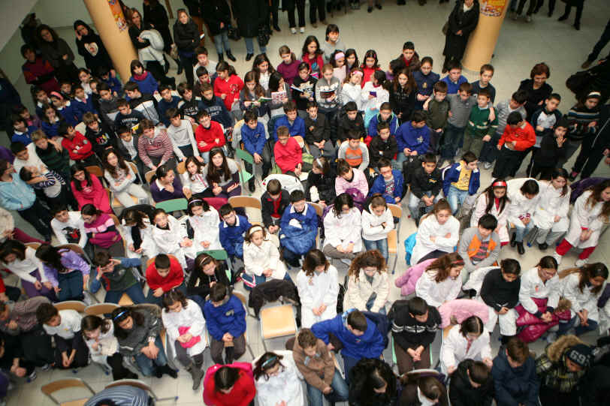
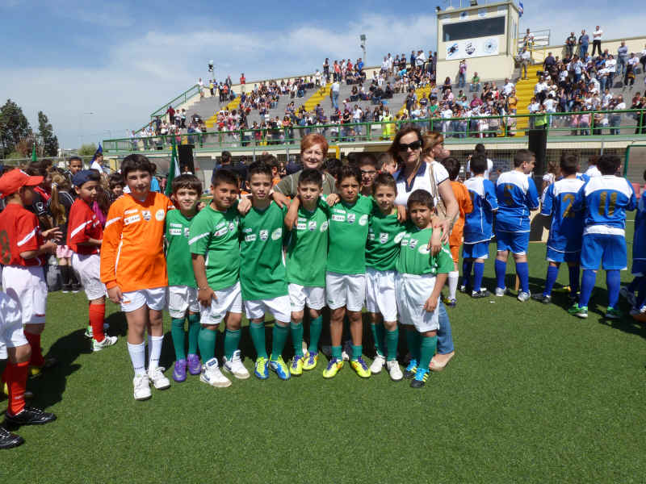
Our school participates in many projects organized in our territory: Nicholas Green Prize,Erg Prize,Theleton,Nutrition Education

Slide 9
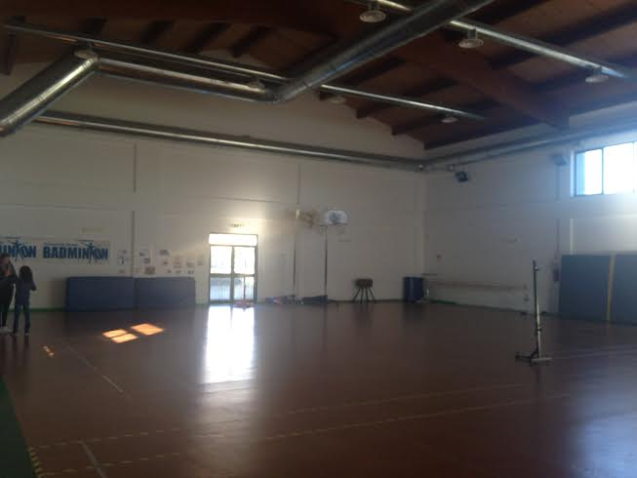
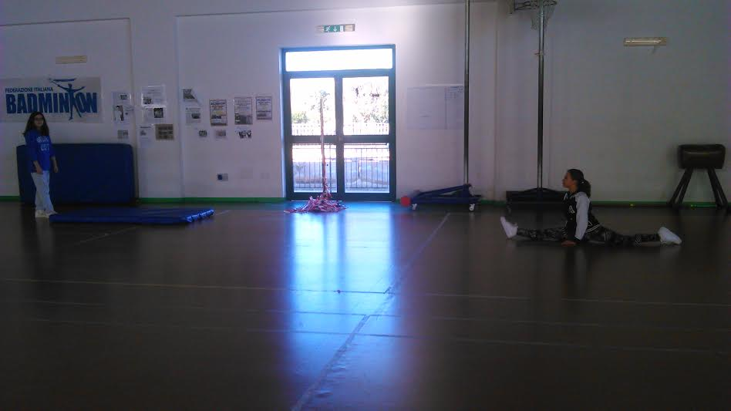
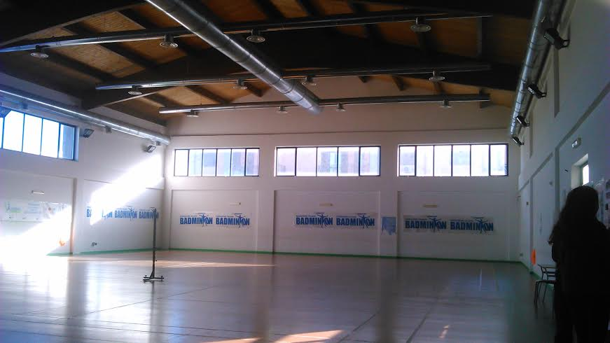
Our gym

Slide 10
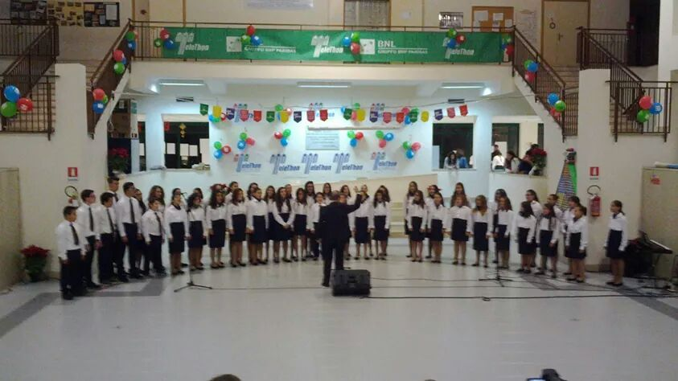
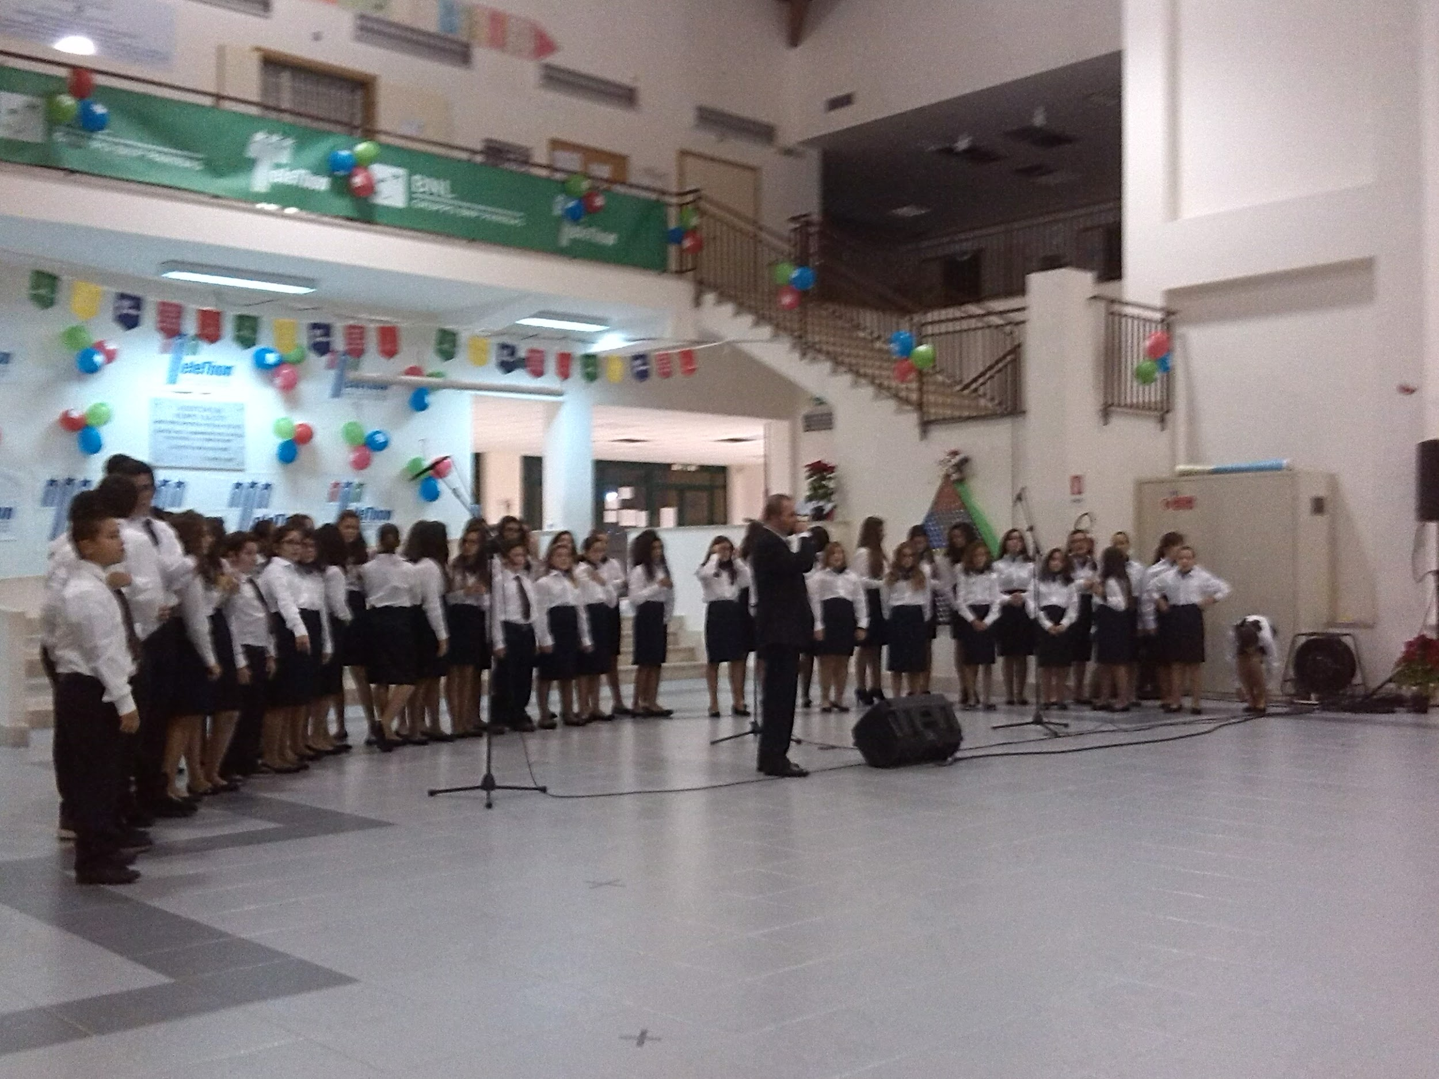
Our Choir!
Today...
In the past...

Slide 11
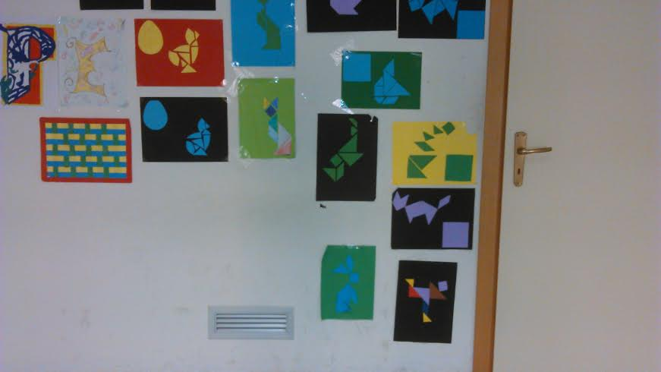
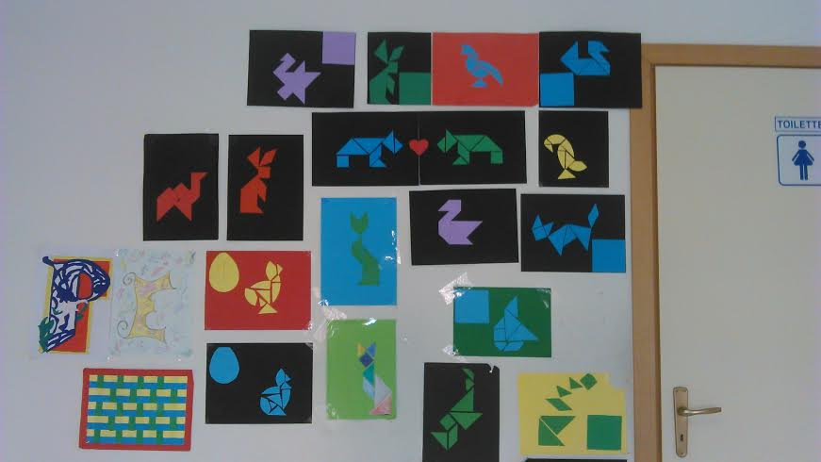
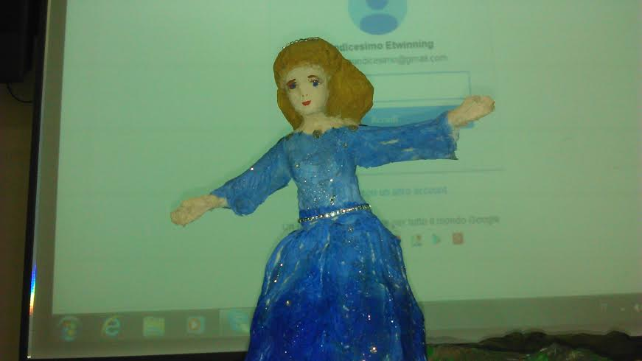
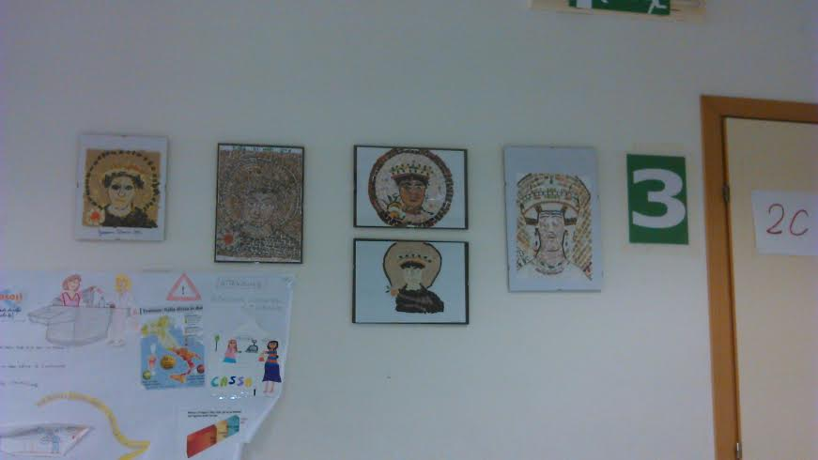
Our works of art

Slide 12
Speriamo di conoscervi presto!
See you soon!
A’ Bientôt!
Hola! Bok!

