Slide 1
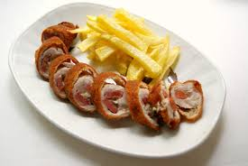
FLAMENQUIN

Slide 2
INGREDIENTS
PORK STEAK
SLICE OF HAM
SLICE OF CHEESE
2 EGG
FLOUR
BREAD CRUMBS
SALT

Slide 3
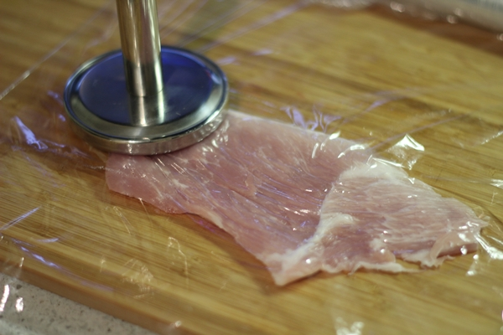
The first and most important thing is to spread the meat well.

Slide 4
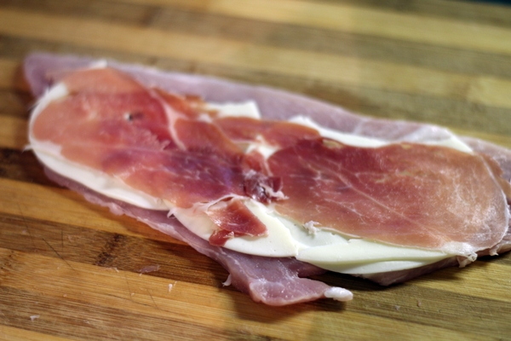
2. We put a slice of ham and a slice of cheese.

Slide 5
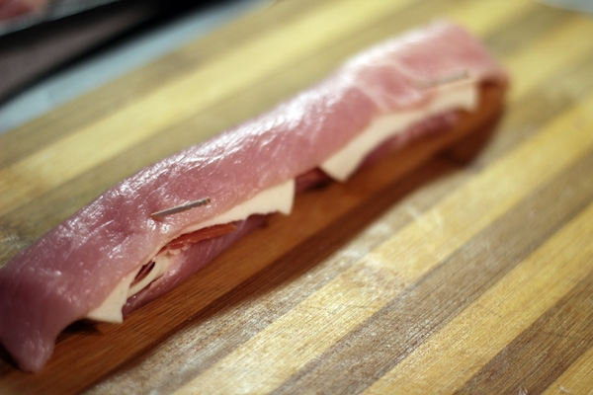
3. We roll carefully

Slide 6
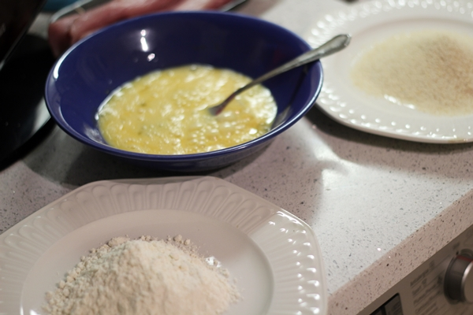
4. Now it's time to dump it. We coat it first with flour, then beaten egg and finally with bread crumbs.

Slide 7
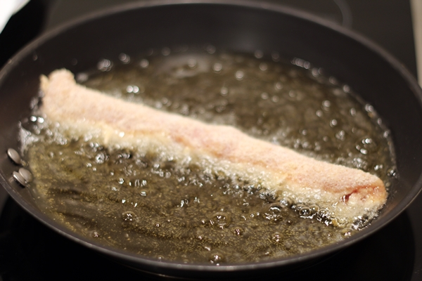
5. We fry it in hot oil.

Slide 8
And then cut it into slices and serve with chips

Slide 9
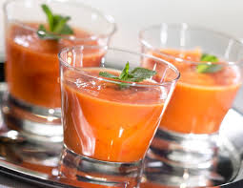
GAZPACHO

Slide 10
INGREDIENTS
1 KG OF TOMATOES
1 CUCUMBER
2 GREEN PEPPERS
⅓ CUP EXTRA VIRGIN OLIVE OIL
SALT

Slide 11
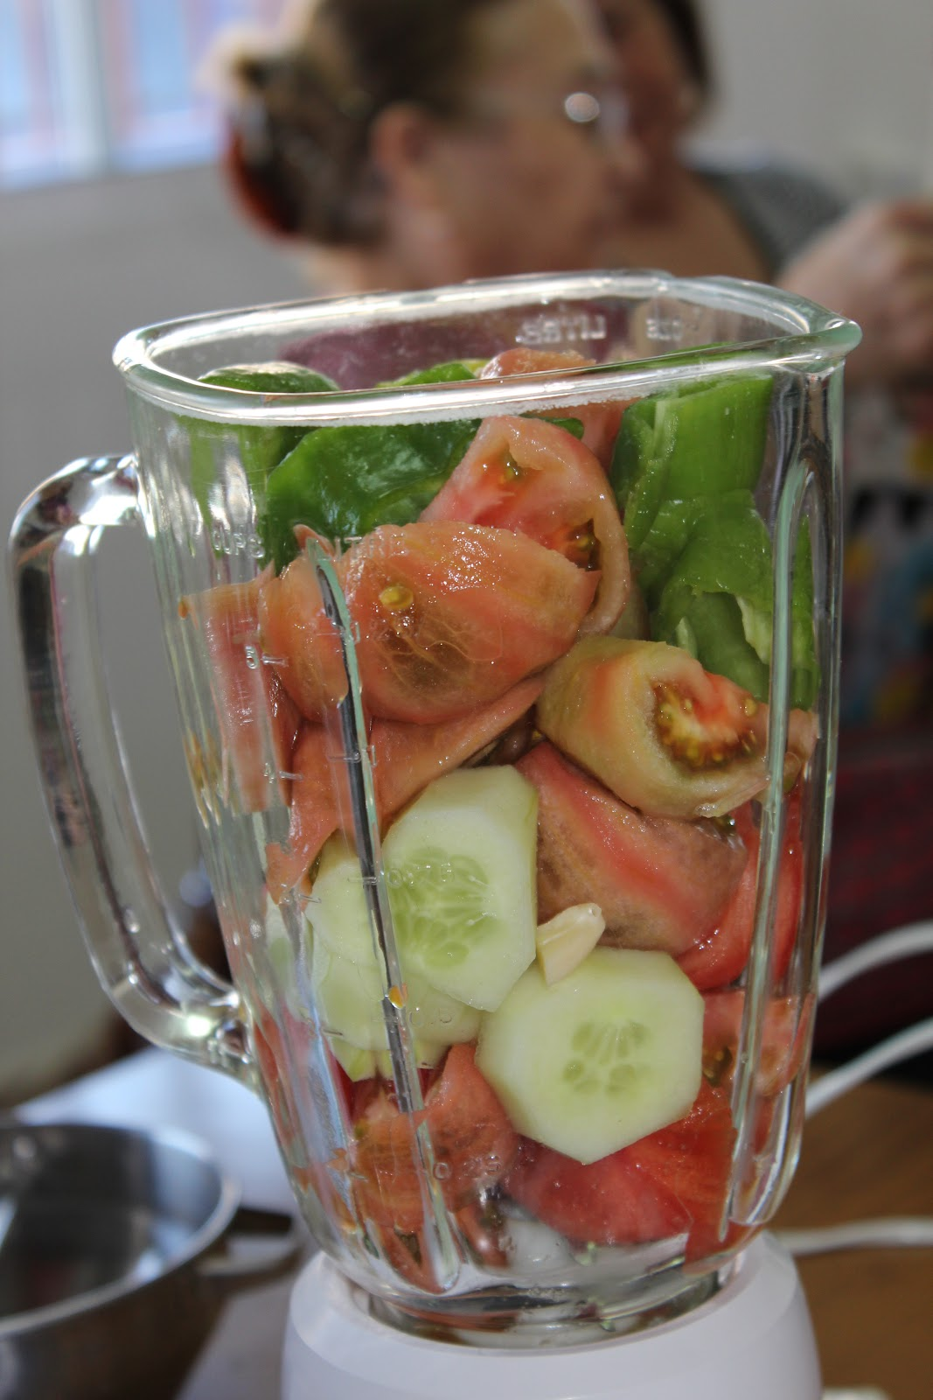
Pour the chopped vegetables into the blender along with the remaining ingredients and beat until the desired consistency is achieved.

Slide 12
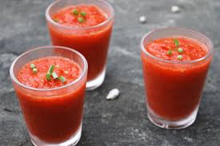
Let it cool in the fridge for at least 1 or 2 hours or until it is very cold.

